Slide 1
Chrome River Invoice

Slide 2
Agenda
Detailed overview of the invoice form
Invoice demonstrations
Manual entry
Prior invoice
Template
Questions

Slide 3
Accounts Payable – Chrome River
What transactions should I process in Chrome River?
Direct pay invoices (non-purchase order related)
What transactions cannot be processed in Chrome River?
Payments associated with a purchase order
Payments associated with a contract
Refund payments

Slide 4
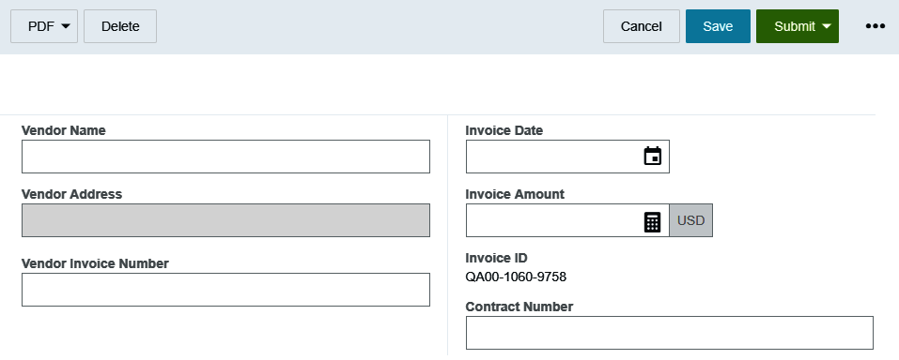
Invoice Header

Slide 5
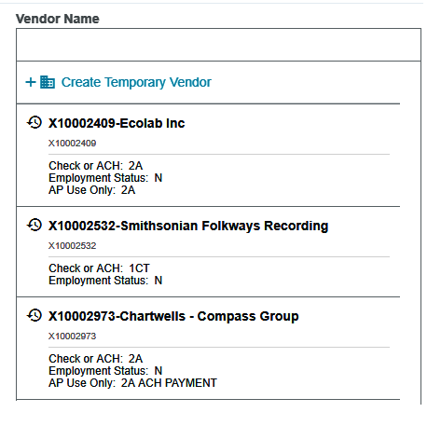
Vendor Name
Fully searchable by the vendor number or any part of the vendor name
Recently used vendors will appear when you click in the field
Check or ACH field notates the default payment method for the vendor
#A = ACH Payment
#CT = Paper Check
Employment Status indicates the current employment status of the vendor
Y = Employee
N= Non-employee

Slide 6
Vendor Name
Cannot search by the FEIN in Chrome River
FCM00300 – Vendor Addresses report is still available if you need to locate a vendor by FEIN
Notes:
Vendor selection criteria
Put vendor id in the comments NO SSN!!!!! NO FEIN!!!!!

Slide 7
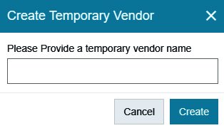
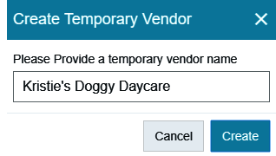
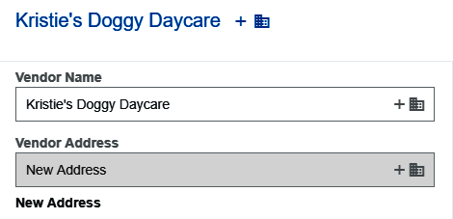
Vendor Name
If you cannot find the vendor, create a temporary vendor
Enter the vendor’s name and click create
The temporary vendor will be listed in the Vendor Name field
Invoice will route to vendor maintenance.
Make sure to either attach the W9 in Chrome River or securely send the W9 to accounts payable.

Slide 8
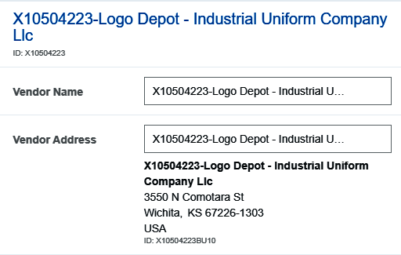
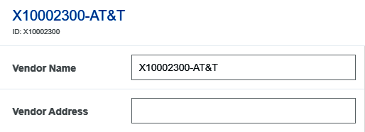
Vendor Name / Address
When you select a vendor with only 1 active address, the Vendor Address field will automatically populate
When a vendor has multiple addresses, the vendor address field will remain blank

Slide 9
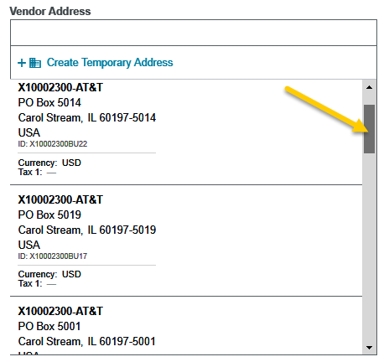
Vendor Address
Click in the Vendor Address field to view all available addresses
This field is fully searchable
If the proper remit address is not in the list, click the Create Temporary Address link

Slide 10
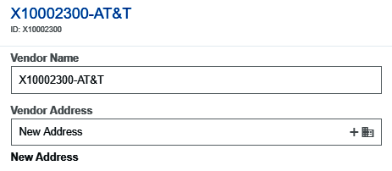
Vendor Address
The value “New Address” will populate in the Vendor Address field
List the new address in the Comments section at the bottom of the invoice form

Slide 11
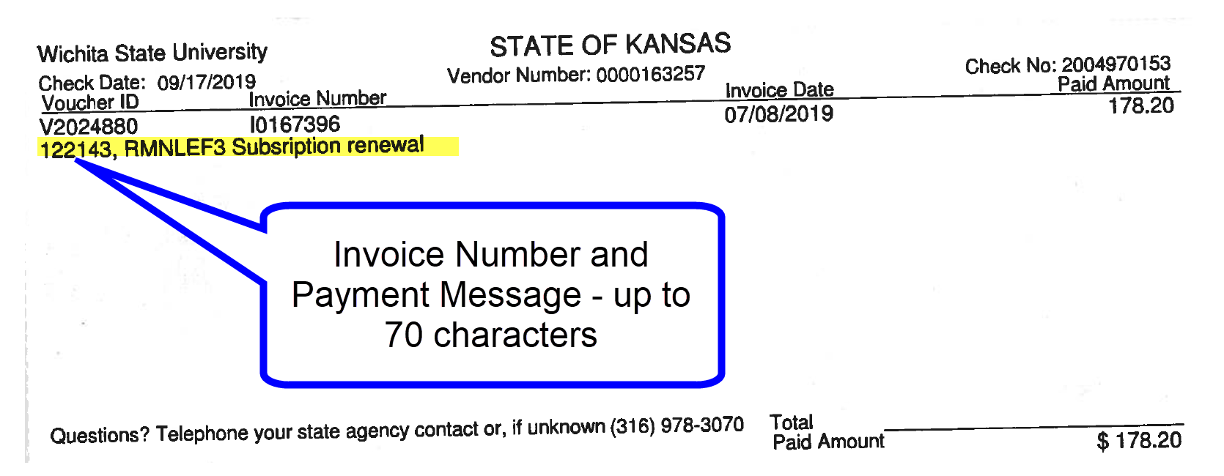
Vendor Invoice Number
Optional field
Allows up to 36 characters
List the vendor invoice number exactly as it appears on the vendor invoice
Will appear on the vendor’s check stub as part of the payment message
Notes:
We strongly recommend 1 to 1 relationship. 1 vendor invoice to 1 Chrome River invoice, This allows us to take advantage of duplicate checking functionality in Chrome River. If you must enter many vendor invoices to 1 Chrome River invoice, leave the Vendor Invoice field blank.

Slide 12
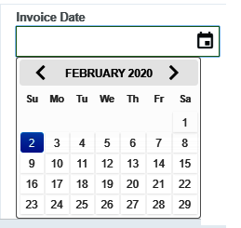
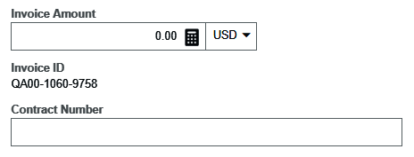
Invoice Date/Amount/Contract Number
Select the appropriate date. Must be the date listed on the invoice
Enter the total invoice amount to be paid.
The invoice id is system generated
Enter the contract number if applicable
Notes:
Cannot be a future date.

Slide 13
Invoice Detail

Slide 14
Payment Message
Enter identifying information for the invoice such as:
Invoice numbers (overflow from Invoice Number field)
Account Number
Customer Number
Order Number
Brief description (Maintenance Subscription 10/23/19-10/22/20)
Will appear in the FOATEXT field in Banner and display on the Vendor Totals by Period report
Up to 70 characters will appear on the vendor’s check stub.

Slide 15
Payment Message
Best practice 1 vendor invoice to 1 Chrome River invoice
Allows for accurate duplicate invoice checking
If multiple vendor invoices are entered on 1 Chrome River invoice, leave the Vendor Invoice Number field blank

Slide 16
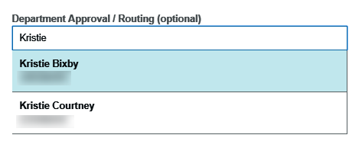
Department Approval / Routing
Allows the department to route the invoice to the approver of their choosing
The invoice will then route to the required approvers

Slide 17
Department Approval / Routing
If the OCR adds a department approver, or if you add one in error
Click on the name and ensure it is highlighted,
Hit the backspace key clear the field
Click the tab key to exit the field
This will completely remove the department approval routing for this invoice.

Slide 18
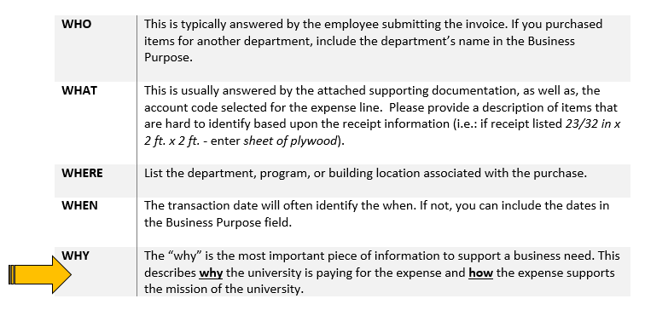
Business Purpose
Enter a detailed business purpose for the expenditure
A business purpose is defined as one that supports or advances the goals, objectives and mission of the university; and adequately describes the expense as a necessary, reasonable and appropriate business expense for the university.
The field appears small but has a high character limit (>220)

Slide 19
Invoice Detail
If your department utilizes either the Activity or Location fields, click the drop down arrow and select the appropriate value
If your department does not utilize either of these fields, leave the defaulted value of -- Select-- in each field
The Department Tracking Number field is an optional field departments can utilize.

Slide 20
Special Handling

Slide 21
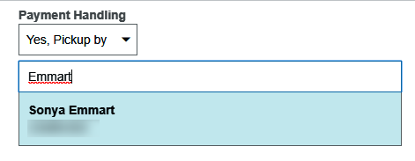
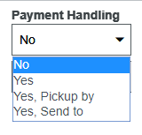
Payment Handling
State of Kansas strongly encourages utilizing ACH as the primary payment method
In special circumstances, there may be a need to have a paper check issued and returned to WSU
Options:
No – utilize default payment method
Yes –only used by AP
Yes, Pickup by –request a check to be returned to WSU, and picked up by the person listed
Yes, Send to –request a check to be returned to WSU, and sent to the individual listed via campus

Slide 22
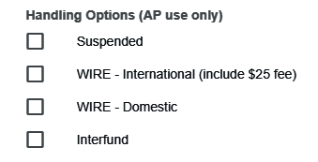
Handling Options (AP use only)
Handling Options - used by the Accounts Payable department to assist with back office processing
Additional Information – Can be used to communicate additional information to the Accounts Payable department.
Example:
Need to hand-deliver check by 2/14/2020 to our visiting lecturer

Slide 23
Comments
Uses:
Communicate a new vendor address
Provide additional information about an expenditure
Approval notes
Once entered, cannot be modified or deleted!!!

Slide 24
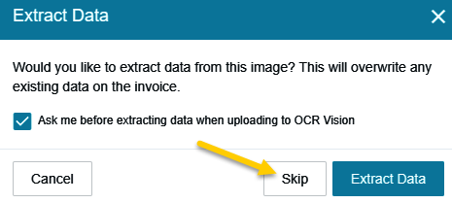
Attachments
Attachment options:
browse file
drag and drop
email
The Extract Data message will appear when you browse or drag and drop.
If you have already entered information in the header select Skip

Slide 25
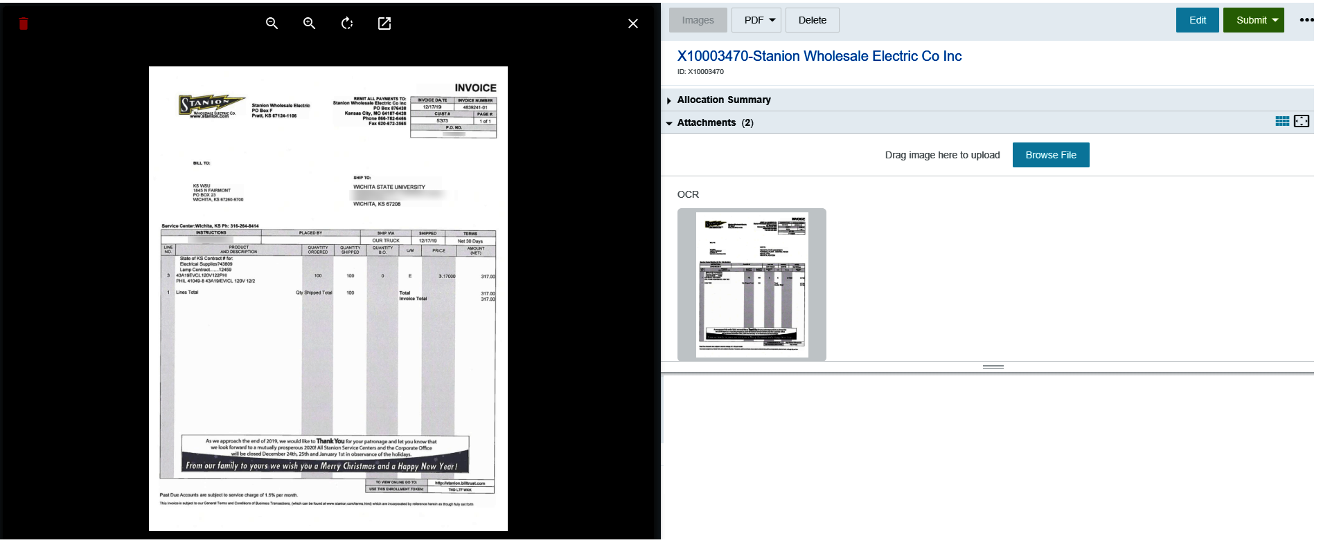
Attachments

Slide 26
Back-Up Documentation
Acceptable
Itemized Invoice
Itemized Receipt
Contract
Event Flyer/Brochure
Program Documentation
Unacceptable
Packing Slip
Quote
Pro-forma Invoice
Statement
Order Confirmation
Proposal
Email correspondence

Slide 27
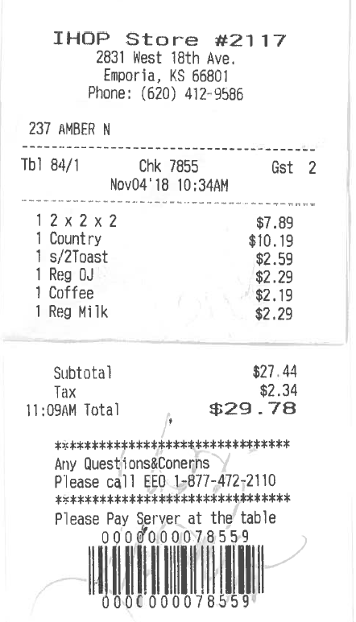
Receipts
Non-Itemized
Itemized

Slide 28
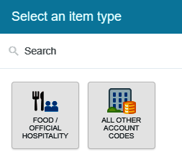
Add Expenses
Use this section to add funding and to select an account code
Click the + Add Expense button
Select an expense tile
Expenditures for food and official hospitality must utilize the corresponding tile

Slide 29
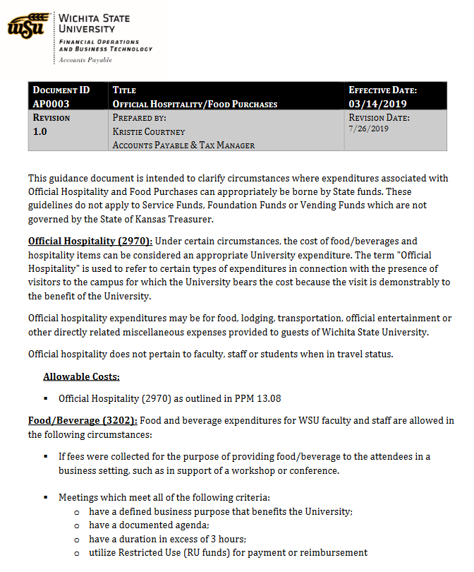
Food vs Official Hospitality
Only 2 account codes should be used with this tile
2970 – Official Hospitality
Outside guests present
Students qualify as outside guests
3202 – Food / Internal Business Related
Only WSU employees present

Slide 30
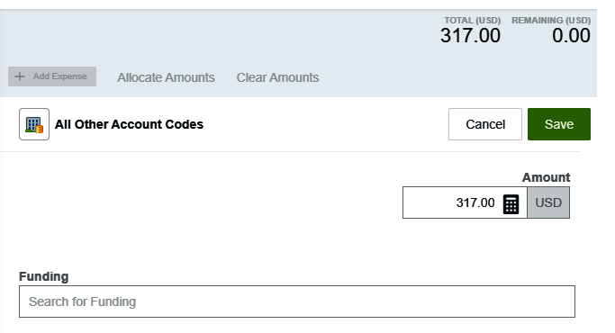
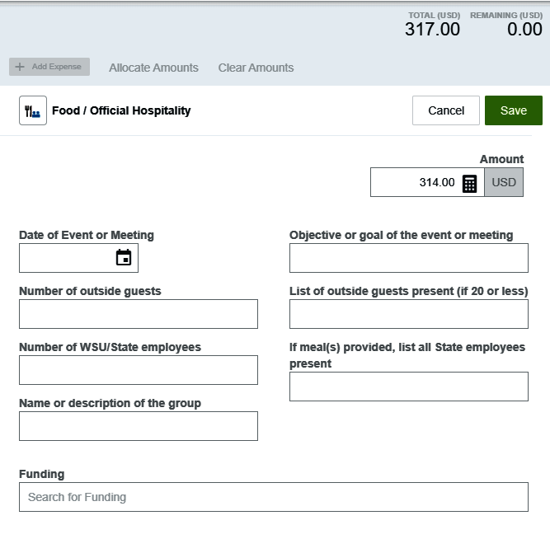
Add Expenses
Use this section to add funding and to select an account code
Enter the total amount of the invoice allocated to this funding/account code selection
Begin typing in the Search for Funding box to locate and select the appropriate funding for the Expense Type.

Slide 31
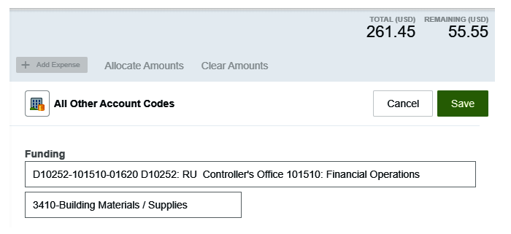
Add Expenses
Once a funding value has been selected, the -- Select -- field will display. Chose the appropriate account code for the expenditure from the drop down list.
Notice the system calculates the remaining amount to be allocated
Click Save
The line item is added to the invoice

Slide 32
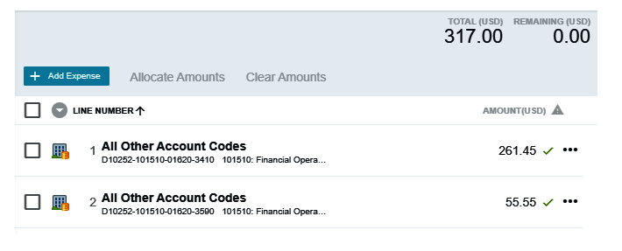
Add Expenses
Repeat the previous steps until the invoice is fully allocated

Slide 33
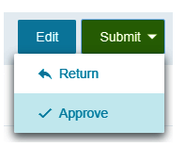
Submit
Click Submit in the upper right corner
Select Approve from the drop down list

Slide 34
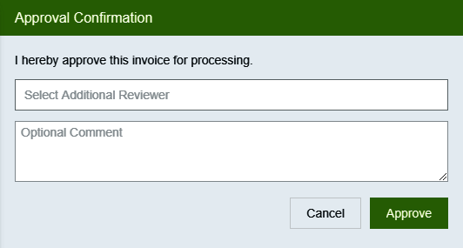
Approval Confirmation
Can select an Additional Reviewer for the invoice
The Optional Comment field is independent from the selection made in the Additional Review field

Slide 35
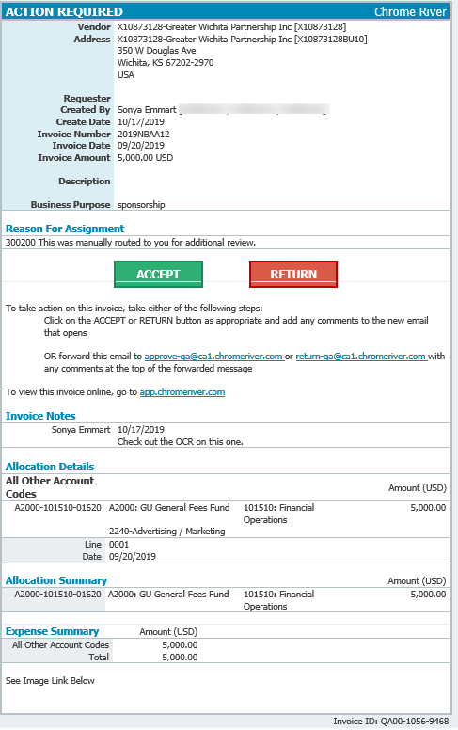
Approvals
Approvers will receive an email notification when an invoice has been routed to them for approval

Slide 36
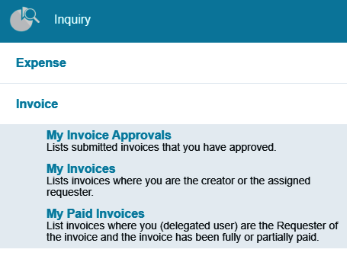
Inquiry
Approvers are able to view any reports they have approved by running an inquiry report

Slide 37
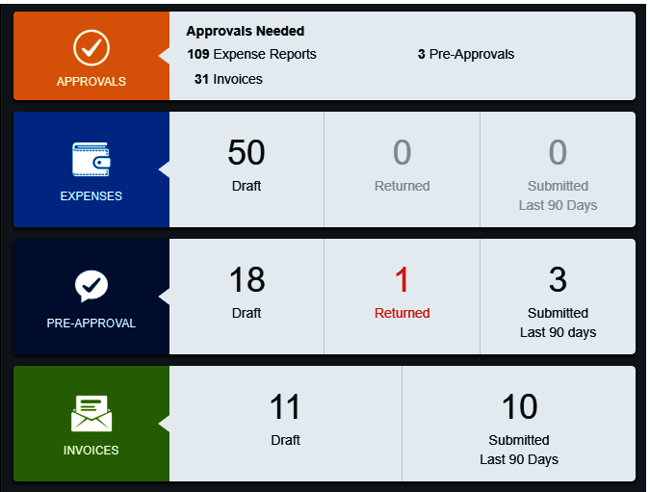
Returned & Recalled
Invoices can be recalled by the creator or returned by an approver
Returned and recalled invoices can only be edited through the Approvals swim lane
Invoices can only be deleted by Accounts Payable staff

Slide 38
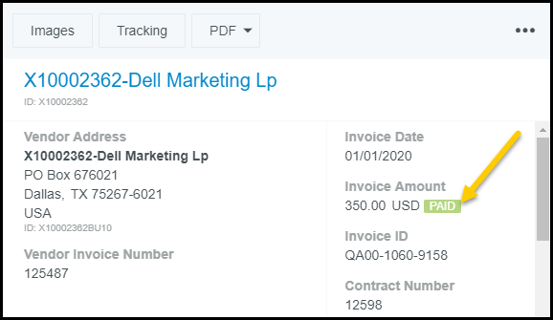
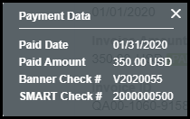
Payment Information
Payment information can be viewed within Chrome River
Look for the status of Paid on the Submitted Invoices page
Click once on the invoice to display
Click on the paid icon

Slide 39
Chrome River to Reporting Services

Slide 40
Chrome River to Reporting Services

Slide 41
Chrome River to Reporting Services

Slide 42
Chrome River to Reporting Services

Slide 43
Chrome River to Reporting Services

Slide 44
Accounts Payable Questions
What documentation am I required to keep?
Paper and electronic copies – keep until scanned image is verified and invoice has been paid in Chrome River. Can be discarded after 1 year
Abide by departmental directives and/or directives of applicable Governing bodies
Scanned images in Chrome River will be retained according to the current retention policy

Slide 45
Closing

