Slide 1
How to create a Travel Expense Report in Chrome River

Slide 2


Expense Report
Wu Shock has returned from the National Mascot Conference and is now ready to create and submit his expense report.
Trip Details:
  Location – Denver, Colorado
  Dates – 6/1/2019-6/4/2019
  Expenses –
    Airfare
    Mileage to & from ICT
    Hotel
    Per Diem
    Conference Registration

Slide 3
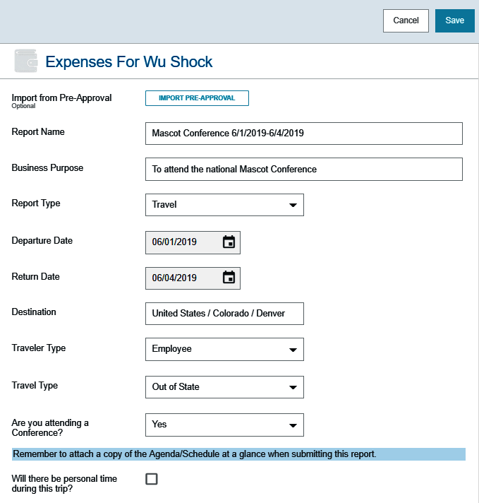
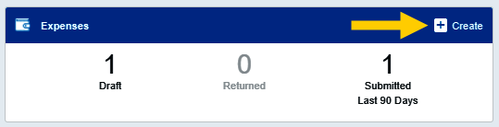
Create Expense Report
Click +Create button in the upper right corner of the Expenses swim lane.
Complete the header information and click Save in the upper right-hand corner

Slide 4
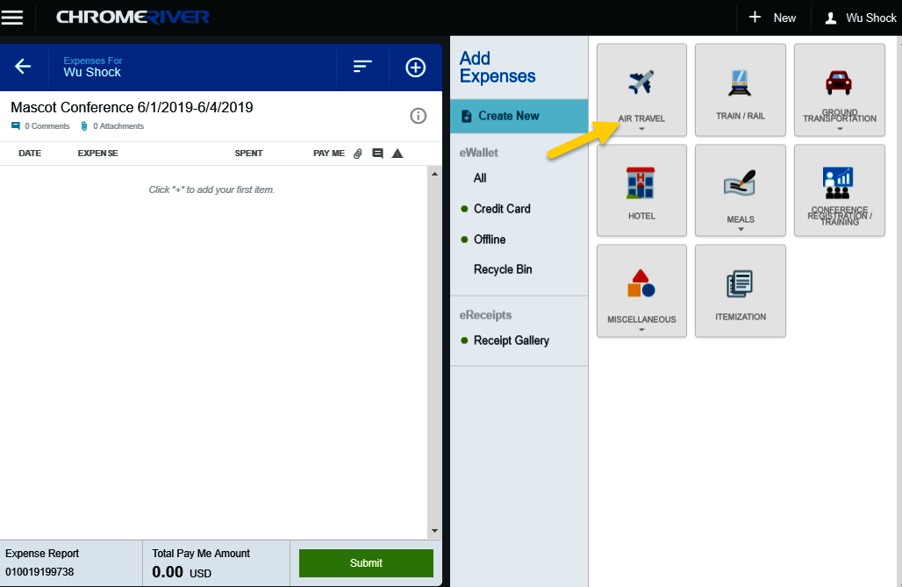
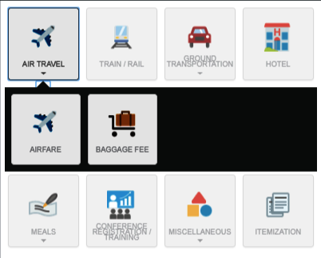
Add Airfare
Select the Air Travel tile
Notice other expense types are displayed in the Air Travel drawer

Slide 5
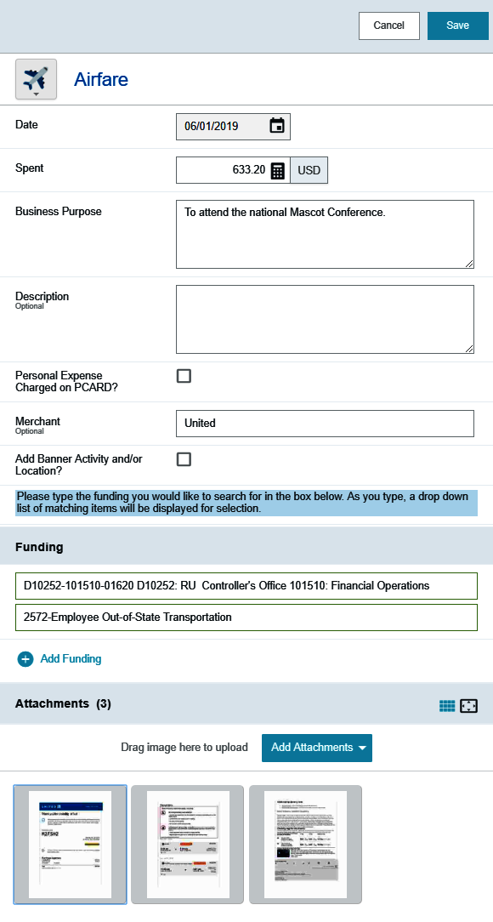
Add Airfare
Select the Airfare tile
Verify and/or complete the following fields:
  Date
  Spent
  Business Purpose
  Description (optional)
  Personal Expense Charged on PCARD?
  Merchant (optional)
  Funding
Upload or Select the receipt in the attachment section

Slide 6
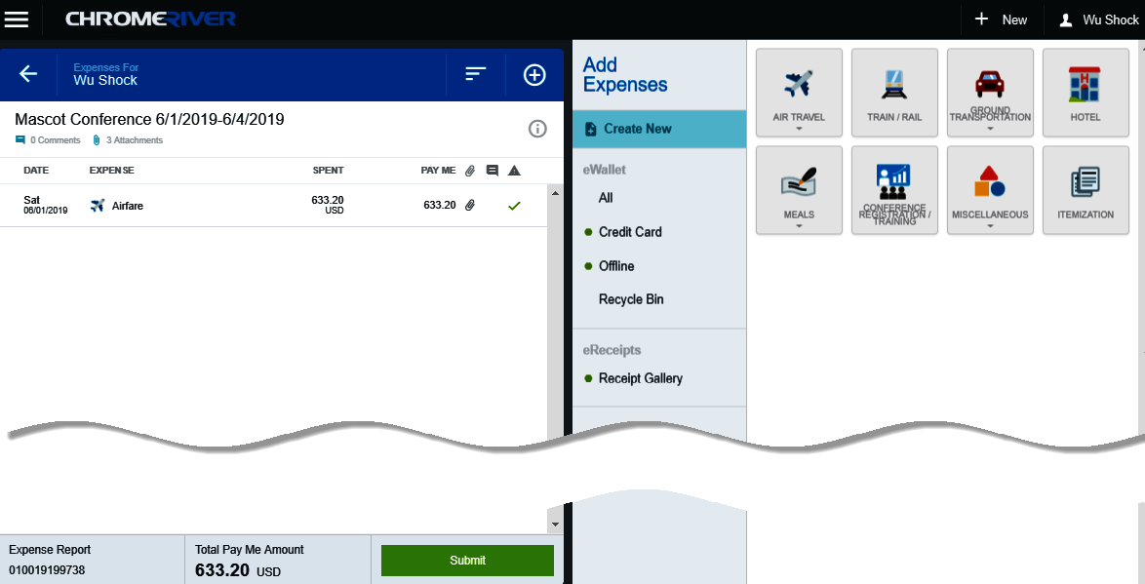
Review Entries
The expense is added to the left side of the Expense Report

Slide 7
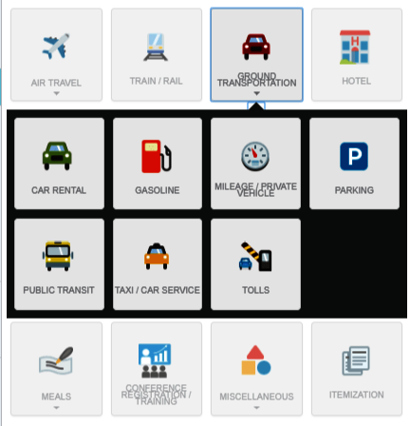
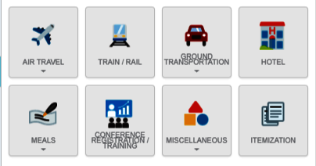
Add Mileage
Select the Ground Transportation tile
Notice other expense types are displayed in the Ground Transportation drawer

Slide 8
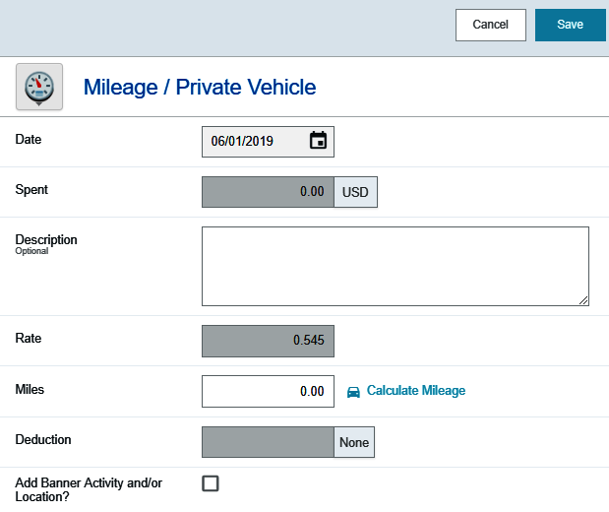
Select Mileage Expense Tile
Select the Mileage / Private Vehicle tile
Complete the Date field

Slide 9
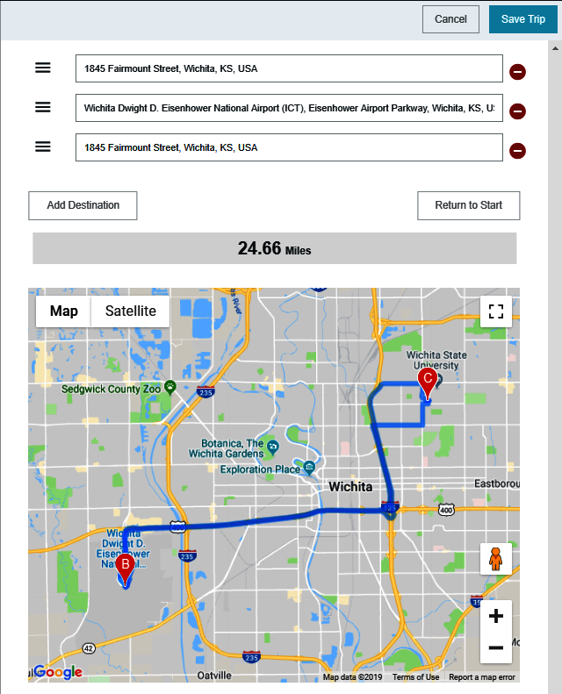

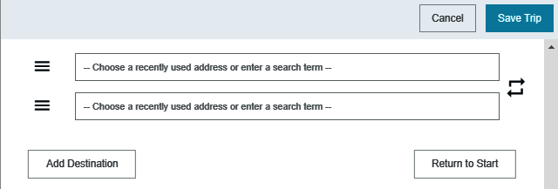
Calculate Mileage
Select the Calculate Mileage link
When finished, click Save Trip in the upper right-hand corner
Enter the beginning and ending destinations

Slide 10
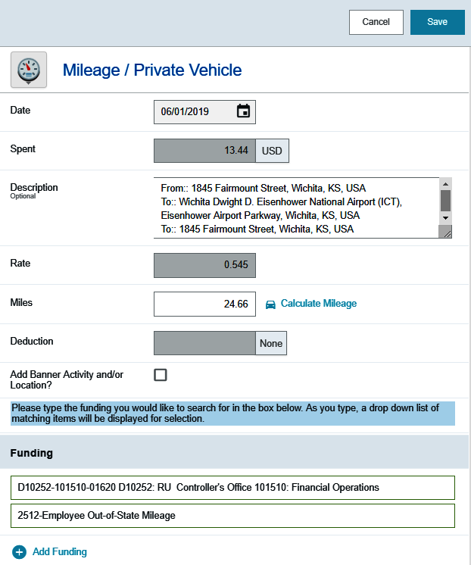
Complete Mileage Form
The following fields will populate based upon the information entered on the Calculate Mileage page:
  Spent
  Description
  Miles
Enter the appropriate funding and click Save in the upper right-hand corner.

Slide 11
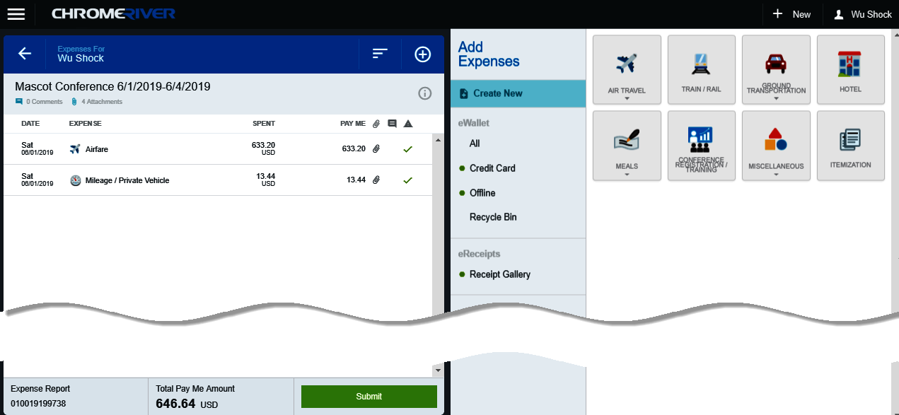
Add Another Expense
The expense is added to the left side of the Expense Report

Slide 12
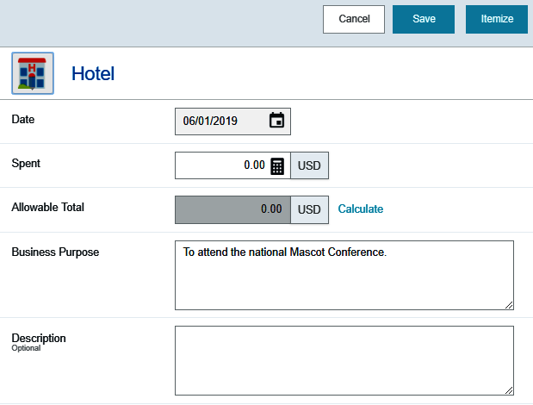
Add Hotel Expense
Select the Hotel tile
The Hotel form is displayed
Enter the Date, Spent amount, and click the Calculate link in the Allowable Total field

Slide 13
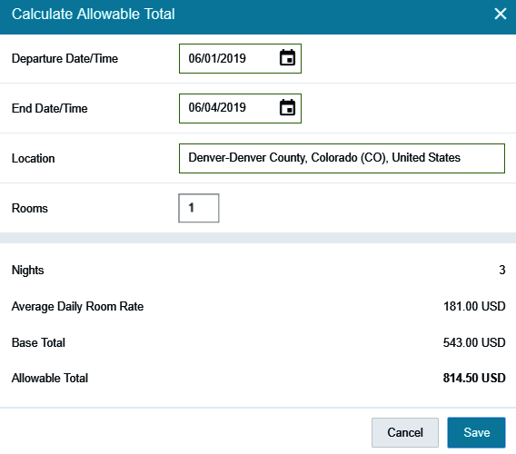
Add Hotel Expense
The Calculate Allowable Total form is used to establish the maximum lodging limit
Complete the following fields:
  Departure Date
  End Date
  Location
  Rooms
Click Save

Slide 14
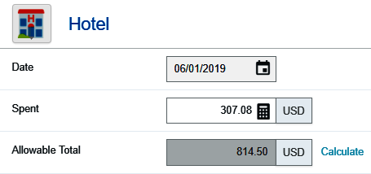
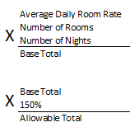
Hotel Expense
The Allowable Total field is now populated.
This amount is calculated as follows:
The maximum reimbursable lodging rates do NOT include taxes and surcharges
No allowance for any tips is included within the lodging rate

Slide 15
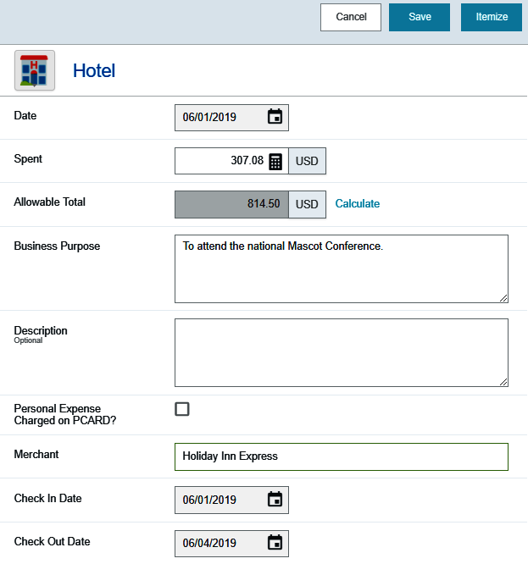
Hotel Expense – Top Section
Verify and/or complete the following fields:
  Business Purpose
  Merchant
  Check In Date
  Check Out Date

Slide 16
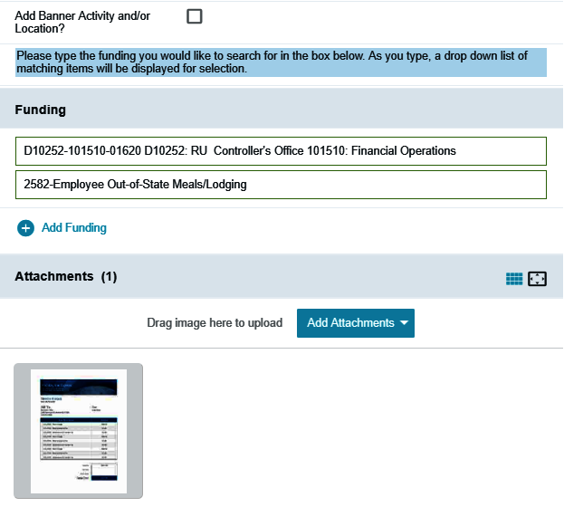
Hotel Expense – Lower Section
Enter the appropriate funding information
Upload or Select the receipt in the attachment section

Slide 17
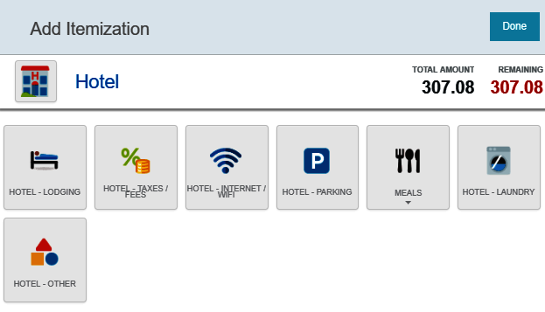
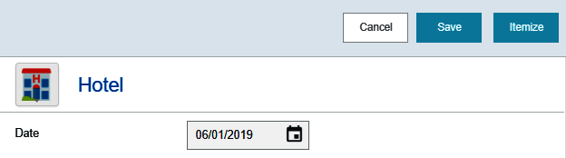
Hotel Expense – Itemize
Click Itemize in the upper right-hand corner of the form
The Add Itemization form will display

Slide 18
Hotel Expense – Itemize
The Add Itemization form allows you to split out the Hotel invoice to the appropriate expense categories.
The Total Amount field displays the hotel invoice total
The Remaining field displays the dollar amount that still needs to be itemized

Slide 19
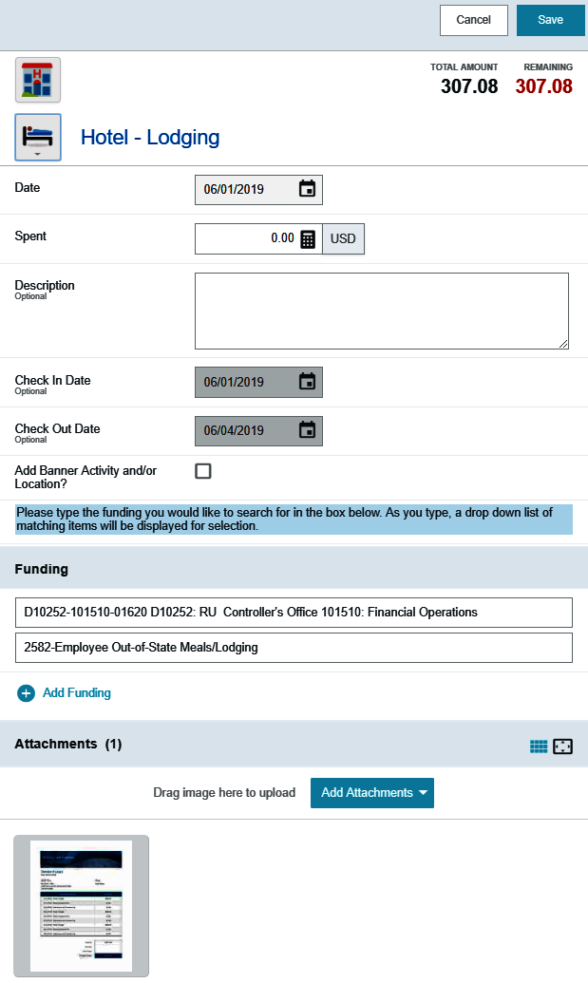
Hotel Expense – Itemize
Click the Hotel-Lodging tile
Click on the attachment at the bottom of the screen

Slide 20
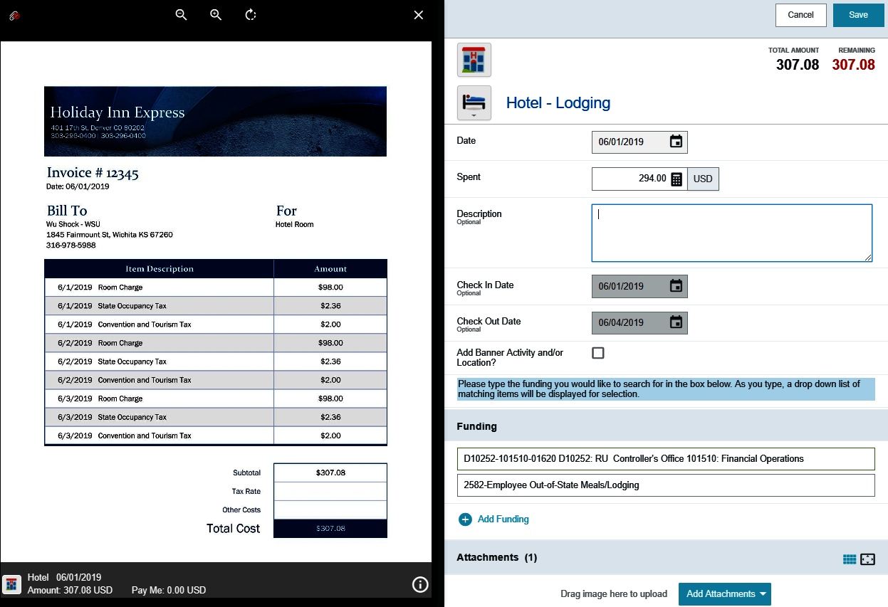
Hotel Expense – Itemize
The Hotel invoice will be displayed on the left side of the screen
Enter the total Room Charge for all days in the Spent field
In this example the room charge is $98.00/day for 3 days totaling $294.00

Slide 21
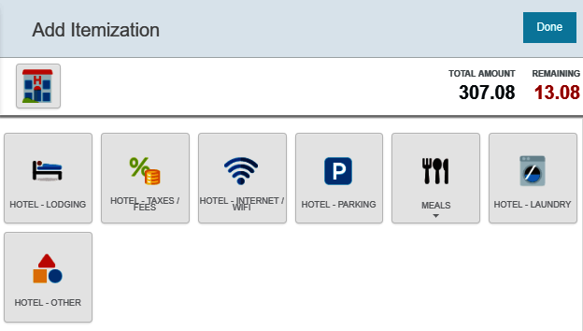
Hotel Expense – Itemize
The Add Itemization screen is displayed
Notice the Remaining amount has been reduced
Select the Hotel-Taxes / Fees tile

Slide 22
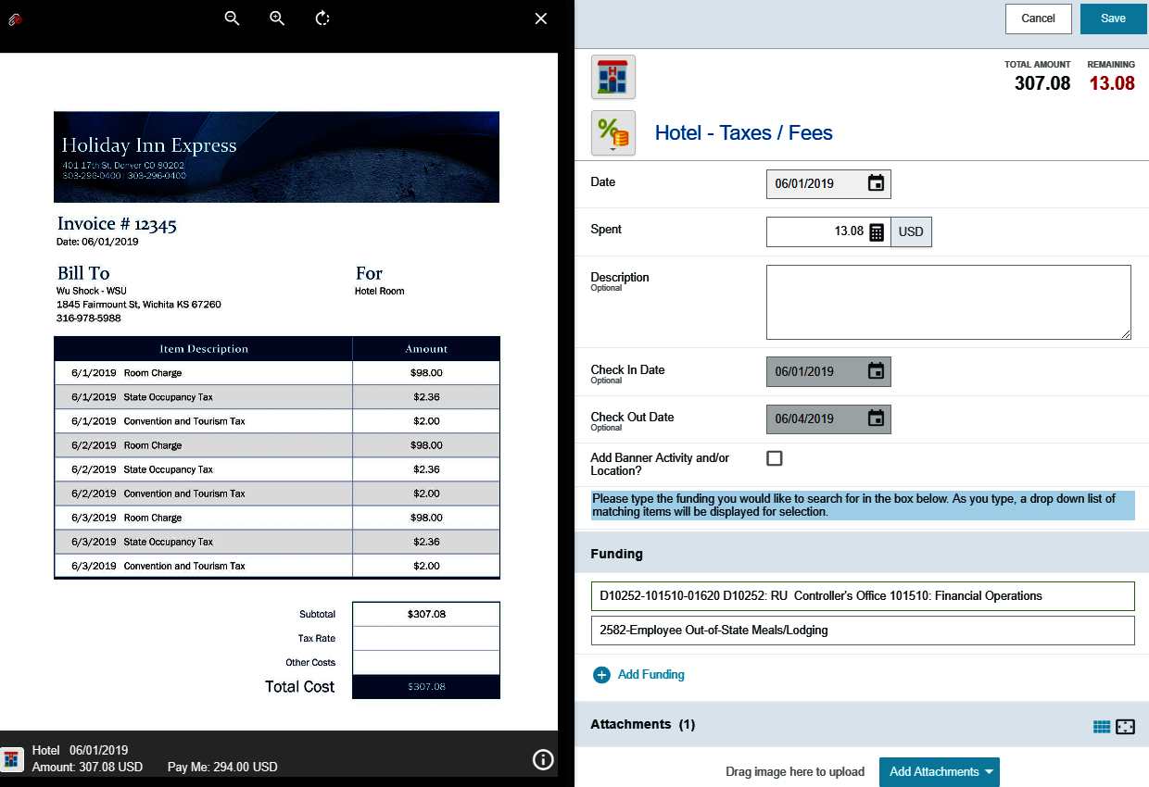
Hotel Expense – Itemize
Enter the total amount for any taxes and fees listed on the invoice in the Spent field
In this example the taxes are is $4.36/day for 3 days totaling $13.08

Slide 23
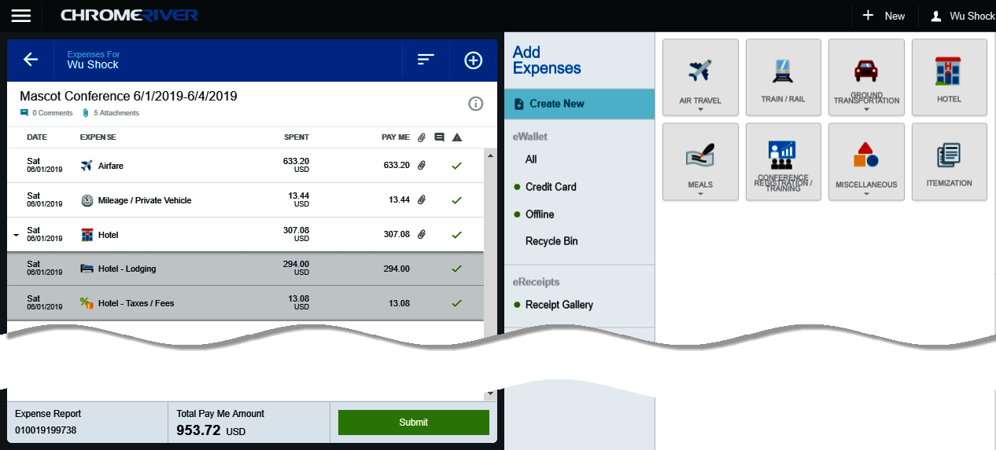
Review Entries
The itemized Hotel expenses have been added to the report

Slide 24
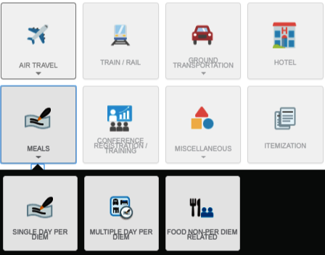
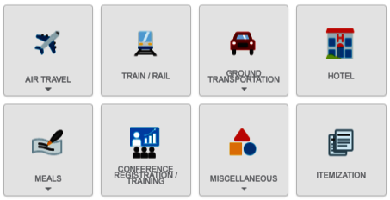
Add Per Diem Expense
Select the Meals tile
Notice other expense types are displayed in the Meals drawer

Slide 25
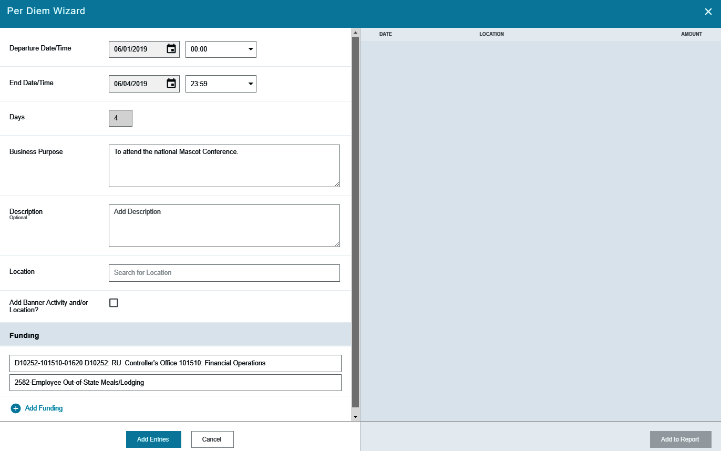
Select Multiple Day Per Diem Tile
Select the Multiple Day Per Diem tile
The Per Diem Wizard form is displayed

Slide 26
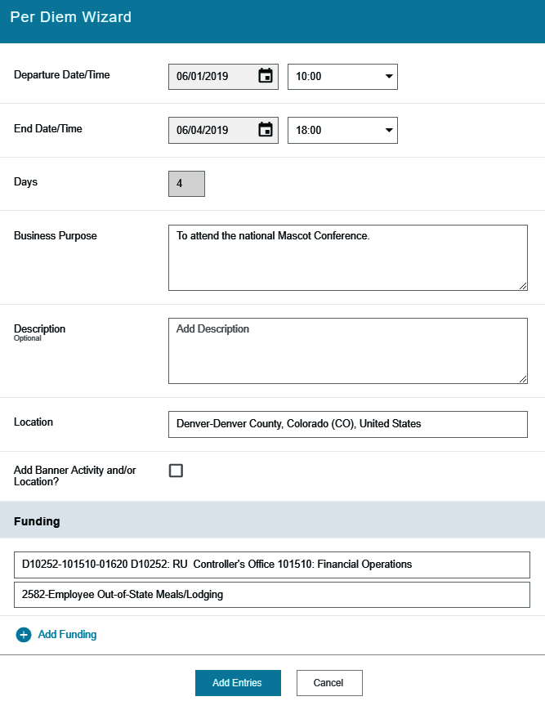
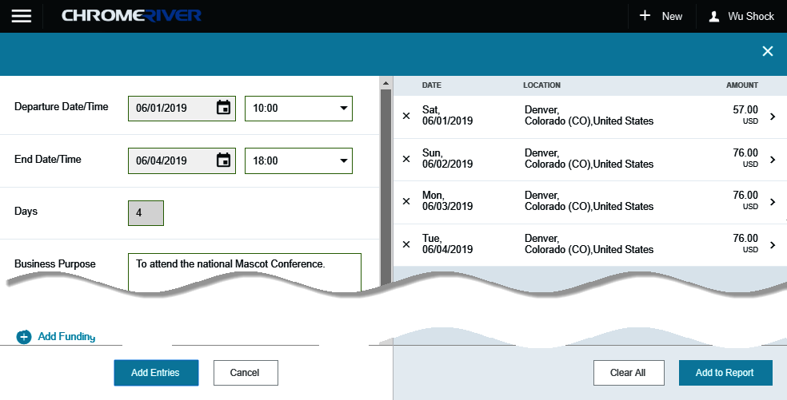
Complete Per Diem Wizard
Complete the following fields:
  Departure Date/Time
  End Date/Time
  Location
  Funding / Account Code
Click the Add Entries button
The Per Diem entries are displayed on the right-hand side of the form.

Slide 27
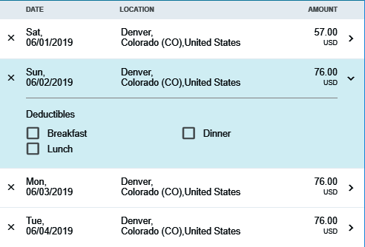
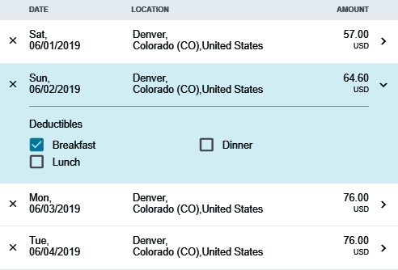
Select Deductibles
Clicking the arrow next to each entry will open or collapse up the Deductibles section.
If you will be provided a meal as part of the travel event or conference, select the corresponding meals check box
Selecting the check box will reduce the Per Diem amount accordingly

Slide 28
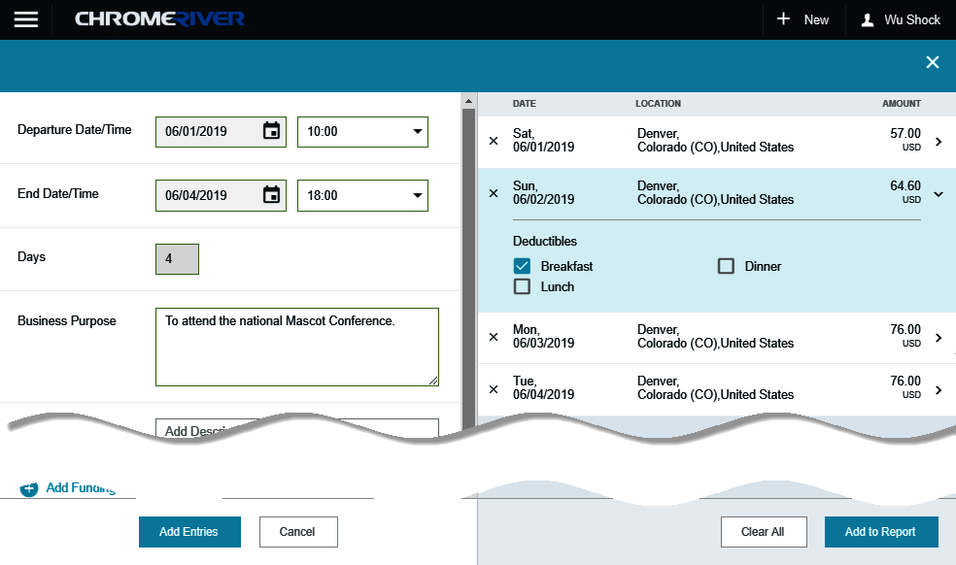
Add Entries to Report
Click the Add to Report button

Slide 29
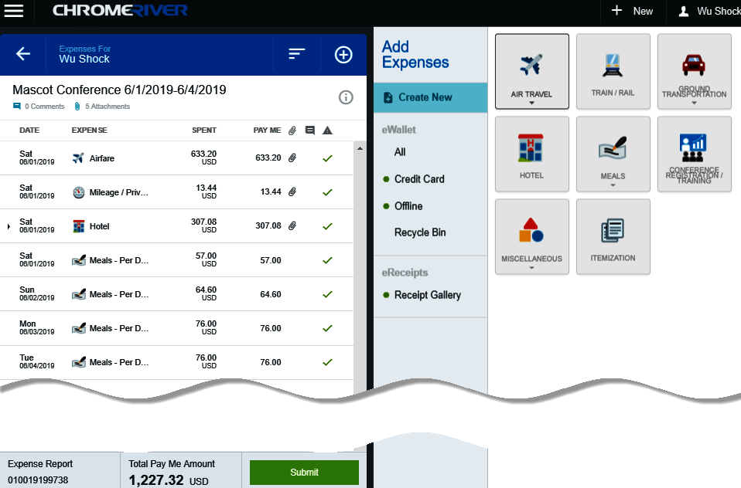
Review Entries
The expenses are added to the left side of the Expense Report

Slide 30
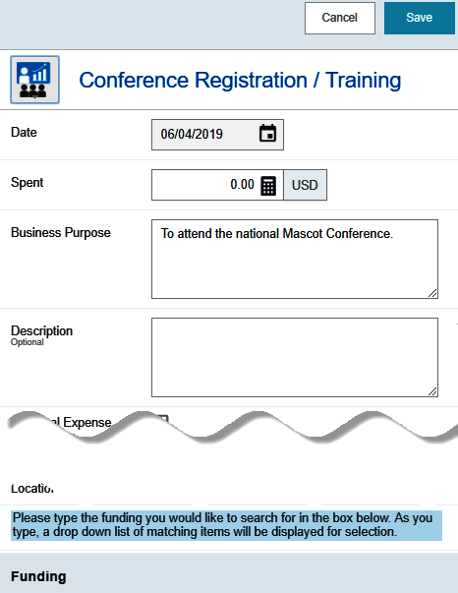
Add Conference/Registration/Training
Select the Conference Registration / Training tile
The Conference Registration / Training form is displayed

Slide 31
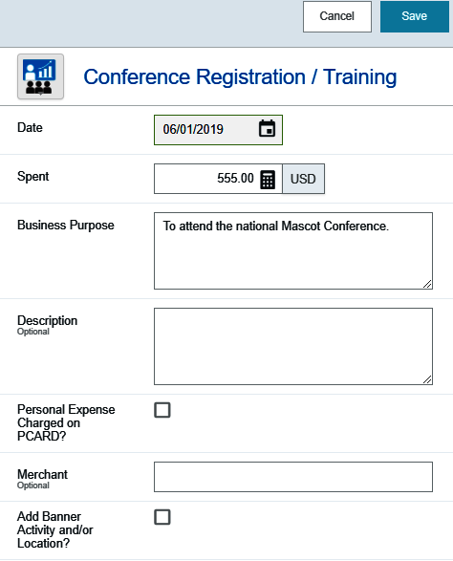
Conference Registration/ Training -Top Section
Verify and/or complete the following fields:
  Date
  Spent
  Business Purpose
  Description (optional)
  Personal Expense Charged on PCARD?
  Merchant (optional)
  Add Banner Activity and/or Location (if applicable)

Slide 32
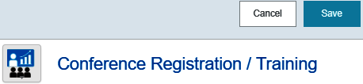
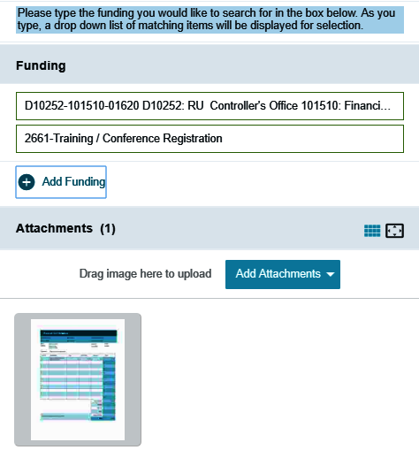
Conference Registration/ Training -Lower Section
Enter the appropriate funding information
Upload or Select the receipt in the attachment section
Click the save button located in the upper right-hand corner of the form.

Slide 33
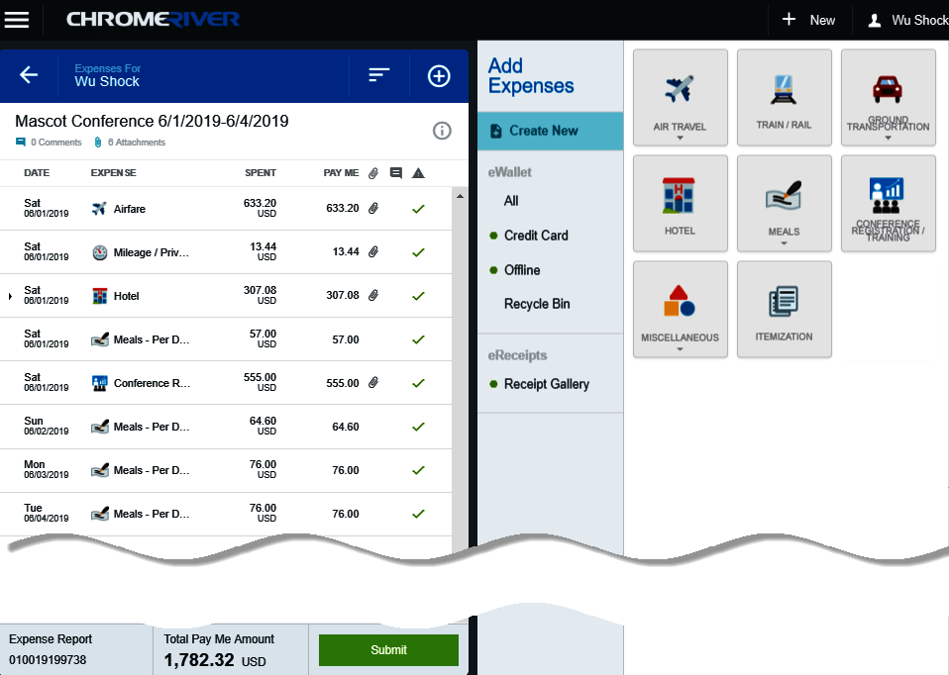
Review Entries
The expense is added to the left side of the Expense Report

Slide 34
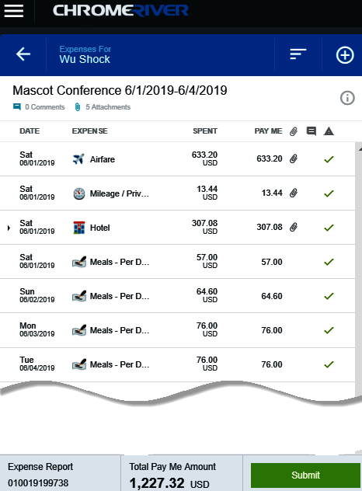
Submit Expense Report
When you are finished adding expenses to the Expense Report, click the Submit button.

Slide 35
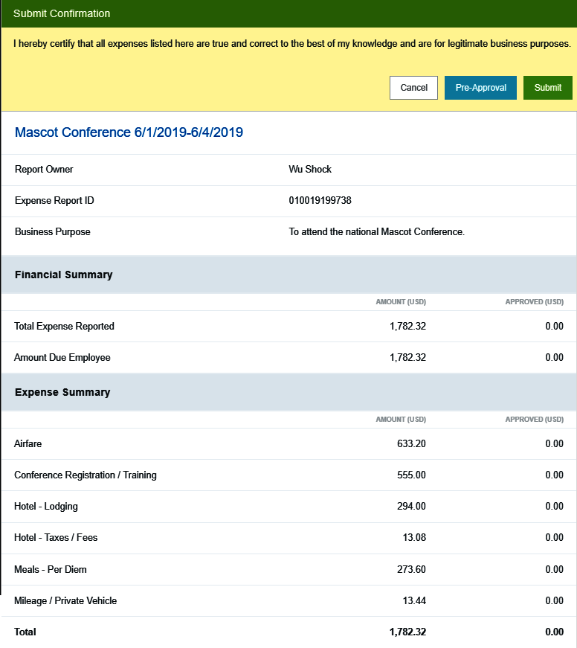
Submit Confirmation – Top Section
The Submit Confirmation page will be displayed.
This page also displays a summary of the Expense Report information.

Slide 36
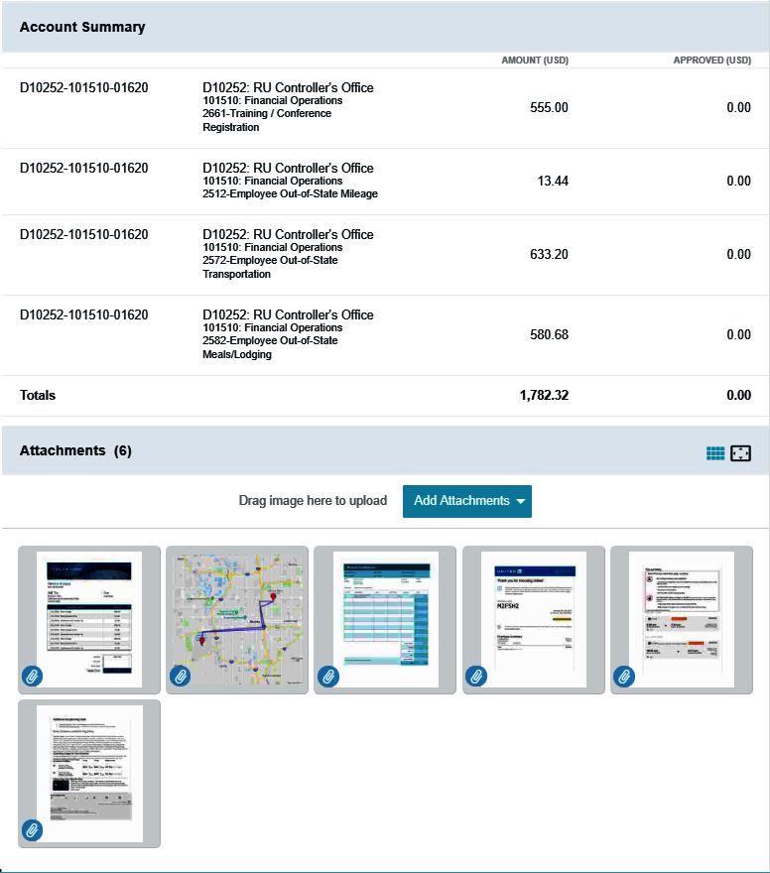
Submit Confirmation – Lower Section
The Account Summary section shows the total expense amount, by account, for each unique funding combination.
All expense report attachments will be displayed in the attachments section

Slide 37
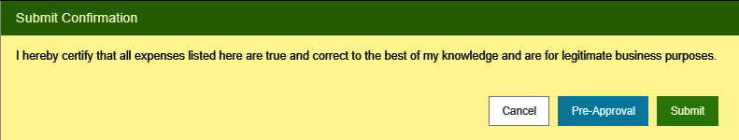
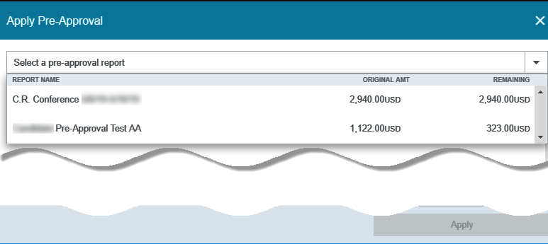
Submit Confirmation – Pre-Approval
If a Pre-Approval needs to be attached to the Expense Report, Click the Pre-Approval button.
The Apply Pre-Approval screen will display.
Click the down arrow to view a list of all approved Pre-Approval reports.

Slide 38
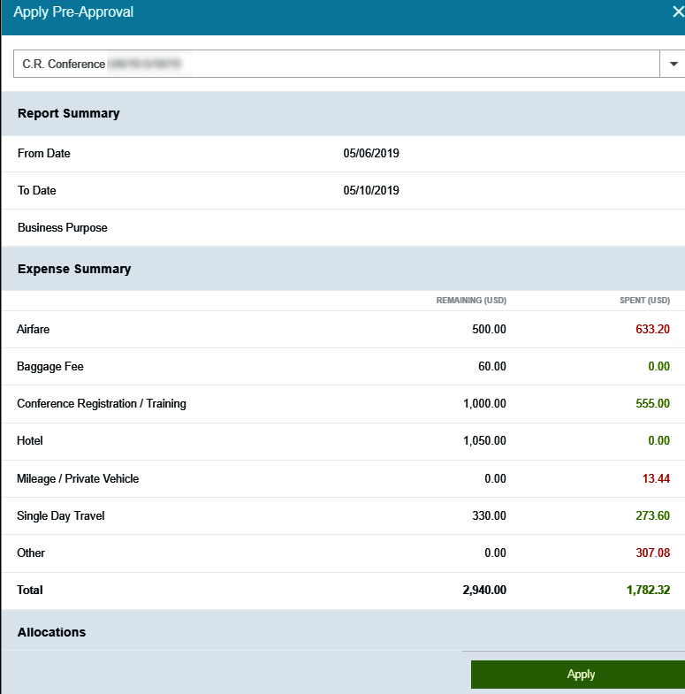
Submit Confirmation – Pre-Approval
Select the Pre-Approval report from the drop down list.
Review the Pre-Approval summary and then click the Apply button.

Slide 39
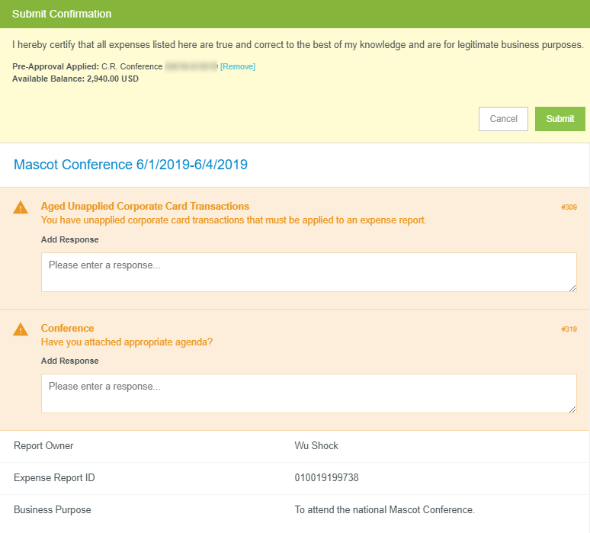
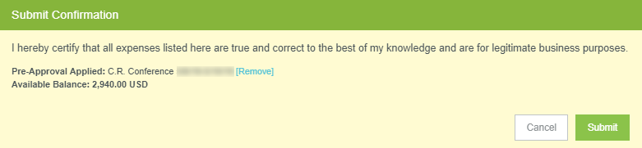
Submit Confirmation – Submit
Reference to the attached Pre-Approval is displayed in the Submit Confirmation box.
Click Submit
The system may display one or more compliance messages, prompting for additional information (if applicable).

Slide 40
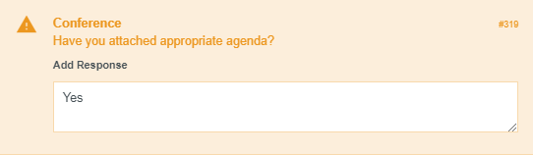
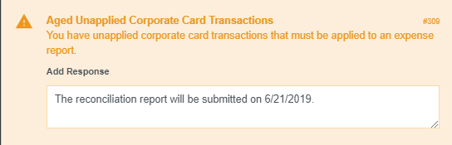
Submit Confirmation - Compliance Rules
Compliance rules alert the user that a response or action is needed.
This compliance rule alerts the expense owner that they have unapplied pcard transactions and prompts for a response.
This compliance rule reminds the expense owner of the requirement to attach an agenda when attending a conference.

Slide 41


Submit Expense Report
Once you have resolved all of the compliance messages, click the Submit button in the upper right-hand corner of the form.

Slide 42

Chrome River
Success!!!
The Expense Report has been successfully submitted for approvals!

