Slide 1
How to manage approvals in Chrome River

Slide 2
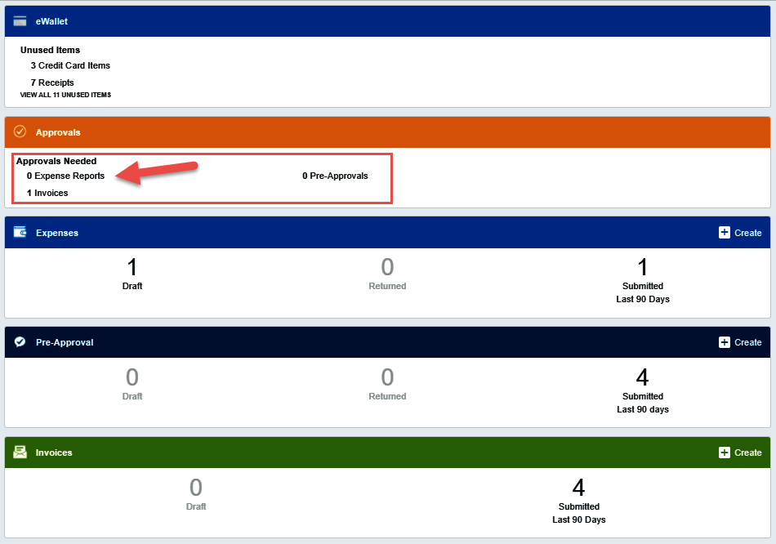
Dashboard
When there are items in your queue to approve the Approvals swim lane will appear.
The number of documents awaiting approval in each category will be displayed.
Click on the category you will be approving.

Slide 3
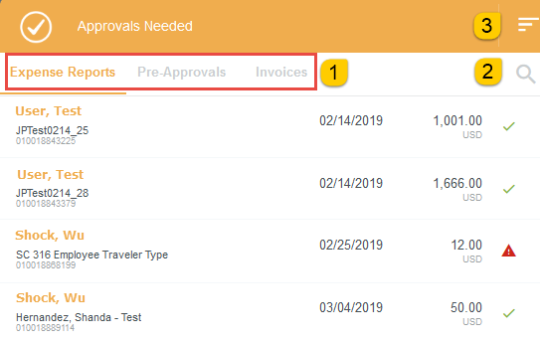
Approvals Needed Screen
This screen will list the items in the queue.
Access other document types by clicking the document titles listed along the top of the page.
Click the search icon to locate a specific Expense Owner.
Change the sort order of the documents by clicking the three line icon.

Slide 4

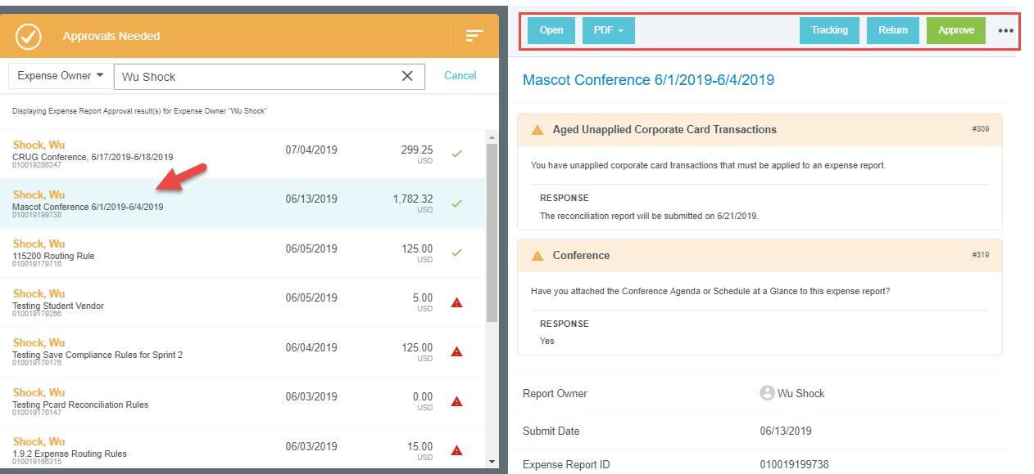
Approvals Screen
Single clicking a specific report will display the report on the right side of the screen.
Notice the options listed across the top of the screen.

Slide 5

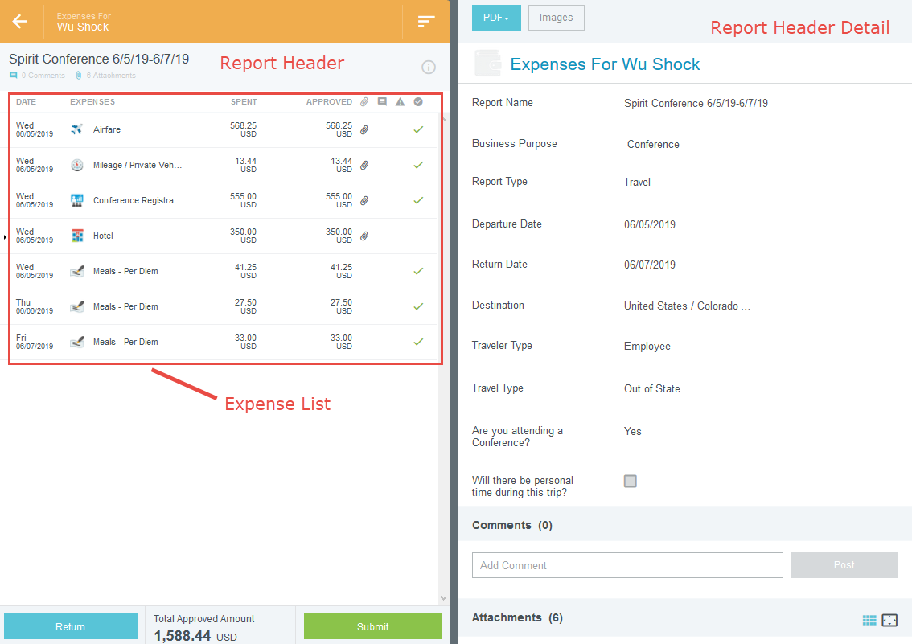
Summary Page Options
Open – Click to open the report to review in greater detail.
The left side of the screen will display the report header along with a list of all expense lines included on the report.
Initially, the report header detail will be displayed on the right side of the page.

Slide 6

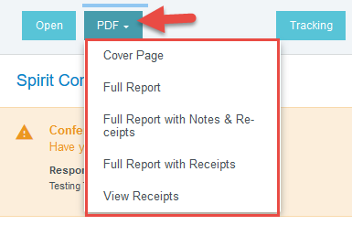
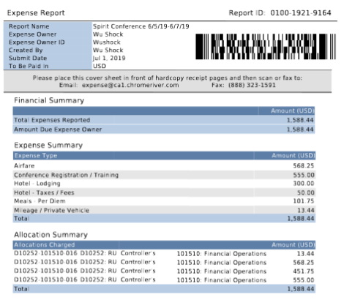
Summary Page Options
Clicking the PDF button will display different PDF options.
Cover Page – print and use as the top page when faxing. This will direct receipts to the specific report.
The other options vary in the amount of information provided on the PDF.
View Receipts produces a PDF of all the attachments on the report.

Slide 7

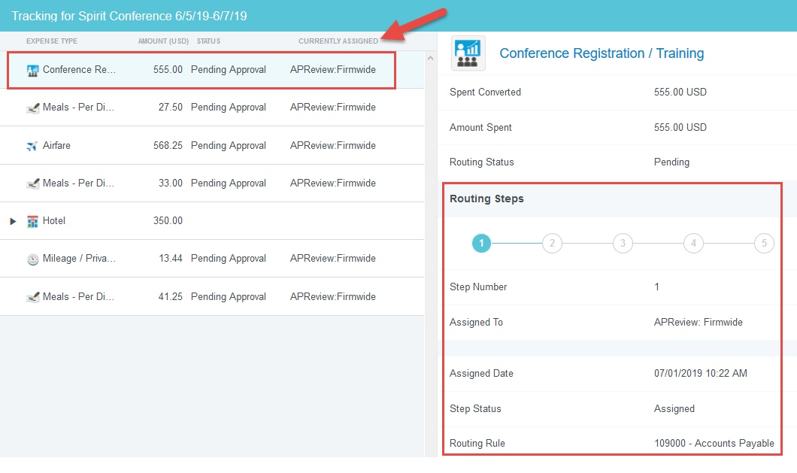
Summary Page Options
Clicking the tracking button displays the expense line list on the left side of the screen.
Based upon the FOAP, each line on a report can route differently.
Click on an expense line to view the tracking information.
The Routing Steps section will display detailed routing information.

Slide 8
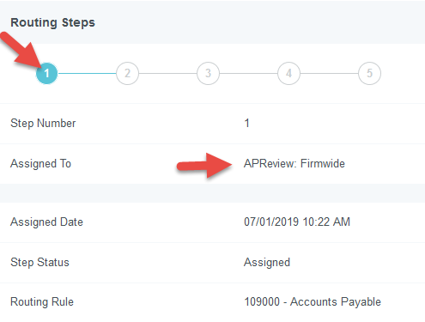
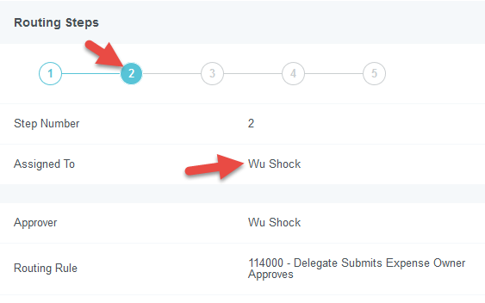
Summary Page Options
The blue shaded circle shows which routing step you are viewing.
Clicking on the next numbered circle will show information about the next approval step.

Slide 9
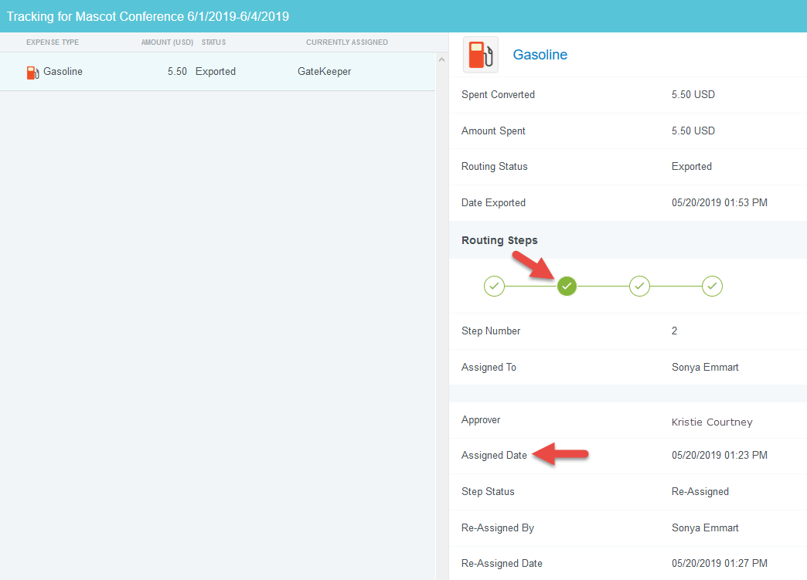
Summary Page Options
When an approval has occurred, the numbered step will be replaced with a green check mark.
Clicking on a step will show additional information about the approval.
The GateKeeper step ensures all expense lines on the report are approved before exporting to Banner.

Slide 10
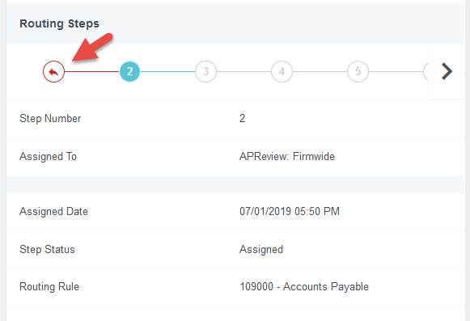
Summary Page Options
Returned lines will be marked with the red return arrow.

Slide 11

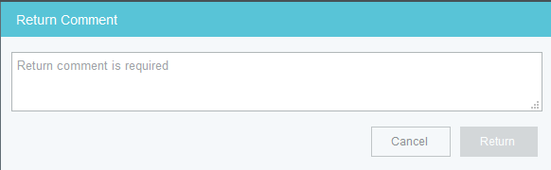
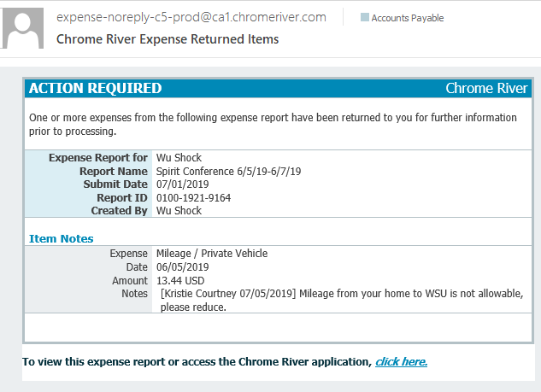
Summary Page Options
Clicking the return button will return the entire report (including all expense lines) back to the expense owner.
The system requires a return comment to be entered.
The expense owner and delegate will receive a notification of the return.

Slide 12

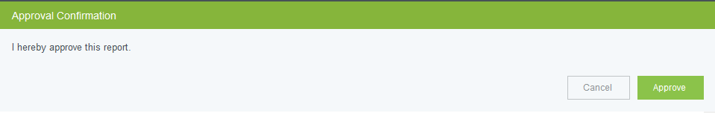
Summary Page Options
Clicking the Approve button from the Summary page will approve the entire document.
The document will be routed to the next step in the approval process.

Slide 13

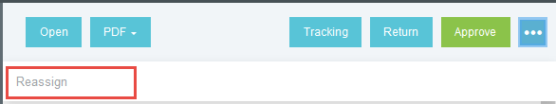
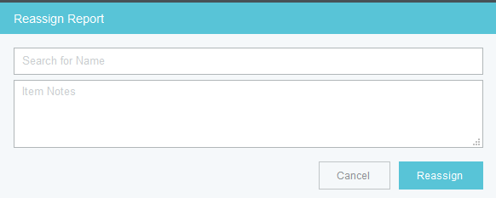
Summary Page Options
Clicking the three dots located to the right of the approve button will display the reassign option.
In the event someone receives an expense report for approval that should be reviewed and approved by a different employee, the expense report can be reassigned.
Please note: by reassigning the report, the assignor relinquishes their approval authority for the report.

Slide 14

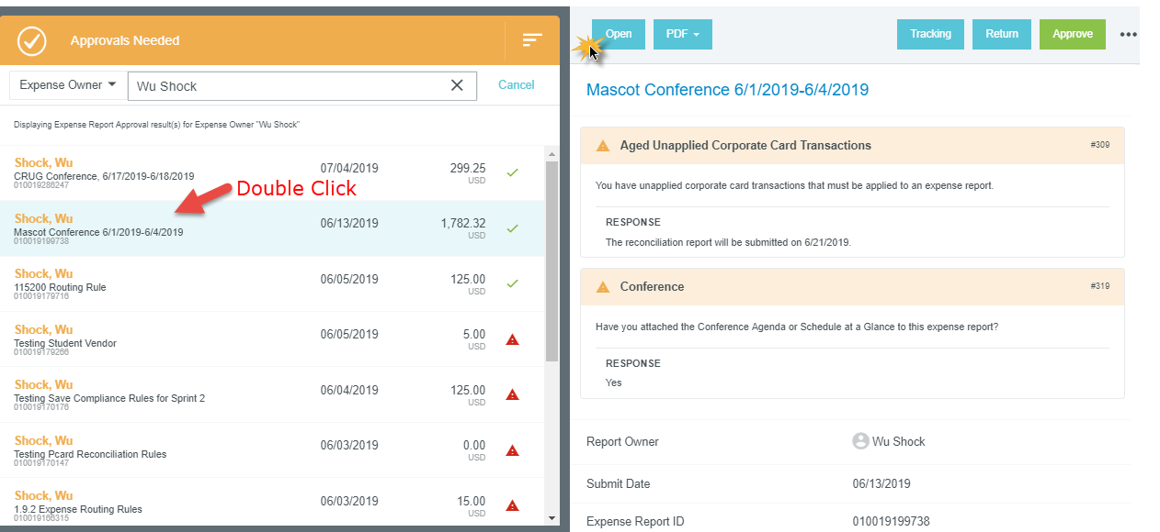
Detailed Expense Information
Double clicking the report name on the Approvals Needed page will open the detailed expense report view.
Clicking the open button on the right side of the page provides the same result as double clicking the report name.

Slide 15
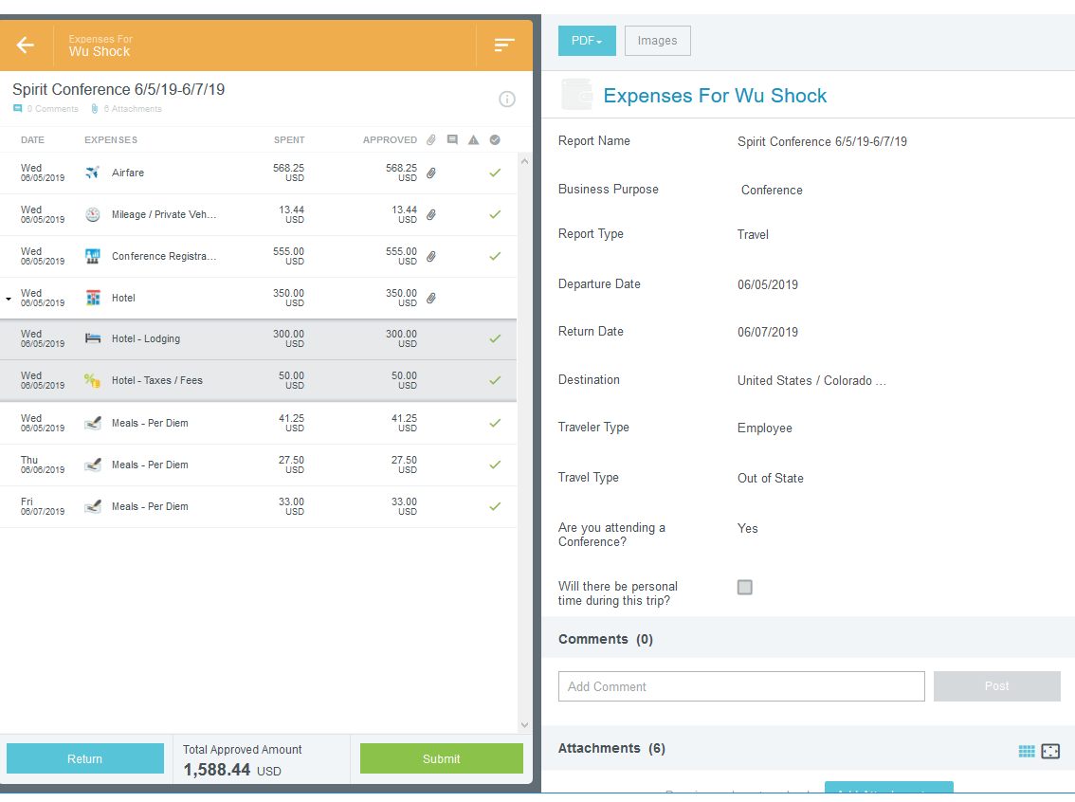
Detailed Expense Information
Notice the expense report header and line items are listed on the left side of the screen.
The detailed header information is displayed on the right side of the screen.

Slide 16

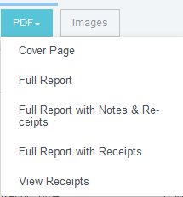
Detailed Expense Information
Clicking the PDF button will display different PDF options.
Cover Page – print and use as the top page when faxing. This will direct receipts to the specific report.
The other options vary in the amount of information provided on the PDF.
View Receipts produces a PDF of all the attachments on the report.

Slide 17

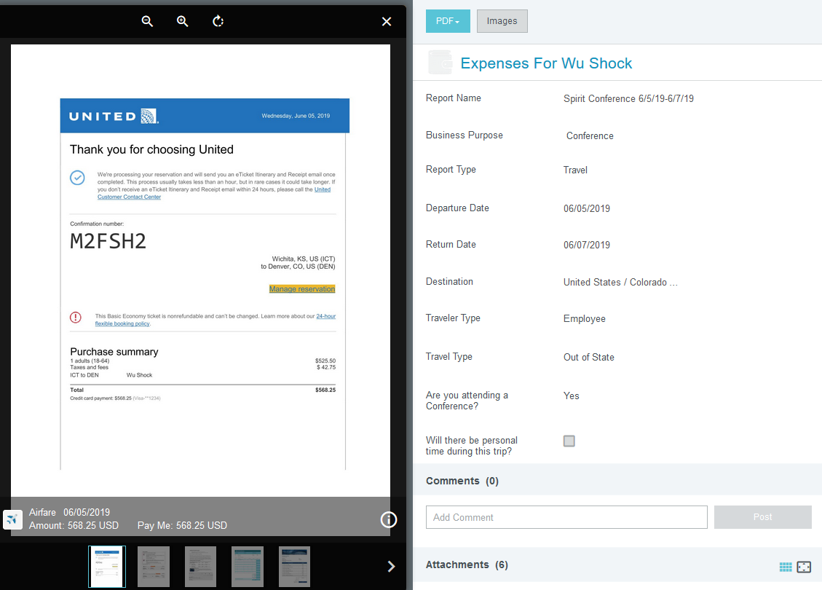
Detailed Expense Information
Clicking on the Images button will display all the images or attachments for the entire expense report.
The images will display on the left side of the screen
Attachments can be added to the header of the expense report by an approver.

Slide 18
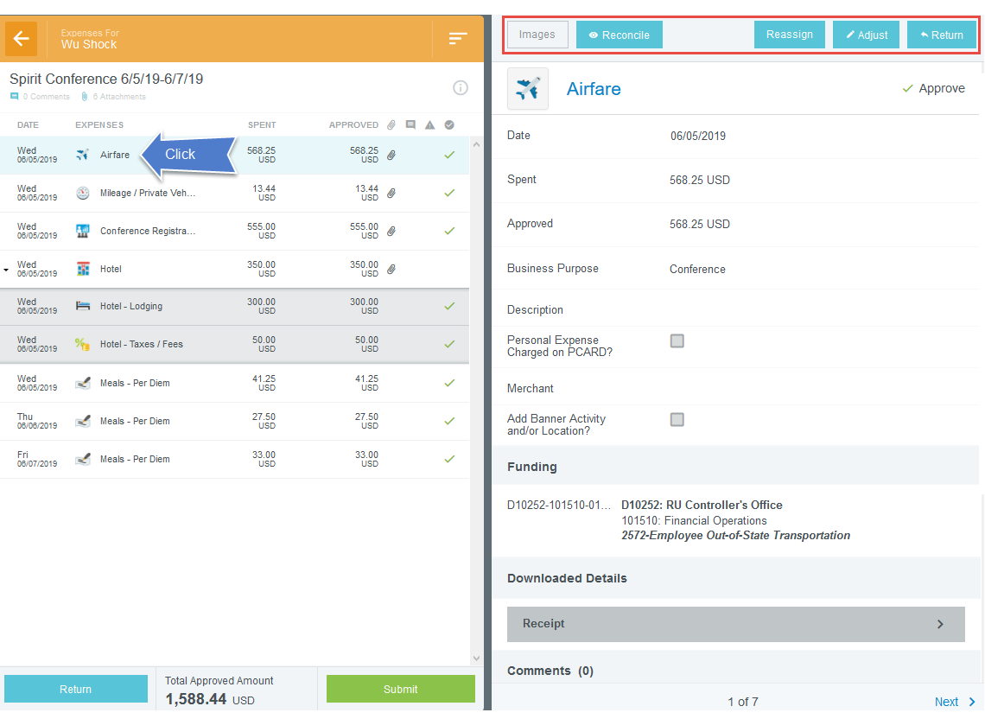
Expense Line Information
To view the detailed expense line information, click on the desired expense listed on the left side of the screen.
The expense form will display on the right side of the page.
Notice the options at the top of the page

Slide 19

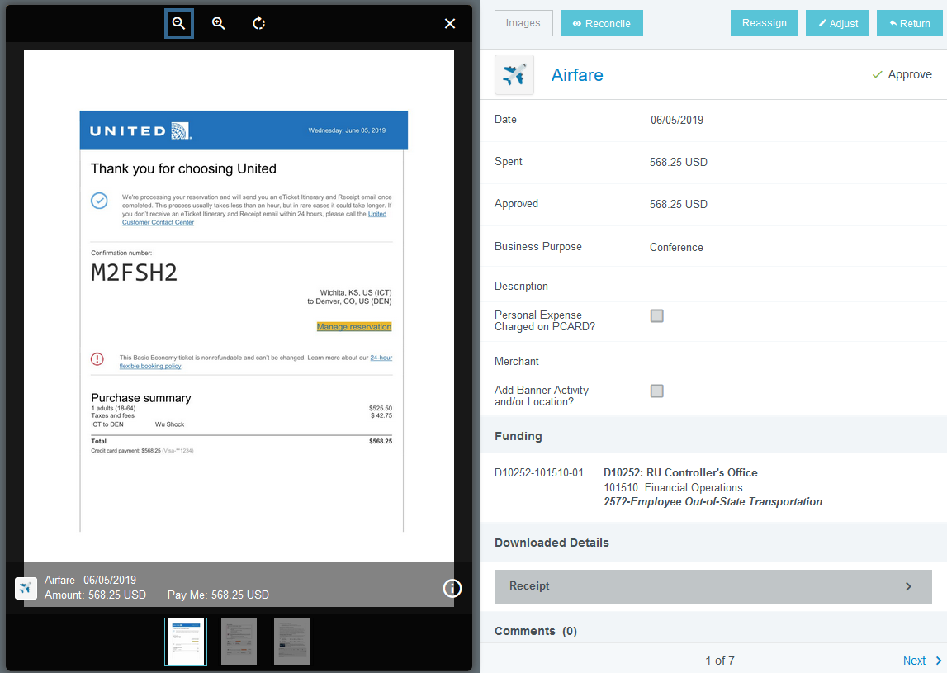
Expense Line Options
Click the Images button to display the expense line attachments.
Unlike the Images option at the summary level, this images option only shows the attachments associated with the line you are reviewing.

Slide 20

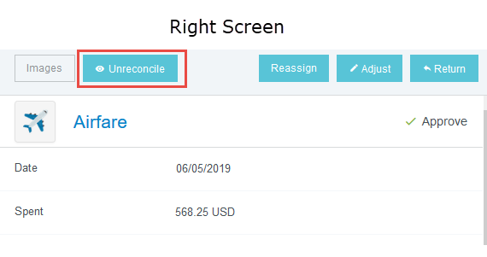
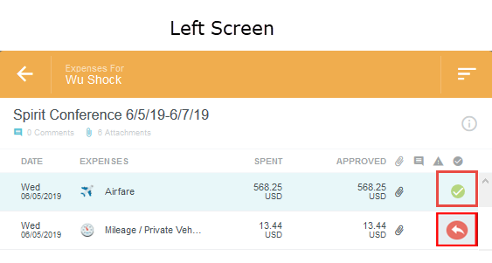
Expense Line Options
If you are auditing a report with multiple expense lines, you can click the reconcile button to mark lines that you have already reviewed.
The check mark icon will be replaced with a checkmark within a green circle icon.
If an item has been reviewed and returned, it will be marked with a return arrow within a red circle icon.
Notice the Unreconcile button is now visible on the right screen.
Clicking this button will unreconcile the expense line and the icon will return to a green check mark.

Slide 21

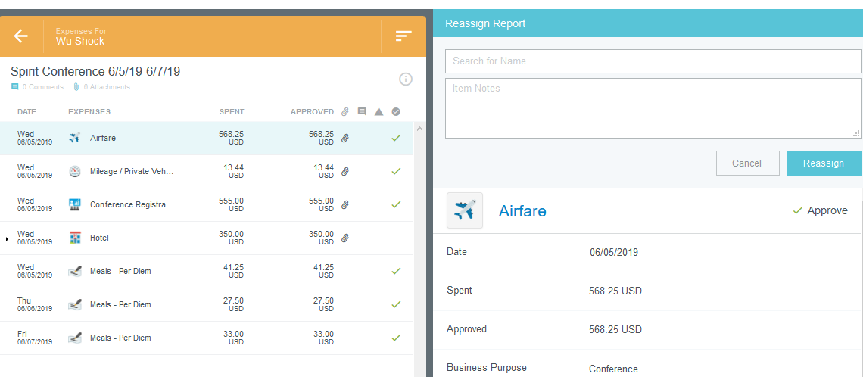
Expense Line Options
Clicking the Reassign button will open up a dialog box asking for the name of the person you want to reassign to, and an Item Note.
If you reassign, you forfeit your approval rights.

Slide 22

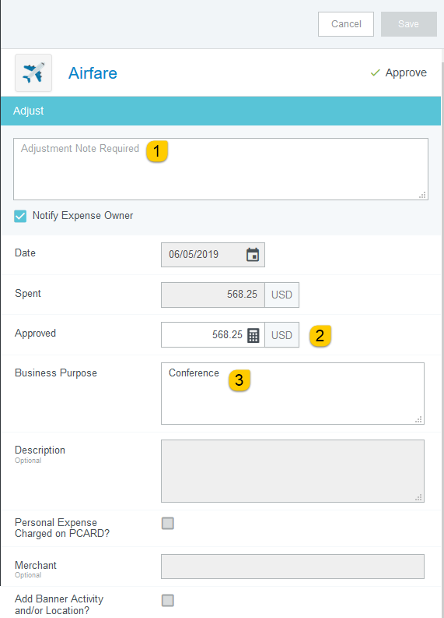
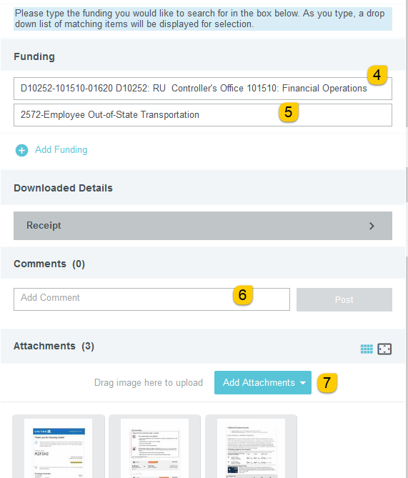
Expense Line Options
During the approval process, approvers have the ability to adjust certain items on the expense report.
The system requires an Adjustment Note to be added. You have the ability to notify the expense owner of the adjustment made.
Approved Amount – can only adjust down
Business Purpose – can fully edit
Funding – can fully edit
Account – can fully edit
Comments – can be added, but never removed
Attachments – can only add

Slide 23

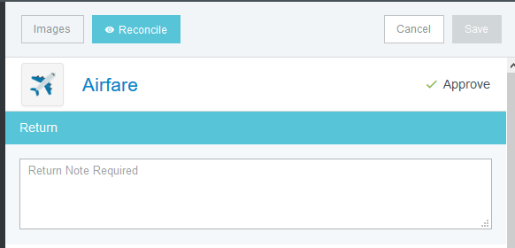
Expense Line Options
Individual expense lines can be returned to the expense owner.
Once returned, only certain items can be fixed by the expense owner.
The system requires a Return Note anytime you are returning an item.
If you mark a line for return, no action will happen until you have tapped the Return or Submit button at the bottom of the line item list.

Slide 24
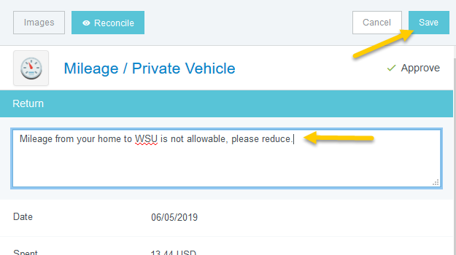
Return Expense Line
Approvers cannot adjust the approved amount on the Mileage / Private Vehicle expense.
If an adjustment is necessary, return the mileage expense line to the Expense Owner
Click the Return button located in the upper right corner of the mileage form.
Enter a return note and click save.

Slide 25
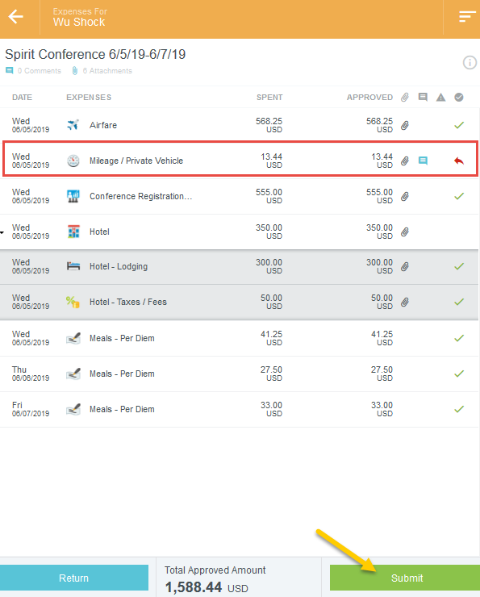
Return Expense Line
The expense line will be marked with a red arrow indicating it has been marked for return
Note: No action will be taken until the report has been submitted
Clicking the Submit button will return the mileage line to the expense owner and move the approved lines forward to the next approver.
Clicking the Return button will return ALL expense lines to the expense owner.

Slide 26
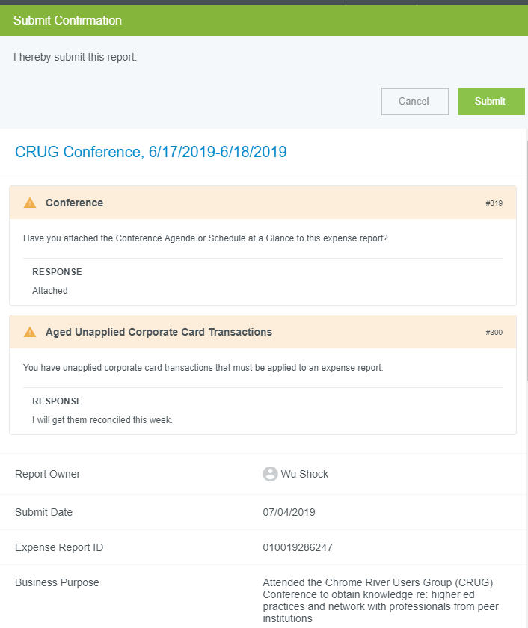
Return Expense Line
Once the Submit button has been clicked, the Submit Confirmation screen will appear.
Note: Even though this is an approval action, once the report has been opened and/or modified, the system removes the approval option presents the Submit option.
After clicking submit, a submit confirmation will display.

Slide 27
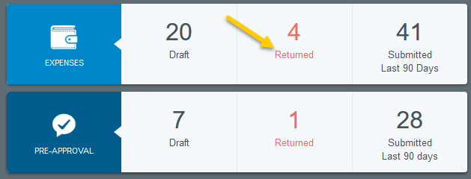
Return Expense Line – Expense Owner View
The expense owner and delegate (if applicable) will receive an email notification of the return.
The expense owner will locate the returned report by looking in the Returned section on the dashboard.

Slide 28
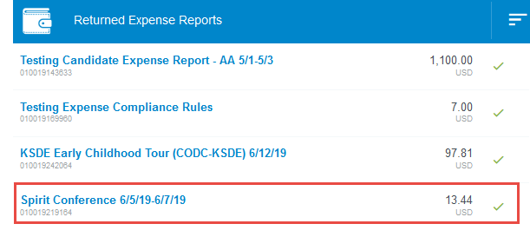
Return Expense Line – Expense Owner View
Notice the amount for the returned expense report.
The system will only display the total amount for all returned lines.
Clicking on the report will open up the summary view of the expense report.

Slide 29
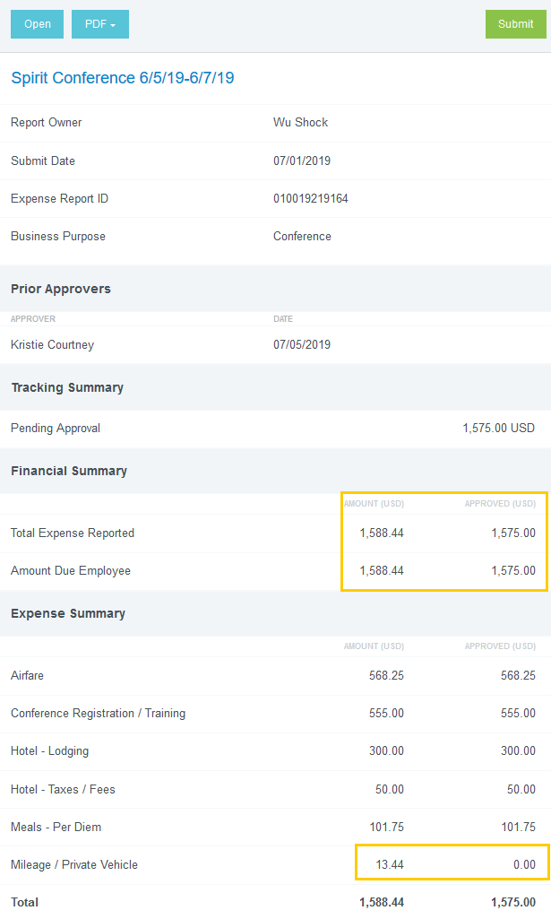
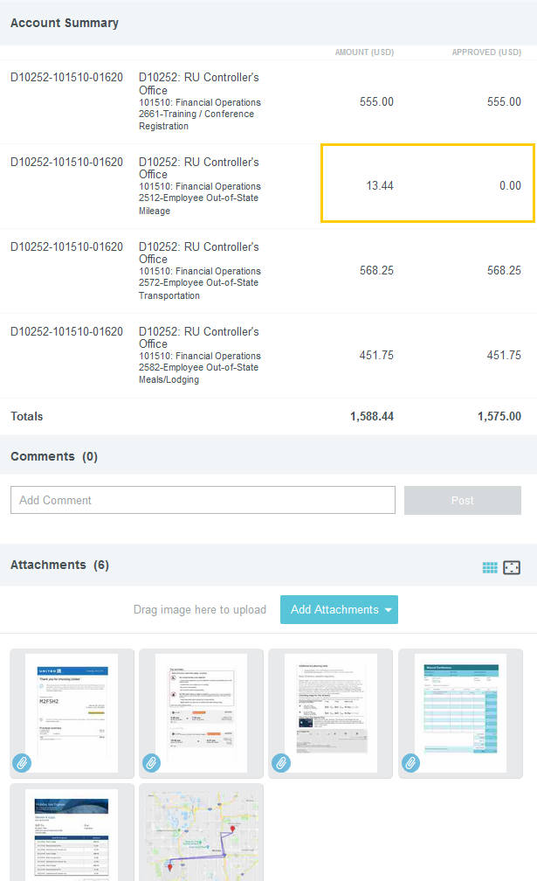
Return Expense Line – Expense Owner View
Scroll down to view the Financial Summary and Expense Summary sections.
The expense owner can easily see which expense has been returned.
Click the open button located in the upper left hand corner of the form.

Slide 30
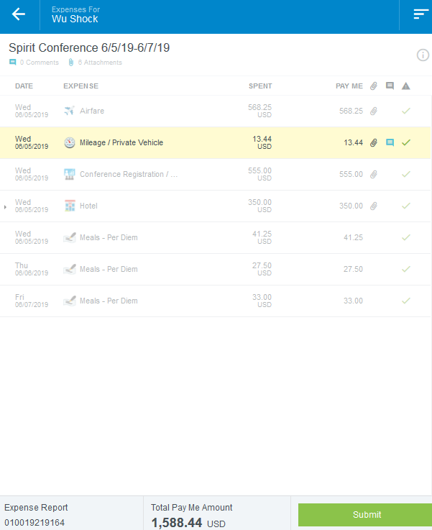
Return Expense Line – Expense Owner View
Notice the returned expense line is highlighted in yellow.
This is the only line that can be modified.
Click on the expense line to open the expense form.

Slide 31
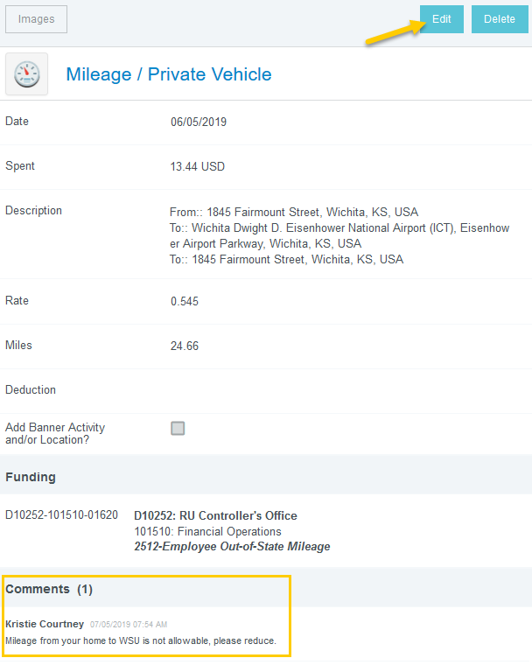
Return Expense Line – Expense Owner View
The expense form is displayed on the right side of the screen
The expense owner can review the return comments, edit the expense line or delete the expense line.
Note, the expense owner CANNOT add expense lines on a returned report.
Click edit to open the expense form for editing.

Slide 32
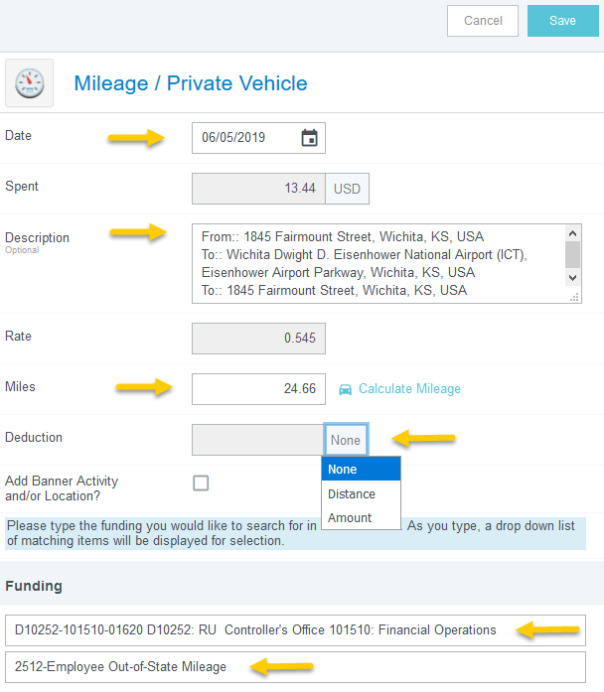
Return Expense Line – Expense Owner View
Notice the fields that are open for the expense owner to edit.
To reduce the mileage amount claimed by Distance or Amount, select the appropriate option from the drop down list.
Enter either the number of miles or the dollar amount in the Deduction field

Slide 33
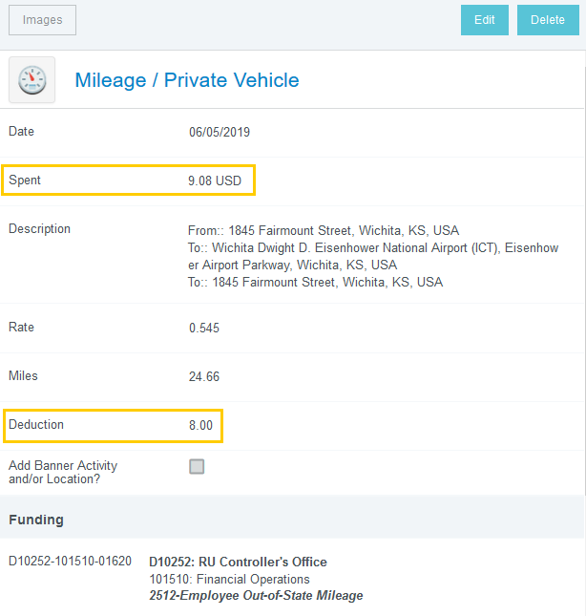
Return Expense Line – Expense Owner View
The system has recalculated the Spent amount.
In this example, a Distance deduction of 8 miles was entered.
The system reduced the Spent amount by $4.36 (8 miles x 0.545)

Slide 34
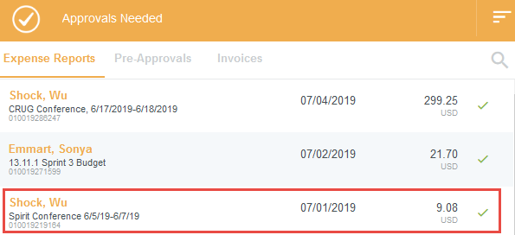
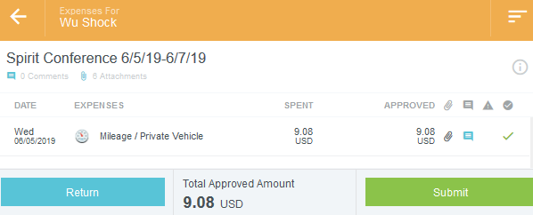
Return Expense Line – Approver View
Once submitted, the Expense Report will be in the approval queue.
The amount shown will only be for the single expense line.
Opening the report will display only the expense line that needs approval.

Slide 35
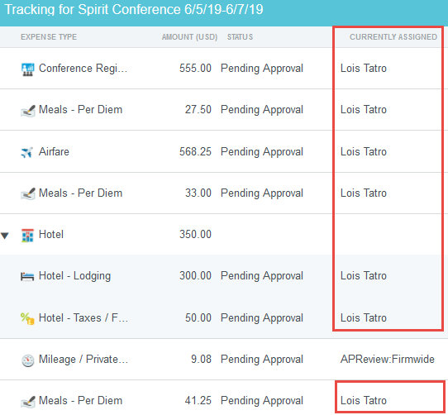
Returned Expense Line – Approver View
Click the tracking button to see the workflow approval path.
Notice all expense lines, except for the mileage line have moved forward to the next approver.

Slide 36
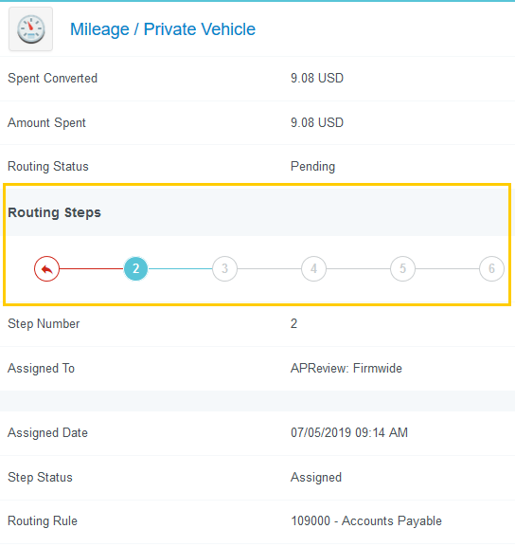
Returned Expense Line – Approver View
Click on the mileage line to view the workflow approval path.
The red arrow indicates the expense line was returned to the expense owner.

Slide 37
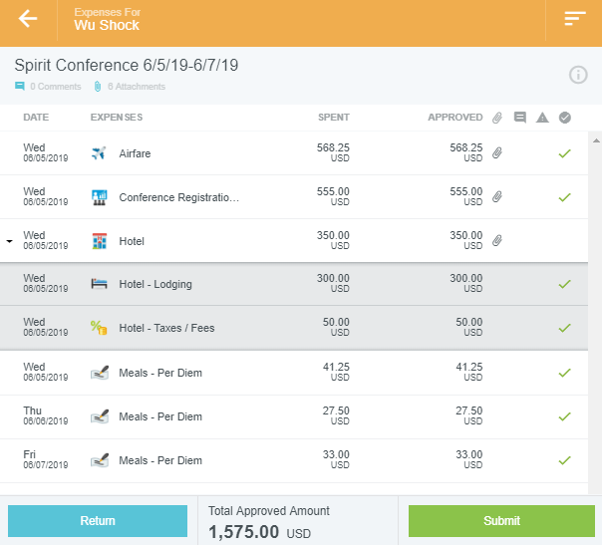
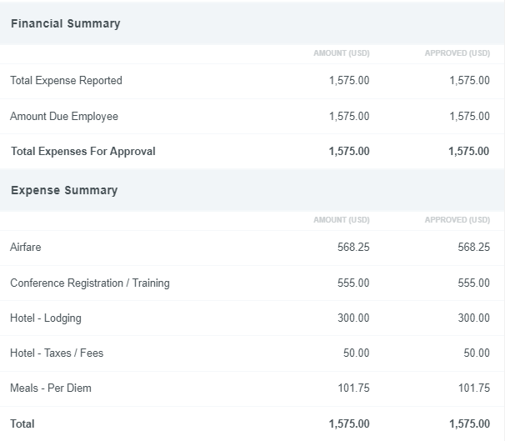
Returned Expense Line – Approver View
Note: There will be NO indication to the next approver that a line has been returned.

Slide 38
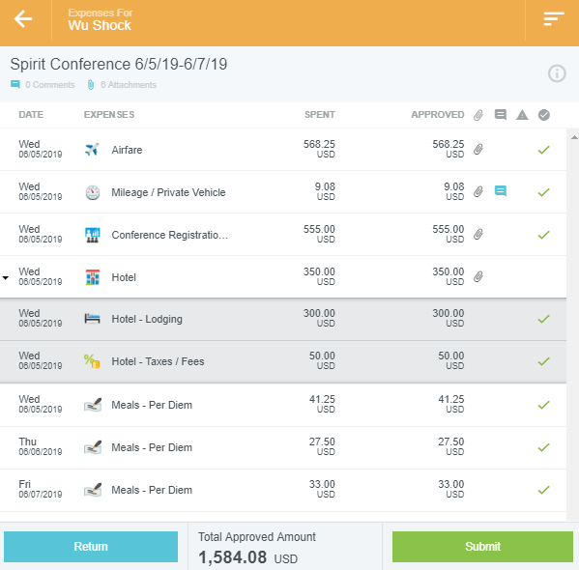
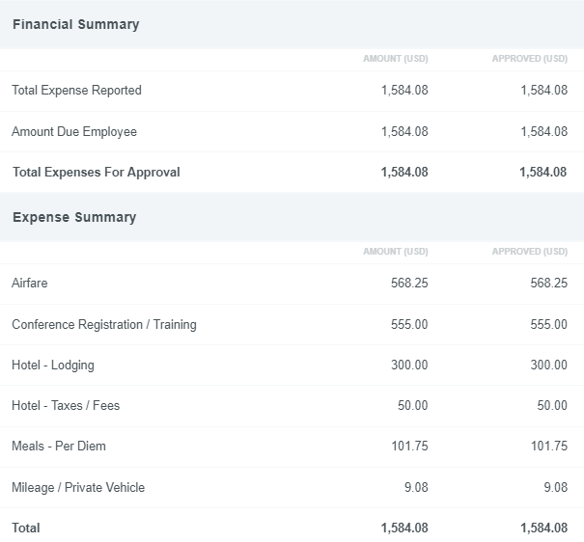
Returned Expense Line – Approver View
If the next approver has not approved the expense report before the returned line makes it to their approval step, the system will automatically update the report to display all approved lines.

