Slide 1

Chief Emergency Building Coordinator
Emergency Building Coordinator
Facilitated by:
Cody Charvat, KCEM
Training & Exercise Officer
Sedgwick County Emergency Management

Slide 2
What’s on tap
Overview of Emergency Management
Where you fit into that picture
Basics of Disaster Preparedness
What’s next?

Slide 3
What is Emergency Management?
“The governmental function that coordinates and integrates all activities necessary to build, sustain and improve the capability to prepare for, protect against, respond to, recover from, or mitigate against threatened or actual natural disasters, acts of terrorism or man-made disasters.”
  - Post-Katrina Emergency Management Reform Act. 2006

Slide 4
A Better Definition:
“Emergency Management is the process of making public officials think about things they don’t want to think about, spend money they don’t have, all to prepare for something they don’t believe will ever happen”
    Mike Selves, former Johnson Co. EM, Past-President International Assoc. of Emerg. Mgrs.

Slide 5
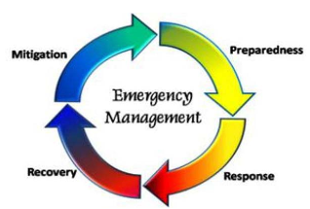
Principals of Emergency Management
Mitigation
Changing the physical
environment or campus
behaviors
Preparedness
Planning for the things
you cannot change or
control
Response
Managing the incident
Recovery
Returning to normalcy

Slide 6
WSU Emergency Management
CEBC - Chief Emergency Building Coordinator
EBC - Emergency Building Coordinator
“EBC’s are charged with making professors and students think about things they don’t want to think about, spend time they don’t want to surrender, preparing for something they don’t believe will ever happen to them.”
Notes:
SCEM can’t be everywhere or write the plan for every church, business or school in our community; we do the community-as-a-whole and rely on our partners to take some of this responsibility on for themselves. That’s why I’m here today: to “deputize” the EBC’s
Describe each position

Slide 7
College/University Gun-Related Events*
Virginia Tech – 2007
In 2017:
  K-State - Jan
  Central St. U, Oh – Mar
  Limestone Coll, SC – March
  U. of W. Florida – Mar
  St. Thomas, MN – Apr
  Utah Valley U. – Apr
  North Lake Coll, Tx– May
  Ravenscroft, IN– June
  UNLV, NV– July
  U. of Arkansas – July
  Texas A&M – Sept
  Tennessee St.– Sept
  St Catherine, MN– Sept
  Akron U., OH – Sept
  USC – Oct, HOAX
Notes:
Most involved guns, one or two involved knives. Not all resulted in injuries, which is why you may not have heard of some of them. Certainly not all were active shooters, but every one occurred in a campus building, parking lot, or on school grounds.
Even with all this, armed incident is not your biggest threat: natural disasters are.

Slide 8
College/University Weapon Related Events*
2017: 34 US School gun incidents (K12-University)
Wichita State University, Fairmount Towers, August 2015 – 1 Dead
Wichita State University, Cessna Stadium lot, July 1993 – 2 dead, 1 injured
Notes:
Most involved guns, one or two involved knives. Not all resulted in injuries, which is why you may not have heard of some of them. Certainly not all were active shooters, but every one occurred in a campus building, parking lot, or on school grounds.
Even with all this, armed incident is not your biggest threat: natural disasters are.

Slide 9
Kstate incident: Unidentified 19 yr old student accidentally discharged firearm inside his dorm, striking self in leg. Transported for non-life threatening injuries.

Slide 10
Duties of a CEBC?
Creates and maintains Emergency Evacuation Plan for their location
Maintains a current roster of EBC names and phone numbers; notifies HR immediately with any changes
Coordinates and assists the response of EBC members to all emergencies
Ensures all EBCs have completed proper training

Slide 11
Duties of a EBC?
Reacts to all emergencies and leads proper procedures
Know all emergency exit locations, meeting points and evacuation procedures for their building
Immediately provide a building status report to CEBC or emergency responders
Visually survey building during emergencies to assure everyone is accounted for
Completes all training requirements for the EBC Program

Slide 12
The Basics of Disaster Preparedness:
Build a kit
  The University has a kit(s) for your building
Make a Plan
  WSU has a master plan; it’s up to the EBC’s to tailor the plan for their building
Stay Informed
  Shocker Alerts, message boards, mobile apps, WEA’s, battery-powered radio

Slide 13
Emergency Preparedness Kit
Contents:
Bag
Vest
Flashlight/Batteries
Whistle *
Emergency Instruction Binder
Quick Reference Card
Notes:
Explain each item and the use
Where the kit will be kept
How the CEBC will distribute necessary items

Slide 14
Planning: All Hazards Approach
At the most basic level the response to disasters or threats can be broken down to two categories:
  Evacuate
  Shelter-in-Place
Notes:
Where is the threat? If it’s inside, you need to get out, if it’s safe to do so. If it’s outside, you need to stay in (if it’s safe to do so).

Slide 15
General Emergency
Response Plan: Evacuation
General Evacuation Information:
  Remain calm
  Evacuate the building; check for occupants who may not have heard the signal
  Offer assistance to disabled individuals and others
  Shut all doors behind you and proceed as quickly as possible
  Follow emergency guidelines and directions given by emergency personnel
  Be sure everyone is accounted for at the Emergency Evacuation Area

Slide 16
General Emergency
Response Plan: Shelter-in-Place
Some slight variances:
  Sometimes it doesn’t matter exactly where in the building you are, other times that means the difference between life and death.
  Sometimes you can’t waste time worrying about closing/opening windows, sometimes that’s exactly what you MUST do
  Sometimes where you are within the room makes no difference, other times it makes all the difference.
BE PREPARED TO ADAPT!

Slide 17
Types of Emergencies
Evacuate or Shelter-In-Place?
Fire
Tornado
Power Outage
Gas Leak
Flooding
Bomb Threats/Suspicious Objects
Explosion
Chemical Spills/Hazardous Materials
Armed Intruder/Active Shooter
Earthquake
– Look for evacuation maps in your kit
– Maps in kit, detailed instrux in online trng.
Notes:
Fire – Evacuation maps will be in Emergency Preparedness Kits and detailed instructions in online training
Tornado – Shelter maps will be in Emergency Preparedness Kits and detailed instructions in online training

Slide 18

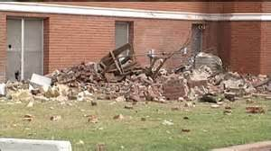
Planning/Response for Quakes
Opposite of tornado safety (mostly):
  Outside can be better than inside
  Underground is not always best
  Whether inside or out, find safe place and stay there!
Stand in doorway/arch if you want, more important to look up for things that might fall on you

Slide 19
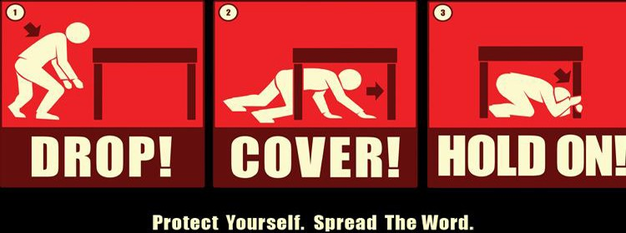
Official FEMA Safety Guidelines

Slide 20
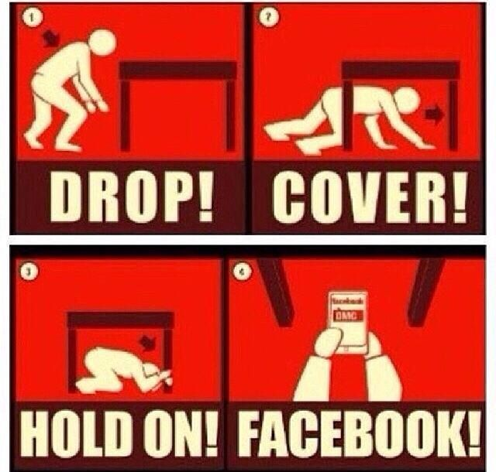
UN-Official Kansas Guidelines

Slide 21
Staying Informed = Staying Alive
Information is available anytime, anywhere: take advantage!
Whatever your favorite, have a backup via a different medium
Technology no substitute for remaining vigilant

Slide 22
CEBC/EBC Training Program
Online Introduction
General Overview Classroom Training
Emergency Response Online Training
Inclement Weather Online Training
Active Shooter Classroom Training
Emergency Evacuation Plan Online Training
Campus Wide Communication and Training
Semi-Annual Training/Meeting
Annual Training Updates
Notes:
Sheryl/Randi:
Brief overview of program
Email with details and how to access online training
March is Severe Weather Awareness Week and Campus Wide Mandatory Tornado Drill– All campus drill on 3/4/14

Slide 23
So Remember…
Emergency Management is a process, not something we can learn during the event
  Mitigation, Planning, Response, Recovery
No single plan/team can cover every situation. EBC’s are the critical link in bringing the broad plan to the individual level
The Basics are simple: Build a Kit, Make a Plan, Stay informed.
This is just the beginning, make sure you stay on top of your training.

Slide 24
THANK YOU!
Chief Emergency Building Coordinator
Emergency Building Coordinator
General Overview
Facilitated by:
Cody Charvat, KCEM
Training & Exercise Officer
Sedgwick County Emergency Management

