Slide 1
RCRA Hazardous Waste Training
Wichita State University | Department of Environmental, Health & Safety

Slide 2
Defining Hazardous Waste
  In order for a material to be considered a hazardous waste, it must first meet the definition of a solid waste. (40 CRF 261.2)
  A solid waste is any material that is discarded.
    Abandoned
    Inherently waste-like
  May be a solid, liquid, gas, or any combination of these physical states.
  Exclusions to the solid waste definition:
    Domestic sewage sent to sanitary sewer
    Spent Sulfuric Acid
    Other industrial exclusions

Slide 3
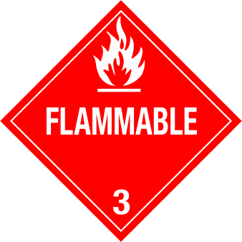
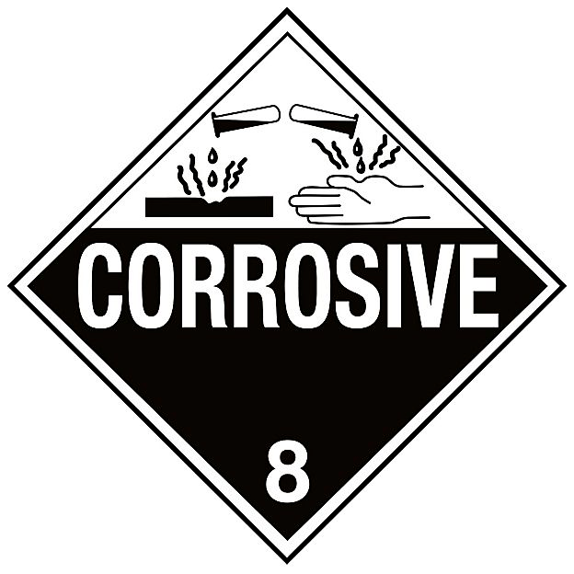
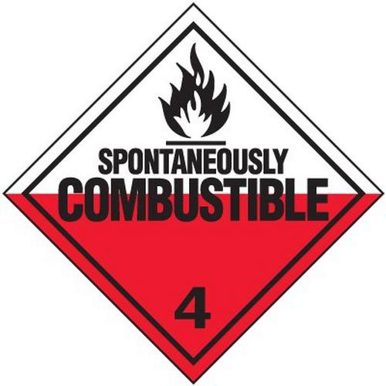
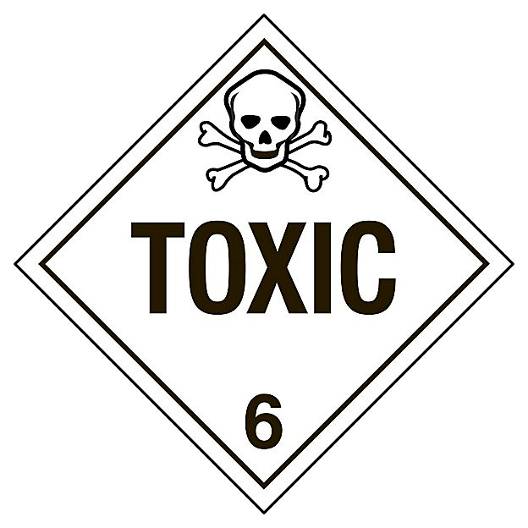
Defining Hazardous Waste
Exhibits characteristic hazards:
  Ignitibility
  Corrosivity
  Reactivity
  Toxicity
Notes:
Summarize your research in three to five points.

Slide 4
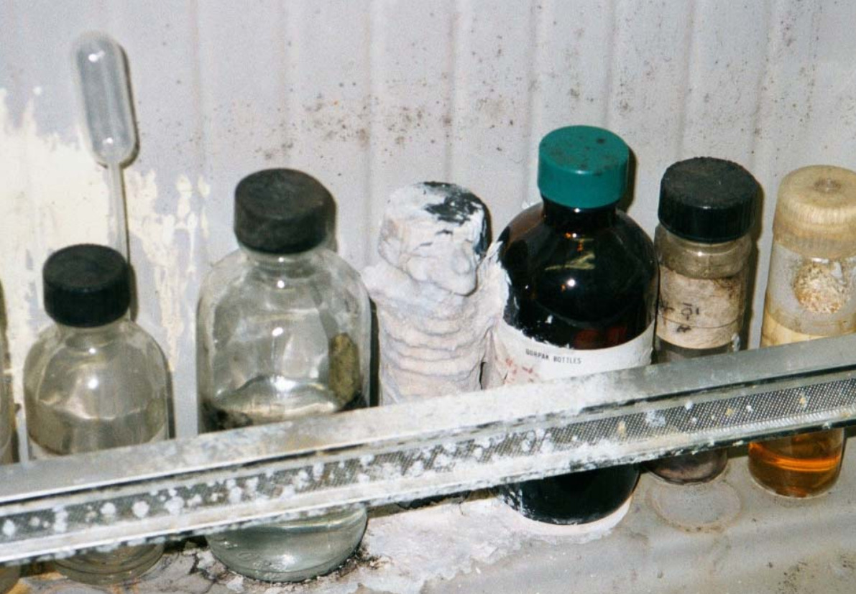
Defining Hazardous Waste
Specifically listed in regulations :
  F-List (Non-specific sources)
  K-List (Specific sources)
  P-List (Acutely Toxic Commercial Chemical Products)
  U-List (Commercial Chemical Products)
Notes:
Summarize your research in three to five points.

Slide 5
Characteristic Hazardous Waste
Characteristic Hazard | EPA Waste Codes
Ignitable | D001
Corrosive | D002
Reactive | D003
Toxic | D004 – D043

Slide 6
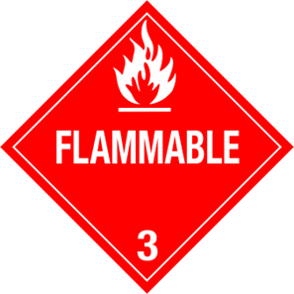
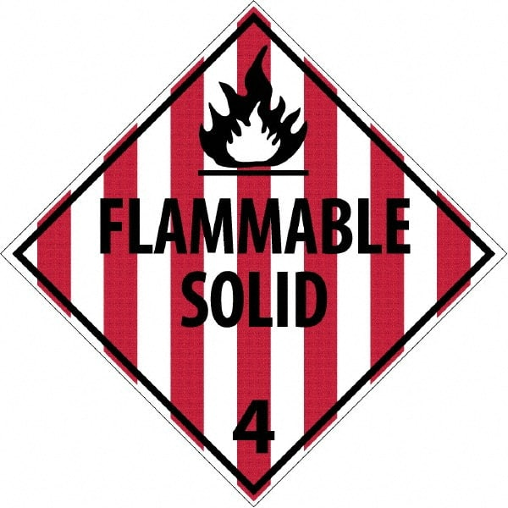
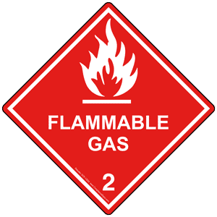
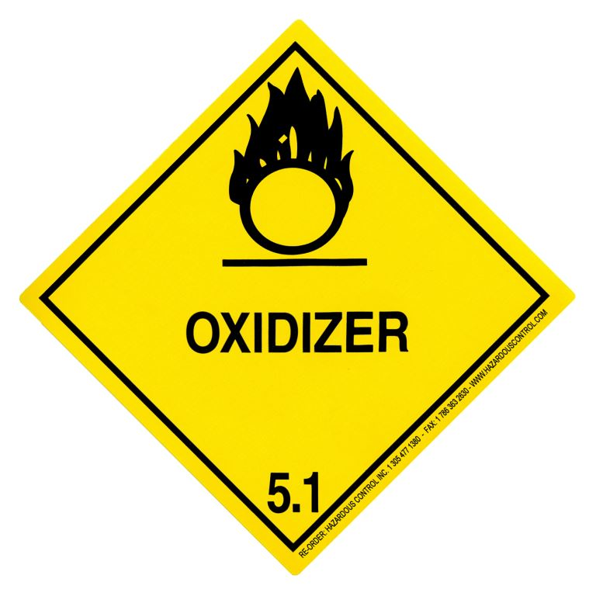
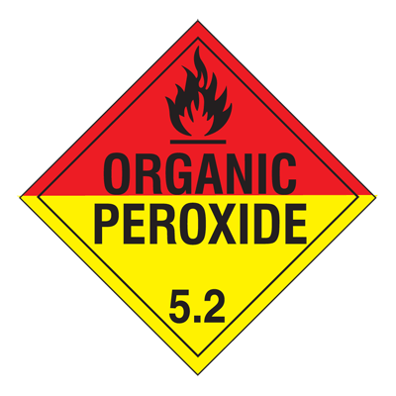
Ignitiblity Characteristic
EPA Waste Code D001
  Liquids with Flashpoint of < 140° F
  Solids that may cause a fire through friction, absorption or moisture
  Solids that may spontaneously combust at normal temperature and pressure
  Ignitable compressed gases
  Oxidizers (chlorate, inorganic peroxides, permanganate)

Slide 7
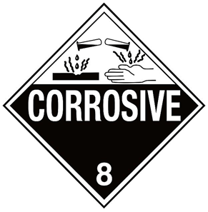
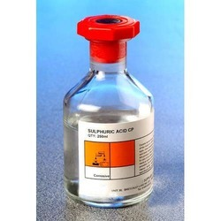
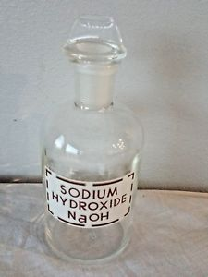
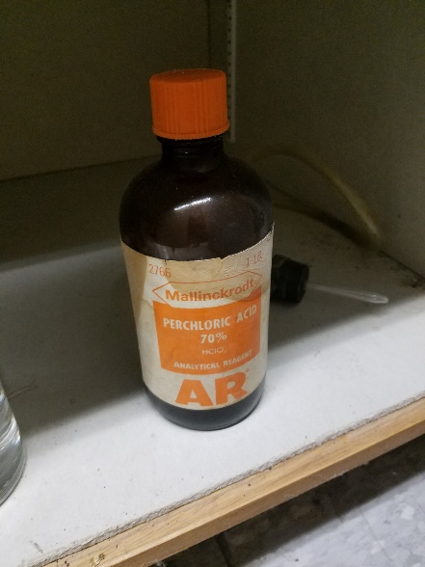
Corrosivity Characteristic
EPA Waste Code D002
  Aqueous material with a pH ≤ 2 or ≥ 12.5
  A liquid that corrodes steel at a rate > ¼ inch per year

Slide 8
Reactivity Characteristic
EPA Waste Code D003
  Normally unstable and readily undergoes violent change without detonating
  Reacts violently with water
  Forms potentially explosive mixtures with water
  When mixed with water, it generates toxic gases, vapors or fumes in a quantity sufficient to present a danger to human health or the environment
  Cyanide or sulfide bearing waste which, when exposed to pH conditions between 2 and 12.5, can generate toxic gases, vapors or fumes in a dangerous quantity
  It is capable of detonation or explosive reaction if it is subjected to a strong initiating source or if heated under confinement
  Readily capable of detonation or explosive decomposition or reaction at standard temperature and pressure

Slide 9
Determining Toxicity
EPA Waste Codes D004 – D043
  Toxicity can be determined by process knowledge using a Safety Data Sheet (SDS) or by a Toxicity Characteristic Leachate Procedure (TCLP)
  TCLP
    Standardized test method used for determining levels of hazardous constituents in a sample material
    Sample material is exposed to an acidic solution that simulates landfill leachate
    Solution is analyzed for toxic constituents
    Analysis is used to determine if the toxic constituent levels are above the regulatory limit in Table 1 of 40 CFR §261.24

Slide 10
Determining Toxicity
EPA Waste Codes D004 – D043
Chemical | EPA Code
Arsenic | D004
Barium | D005
Benzene | D018
Cadmium | D006
Chemical | EPA Code
1,2-Dichloroethane | D028
1,1-Dichloroethylene | D029
2,4-Dinitrotoluene | D030
Endrin | D012
Chemical | EPA Code
Pyridine | D038
Selenium | D010
Silver | D011
Tetrachloroethylene | D039
Carbon Tetrachloride | D019
Chlordane | D020
Chlorobenzene | D021
Heptachlor | D031
Hexachlorobenzene | D032
Hexachlorobutadiene | D033
Toxaphene | D015
Trichloroethylene | D040
2,4,5-Trichlorophenol | D041
Chloroform | D022
Chromium | D007
o-Cresol | D023
Hexachloroethane | D034
Lead | D008
Lindane | D013
2,4,6-Trichlorophenol | D042
2,4,5-TP (Silvex) | D017
Vinyl Chloride | D043
m-Cresol | D024
p-Cresol | D025
Cresol | D026
Mercury | D009
Methoxychlor | D014
Methyl Ethyl Ketone | D035
These waste codes apply when the waste fails a Toxicity Characteristic Leaching Procedure (TCLP) test.
2,4-D | D016
1,4-Dichlorobenzene | D027
Nitrobenzene | D036
Pentrachlorophenol | D037

Slide 11
Listed Hazardous Waste
F-Listed Waste
K-Listed Waste
P & U-Listed Waste
Non-specific sources
Specific Sources
Discarded Commercial Chemicals

Slide 12
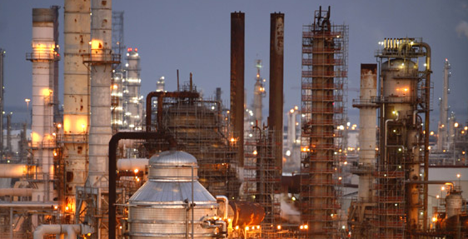
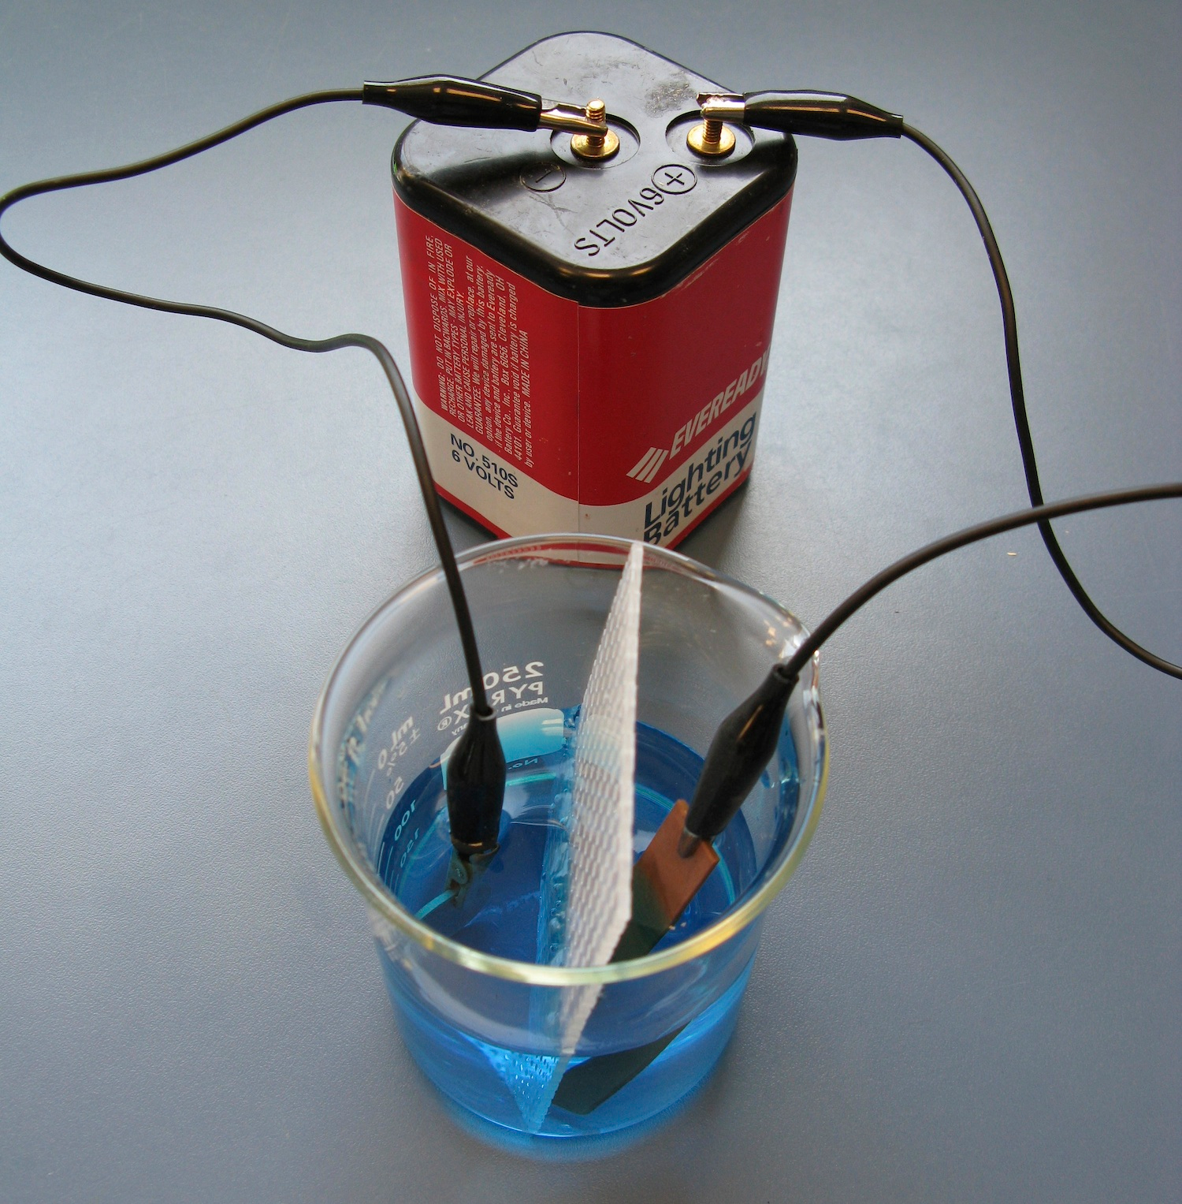
F-Listed Waste
Wastes from non-specific sources
  Spent Non-Halogenated Solvent (F003, F005)
  Spent Halogenated Solvent (F001, F002)
  Degreasing Operations
  Electroplating
  Petroleum Refining

Slide 13
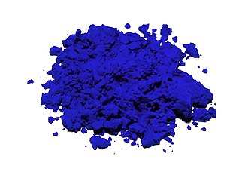
K-Listed Waste
Wastes from specific sources
  Wood preservation process wastes
  Inorganic pigment production wastes
  Organic Chemical distillation still bottoms
  Pesticide production wastes
  Explosives manufacturing wastes
  Veterinary pharmaceuticals production residues and sludges
  Ink formulation washes and sludges

Slide 14
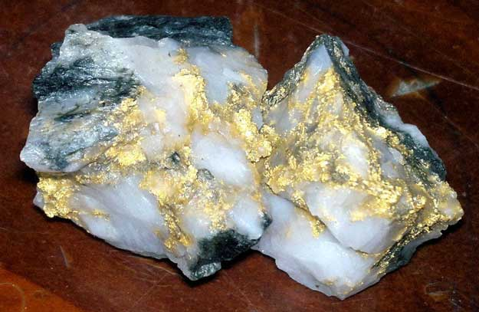
P-Listed Waste
Discarded Commercial Chemical Products
  Acutely Toxic Chemicals
  Very hazardous to health and environment
  Must be in unused form for P-code to apply
  Container residues and spill residues are considered P-listed wastes
  Examples:
    Sodium Azide – P105
    Acrolein – P003
    Sodium Cyanide – P106
    Nicotine, & Salts – P075
      Used nicotine patches/gum are not considered P-listed wastes since they have been used for their intended purpose.

Slide 15
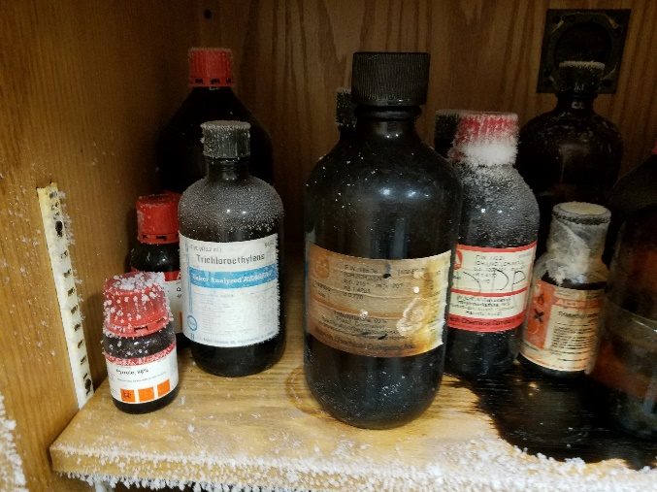
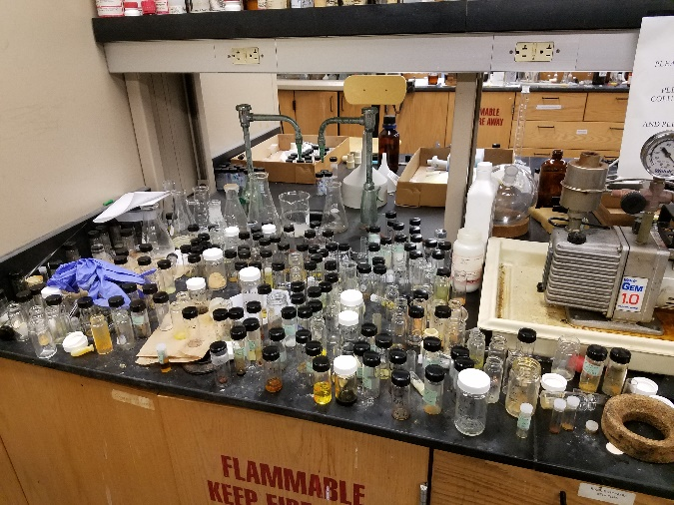
U-Listed Waste
Discarded Commercial Chemical Products
  Toxic Chemicals
  Slightly less hazardous than P-listed wastes
  Must be in unused form for U-code to apply
  Container residues and spill residues are considered U-listed wastes
  Examples:
    Acetone – U002
    Acetonitrile – U003
    Hydrofluoric Acid – U134
    Methanol – U154
    Mercury – U151

Slide 16
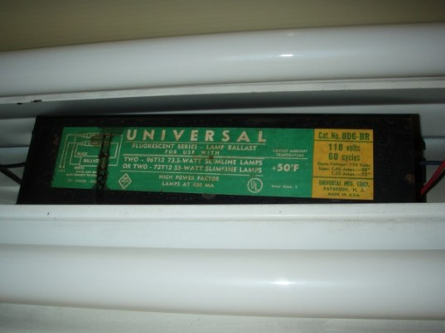

Other Wastes
Universal Waste
Polychlorinated Biphenyl (PCB)
Used Oil
Medical Waste
Lead-Acid Batteries

Slide 17
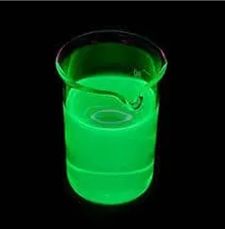
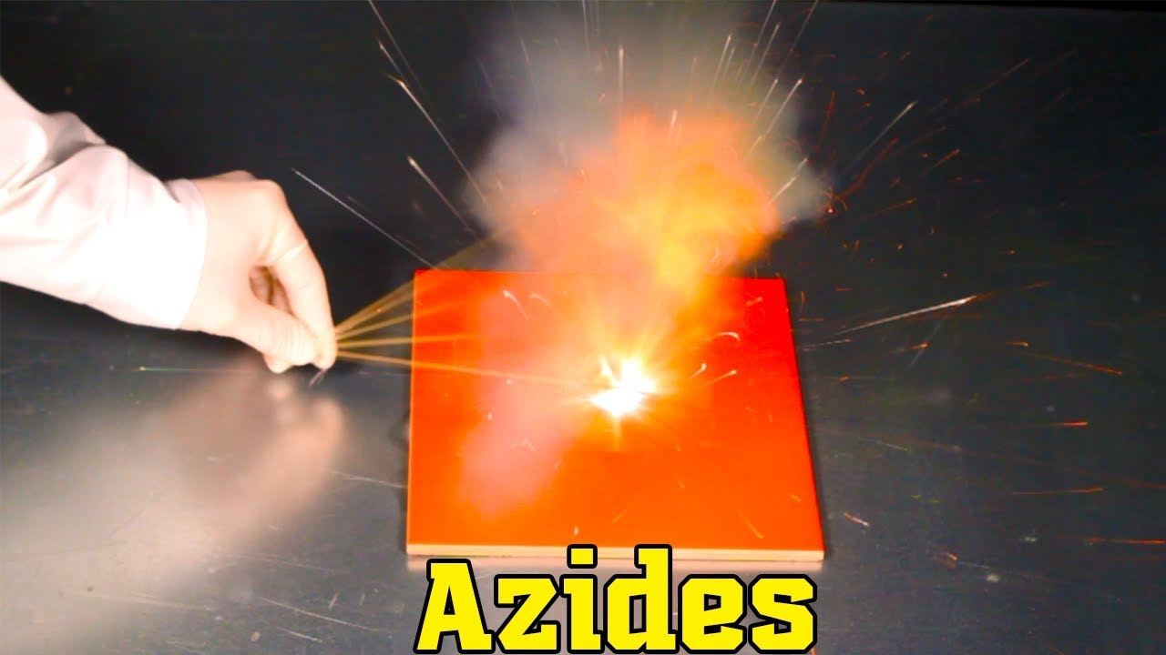
Hazardous Waste Generator Requirements
Wichita State University is subject to Large Quantity Generator (LQG) Standards:
  Large Quantity Generators
    Generate 2,200 lbs or more of hazardous waste in a calendar month.
    Generate or accumulate 2.2 lbs or more of acutely hazardous waste (P-list waste).
      P105 – Sodium Azide
      P003 – Acrolein
      P102 – Propargyl Alcohol
      P028 – Benzyl Chloride

Slide 18
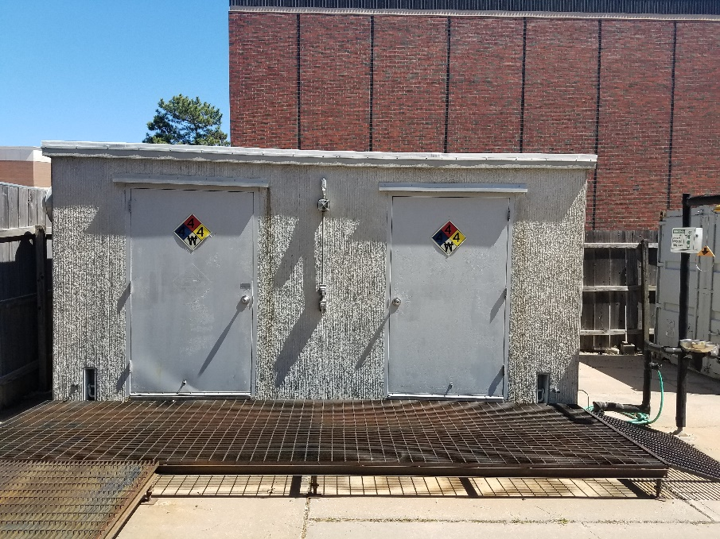
Hazardous Waste Generator Requirements
Wichita State University is subject to Large Quantity Generator (LQG) Standards:
  Large Quantity Generators
      Accumulation of hazardous waste up to 90 days.
          Hazardous waste must be shipped off site within this time period.
          90-day limit does not apply to satellite accumulation.
      If hazardous waste is stored longer than 90 days, only one extension may be granted by KDHE .
      Must submit annual waste report and monitoring fee to KDHE
      Conduct weekly inspections of hazardous waste storage areas.
          Satellite accumulation areas not part of inspection requirement.
      Must conduct waste determinations for every waste stream generated.
          Documented for at least 3 years after last shipment of waste stream.
          Additional supporting documentation required
            Safety Data Sheets (SDS’s)
            Process Flow Diagrams
            Analytical Results (TCLP)
        The only waste stream not required to have a waste determination is office trash

Slide 19
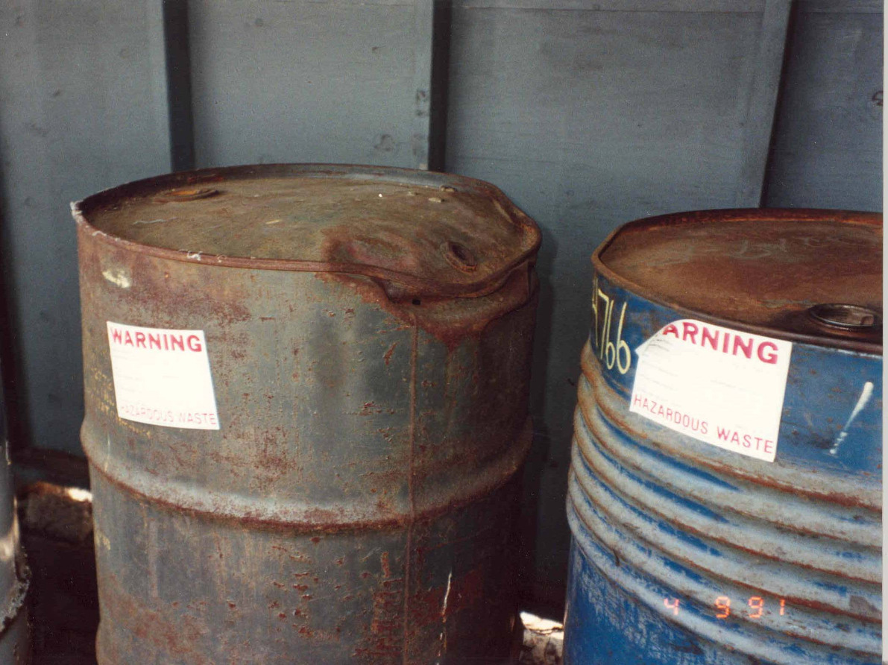
Inspections
Large Quantity Generators must conduct and document weekly inspections of hazardous waste storage areas.
  Container labeling
  Accumulation start dates
  Container closure and condition
  Evidence of leaks or spills
  Accumulation area locked and secured
  Containment area base in good condition
  Incompatible wastes segregated
  Adequate aisle space
  Legible hazard signs

Slide 20
Inspections
Weekly inspections records must also include:
  Name and signature of the inspector
  Date and time of the inspection
  Observations of any deficiencies
  Date, time, and nature of any remedial actions

Slide 21
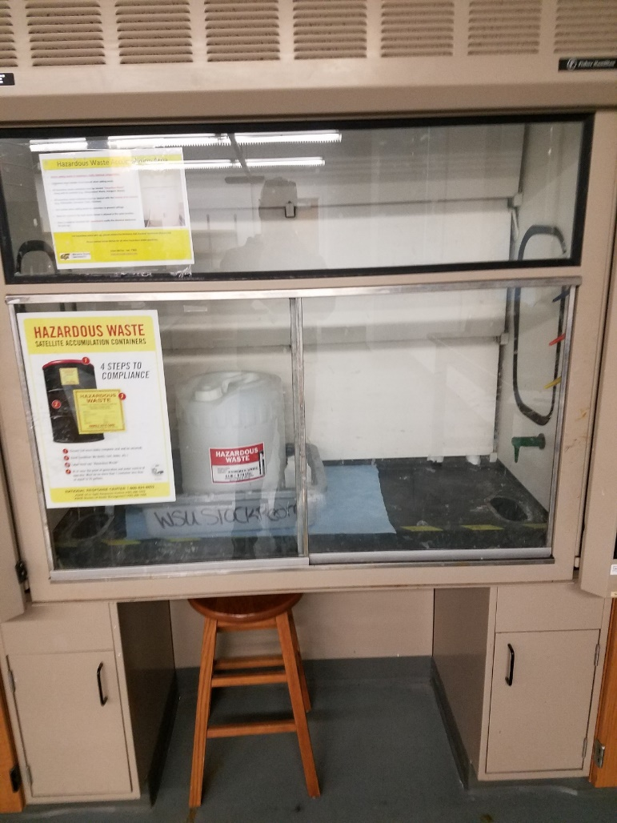
Satellite Accumulation
  Hazardous waste generators may accumulate up to 55 gallons of hazardous waste or up to 1 quart of acutely hazardous waste in one area if:
      The container is located at or near the point of waste generation
      Under the control of the operator
      Labeled with the words “Hazardous Waste”
      Kept closed except when adding or removing waste
          Funnels latched
          Lids and bungs tightened

Slide 22
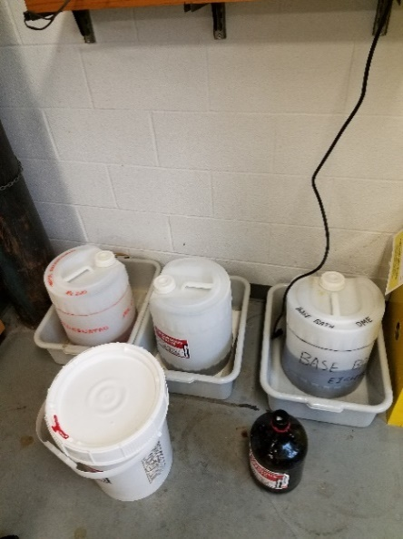
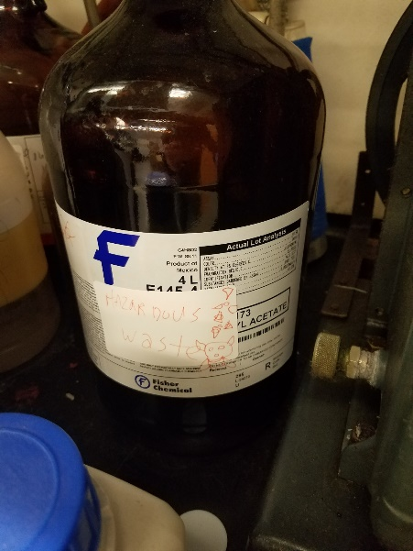
Satellite Accumulation
  Only one satellite container per waste stream is allowed in the same location
      Once a satellite container becomes full, it must be marked with the date if became full and moved to the hazardous waste storage area within 72 hours.
      Satellite containers can not be consolidated into another satellite container
  Hazardous waste accumulation in containers greater than 55 gallons must be managed as “Storage Containers.”
      Must be marked with an accumulation start date on the day waste is first placed in the container
      Must be shipped off site within 90 days
      Must be inspected weekly

Slide 23
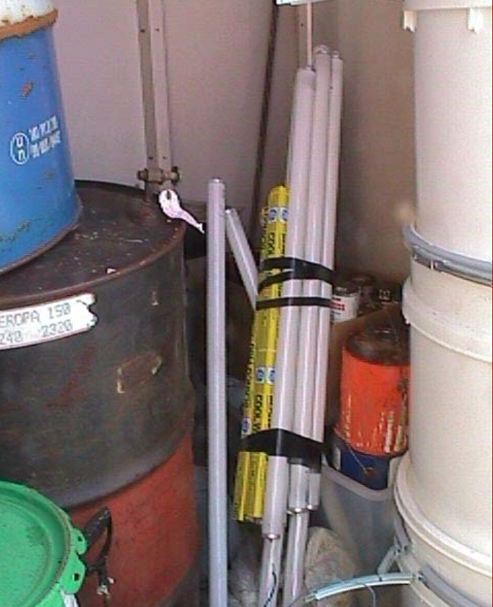
Universal Waste
Universal Waste includes:
  Used Batteries
  Pesticides
  Mercury-containing equipment
  Waste Lamps
    Fluorescent
    HID
    Neon
    Mercury Vapor
    High Pressure Sodium
    Metal Halide
    LED

Slide 24
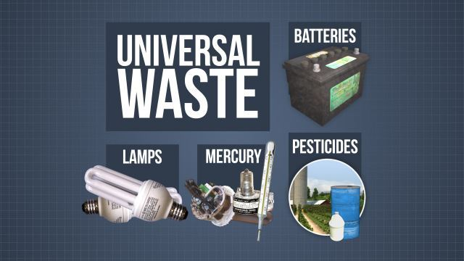
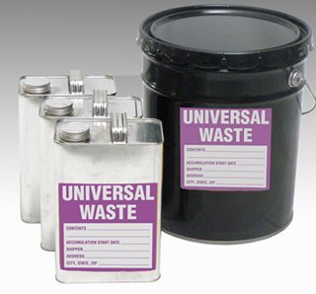
Universal Waste Requirements
Universal Waste containers must be:
    Closed except when adding or removing waste
    Marked with an accumulation start date on the day waste is first placed in the container
    Shipped off site within 1 year
    Labeled with the words “Universal Waste “

Slide 25
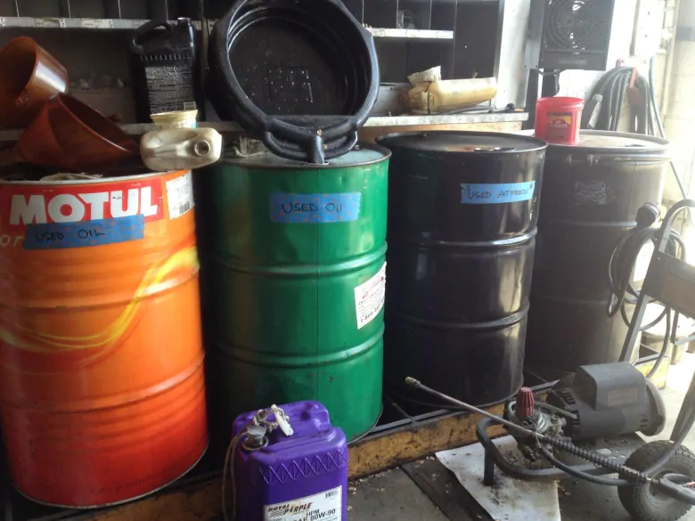

Used Oil Definition
    Definition of Used Oil (40 CFR 279.10)
      Any oil that has been refined from crude oil, or any synthetic oil, that has been used and as a result of such use is contaminated by physical or chemical impurities.
      Used Oil includes, but is not limited to
        Materials that contain free-flowing used oil
        Wastewaters that contain more than “de minimis” amounts of used oil
        Water-soluble cutting oils and coolants
        Heat transfer oils

Slide 26
Used Oil Requirements
    Used oil generators must comply with the following storage requirements:
      All containers, aboveground tanks, and fill pipes for underground tanks must be labeled with the words “Used Oil”
      All storage units must be in good condition
        Not leaking or corroded
      Used oil spills must be cleaned up immediately in order to prevent the release from impacting the environment
        Granular absorbent, spill pads, rags
        Any used oil spill debris may be placed in the regular trash for landfill disposal
      Free-flowing used oil must be shipped off-site for recycling

Slide 27
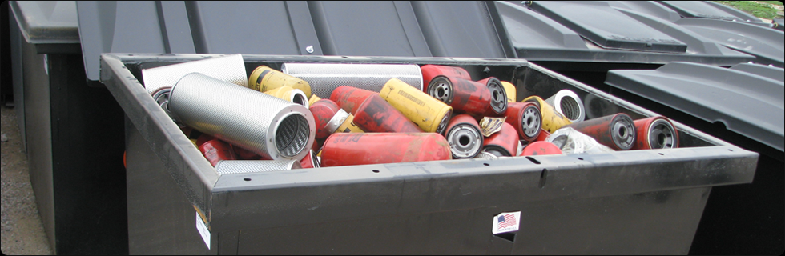
Used Oil Filters
    Non-tern used oil filters that are properly hot drained for 12 hours or are processed to remove all free-flowing used oil are exempt from the hazardous waste regulations.
      May be disposed of at a permitted landfill (recycling preferred)
      Still require proper labeling
        “Used Oil Filters”

Slide 28
Empty Containers
    Containers are considered empty when:
      All contents are removed by normal procedure and
        < 1 inch or < 3% remains in a non-bulk container
        <0.3% remains in a bulk container
          Bulk container is considered > 119 gallons
      Normal Procedure refers to the standard process of removing contents from container
        Siphon pump
        Hand-pouring
      The general rule for an empty container on campus is “drip dry”
    These standards do not apply to compressed gas cylinders or acutely toxic chemicals (P & U List)
      Cylinders must be at or near atmospheric pressure
      Acutely toxic chemical containers must be triple-rinsed with an appropriate solvent before they can be considered empty

Slide 29
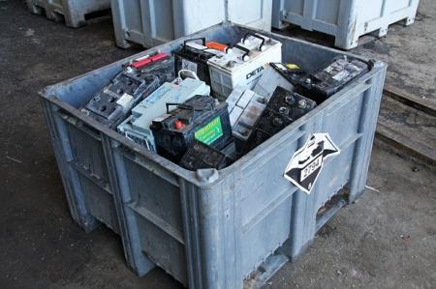
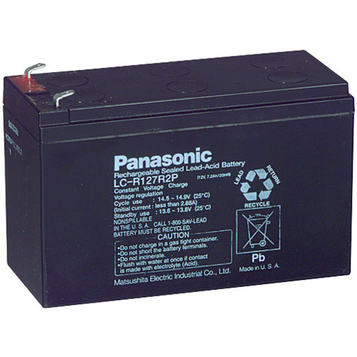
Lead-Acid Batteries
    Lead-acid batteries are regulated as hazardous wastes only if they are NOT recycled.
      May also be managed as Universal Waste
      Must be labeled “Universal Waste Batteries” with an accumulation start date
    Leaking batteries are considered hazardous waste until the leaking sulfuric acid is cleaned up

Slide 30
Mud-Trap Waste
    The mud-trap located north of the Landscape Building is used for the collection of dirt, leaves, grass clippings and grime from the power-washing of landscape equipment.
      Nothing else should be poured or allowed to drain into the pit
      Wipe off any of the following substances prior to washing equipment
        Oil
        Fuel
        Pesticides
        Any other chemical
    Mud-trap waste samples are routinely sent for analytical testing to verify it is non-hazardous.

Slide 31
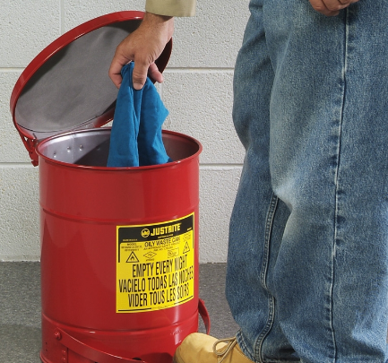
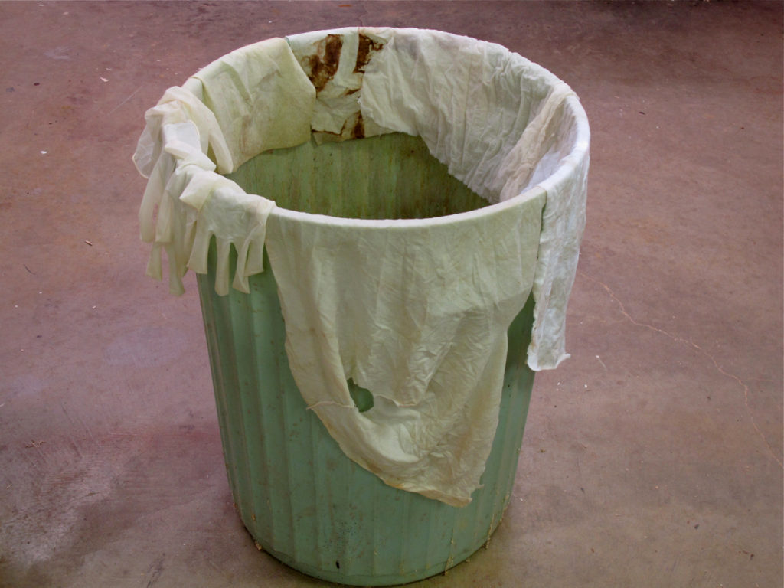
Solvent-Contaminated Rags
    Solvent-Contaminated Rags may be considered hazardous waste depending on the chemical being used.
      These rags are managed as hazardous waste within Facilities Services and must be disposed of in an appropriate hazardous waste container
          Paint Shop
          Carpentry Shop
          Automotive Shop
      Do not throw into regular trash or allow to air dry

Slide 32
Review
    All hazardous waste containers must:
        Remain closed except when adding or removing waste (funnels latched/lids closed)
        Be labeled with the words “Hazardous Waste”
    All universal waste containers must:
        Remain closed except when adding or removing waste
        Be labeled with the words “Universal Waste “
        Be marked with an accumulation start date
    All used oil containers must:
        Be labeled with the words “Used Oil”
    No wastes shall be poured down the drain or into the mud trap
    No waste shall be allowed to air-dry prior to disposal

Slide 33
Review
    If you have any questions about waste disposal, please contact the EHS department.
      Andrew Clem - x7904
      Mike Strickland - x3347

Slide 34
Questions?

