Slide 1
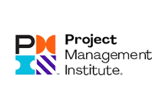
Why You Should Get the PMP
PMI.org

Slide 2
#1 The PMP Sets the Global Standard
Top Reasons to Earn Your PMP® Certification
Earning your Project Management Professional (PMP)® certification opens the door to a world of opportunities. It provides the professional credibility to aim higher and earn more. Discover the benefits of earning the PMP.

Slide 3
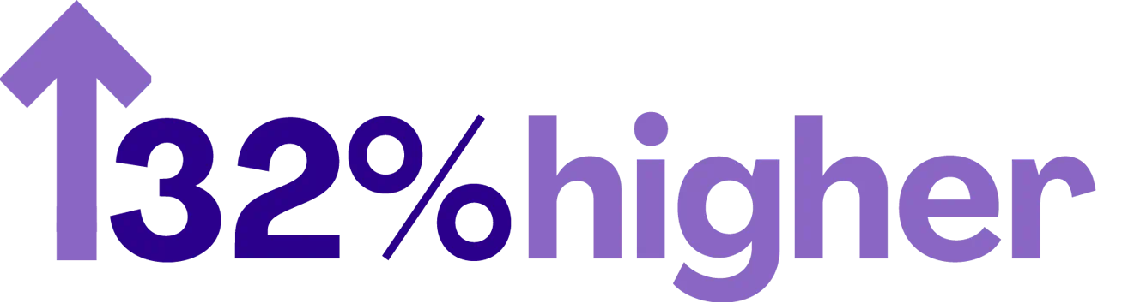
Top Reasons to Earn Your PMP® Certification
#2 Earn More
It’s a fact—in most industries and locations worldwide, you earn more as a PMP certified project leader.
The PMI Earning Power: Project Management Survey—Twelfth Edition (2021) reports that PMP-certified respondents in 40 countries make an average of 16% more than their non-certified counterparts. This percentage increases 32% for PMP holders in the U.S.
In addition to a one-time salary increase, 22% of respondents report an increase of at least 5% over the year.

Slide 4
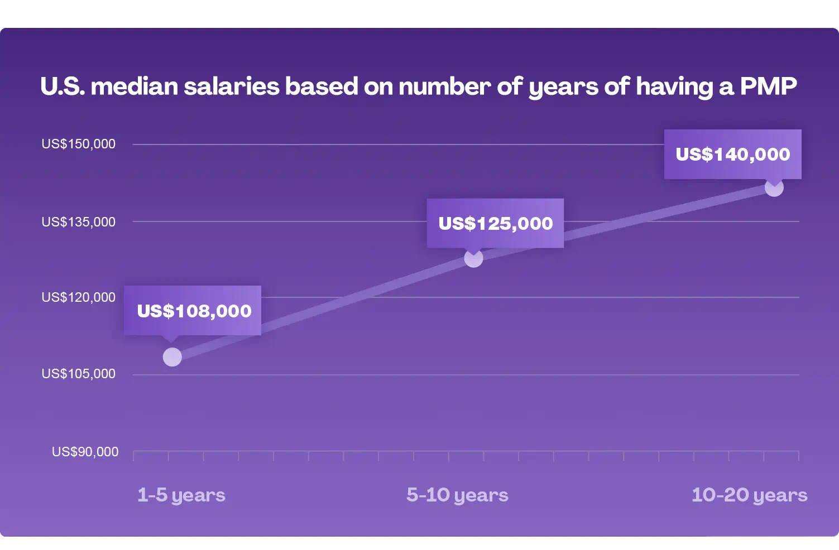

Slide 5

Top Reasons to Earn Your PMP® Certification
#3 Expand Your Career Opportunities
Organizations across the globe look for PMP-certification. Some even require it as a pre-requisite.
Why? Because the PMP is a world-renowned certification that verifies valuable experience in leading and directing projects. And it opens doors to better jobs and projects.
So, add the PMP behind your name and put yourself in high demand.
Created by project professionals for project leaders, the PMP validates that you have the project management skills employers need. The demand for skilled project managers increases every day. So, increase your marketability and see what exciting opportunities await you with the PMP certification.

Slide 6

Top Reasons to Earn Your PMP® Certification
#4 Tap Into a Growing Community
Earning your PMP means joining a global community that empowers you to:
Network with the best in your field
Seek insight from professionals facing similar challenges
Find mentors and peers who help you thrive
Joining our elite community also provides opportunities to:
Become a PMI member
Join a local PMI chapter
Attend PMI trainings around the world
Through these community engagements, you’ll get valuable insight from our resources and other PMP certified professionals. And as you grow with our community, you could even mentor fellow professionals yourself.
Now it’s your time. Invest in yourself and take your career to the next level with PMP certification.

Slide 7
Top Reasons to Earn Your PMP® Certification
#5 Fill the growing shortage of Project Managers
Growing shortage of Project Managers in every field. Love what you are doing? Great! Stick with what you love but add a PMP certification and your career opportunities for growth and salary increases by 32.2% over those who don’t have a PMP in your field!
Project management professionals are in high demand globally, as organizations worldwide recognize the value they bring to project execution and overall business success.
By 2030, the world will be short of around 25 million project professionals, generating a potential hit to global GDP of up to $345.5bn, research has revealed. There are three key reasons behind this shortfall, according to Project Management Institute's (PMI) '2021 Talent Gap Report.
13 million people are predicted to retire from the profession over the next eight years
Demand is rising for project professionals particularly in emerging and developing countries as their economies grow
Increase in the number of jobs requiring these skills in heavily ‘projectized industries,’ such as construction, publishing, and financial and professional services
25,000,000 shortage of Project Professionals by 2030

Slide 8
Top Reason to Join PMI
Networking Opportunities – be mentored!
Date Joined | PMI Number | Name
07/02/2024 | 10,499,300 | Christopher
04/01/2011 | 1,454,939 | Warren
05/09/1997 | 96,007 | Anita
08/02/1996 | 42,770 | Dale
PMI Wichita has 255 local members currently, many more joined our chapter from 1996 through 2024. Lots of opportunities to network locally with new and older members who are new to the profession and those who have been around for a while.

Slide 9

Earn your PMP in six months
Join PMI.org
Learn and Accomplish the 6 steps to earning a PMP
Read PMBOK v7 for concepts and overview
Read and study PMBOK v6 for technical skills
Concurrently earn your 35 hours of training required for the test from CMD (WSU’s Barton School of Business). A less expensive option is The Mathis Group
Apply to sit for the PMP 3-4 months into the future
Study one topic or knowledge area each week for 11 weeks until you can pass that section’s PMP practice tests at 90%
Take the CAPM or PMP test based upon your years of experience!
Top hint: Don’t go alone – take a study and accountability buddy with you! ITS is hosting a study group twice a year, call x7575 for more information.

Slide 10

What are your Questions?
Warren Glore, PMP, warren.glore@wichita.edu 316-978-7574
Anita Barrett, PMP, anita.barrett@wichita.edu 316-978-7575

