Slide 1
JCCC Project Management Office A New Model For JCCC’s Future
Project Management Summit 2020

Slide 2
Creation of the JCCC PMO “A Look Back”
Laying a foundation
All good structures start with a solid foundation
Strategy and Planning
Focus on continuous improvement
CIO Reorganizes Information Services in 2019
Realignment of dept responsibilities
Focus on doing the right things
Focus on structured workflow
Creation of PMO, not an EPMO
Moved existing PMs into PMO

Slide 3
Project Budgeting Process Changes
Requests Submitted EnMasse
→ Vetting / Estimating Frenzy
→ Determine Approved Items
→ Approved Items Set Budget
→ Plan, Execute, Amend
Lessons Learned:
Project Needs Inquiries
→ Minimal Effort Estimating
→ Set Budget
→ Intake Governance Thru Year
→ Approvals Get Budget
→ Plan, Execute
Benefits Realized:
Heavy resource burden upfront, vetting and estimating, short window
Large gap between planning and execution, 6-18 months
New ideas / needs / priorities emerge
Effort to amend planned vs unplanned
Estimates change over time
More efficient use of resources
Data more applicable and relevant
Shorten gap between intake / execution
Minimize changes and their impact
Reduce urgency at onset
Minimize duplication of effort
Emphasizes focus on getting it right

Slide 4
Project Intake and Governance JCCC Executive Technology Steering Committee (JETSC)
Purpose and Goals
Provide direction/prioritization to IS and Cabinet
Committee Structure
12 person group with Chair and Co-chair
Key Criteria Reviewed
Alignment to College strategic goals
Meet monthly
Reps from across various branches
Estimated costs, 1 year, 3 years
Funding source (if not technology budget)
Business need and drivers
Is it required for compliance
Requirements
Estimated duration
Ensure alignment to JCCC strategic goals
Promote transparency and reportability
Create rules and structure for consistency

Slide 5
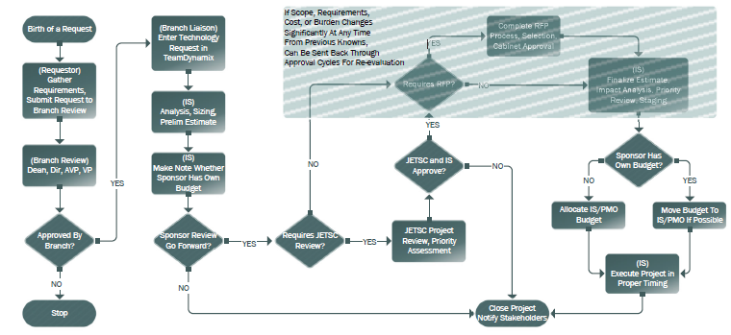
JCCC Project Governance Workflow

Slide 6
Project Technology Tools
Collaboration and Communications
TeamDynamix Project Portfolio Mgmt (PPM)
Project and Resource Management
Microsoft Tools: Office, Sharepoint, Teams
Virtual Meeting Collaboration
Zoom (more now than ever)

Slide 7
Questions
or Comments?

