Slide 1
Getting Help!
Carolyn Speer, Ph.D.

Slide 2

Agenda
Help for the physical classroom
Help for Blackboard, Panopto, Zoom
Help for grade submission
Help with computer and login issues
Help with the library
Help for HR Questions
Help for students

Slide 3
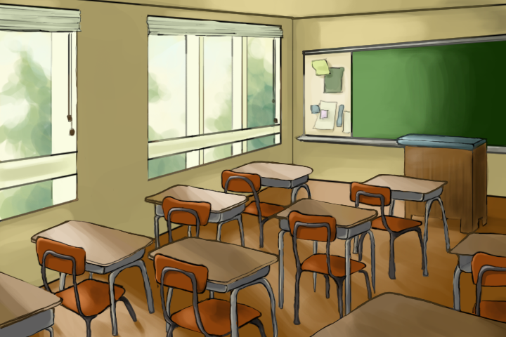
Campus Media Service: Physical Classrooms
You are not ”alone” in your classroom!
Call 978-3588 if your classroom technologies are acting up
Call the same number if you need something for your classroom
Hint: Get training on the media in your classroom: Wichita.edu/KeyTraining
This Photo by Unknown Author is licensed under CC BY-NC-ND

Slide 4

OIR: Help with Digital Things
You are not “alone” in your digital classroom!
Blackboard and Panopto help, and some Zoom help (CMS too).
Two ways to access:
  OIR@Wichita.edu
  Wichita.edu/BbSupport
DEV shells, merges, training, pedagogy, problems
Help with LinkedIn Learning
This Photo by Unknown Author is licensed under CC BY-SA-NC

Slide 5
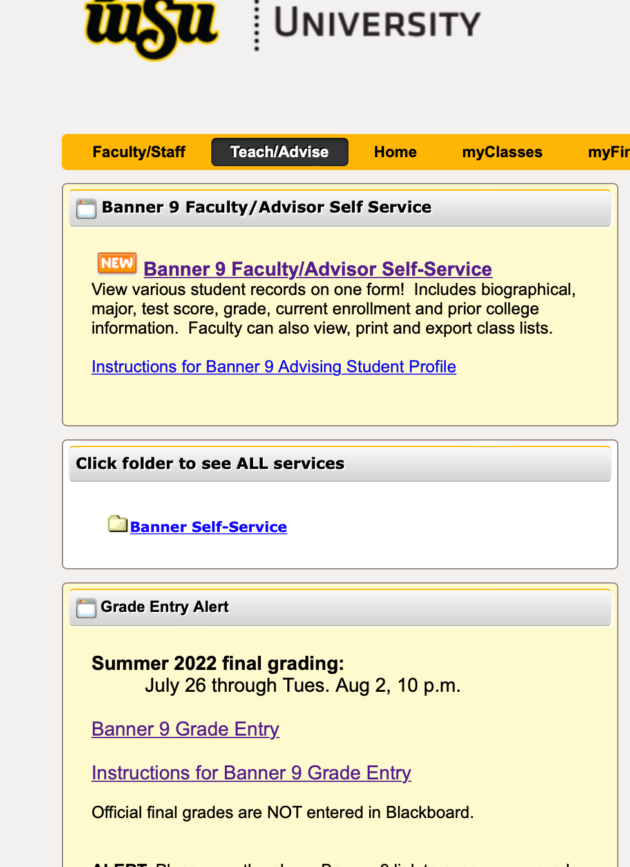
Help with Banner:
Grades do not automatically roll from Blackboard to the University grade system (Banner)
Call 316-978-HELP or email Helpdesk@Wichita.edu for help and questions
Other Banner info:
  Dates of course
  Student email capability

Slide 6

Help with Computers and Passwords
ITS does support for university-provided computers
ITS also handles ALL password issues
  Central authentication for most systems (SSO, CAS, other shorthand)
Call 316-978-HELP or email Helpdesk@Wichita.edu
Not for Blackboard problems
This Photo by Unknown Author is licensed under CC BY-NC-ND

Slide 7

Help with the Library
Your Subject Librarians are there to help you
Chat function is wonderful! Libraries.Wichita.edu
Librarians can be embedded into your Blackboard courses to provide info for students
Learn more 4:00pm Thursday
This Photo by Unknown Author is licensed under CC BY-SA-NC

Slide 8

Help with HR Questions
Benefits questions: TotalRewards@Wichita.edu
HR Business Partners
Accommodations requests for employees (not students)
Grow@WSU: Shockerstart.Wichita.edu/training = HR training available to you
This Photo by Unknown Author is licensed under CC BY-SA

Slide 9

Help for Your Students
General Help: OneStop (Wichita.edu/onestop)
Blackboard help: Wichita.edu/BbSupport
Mental health and other concerns: Wichita.edu/careteam
Shocker Support Locker: Wichita.edu/shockersupportlocker
This Photo by Unknown Author is licensed under CC BY-NC-ND

Slide 10
Thank You!

