Slide 1
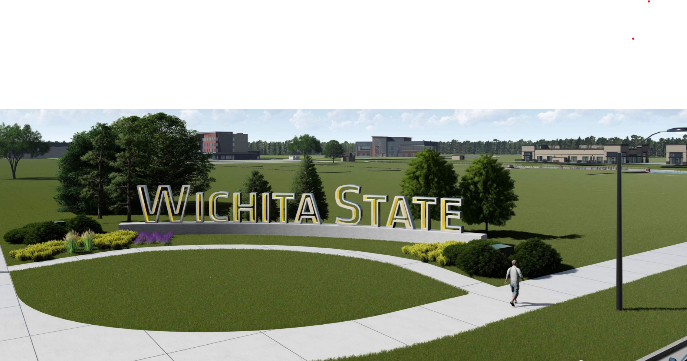
Campus Updates
Shirley Lefever
Executive Vice President and Provost
Notes:
Welcome! We are so glad you are here!
My background:
Came to WSU in 2005 as Dept. Chair for Curriculum and Instruction, in College of Education.
2008 appointed to Associate Dean for the College with responsibility for undergraduate programs.
In 2012 became Sr. Assoc. Dean and Assessment Coordinator, responsible for accreditation, academic faculty support.
2013, Interim Dean
2014 Dean, College of Applied Studies
2020 Interim EVP and Provost
Spring, 2022, Permanent EVP and Provost
My role is to support the academic mission of the university.

Slide 2
Wichita State …
  Vision: To be one of the most innovative public universities, known for providing impactful student experiences and driving prosperity for the people and communities we serve.
  Mission: To be an essential Educational, Cultural and Economic driver for Kansas and the greater public good.
Goals
Student Centeredness
Research and scholarship
Campus culture
Inclusive Excellence
Partnerships and Engagement
2

Slide 3
Goal 1
Provide an accessible, affordable, and impactful higher education for all Kansans
Actions
Financial aid support
Paid Applied learning opportunities
3
Notes:
the state legislature recently awarded WSU $19 million dollars specifically for need-based aid, and we’re continuing to raise private funds to ensure that everyone has access to a Wichita State education

Slide 4
Point of Difference
WSU:
  1 out of 4 UG freshmen students identify as underrepresented minorities
  1 out 5 Pell eligible students in Kansas public universities are enrolled at WSU
  Nearly half our students are First Generation
  WSU is on track to becoming a Hispanic Serving institution by 2030
WSU leverages paid applied learning and other employment experiences to help students
  Annually more than 5,000 students earn $26 million

Slide 5
Headcount and Student Credit Hour History
Notes:
Fall, 2021 highest enrollment in 30 years with over 16,097 and largest ever class of FTIC. On track to meet and hopefully exceed these numbers for fall, 2022 moving toward our goal of 17,000 by 2025.

Slide 6
Retention Rates
In 2020, WSU retained 71.9 percent of its first-time, full-time bachelor’s degree seeking students from their first to second year. This is a 0.6 percentage point decrease over the past five years.
2015 | 2016 | 2017 | 2018 | 2019 | 2020 | 5 Year Change
72.4% | 73.0% | 73.0% | 71.5% | 75.7% | 71.9% | -0.6%

Slide 7
Closing Equity Gaps
NISS Recommendations:
Systematize the use of academic data to identify courses with
high non-pass rates and improve outcomes in these courses
Standardize academic advising to ensure students receive consistent support across all majors
Develop intentional pathways to help students learn about, select, and transition between academic majors
Strengthen financial aid through collaboration with other units and coordinated, proactive outreach to students
Notes:
In particular, NISS recommendations point out need to focus on URM student population and decreasing the graduation rate equity gaps.

Slide 8
Goal 2
Actions
Provide relevant applied learning experiences that match the needs of industry, agency and community partners
Continue to increase industry partners
Increase paid applied learning opportunities and other employment experiences on campus
8
Notes:
previous year of 5,000 students/$26 million annual income

Slide 9

















Current Partnerships
on Innovation Campus

Slide 10
Goal 3
Elevate WSU as a premier,
urban public research university
in the united states
Seek and capitalize on opportunities for innovation and research
10
Notes:
previous year of 5,000 students/$26 million annual income

Slide 11

GROWING & DIVERSIFYING ECONOMY
Preparing our students for the jobs of today + tomorrow
National Institute
for Research & Digital Transformation
11
Notes:
But we know we need to do more in terms of growing new and existing businesses, and we recognize the need to diversify. And as you all know, there is a data revolution currently happening in many of our industries, including manufacturing. Everything from advances in connectivity, sensorization, computing, and automation are changing the fundamental economics of how we do business — meaning this is of local interest. This is also important to Wichita given our city’s manufacturing base. Creating a digital ecosystem, to include the health sciences, is where we have been making significant progress.

Slide 12
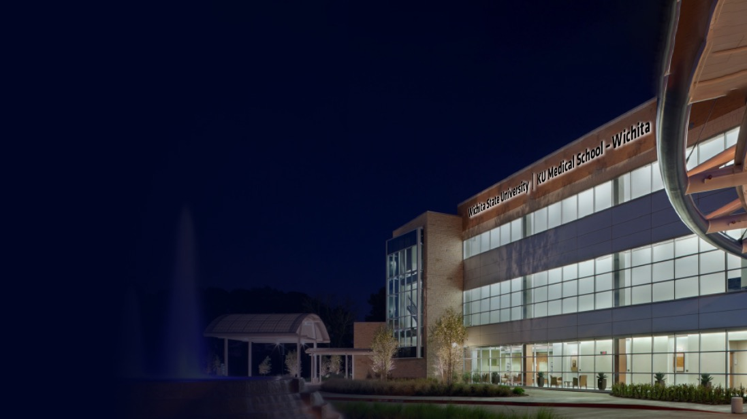


Wichita Biomedical Center
Combining the strengths of WSU’s College of Health Professions with KU’s Medical School-Wichita into one “academic health science center” facility to address health needs and diversity and grow the Kansas economy.
12
Notes:
• Support Wichita downtown development via hospitality, culinary arts and health sciences
• Benchmarks:
• Opening of WSU Tech hospitality culinary arts program
• Complete architectural program statement and secure funding for
joint health sciences education center with KU
Develop, enhance, and maintain exceptional campus facilities
• Benchmark: • Fund KBOR Maintenance Assessment at required level

Slide 13
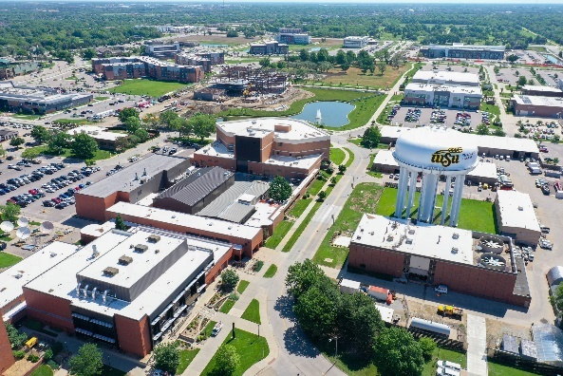
2012
2013
2014
2015
2016
2017
2018
2019
2020
Planning Begins
Strategic Planning, Campus Master Plan Completed
INNOVATION CAMPUS
Shocker Hall,
Koch Global Trading Center
STRATEGIC ENROLLMENT MANAGEMENT
(SEM)
Airbus, Hexagon, Dassault Systèmes partners,
Braeburn Square
Food Truck Plaza,
1-35 corridor strategy
John Bardo Center, Airbus, GoCreate, Starbucks, The Flats, Shocker Studios
LETC, PB2, Pizza Hut Museum, Meritrust, Spirit,
WSU Haysville
Fuzzy’s, The Suites
Shocker City, Textron, ATLAS
YMCA, Journey East, AVET, NetApp, Hyatt, MDL, Deloitte
PAID APPLIED LEARNING EARNINGS
TOTAL GRANT AWARDS
I35 CORRIDOR ENROLLMENT

