Slide 1
Title IX Updates
Lucretia Taylor, J.D.
Title IX Coordinator
Office of Institutional Equity and Compliance

Slide 2
What is Title IX?
Title IX of the Higher Education Act of 1972 is the civil rights law that bars sex discrimination (including pregnancy, sexual orientation and gender identity) by educational institutions that receive federal funding.

Slide 3
Title IX of the Higher Education Act of 1972
No person in the United States shall, on the basis of sex, be excluded from the participation, be denied the benefits of or be subjected to discrimination under any education program or activity receiving Federal financial assistance.
Title IX of the Education Amendments of 1972 Implementing Regulations @ 20 U.S.C. § 1681 & 34 C.F.R. Part 106.

Slide 4
Scope of Title IX
Title IX applies to schools, local and state and other institutions that receive federal financial assistance including:
  Local school districts
  Postsecondary institutions
  Charter schools
  For Profit schools
  Libraries and Museums

Slide 5
Language Interpretation
Initially . . .
Male and female students must have equal access to admissions, resources, financial assistance.
Gender equity in faculty hiring practices, promotions and salary differentials.
College athletics (equity)

Slide 6
Language Interpretation
A broader interpretation emerged as time went on . . .
Sexual violence and harassment
  The U.S. Supreme Court has established that sexual harassment qualifies as discrimination in violation of Title IX
  Schools must take steps to prevent sexual misconduct on their campuses
Education for pregnant and parenting students

Slide 7
Institutional Requirements
Title IX requires all institutions to regularly and consistently notify the public, applicants, employees, students, its nondiscrimination policy on the basis of sex in the programs and activities they operate (WSU Policy 3.06).

Slide 8
Title IX Coordinator
Title IX requires the designation of a Title IX Coordinator. This individual has the primary responsibility for coordinating a University’s efforts related to intake, investigation, resolution and implementation of measures to stop, remediate, and prevent discrimination, harassment and retaliation.

Slide 9
Grievance Process
One of the important aspects of Title IX is the requirement of a Grievance process to promptly and equitably resolve complaints alleging discrimination on the basis of sex.

Slide 10
Sex Discrimination Under Title IX
Sexual Harassment
Sexual Harassment is defined as unwelcome sexual advances, requests for sexual favors, and other physical or verbal conduct of a sexual nature.

Slide 11
Elements of Sexual Harassment
Unwelcome Conduct
  determined by a reasonable person
  behavior so severe, and
  pervasive, and,
  objectively offensive,
  that it effectively denies a person equal access to a University’s education or activity.

Slide 12
Elements of Sexual Harassment
Quid Pro Quo
  an employee of the institution,
  conditions either implicitly or explicitly the provision of an aid, benefit, or service of the institution,
  on an individual’s participation in unwelcome conduct.

Slide 13
Sexual Assault
Sexual Assault means one of the following offenses, whether forcible or non forcible when directed at a person without the person’s consent, including instances where the person is incapacitated:
  Rape
  Fondling
  Incest
  Statutory Rape

Slide 14
Dating and Domestic Violence
Dating Violence is defined as violence committed by a person who is or has been in a social relationship of a romantic or intimate nature.
Domestic Violence is defined as a fcrime of violence committed by a current or former spouse or intimate partner.

Slide 15
Stalking
Stalking is defined as engaging in a course of conduct directed at a specific person that would cause a reasonable person to:
  fear for their safety or the safety of others, or
  suffer substantial emotional distress

Slide 16

Title IX Notice of Proposed Rulemaking
2022

Slide 17
Propose New Title IX Regulations
June 23, 2022, the Office of Civil Rights published the Notice of Proposed Rule Making (NPRM) outlining proposed changes to Title IX regulations.
On July 12, 2022, the NPRM was published in the Federal Register and the 60-day comment period began.
Review and comment period ends on September 12, 2022.

Slide 18
What are the proposed changes?
Clarifying that Title IX’s protections against discrimination based on sex apply to sexual orientation, gender identity, and sex characteristics.
Replacing the 2020 standard of sex-based harassment (“severe, pervasive, and objectively offensive”) with the broader Title VII standard (“severe or pervasive”).

Slide 19
What are the proposed changes?
Requiring institutions to address conduct that occurs off-campus when the respondent is a representative of the institution or otherwise engaged in conduct under the institution’s control (providing coverage for study-abroad programs, for example).
Making the live hearing and cross-examination requirement optional.
Requiring institutions to provide supportive measures to students and employees affected by any type of sex discrimination, including but not limited to sexual harassment.

Slide 20
What are the proposed changes?
Expanding the rights of parents and guardians to act on behalf of a student, including seeking assistance under Title IX and participating in a grievance procedure.
Expanding the rights of students and employees who are pregnant or have pregnancy-related conditions.

Slide 21
Timeline for proposed changes
The final rule is expected to be issued in Spring 2023, with the effective date approximately Summer/Fall 2023.
There will be a separate rulemaking process to address Title IX’s application to athletics.
Universities must continue to fulfill obligations under the current regulations for the 2022-2023 academic year.
Schools should expect to implement new Title IX regulations before the start of the 2023-2024 academic year.

Slide 22

Title IX at WSU

Slide 23
Policy 3.06/Sexual Harassment, Discrimination and Retaliation for Employees, Students and Visitors
The University’s Title IX Policy
  Prohibits all forms of discrimination on the basis of sex.
Forms of discrimination on the basis of sex covered by 3.06
  Sexual Harassment
  Quid Pro Quo
  Sexual Assault
  Dating Violence
  Domestic Violence
  Stalking

Slide 24
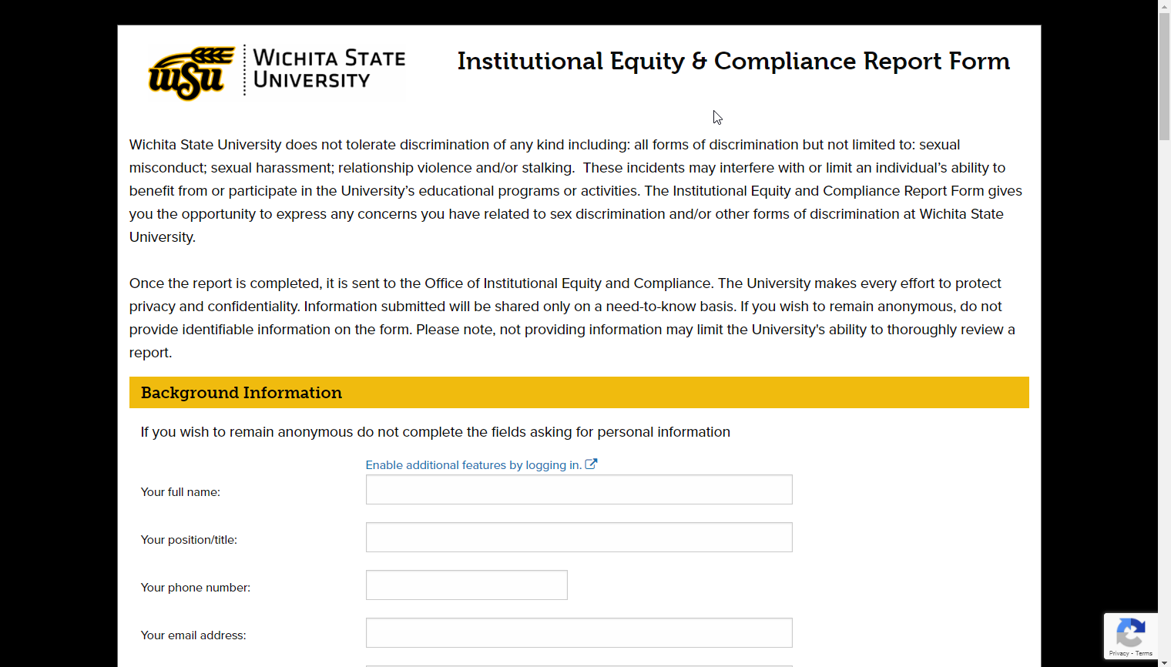
Where to Report

Slide 25
What Happens When OIEC Receives a Report?
Contact the individual impacted
  OIEC responds to every report
Offer appropriate supportive measures (interim measures)
Inform of their options and explain process for filing a Formal Complaint
Invite the individual impacted to meet with us

Slide 26
Supportive Measures
Referral to counseling, medical, and/or other healthcare services
Referral to the Employee Assistance Program
Visa and immigration assistance
Student financial aid counseling
Referral to community-based service providers
Altering campus housing assignment(s)
Altering work arrangements for employees or student-employees
Safety planning
Providing campus safety escorts
No contact orders between the parties
Academic support, extensions of deadlines, or other course/program-related adjustments
Trespass
Timely warnings
Class schedule modifications, withdrawals, or leaves of absence
Increased security and monitoring of certain areas of the campus
Any other actions deemed appropriate by the Title IX Coordinator

Slide 27
Right to an Advisor
The parties may each have an Advisor of their choice present with them for all meetings and interviews within the resolution process, if they so choose. The parties may select whomever they wish to serve as their Advisor.
  This could include an attorney, advocate or support person.
The Advisor cannot have institutionally conflicting roles, for example, the Title IX Coordinator who has an active role in the matter, or a supervisor who must monitor and implement sanctions.
A party cannot insist on an Advisor who doesn’t have the inclination, time or availability.

Slide 28
Grievance Process – Six Parts
Reporting of prohibited conduct
University’s response to the report
Filing of a Formal Complaint
Investigative Process
Use of one of the Resolution Processes
  Informal Resolution
  Hearing
Appeal Process

Slide 29
WSU’s Formal Grievance Process
Report of
Prohibited
Conduct
University’s Response
Formal Complaint
Investigative Process
evidence collected
Hearing or
Informal Resolution
Appeal
Triggers University
Response
Outreach
Supportive Measures
Options
NOTICE to Parties
Party & witness interviews (right to an advisor)
Evidence collection
Evidence obtained and Witness statements
Summary of relevant evidence
Both parties may appeal decision
Facilitated negotiation or
Live hearing (Zoom option)

Slide 30
Questions??

