Slide 1
Gender Inclusive Classrooms
Jennifer Pearson
Department of Sociology
2023 Academic Resources Conference

Slide 2
The LGBTQ+ population
Source: Gallup Poll 2021: https://news.gallup.com/poll/329708/lgbt-identification-rises-latest-estimate.aspx

Slide 3
Key Terms/Concepts
Sex Assigned at Birth
Gender Identity and Expression
Transgender/Trans
Nonbinary
Cisgender
Misgender

Slide 4
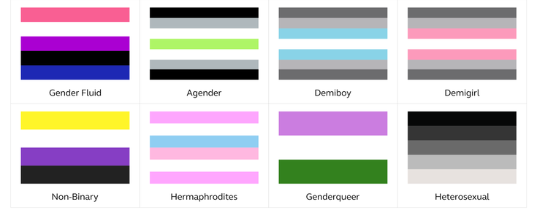
Diverse Gender Identities
*

Slide 5
Maslow’s Hierarchy of Needs Source: Center of Daring

Slide 6
Gender Inclusive Classrooms
Pronoun Rituals
Normalize Gender-Neutral Pronouns
Use Gender-Neutral Language
Acknowledge Mistakes and Move On
Be Mindful of Gender Stereotypes in Thoughts, Expectations, and Interactions
Advocate for Students
Never Out a Student without Their Consent
Educate Yourself

Slide 7
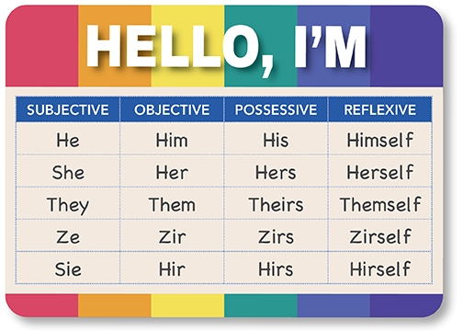
Gender Neutral Pronouns
*
Source: https://www.baptistjax.com/juice/stories/community-health/dont-assume-ask

Slide 8
Campus Resources: Students
Wichita State Name Change Process
OutReach Support Groups
Transgender/Nonbinary Support Group
LGBTQ+ Support Group (currently inactive)
Spectrum: LGBTQ & Allies
Office of Diversity and Inclusion
LGBTQ Resource Page
Reporting Discrimination: wichita.edu/reportit

Slide 9
Campus Resources: Faculty
Office of Diversity and Inclusion
LGBTQ Resource Page
LGBTQ+ Task Force
CAPS LGBTQ+ Preventing Suicide Training
Reporting Discrimination: wichita.edu/reportit
Training – More to come…

Slide 10
Resources for Learning More
Gender: Your Guide by Lee Airton ebook available through WSU Libraries
No Big Deal Campaign (Lee Airton)
Good Practices: Names and Pronouns (University of Maryland, College Park)
Pronoun Guidance (Vanderbilt University)
Teaching Beyond the Gender Binary (Vanderbilt University)

Slide 11
Community Resources
GLSEN Kansas: GLSEN is a national network of educators, students, and local GLSEN Chapters working to make K-12 schools safer and more inclusive through programs, advocacy, research, and policy work.
National Center for Transgender Equality: The National Center for Transgender Equality advocates to change policies and society to increase understanding and acceptance of transgender people.
The Center of Wichita: The Center houses a youth program called Get Connected and a support group for LGBTQ families and youth, Q-Family Connection.
M-Care: M-Care provides inclusive and affirming healthcare for LGBTQIA+ folx and community allies.
Wichita PRIDE: Celebrate the LGBTQ+ community in Wichita and surrounding areas at events during Pride month (June) and throughout the year.
Equality Kansas: Advocacy group that promotes inclusive policies at the state and local level and fights discriminatory legislation.

