Slide 1
What You Need to Know About the Accessibility Auditing Process
Thursday, May 20, 2021
11:00 – 11:50am
Zoom
Presented By:
Heather M. Merchant

Slide 2
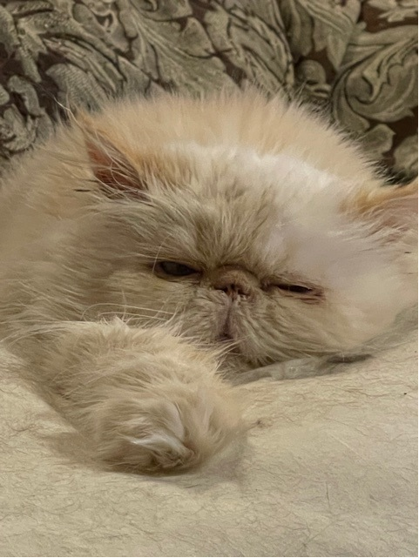
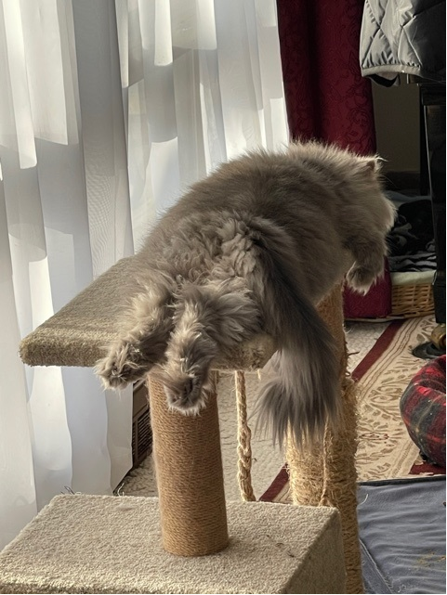
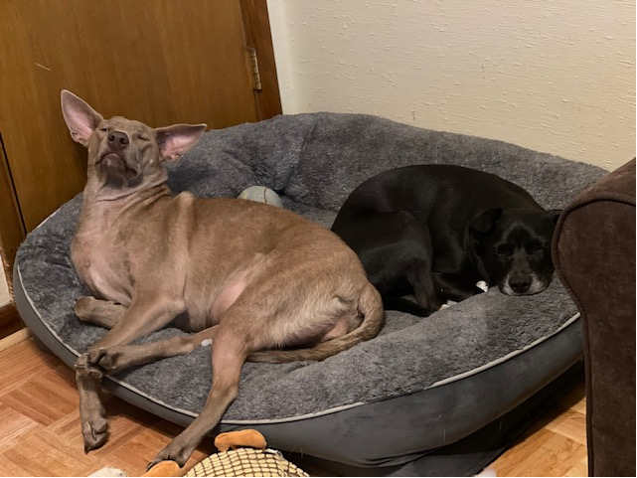
Introduction Heather M. Merchant
Media Resources Center – Office of Instructional Resources
Educational Accessibility Technologist
Provide course, software, and tool accessibility reviews and audits
Former Instructional Designer
Geology lecturer for Lifelong Learning
BS Geology, MS Structural Geology, MBA Marketing

Slide 3
Agenda
What is EIT?
Why does our EIT need to be accessible?
What determines accessibility?
What needs to be audited before use?
How do I know if my EIT has already been audited?
How do I request an audit?
What is the audit process?
Can I still use my tech if it’s not accessible?
Questions?

Slide 4
What is EIT?
Examples
Electronic and Information Technology
Technology or equipment
create, converse, or duplicate
data or information
An ATM machine
Learning Management System
Blackboard
Software
Apps
Digital platforms

Slide 5
Why does our EIT need to be accessible?
WSU Policy 8.11 – Accessible Content (2017)
WSU Technology Corrective Action Strategy
Accessible to students, faculty, staff and participants who have disabilities
Websites
Web-based applications
LMS
Instructional materials
Must comply with:
ADA Section 508 of the Federal Rehabilitation Act of 1973 and later amendments
WCAG 2.0 AA success criteria for web content

Slide 6
What determines accessibility?
Individuals with disabilities receive the
Same information
Same interactions
Same services
Same time
Can students using assistive technology use the app?
Vision
Screen-reader compatible
Keyboard-only navigation
Resizing
Use of color
Hearing
Captions
Transcripts
Sounds conveying information
Mobility challenges
Keyboard-only navigation

Slide 7
What needs to be audited before use?
Software provided by publisher
Homework platforms
Web-based tools
Free apps
For-cost apps
Software
LMS outside of Blackboard

Slide 8
How do I know if my tech has already been audited?
Accessible Publisher Software webpage
Webpage updated after each audit
Several times a year, every tool on the page is re-audited

Slide 9
How do I request an audit?
Accessibility Review Request
Request evaluation of publisher or vendor provided software
Review will evaluate the accessibility of the tool based on the Voluntary Product Accessibility Template or a review of the tool’s functionality

Slide 10
What is the audit process?
VPAT Available
No VPAT Available
Request VPAT from publisher or vendor
Review of VPAT for WCAG 2.0AA guidelines
Receive email with an attached report
Results
Determination
Conformance issues declared in VPAT
Review functionality of tool
WCAG 2.0AA and ADA requirements
Longer wait time
Need access to tool

Slide 11
Can I still use my tech if it’s not accessible?
NO
There is a more-accessible option available
YES
Compliance is not technically possible or feasible given current technology
The information or service is used by a specific, limited audience which has no known need for accessibility features
For third party and/or vendor delivered products, no accessible and equally effective alternative for the information or service exists
Making the information or service accessible would require extraordinary measures that constitute an undue burden to the university
Accessibility Exception Process
Accessibility Exceptions Request Form

Slide 12
Questions?
Email: heather.merchant@wichita.edu

