Slide 1
Software Showcase Meet your free Software!
Presented by:
Shadi Tafaroji, Director of Client Services, WSU
Amy Belden, ITS Applications Training Manager, WSU
Ali Levine, ITS Applications Training Lead, WSU

Slide 2
Free Software Available on campus for Faculty, Staff, & GTAs
Office 365
Power BI (online version)
Project Online (per request)
Adobe Creative Cloud
ARC GIS
EndNote
Snagit
LinkedIn Learning
Concurrent – MATLab
Concurrent – SAS
Concurrent – SPSS / AMOS
Work from home license
Zoom Basic
Licensed Version – Additional Cost
Microsoft Products available for additional cost:
Project Plan 3
Visio
Full description of each software can be found at the Procurement Website
Procurement website: https://wichita.edu/itsprocurement

Slide 3
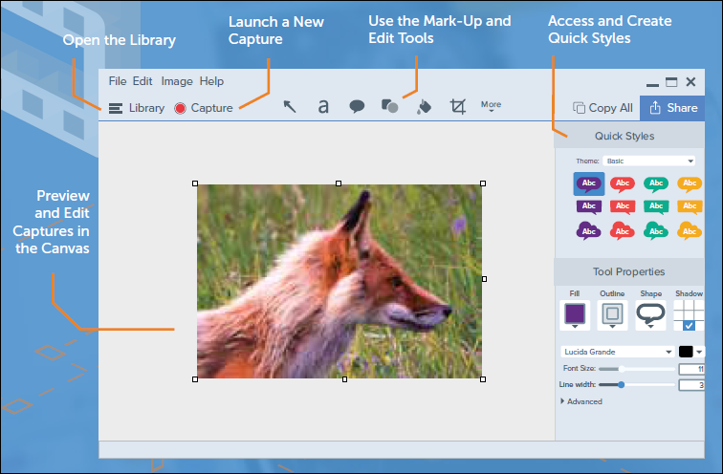
Snagit
Snagit is a premium screen capture and screen recording tool that includes the ability to edit and modify what has been captured.
Instructions for downloading located in the Software Catalog
WSU Snagit webpage: Wichita.edu/snagit

Slide 4
Microsoft Office
WSU Owned Machines: Contact Help Desk (4357)
Personal Computers: Follow the instructions for up to 5 free downloads.
Why Update to 365?
New Features
AI
Accessibility
More Information:
Life Changing Tips in Microsoft Office: Tomorrow, May 18th at 1:00 pm
Visit wichita.edu/msoffice
Digital Credential: Microsoft Office Power User

Slide 5
Adobe Creative Cloud
Request: Ticket Available through Software Catalog link
Machines: University devices only
Only 2 devices concurrently
Will be prompted to log out of another device if you log into a third.
Captivate: Reminder that Captivate is not included with Creative Cloud, but ticket available through Software Catalog to request a quote.

Slide 6
Thank You! Questions?
Reminder: If you are interested in any software that is not listed or we have not discussed, please go to the ITS Procurement page and request a Quote.
ITS Procurement Page: wichita.edu/isprocurement
Additional links discussed:
Snagit: wichita.edu/snagit
Office 365: wichita.edu/msoffice
Adobe: wichita.edu/adobe
Thank you and Enjoy the rest of the week!

