Slide 1
Using PowerPoint to Create GREAT Infographics

Slide 2
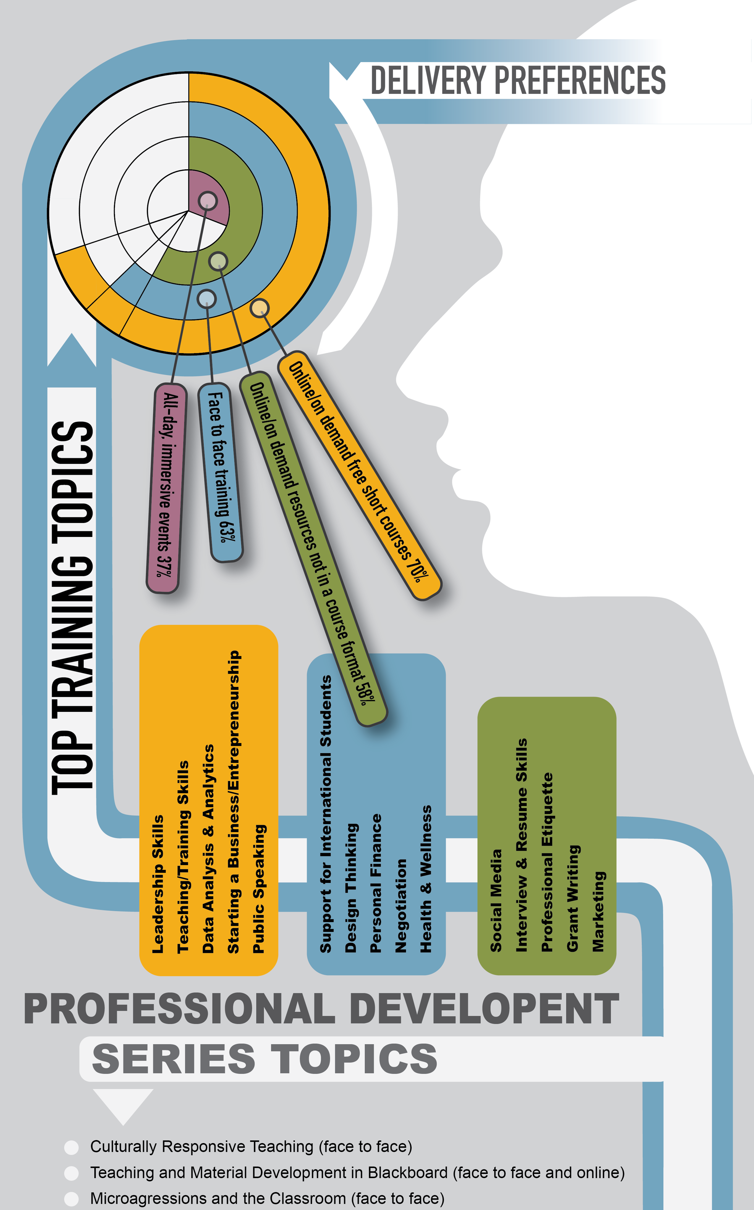
Why use infographics?
Infographics can accomplish several things, making this communication tool a valuable resource:
Visual representation of the concept or idea furthering or deepening the learners understanding.
Ability to code meaning with and relationships between elements and concepts.
The necessity to organize and condense your concept or idea into meaningful bits of information.
  This also enables crafting a better alt-text for screen-readers and learners with visual impairment.

Slide 3
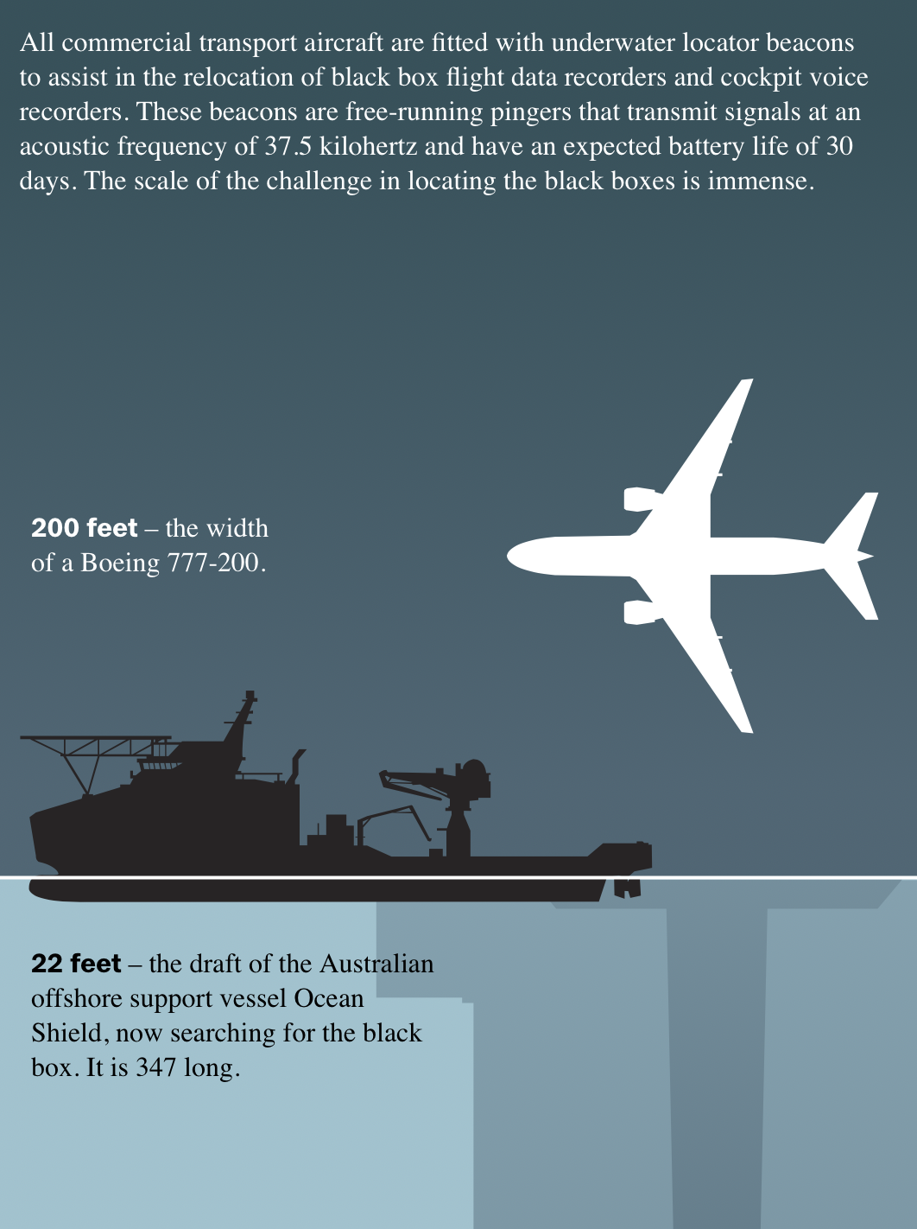
Types of Infographics
Responsive VS Static.
Infographics can be designed for responsive action, such as within a website. Examples include the formatting of the infographic to change depending on the screen size, orientation, and device being used. These type of designs can also be embedded with links or pop-ups for additional or deeper information the graphic is conveying.
So, why talk about responsive design? To plant seeds, my friend.
Let’s begin.

Slide 4
Responsive Design
Infographics can be designed for responsive action, such as within a website. Examples include the formatting of the infographic to change depending on the screen size, orientation, and device being used. These types of designs can also be embedded with links or pop-ups for additional or deeper information the graphic is conveying.
The Depth of the Problem
Infographics + Responsive Design: A Perfect Match
The Bright Future of Car Sharing
How might responsive design be used in the classroom or PPT presentation?
A bad example
Learn More
Another bad example
Learn More
A good example
Learn more

Slide 5
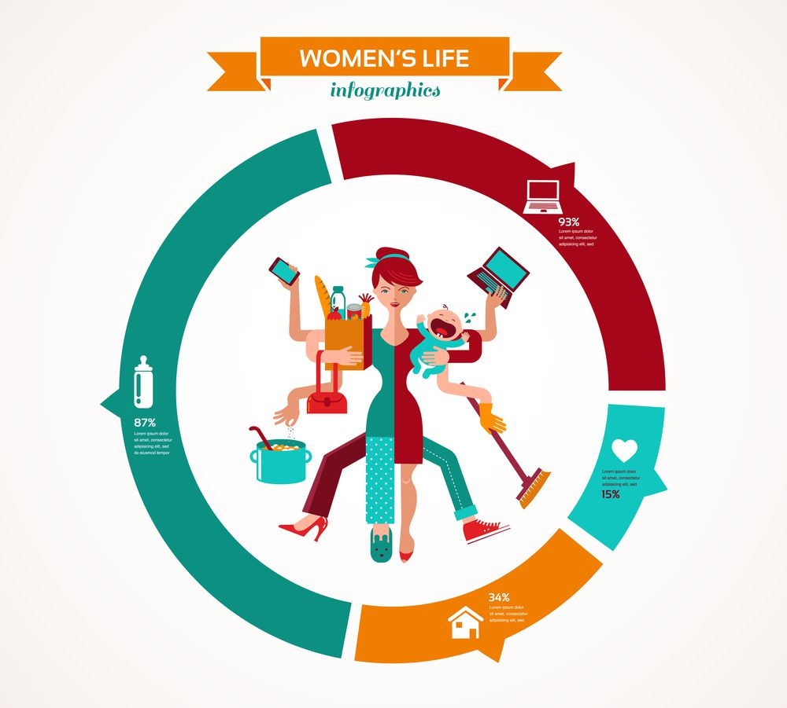
Static Design
We will be looking at an example of an infographic that has the typical issues and how to fix those.
We will also examine examples of an infographic I have created. We will examine less-than-ideal options and better options when it comes to building and using your infographics.
We will also explore the tools and resources PowerPoint has for building organized and efficient infographics.

Slide 6
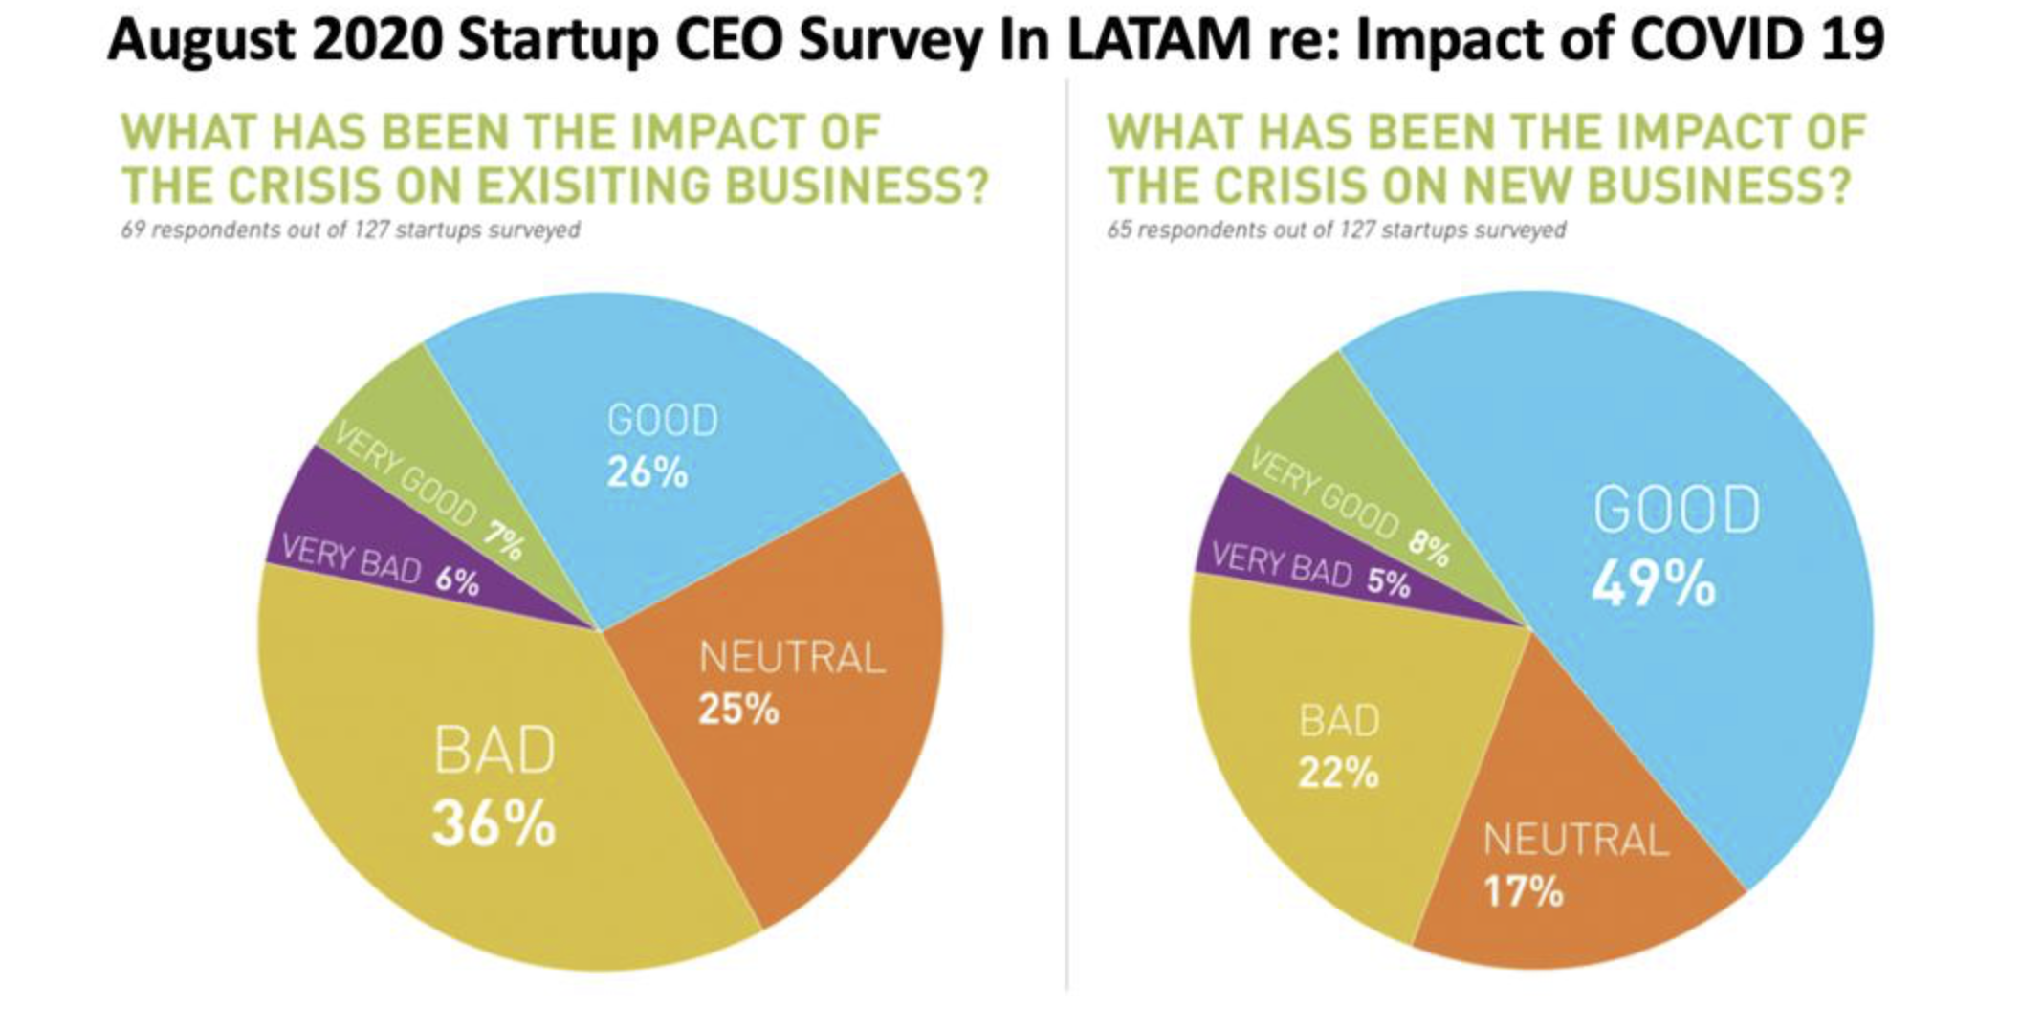
An example of a problematic infographic. Let’s explore.

Slide 7
A better way to organize the Information.
Let’s examine what’s different.
BAD
GOOD
BAD
GOOD

Slide 8
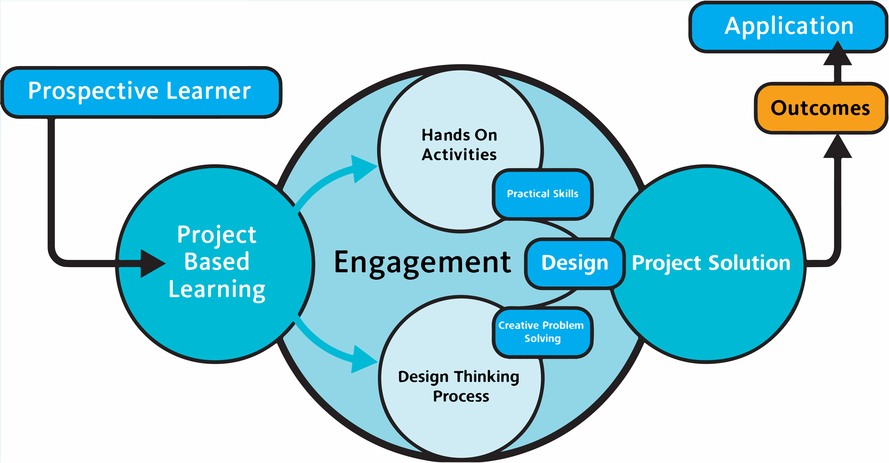
Why is this not a great option?

Slide 9
Let’s examine the main challenges in this example.
This is an infographic I created several years ago. It has a few challenges that can be improved for ease of read and understanding. It also has elements that can be improved for accessibility.
In this example we will be looking at the problems with using an infographic built/designed elsewhere and used in this PPT as an image.
Read
Accessibility
Color Contrast
Color Hierarchy/Theme

Slide 10
Why is this not a great option?
Application
Prospective Learner
Outcomes
Hands On
Activities
Practical Skills
Project
Based
Learning
Engagement
Design
Project Solution
Creative Problem
Solving
Design Thinking
Process

Slide 11
Let’s examine the main challenges in this example.
This version was built in PowerPoint but if we look under the hood, we will quickly see the mess any type of screen-reader will have.
This type of approach to making your infographic will also be a challenge for you to:
Navigate while you work
Keep organized
Make future modifications
Make accessible

Slide 12
A Better Version
Prospective Learner
Application
Hands On
Activities
REAL WORLD EXAMPLES
Outcomes
Practical Skills
Project
Based
Learning
ENGAGEMENT
Project
Solution
Design
Problem Solving
Design Thinking
Process

Slide 13
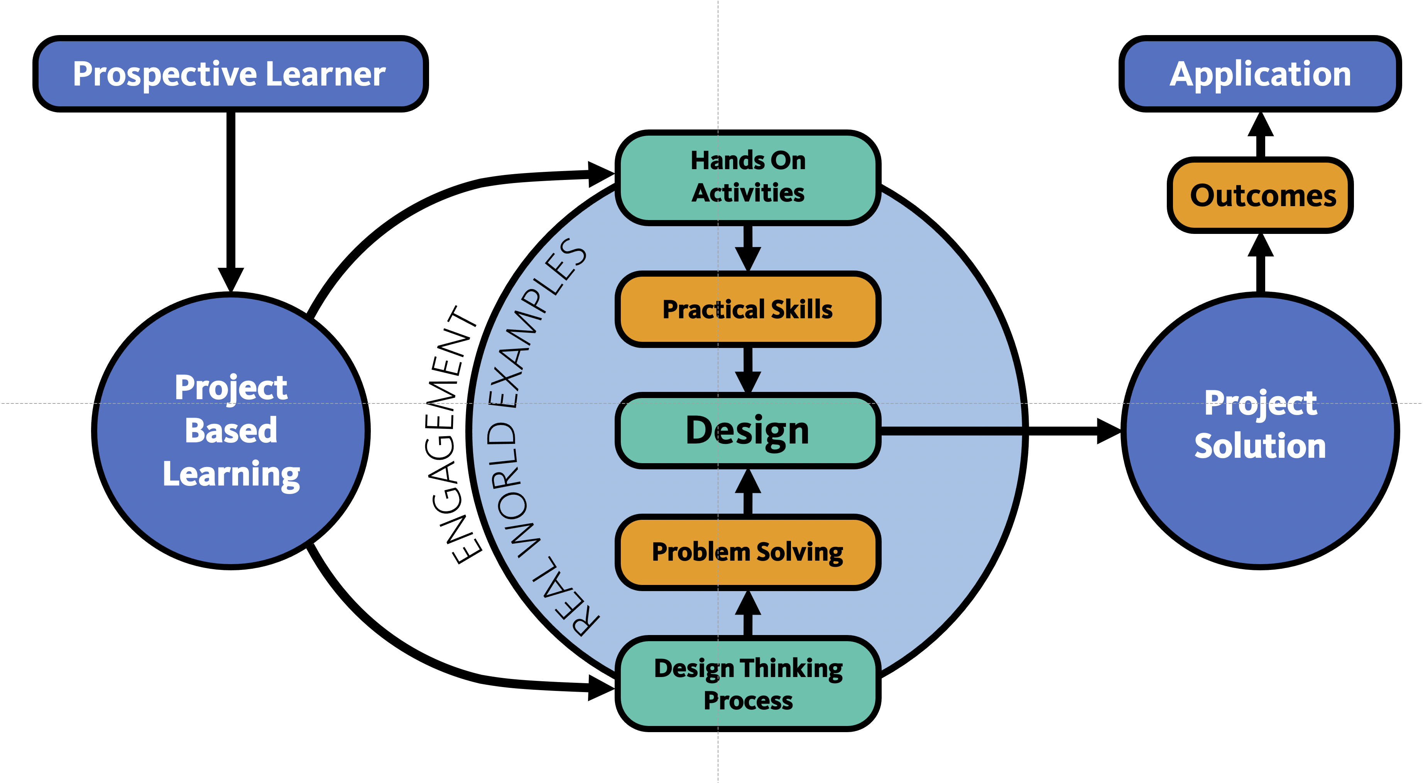
This version was created using PPT’s shapes.
Even though this version is created using shapes, just like the previous version, we have used a couple of tools to make it better organized and accessible.
Some of the design modification are:
Layer organization
Color coding
Contrast refinement
Grouping

Slide 14
A Better Version
Project Based Learning
Engagement
Real Word Examples
Level Based Achievements
Design Thinking
Problem Solving
Hands On Activities
Practical Skills
Project Solution
Design
Measurable Outcomes
Application
Prospective Learner
Challenge/Inspire

Slide 15
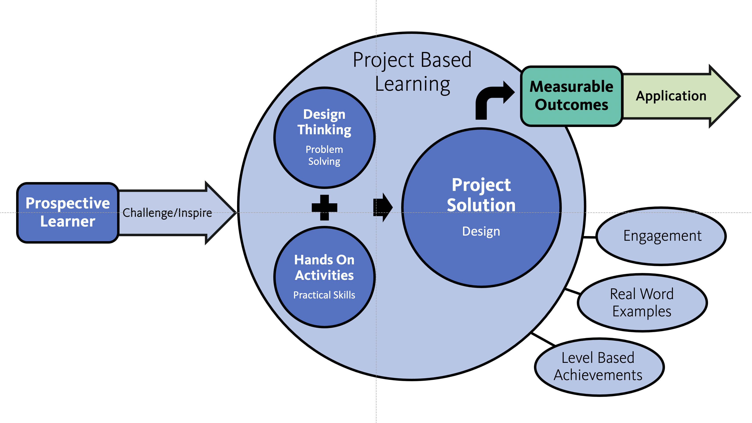
This version was created using PPT’s SmartArt.
PowerPoint’s SmartArt is much like Chart’s in PPT.
Let’s look under the hood.
The benefits of using a tool like SmartArt are:
Element organization
Easy color coding
Easier and faster creation
Grouping

Slide 16
Further options.
Nutrition
Green
Your infographic does not need to be defined by perceived restrictions. You can combine tools and modify slide parameters.
Let’s quickly look at those options:
You can create vertical pages and infographics
  please note in a PPT presentation you are only able to use one dimension for the presentation.
You use SmartArt and Charts together, along with shapes.
  Stay organized.
Use of images or media.
Eat
Digest
Energy

Slide 17
Thank you!
Be sure to join Jeremy Webster, our team’s “webmaster”, for his session:
2:00-2:50: Ensuring Infographic Accessibility with Jeremy Webster.

Slide 18

the end

