Slide 1
Rapid Session #1, Bb Tools

Slide 2
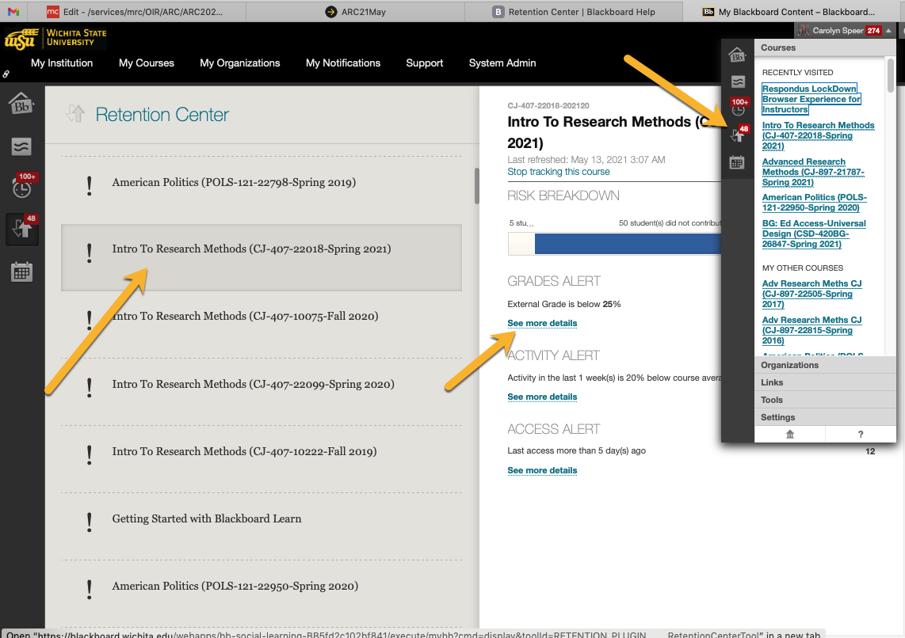
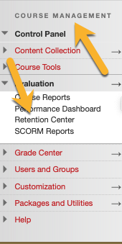
Accessing the Blackboard Retention Center

Slide 3
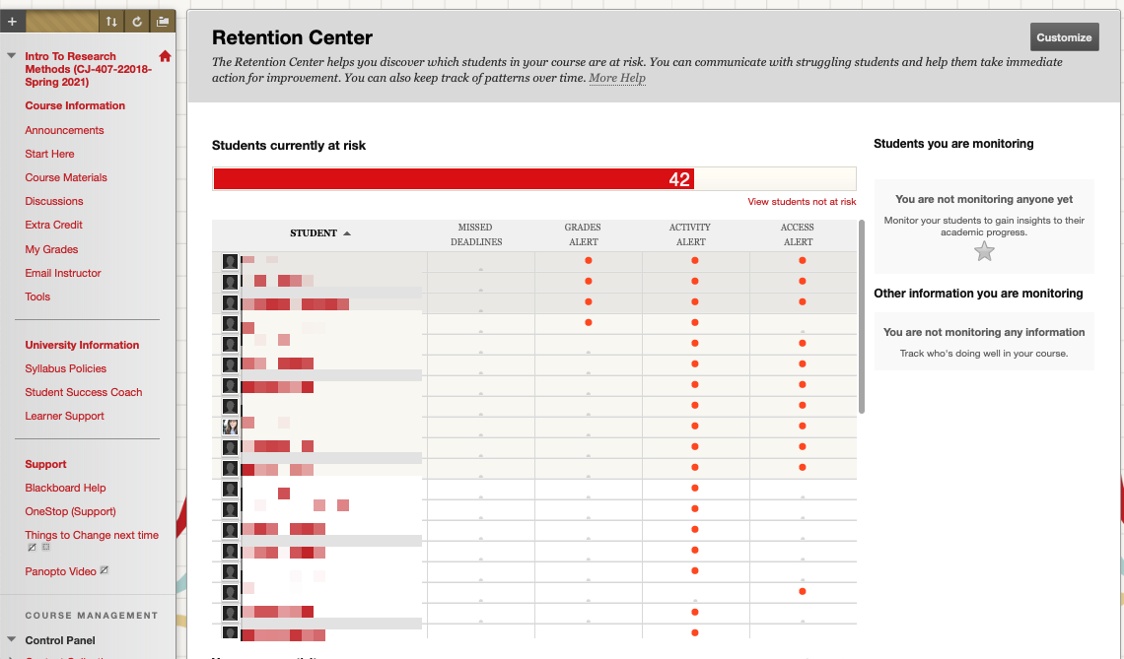
Retention Center Overview

Slide 4
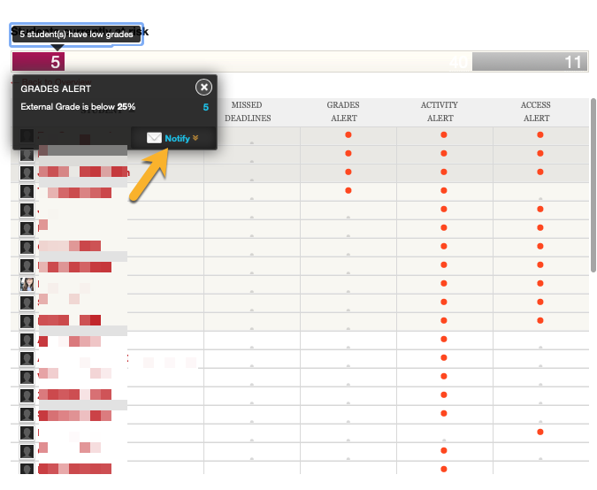
Drilling Down in the Retention Center

Slide 5
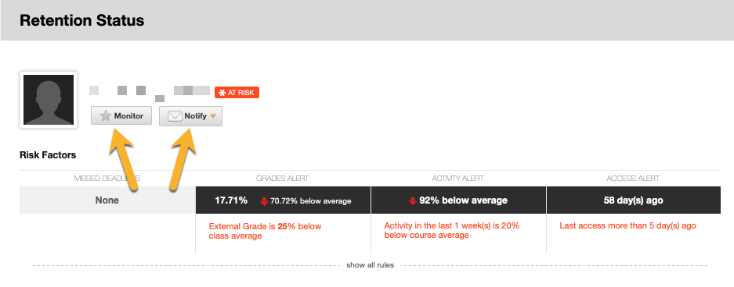
Favoriting and Monitoring in Retention Center

Slide 6
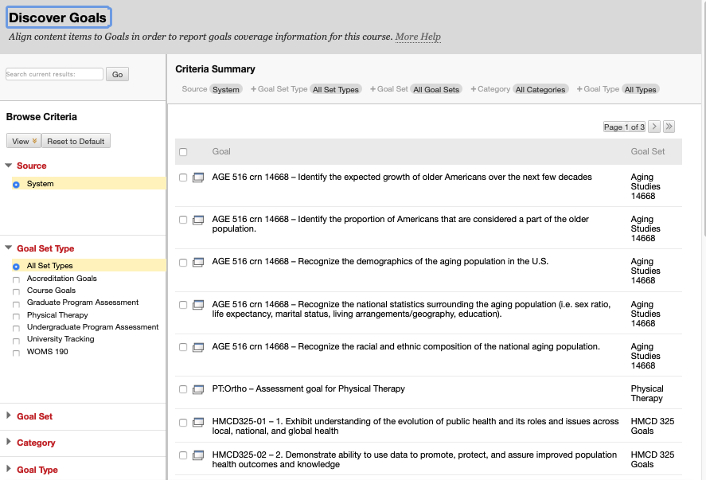
Blackboard Goals – Anyone Can Use!

Slide 7
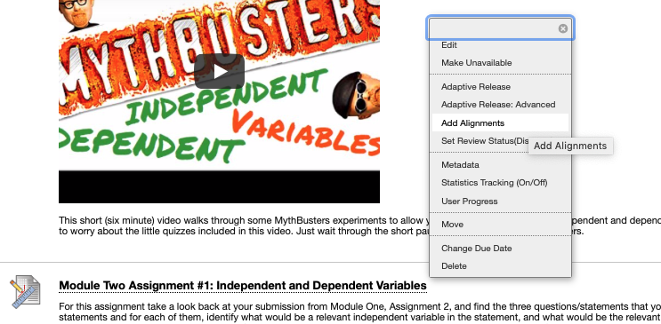
Alignment to Goals is Easy

Slide 8
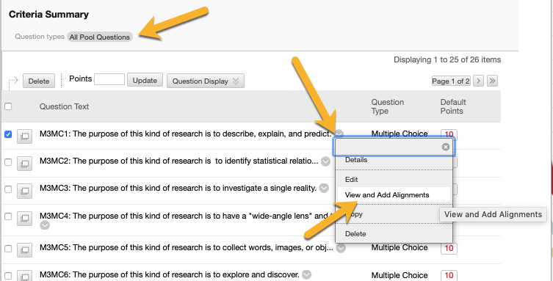
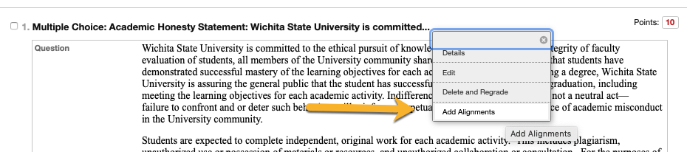
Align Specific Test Questions

