Slide 1
Faculty Annual Activity Reports: Essential Skills
Rachel Crane
Chair, Faculty Evaluation Alignment Committee
Fall 2024
Notes:
Welcome to this introduction of the Faculty Success platform, which now replaces our current annual faculty evaluation process (otherwise known as the FAR).

Slide 2
Outline
About Faculty Success
Logging In
Entering Activities
Importing Citation Data
CV Imports
Reports
Submitting the Faculty Annual Activity Report (FAAR)
Submitting the Faculty Personnel Record for Tenure & Promotion
Resources
Notes:
In this presentation: What Faculty Success is. How to access it. How to enter activities. How to import citation data. How to use the CV Imports Tool. How to generate reports. How to submit your FAAR. The application for Tenure and/or Promotion, (though only briefly mentioned at this point). And links to helpful resources.

Slide 3
About
Faculty Success by Watermark (Watermark Insights)
Faculty Success is a streamlined system for managing and reporting on faculty activity information for accreditation, annual review, promotion and tenure. It is already in use on hundreds of campuses in over twenty-five countries.
Faculty Success will allow us to:
Quickly generate reports for Faculty Annual Activity Review, Tenure and Promotion Review, as well as create customized CVs
Track teaching, research, and service activities
Import data from existing campus systems, including information on courses taught and grants
Move from static to real-time reports
Note: The Barton School of Business is in the process of migrating from Sedona to Faculty Success (as of 9/3/24).
Notes:
As the slide states… This is a platform developed by Watermark, a streamlined system for the gathering of faculty activity information for accreditation, annual review, promotion and tenure. It has the capability to generate reports quickly; track teaching, research, and service activities; import data from existing campus systems such as Banner; move us from static to real-time reports; and in future, reduce redundancy in record keeping.

Slide 4
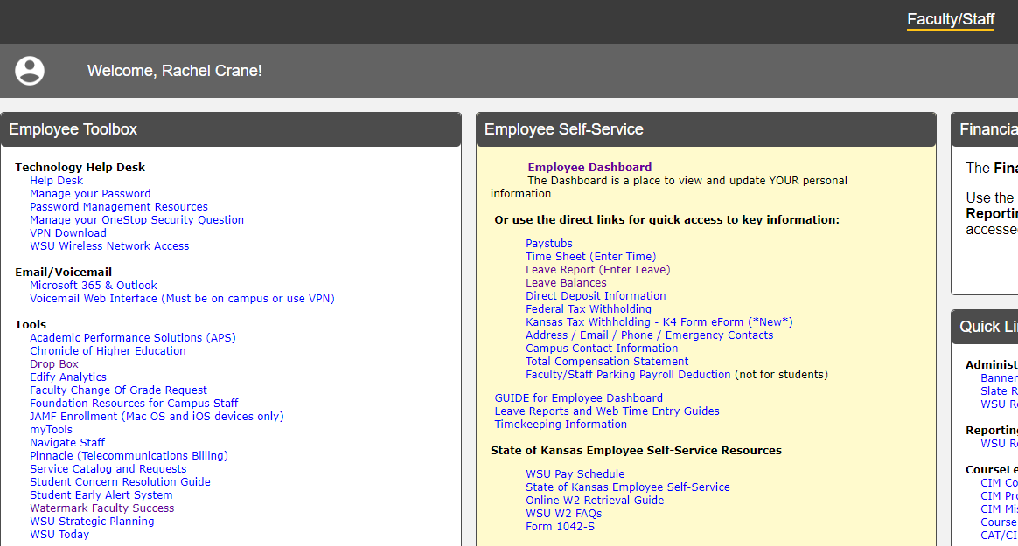
Logging In
Log in using your MyWSUID@Wichita.edu and Password on the Portal:
(Note: Watermark Faculty Success was formerly known as Digital Measures.)
A Link is also located on the WSU Academic Affairs - Academic Forms and Calendars –
Performance Evaluation Forms (FAAR), webpage.
Notes:
To access Watermark Faculty Success, log in to links located on the MyWSU Portal or on the Academic Affairs webpage. On the Portal the link is found on the Faculty/Staff tab, in the Employee Toolbox, under the MyTools heading. The link on the WSU Academic Affairs webpage is listed under the heading for Academic Forms and Calendars, labeled as Performance Evaluation Forms (FAAR).

Slide 5
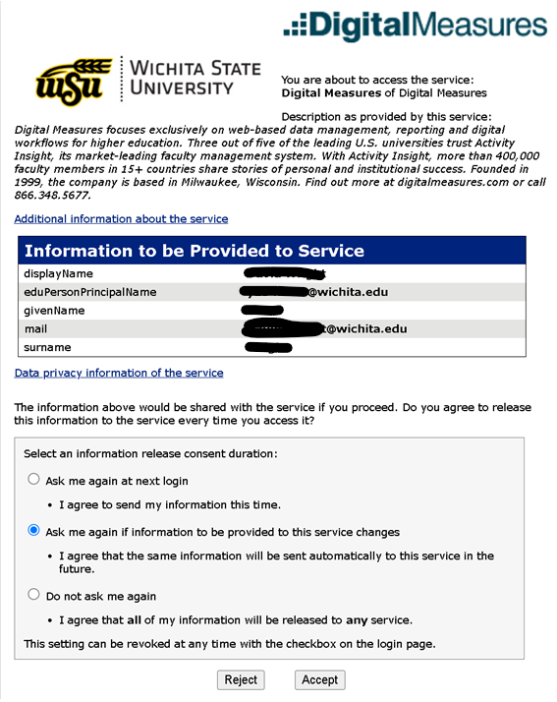
Logging In (continued)
Confirm your acceptance of the service:
Notes:
Please confirm your acceptance of the service.

Slide 6
The Activities Screen - Choose a link to enter an activity:
Notes:
When logging in directly by way of the Portal or the Academic Affairs webpage, the Activities Screen is the default. Depending on the college, you will see a difference in the Activity Fields available to you. For example, in the area of Teaching/Mentoring, the College of Health Professions has a unique Activity Field for ‘Clinical Teaching.’

Slide 7
Entering Activities –Navigation Bar
The navigation bar at the top of the screen displays three main utilities: Activities, CV Imports and Reports. Once you are notified that it is time to submit your FAAR, you will see a Workflow option.
Activities: Enter or update information about your activities and accomplishments.
CV Imports: Import your CV and convert entries into records in Activities.
Reports: Run reports that have been custom-built for you or generate an entirely new report.
Additionally note the help options:
Help: The question mark icon (?) allows you to find helpful guides and ask questions.
Notes:
You will also note the navigation bar at the top of the screen displays three main utilities: Activities, CV Imports and Reports. Once you are notified that it is time to submit your FAAR, you will see a fourth option for Workflow. Use the Activities screen to enter or update information about your activities and accomplishments. Change to the CV Imports tab to import your CV and convert entries into Activity Records. Utilize the Reports screen to run custom-built reports or generate new reports (including a new and up-to-date Vita). Also very important, the question mark icon (?) leads you to resources and contacts for asking questions.

Slide 8
Back to the Activities Screen…
Here, the link for Awards and Honors has been selected. The resulting screen displays past records. Click on the ‘ADD NEW’ button to create a new entry.
Notes:
Back to the Activities Screen. In this example we have selected the link for Awards and Honors. The resulting screen displays previously entered records. Click on the ‘ADD NEW’ button to create a new entry.

Slide 9
After entering the information, click ‘SAVE’ or ‘SAVE + ADD NEW’
Notes:
This is an example of what the fields look like for an Awards and Honors Activity Record. After entering your information, click the ‘SAVE’ or ‘SAVE + ADD NEW’ buttons.

Slide 10
To edit or view a previously entered activity record, click anywhere in the record row.
Note: Some activity records have been added to the system for you.
Additionally, some fields may have access restrictions and therefore cannot be edited. Restricted fields are indicated by a red ‘R’ ( ) at the end of the field title. If revisions are needed to restricted records, contact your Faculty Success Administrator using the Help link. For example, the ‘Rank’ field is a pre-populated, restricted field:
Notes:
To edit or view a previously entered activity record, click anywhere in the record row. As you explore, you will eventually note that some activity records may have already been added to the system for you. Also note that occasionally fields have been designated as ‘restricted,’ meaning that they are not available to be edited. Restricted fields are indicated by a red ‘R’ at the end of the field title. The example screen shot of the Faculty/Staff Rank field from the Yearly Data Activity Record displays the restricted field indicator.

Slide 11
…and edit accordingly
Please note that asterisks (*) indicate required fields.
Notes:
Once you have accessed the activity record, you may edit accordingly. Note here that a small asterisk indicates a required field.

Slide 12
Importing Citation Data Available in ‘Publications,’ in the Scholarship/Research section, you may import citations in bulk. Click on the ‘IMPORT’ button at the upper right of the screen.
Notes:
In the Publications Activity area, you may wish to import citation data in bulk. Click on the ‘IMPORT’ button at the upper right of the screen.

Slide 13
There are two ways for you to bring citations into Faculty Success in bulk from other databases:
Import BibTeX files for example, EndNote, Google Scholar, Mendeley, RefWorks, HeinOnline, or Zotero. For more information on BibTeX Imports. For more details, please consult this article: Click here for more details.
Import directly from Crossref, Scopus, and PubMed. For more details, please consult this article: Click here for more details.
Notes:
There are two ways for you to bring citations into Faculty Success in bulk from other databases The first is to import BibTeX files from EndNote, Google Scholar, Mendeley, RefWorks, HeinOnline, or Zotero. There are instructions that differ slightly for each product, so we recommend consulting this helpful article from Watermark, linked in this slide as well as the final slide of resource links. Likewise, you may import directly from Crossref, Scopus and PubMed third Party platforms. Again, there is a more detailed article about importing from each platform embedded in this slide as well as the final slide of resource links.

Slide 14
CV Imports Allows you to upload data from your CV and convert it into activity records. This tool uses highlighting technology to assist you in identifying areas of your CV that correspond to specific activity screens within Faculty Success.
Notes:
Another way to upload data in bulk is by way of the CV Imports tool. CV Imports allows you to upload data from your CV and convert it into activity records. Note the possible file extensions allowable.

Slide 15
Three steps: Upload CV –> Highlight Content –> Review
My CVs: All CVs you have previously uploaded will appear in this section. You can choose to continue to work where you left off by selecting the ‘Open’ button or the red trash can icon to permanently delete the CV.
(Note that deleting a CV will erase any progress you had made, and this action cannot be undone.)
Notes:
There are essentially three phases in using the CV Imports tool: uploading the CV – highlighting or designating content - Reviewing content. Note all CVs previously uploaded will appear in the section below the upload box. You can choose to continue to work where you left off by selecting the ‘Open’ button. Note that if you are already in progress and delete the CV you are working with, the deletion will erase the progress you have already made and cannot be undone.

Slide 16
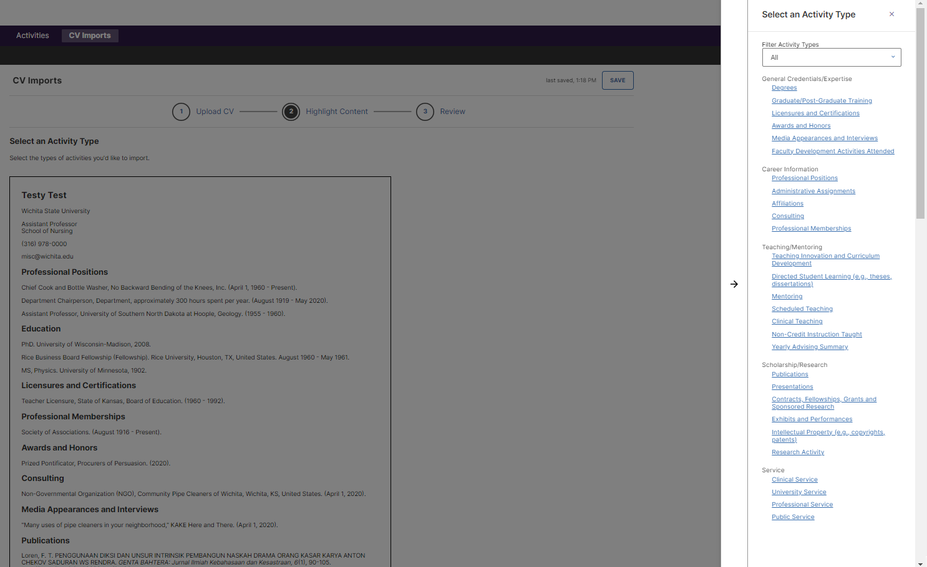
After you have uploaded your CV, you will want to select and ‘Activity Type.’ Click on the activity at the right-hand side menu, - view all options by using the scroll bar.
Notes:
After you have uploaded your CV, you will select the ‘Activity Type’ you want to begin working with. Select the activity from the menu at the right. You may need to use the scroll bar to view all options.

Slide 17
Then highlight the entries you wish to add. To continue, click on the ‘NEXT’ button. For example:
Notes:
Then highlight the entries you wish to add. To continue, click on the ‘NEXT’ button. Here is a screen shot of an example.

Slide 18
Confirm entries. (If you notice any entries you wish to remove, click on the trash can icon.) If everything looks correct, then move on to the next section:
Notes:
Confirm entries. If there are entries you now wish to remove, click on the trash can icon. If everything looks correct, then move on to the next section.

Slide 19
The “Highlight Fields” screen displays the recommended and required fields for you to work with. All required fields are followed with an asterisk (*). Click the ‘NEXT’ button at the bottom right of the screen to continue.
Notes:
The “Highlight Fields” screen displays the recommended and required fields for you to work with. All required fields are followed with an asterisk (*). Click on the ‘NEXT’ button at the bottom right of the screen to continue.

Slide 20
The program moves on through each recommended field, in this case ‘Add Contribution Type’ (Book, Book Chapter, Book Review, Conference Proceeding, Instructional Material, Journal Article, Magazine/Trade Publication, Newsletter, Newspaper Article, Software, Technical Report, Textbook, Other):
Notes:
The program moves on through each recommended field, in this example it is the opportunity to add the ‘Contribution Type.’ The possibilities listed in the pull-down menus are: Book, Book Chapter, Book Review, Conference Proceeding, Instructional Material, Journal Article, Magazine/Trade Publication, Newsletter, Newspaper Article, Software, Technical Report, Textbook, Other. Note that you can also select one format from top-most box ‘Apply to All’ if all formats are the same.

Slide 21
In this example we now ‘Add Current Status’ (In Preparation; Not Yet Submitted, Working Paper, Submitted, Not Accepted, Accepted, or Published)
Notes:
Moving on to edit the ‘Current Status.’ In this example we selected a status from the ‘Apply to All’ pull-down menu, as all entries listed have already been published.

Slide 22
To designate data for specific fields, you will sometimes need to highlight specific sections of information/data. Here we highlight the ‘Title of Contribution’ (the title of the work).
Notes:
To designate data for specific fields, you will sometimes need to highlight specific sections of information. In this case the title of the work. Note that we can view the record in progress by clicking on the little arrow at the end of each entry.

Slide 23
…a view of the Entry 1, in progress
Notes:
And like so, we can view the progress of the first entry.

Slide 24
Continuing with this example, confirm or add authors, editors, and/or translators. As stated in the directions, add in the contributors in order of contribution. Note that the ‘Role’ field is required (options are Author, editor, or translator). The ‘Actions’ pull-down option allows you to add, move or delete rows.
Notes:
Continuing with this example, confirm or add authors, editors, and/or translators. We need to enter all author, editor, or translator information. If this step is skipped, the information will not be transferred to the activity record. Where your own authorship is concerned, you should search for yourself in the ‘People at Wichita State University’ field. When complete, proceed by selecting the ‘Next’ button.

Slide 25
‘Expected Date of Submission,’ ‘Date Submitted,’ ‘Date Accepted,’ do not apply in this example as all entries here have been published. Therefore,we will click on the next button until we reach the ‘Date Published’ area.
Notes:
We move on to “Expected Date of Submission.” As all entries have been published, we will skip this section along with ‘Date Submitted,’ and ‘Date Accepted’ and we will click on the ‘NEXT’ button until we reach the ‘Date Published’ area.

Slide 26
In this example, we enter the date information, to ensure that this information is included in the Activity Record. Again, if we skip this step, the information will not be transferred.
Notes:
In this example, we enter the date information, to ensure that this information is included in the Activity Record. Again, if we skip this step, the information will not be transferred and the citations will be incomplete.

Slide 27
Review and confirm by clicking on the ‘Next’ button.
Notes:
And finally, review and confirm by clicking on the ‘NEXT’ button.

Slide 28
Reports To see what your Faculty Annual Activity Report (FAAR) or your Faculty Personnel Record for Tenure and/or Promotion looks like, to generate a new CV, or create a new report of your data, select the ‘Create a New Report’ button.
Notes:
To utilize the Reports function, perhaps to see what your Faculty Annual Activity Report (FAAR) or your Faculty Personnel Record for Tenure and/or Promotion looks like, or to generate a new CV select one of the report rows listed on the Reports screen. If you wish to create an entirely new report from your data, select the ‘Create a New Report’ button.

Slide 29
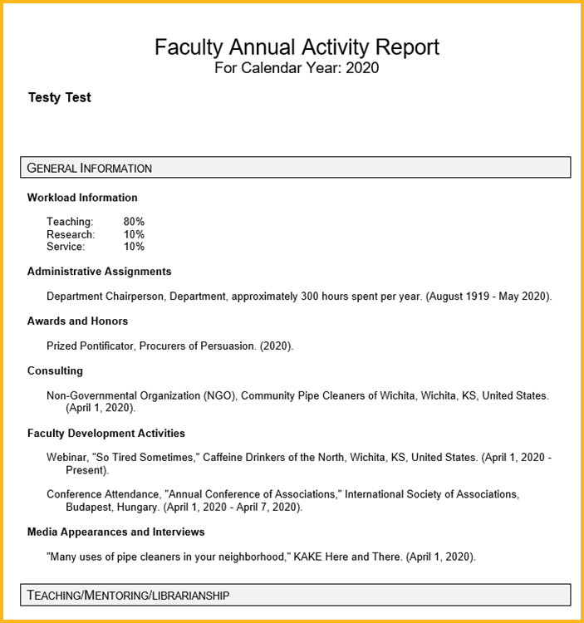
To view a copy of your FAAR, adjust the Date Range for the applicable calendar year and click the ‘RUN REPORT’ button.
Find the report in your ‘Downloads’ folder. See fictitious example
Notes:
To view a copy of your FAAR, select the Faculty Annual Activity Report, the first report listed on the Reports screen, adjust the Date Range for the applicable calendar year, and click the ‘RUN REPORT’ button. Find the report in your ‘Downloads’ folder. Here is a screen shot of the first portion of a fictitious example of a FAAR from 2020.

Slide 30
To view a copy of your Faculty Personnel Record for T&P, adjust the Date Range for the applicable calendar years and click the ‘RUN REPORT’ button.
Find the report in your ‘Downloads’ folder. See fictitious example
Notes:
Likewise, to view a copy of your Faculty Personnel Record for T&P, select the appropriate link from the list of Reports on the ‘Reports’ screen, adjust the Date Range for the applicable calendar years and click the ‘RUN REPORT’ button. Find the report in your ‘Downloads’ folder. Here again is a fictitious example of the beginning portion of a Faculty Personnel Record.

Slide 31
Create a new CV
by selecting the ‘Vita’ link, which opens a Watermark Vita template.
Notes:
You may wish to create an all-new CV by selecting the ‘Vita’ link, which opens a Watermark Vita template.

Slide 32
OR create a new CV…
with a different layout, or a completely new report by clicking on the ‘CREATE A NEW REPORT’ button. Then choose from a Blank Document or Vita option.
For more detailed information see the article “Custom Reports in Faculty Success”
Notes:
Or create a Vita with a different layout, or a completely new report by clicking on the ‘CREATE A NEW REPORT’ button. Then choose from a Blank Document or Vita option. Embedded in this slide is another helpful article with additional information. This link is also listed on the final slide.

Slide 33
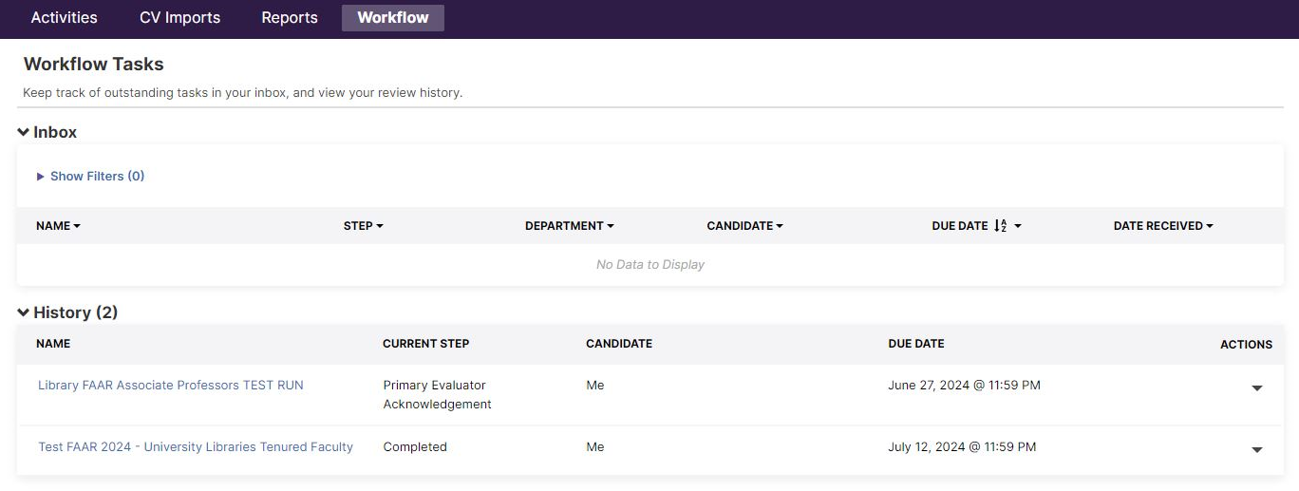
Submitting the Faculty Annual Activity Report (FAAR)
Initially, you may not see a Workflow tab. However, once you are notified by email that it is time to submit your FAAR, one will appear. The email message link will default to the Workflow screen.
If you have more activities to enter before submission, select the ‘Activities’ tab.
If you want to review your FAAR before proceeding through the submission process, click on the ‘Reports’ tab and run a report of your FAAR.
When you are ready to begin the submission, click on the link provided in the Workflow Inbox. Here is a sample of the screen:
Notes:
As stated earlier, you may not initially see a Workflow tab on your navigation bar. However, once you are notified by email that it is time to submit your FAAR, one will appear. When you click on the link in the email message, you will arrive by default at the Workflow screen. If you have more activities to enter before submission, select the ‘Activities’ tab.
If you want to review your FAAR before proceeding through the submission process, click on the ‘Reports’ tab and run a report of your FAAR.
When you are ready to begin the submission, click on the link provided in the Workflow Inbox. Here is a sample of the screen of a faculty member that participated in a submission test, so there is no current FAAR listed to submit in the Inbox, but this is generally what the Workflow screen will look like.

Slide 34
Submitting the Faculty Personnel Record for Tenure & Promotion Review
Coming in 2025
You should receive an email notification when the submission process is open to you.
To review and begin to create your Faculty Personnel Record in advance of the submission process, click on the ‘Reports’ tab and run a report of your ‘T&P Review Faculty Personnel Record.’
More details will be available in the coming months.
Notes:
The 2024, Annual Reviews will be processed by way of Watermark Faculty Success. In 2025, Tenure and Promotion reviews will be submitted by way of Watermark Faculty Success. More details will be available in the coming months.

Slide 35
Resources
Faculty Success Login
Faculty Success on WSU Watermark Tools webpages
Faculty Success Overview https://support.watermarkinsights.com/hc/en-us/articles/5193405933595-Faculty-Success-Overview
BibTeX Imports
Publication Import Overview (Importing directly from Crossref, Scopus, and PubMed)
CV Imports (video) https://watermarkinsights.hubs.vidyard.com/watch/Abr5Q57a8kUYv5VJeWTNEo
Creating Custom Reports in Faculty Success
Frequently Asked Questions [FAQs] https://support.watermarkinsights.com/hc/en-us/articles/5197574823195-Frequently-Asked-Questions-FAQs
Watermark Faculty Success Help Center https://support.watermarkinsights.com/hc/en-us/categories/4409237050523-Faculty-Success
WSU Faculty Success System Administrator, Rachel Crane Rachel.Crane@wichita.edu 316-978-5078
Notes:
A listing of resources. Thank you for your time and attention.

