Slide 2
Advanced Blackboard
All About Professor Feedback

Slide 3
Agenda/Topics
Feedback to Assignment
SafeAssign Reports
Feedback to Discussion Board
Feedback to Tests

Slide 4
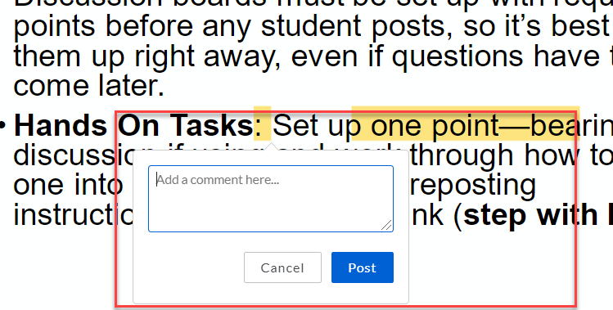
Feedback to Assignments
Instructor can give feedback to submitted assignment in two ways.
General feedback on overall quality of the work submitted.
Specific comment on specific area on the submitted work.

Slide 5
How Students see Feedback on Assignment
The student click on My Grades and locate the assignment.
Clicking the comment bubble pops the general feedback on submitted work.
Clicking on the grade, opens the submission where the student can see both general and specific feedback.

Slide 6
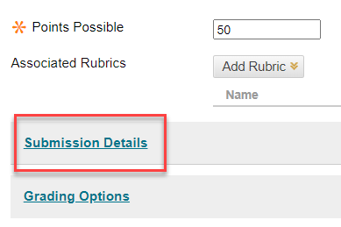
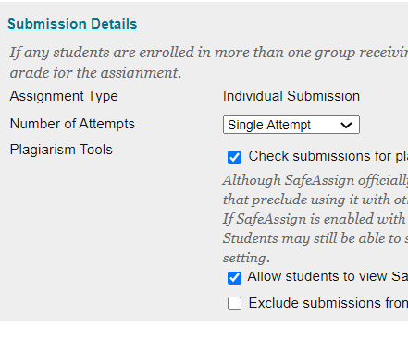
SafeAssign Report
SafeAssign is WSU’s only plagiarism checking tool.
To add SafeAssign to your assignment, click on Submission Details in the assignment setting.
This should be set before students submit their attempt.

Slide 7
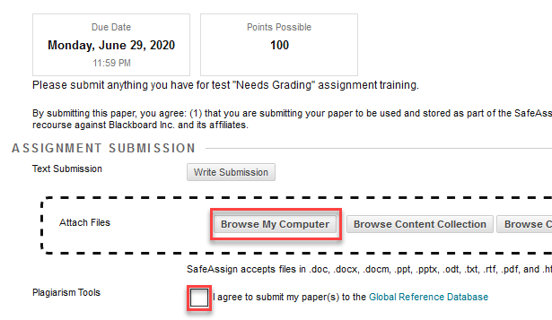
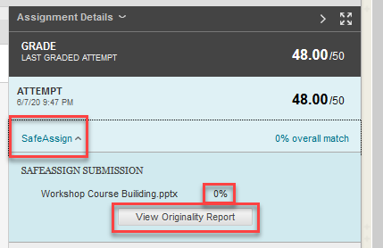
How SafeAssign Report is Checked
Students can submit their work whether they consent to the SafeAssign check or not.
the student agreed for SafeAssign, both the student and the instructor can see the originality report for the work submitted

Slide 8
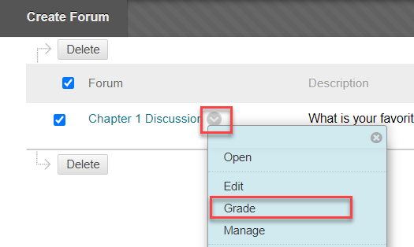
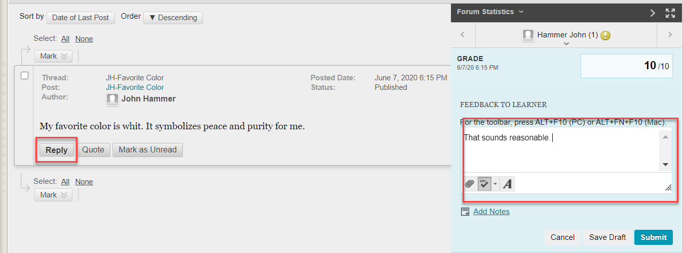
Feedback to Discussion Board
The instructor can grade Discussion Forums from the Needs Grading Section, or directly from the discussion board.
Then, give feedback in the provided space.

Slide 9
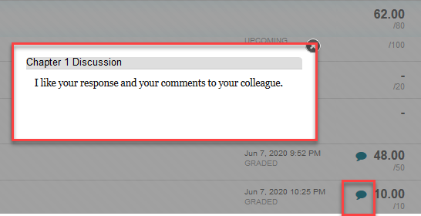
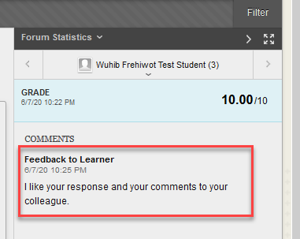
How Students see Feedback on Discussion Posts
To see their grade and feedback, students click on My Grades and locate the discussion forum.
Clicking the comment bubble pops the general feedback on submitted work.
Clicking on the grade, opens the submission where the student can see both general and specific feedback.

Slide 10
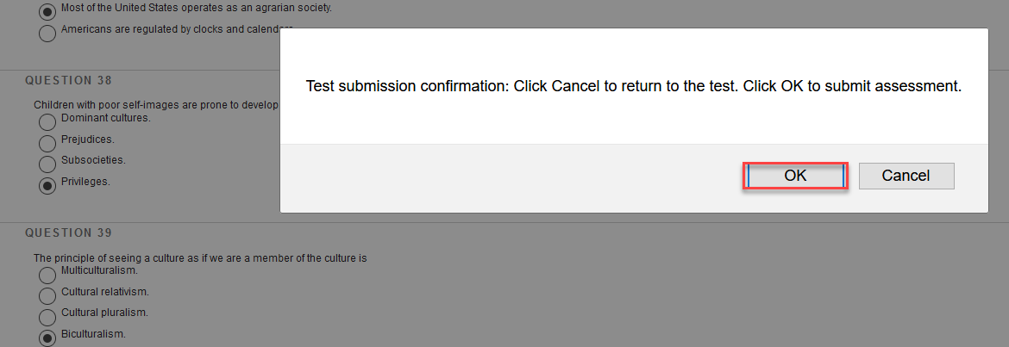
Feedback to Tests
What students see after they submit their attempt depends on how the instructor set the test.
Before students submit their attempt, Blackboard will make them confirm; they will see what the instructor chose to show including feedback.

Slide 11
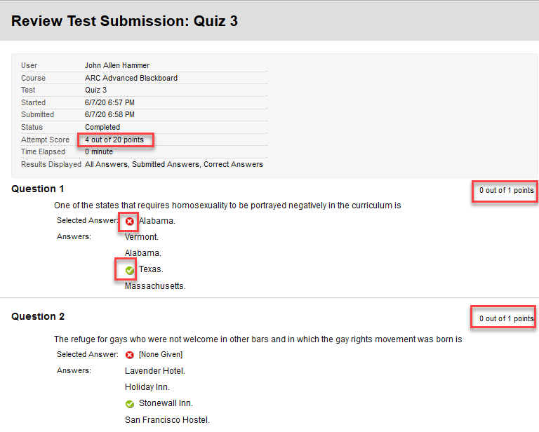
Test Feedback with all Options Selected
When the Test is set to show everything:
Students see everything.

Slide 12
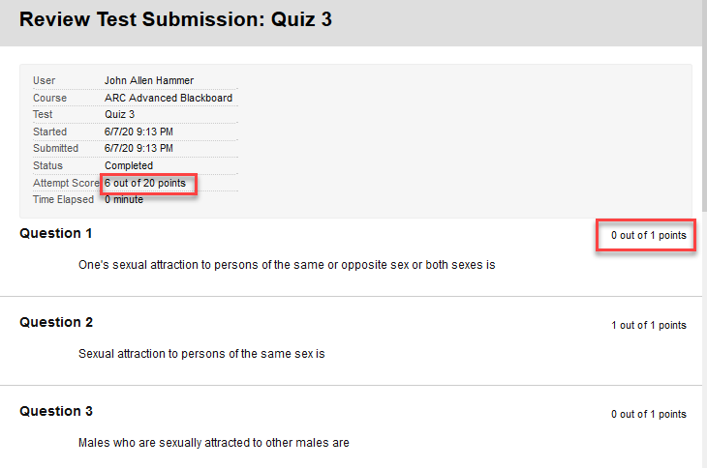
Test Feedback with Some Options Selected
Students will only see their score; they won’t see the answer options, the correct answer, or what they submitted.
If the test is set to show only Score Per Question:

Slide 13
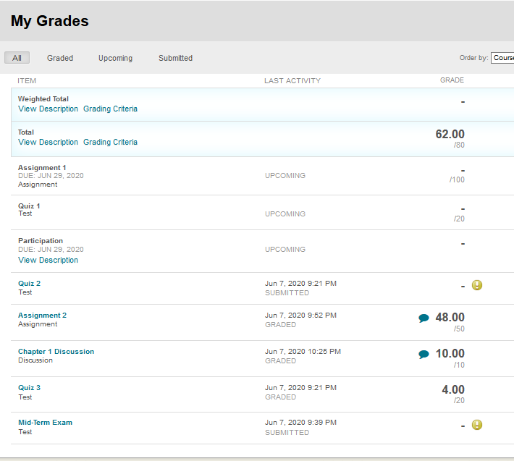
What the Student Sees Overall
Graded: Ch. 1 Discussion, Assignment 2, and Quiz 3
Needs Grading: Quiz 2, and Mid-Term Exam
Not Submitted yet: Assignment 1, Quiz 1, and Participation

Slide 14
Thank You!

