Slide 2
Advanced Blackboard: All About Test

Slide 3
Agenda / Topics
Features of the test tool
Creating test, importing, and exporting test
Deploying Test and Test settings
Difference between test and pool
What are surveys for

Slide 4
Session Objectives
At the end of the session, you will be able to:
    Create test with different question types
    Import and export test from excel or to and from another course
    Identify the difference between tests and pools and create test sets from a pool
    Create and utilize survey

Slide 5
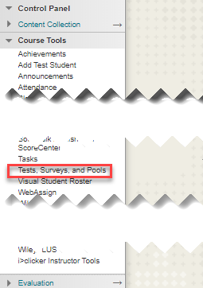
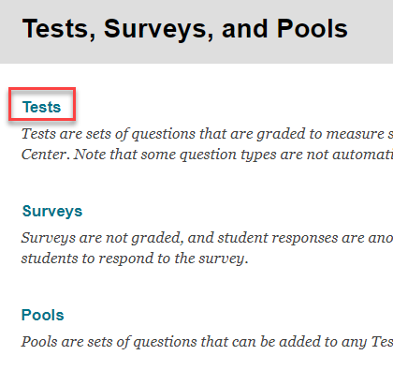
Test Tool
To find the Test tool, click
  Course Tools, under Control Panel
  Tests, Surveys, and Pools
  Tests

Slide 6
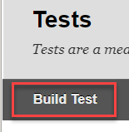
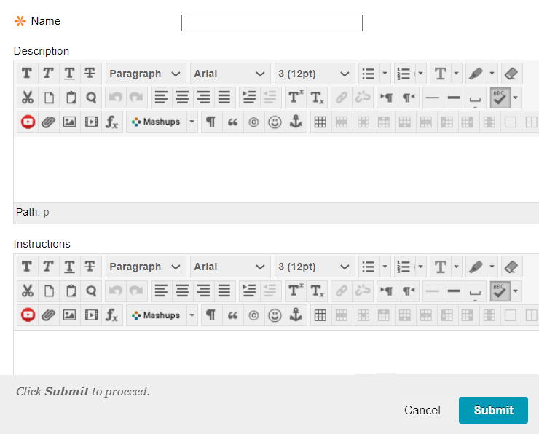
Test Building
Build Test
Name your test
Add a description and/or instruction to the test.
If you prefer to add the description and instruction later, that is also possible.

Slide 7
Adding Question Options
Create Question
Reuse Question
Upload Question
This option allows you to create your questions one by one.
You can choose from the list of question types.
  Calculated Formula
  Multiple Choice
  Multiple Answers
  True/False
  Fill in the Blank
  Fill in Multiple Blanks
  Short Answer
  Essay
  Matching
  Ordering
  File Response
This option allows you to reuse questions that you created in pools and create the test.
  Create Question Set
  Create random Block
  Find Questions
The Question Set option allows you to choose questions from other tests, or pools.
Random Block allows to choose questions only from Pools.
You can create multiple Question Sets and Random Blocks in one test.
E.g. by level of difficulty, chapters covered, item types …
Write questions offline in a text file and upload it into tests, surveys, and question pools, use the “Upload Questions” option.
The questions and the file you want to upload must meet certain guidelines.
Tab-delimited Microsoft excel format is a good example. (See sample in the next page)
  No header raw
  No blank lines
  One question per raw
Save the file and upload it to the test by browsing the file you saved on your computer.
You can assign points while uploading or change values after the upload is complete.

Slide 8
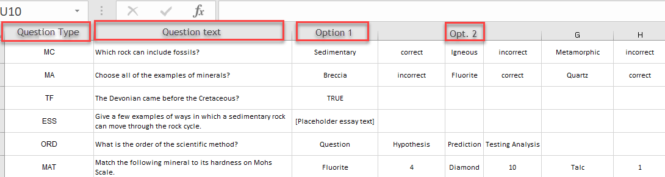
Sample File for Upload
This is an example of Excel tab-delimited file format to create your questions.
The first column is the question type in abbreviation. MC (Multiple Choice, MA (Multiple Answers), TF (True/False), ESS (Essay), …
The next column is the question text.
The columns that follow depend on the type of question.

Slide 9
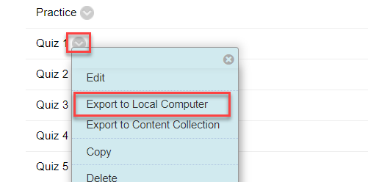
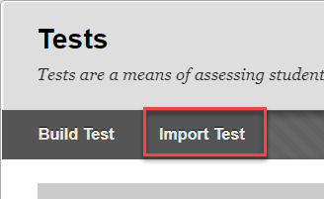
Importing a Test
If you have a test that you used in one course, and you want to use that same test in your other course, you can export the test from one course and Import it to another.
            First, export the test from the course, never open the zipped package.
            Then, locate the Tests, Surveys, and Pools tab of the course where you want to import the test to.
            Import the test by browsing your computer and attaching the zipped package.

Slide 10
Deploying a Test
Until you deploy the test to the course content area, it will not be available for students to see it.
To deploy a test to a content area:
  Open the folder where you want to make it available at
  Click “Assessment”, and select “Test”
  Choose the test
You can deploy a test only once.
If a test is already deployed, it will not be available for choice anymore.

Slide 11
Test Setting Options
After the test is deployed, a test setting option will open
  You can add or edit a test description, you can choose to show it before students begin the test
  Choose to open the test in a new window or same window
  Make the test available or not
  Allow multiple or single attempts, for multiple attempt, you should choose which score to include in the gradebook
  NEVER check the “Force Completion” option
  You can choose to set Timer for the test; you can turn Auto-Submit on or off
  You can set a Display After and Display Until dates

Slide 12
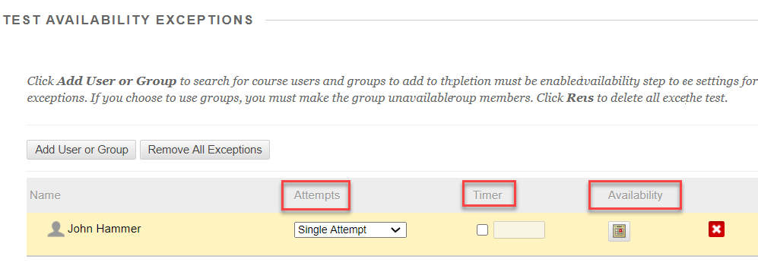
Test Setting Options/Availability Exceptions
  You do not need a password
  Test Availability option allows you to add students or groups of students to have exceptions with;
    Test availability dates
    Number of attempts
    Number of attempts

Slide 13
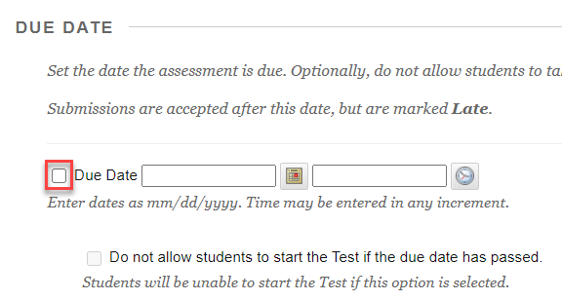
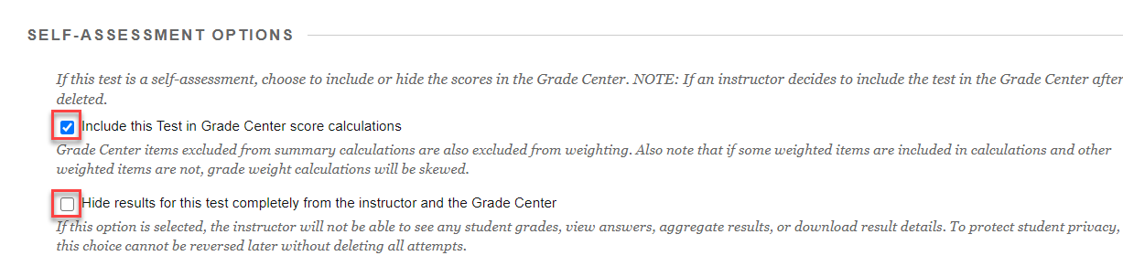
Test Setting Options/Due Dates and Gradebook
  Adding a due date helps students better plan their schedule
  You can choose the test to be included in the grade center or just a Self Assessment

Slide 14
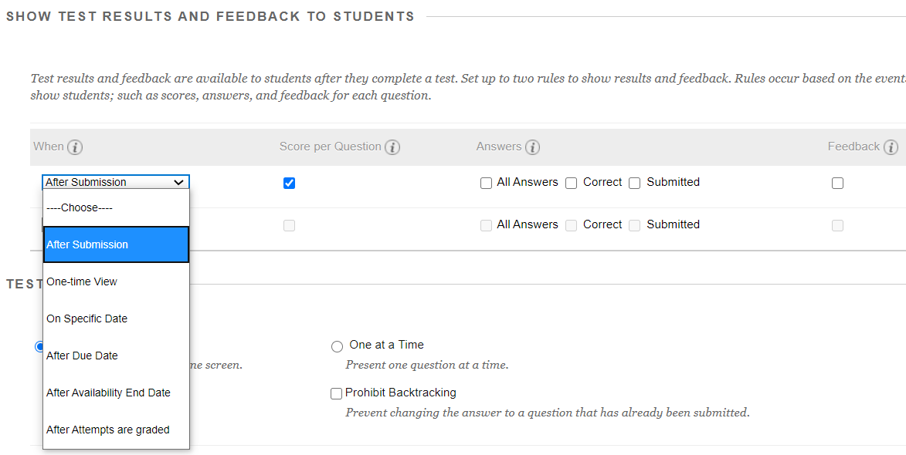
Test Setting Options/Results and Feedback
  You can choose what to show students when.
    After submission
    On specific date
    After availability date
    After due date
        Score per question
        All answers
        Correct answers
        Submitted answers
        Feedback

Slide 15
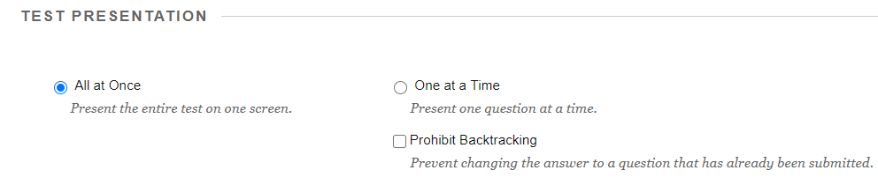

Test Setting Options/Showing Questions
  You can choose to show all questions at once or one question at a time.
  If you choose to show one question at a time, you can allow back tracking or not.
  The last option to choose is to randomize the questions or not.

Slide 16
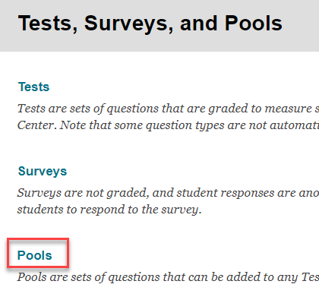
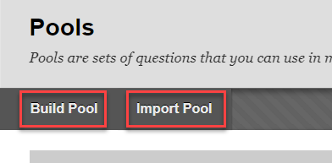
Pools
A question pool is a collection of questions that is stored for repeated use.
You can use pools to create tests and surveys. You can also export and import pools for use in tests in other courses.
Questions in a pool are almost identical to test questions. They can contain feedback, metadata, and all the other elements of a test question, but they don't contain point values.
Pools are typically used to create a database of questions that can be reuse in multiple tests.
You can’t add Pools directly to the course content area, the question in pools should first be created as a test in the Tests area.

Slide 17
Surveys
Blackboard Surveys are a tool to gain information from your students and are similar to the Test tool.
Surveys are different from Tests in that all responses are anonymous, there are no correct/incorrect answers, and they are generally not graded.
Surveys can be used to get feedback on your course or teaching style, as well as gather information concerning student opinions or viewpoints on sensitive topics for class discussion.
Don’t use Surveys if you want to know whom the survey responses belongs to.
You can assign points for completing the Survey by modifying the “Points Possible” field for the Survey within the Grade Center, but cannot grade individual questions.

Slide 18
Thank you!

