Slide 2
How to Host a Zoom Murder

Slide 3
Agenda
Session attendance
Why Zoom mysteries?
Finding mysteries
Player info
Backgrounds
Zoom tools to know
Using PPT for riddles
Prizes

Slide 4
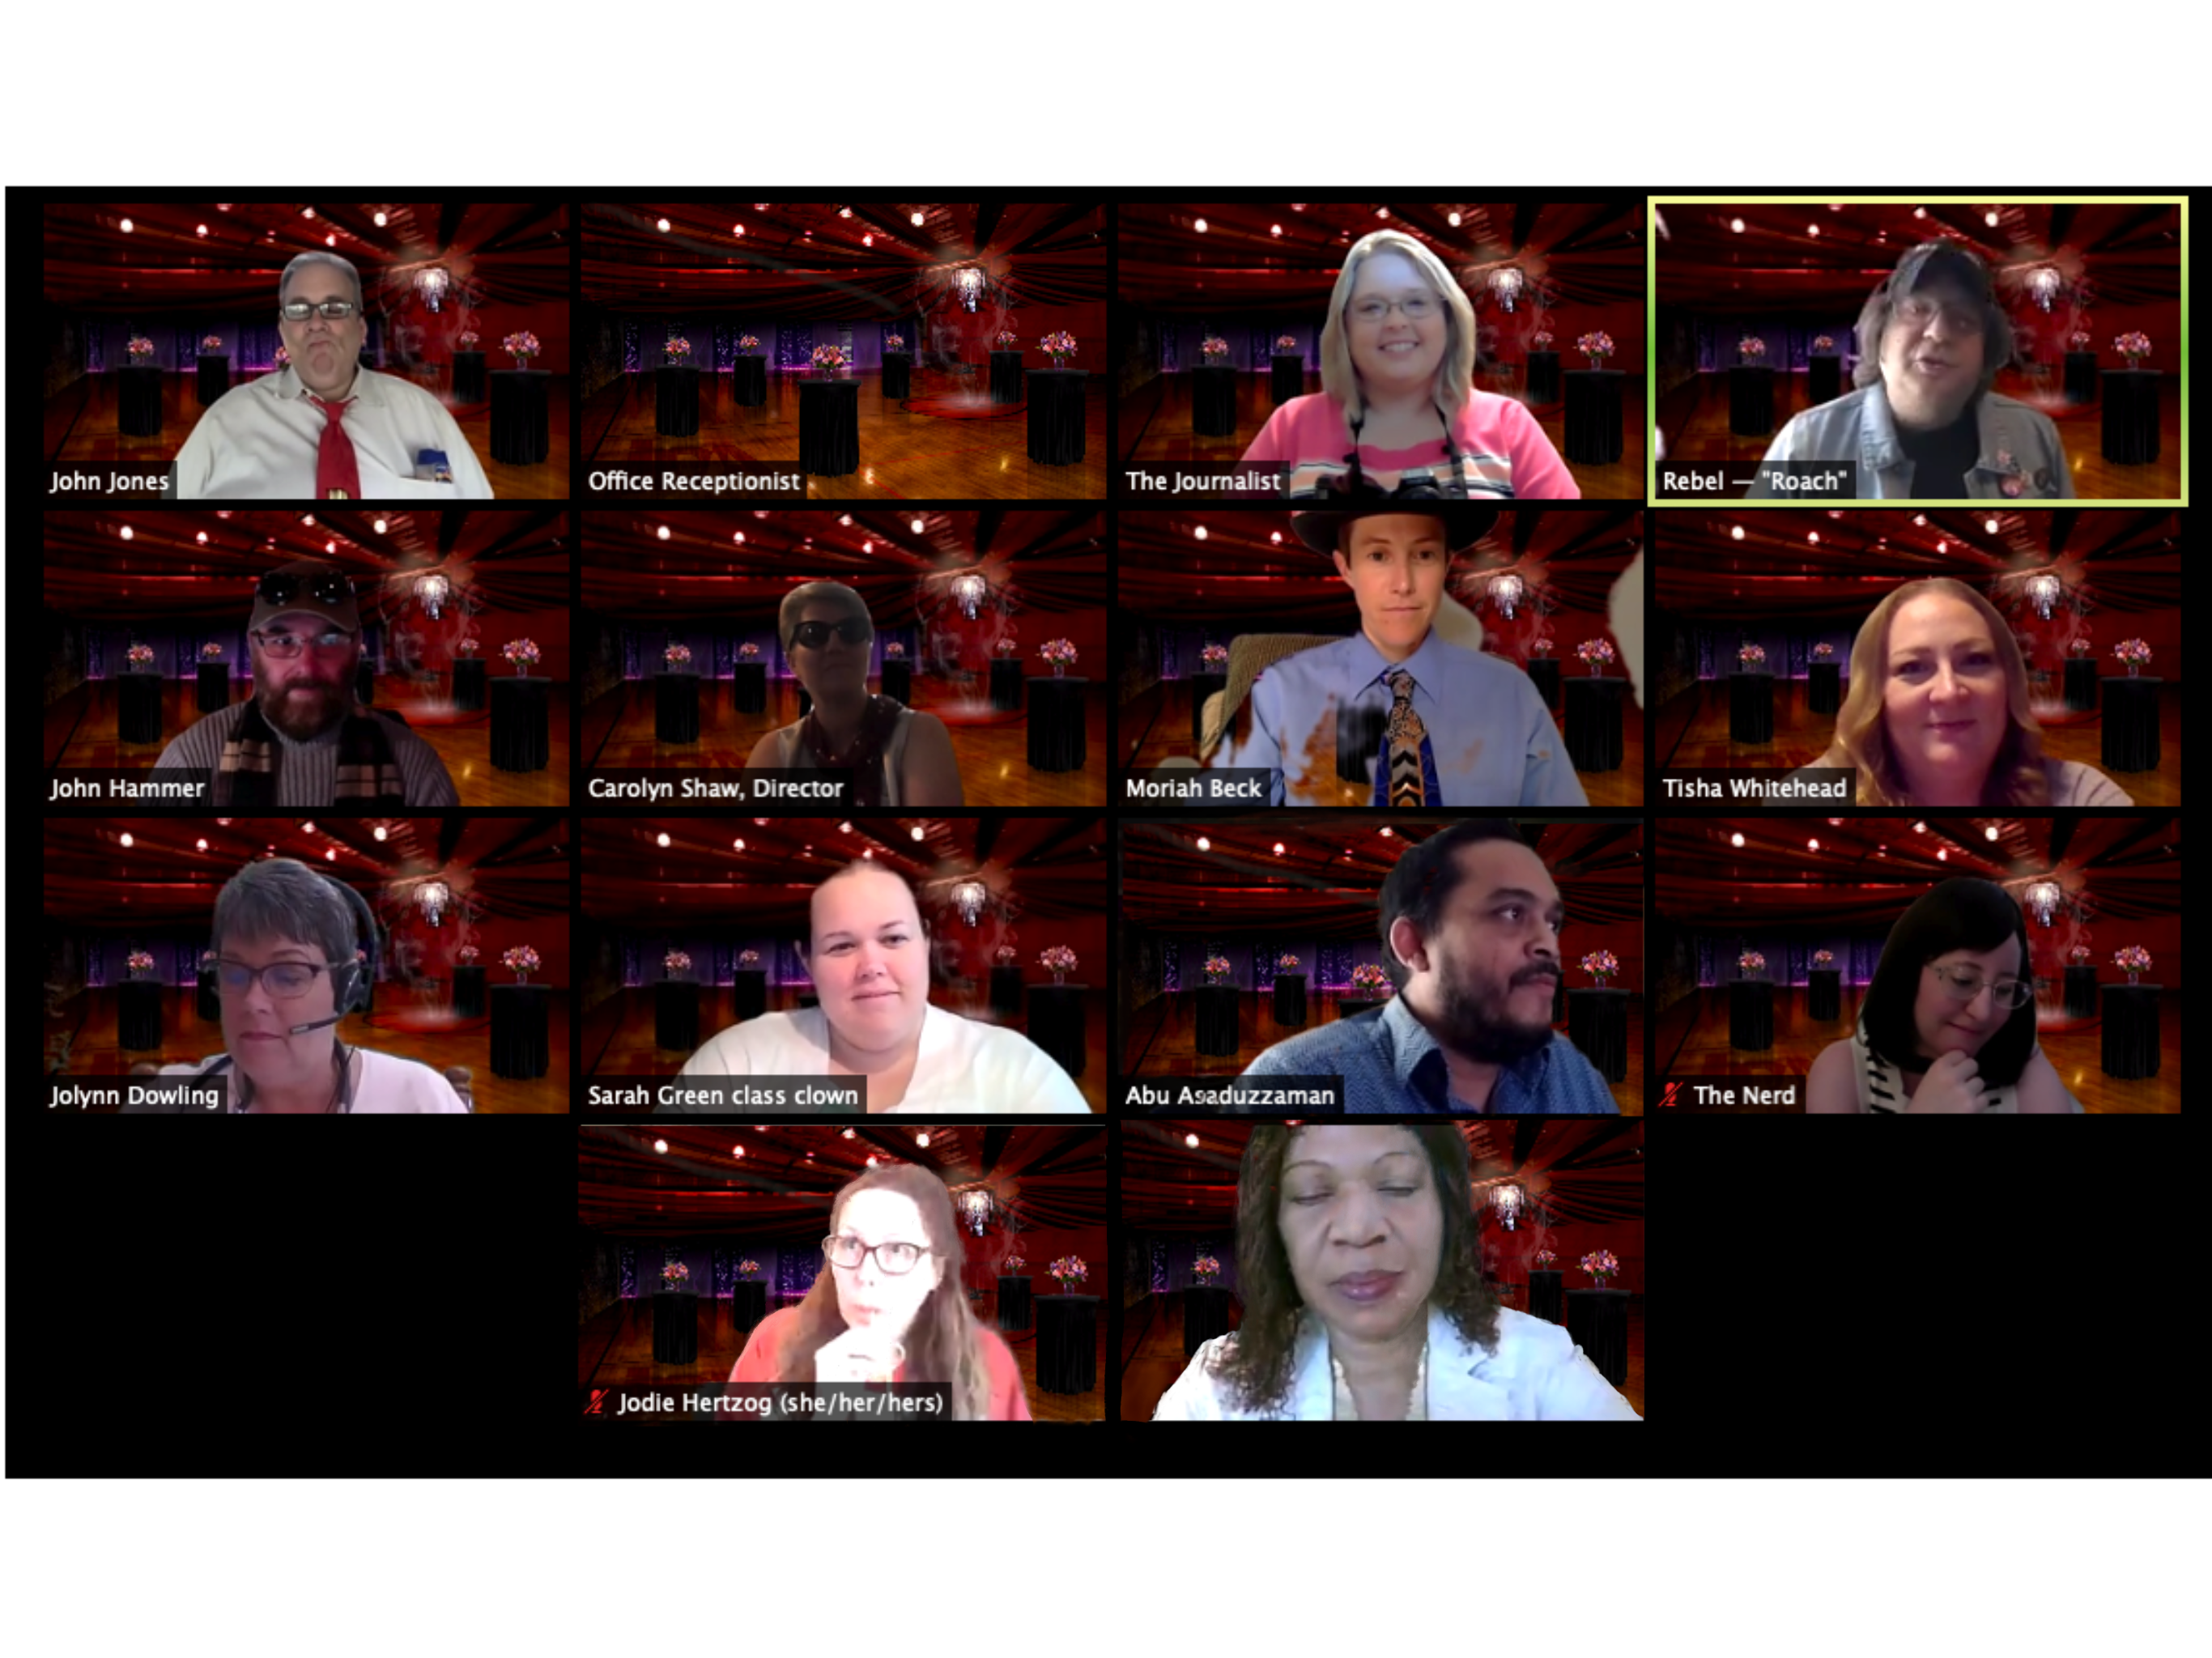
Why Zoom Mysteries?
Fun, social opportunity online
Can be fitted to classroom use with games, storylines, etc.
Great Zoom training opportunity
Generates social media images and information
Possible revenue generation

Slide 5
Finding mysteries
Free online (one included as an asset to this session at https://Wichita.edu/Topics)
Playingwithmurder.com has a free “Jazz Age Jeopardy”
Mymysteryparty.com
Notes:
Free image from needpix.com

Slide 6
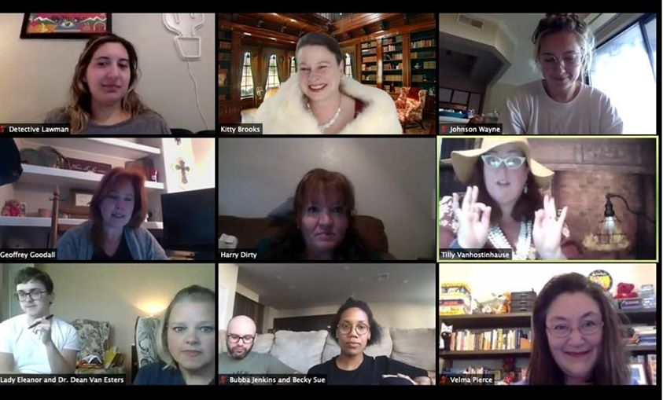
Player info
Make sure your character documents are very streamlined and clear.
Contact your players as soon as you can, but it’s a balance with waiting to have a full group.
They will need character info, costume info (if any), backgrounds (if provided), and a Zoom invite for the night.
Also: provide Zoom training in your initial contact information!
Be flexible!

Slide 7
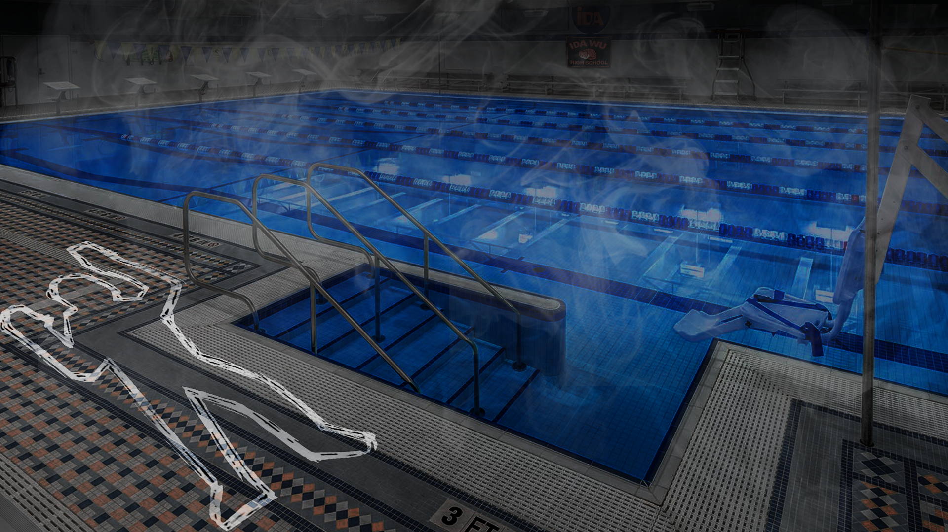
The importance of backgrounds
Zoom allows for changing backgrounds, so use it when possible
Search for Zoom backgrounds and provide them
If you have an artist, great!
Backgrounds help set the stage and are like “costumes” for the game

Slide 8

Other Zoom tools for training
Changing names
Private chat
Waiting room
Breakout rooms
Zoom has great training, and you can also use WSU’s video-based trainings for Zoom: https://www.youtube.com/playlist?list=PL3hwAwZEiCSer-Te7SxM75L3cXRb_B2DR (link available with session assets)

Slide 9
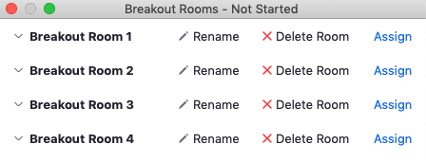
All about breakout rooms
Breakout rooms can be confusing in real time
Use the “broadcast to the room” feature
Participants can send a request for help from the rooms
Ask yourself: do I need these for this game? What is the goal of the rooms?

Slide 10
Riddles and other PPT uses
Zoom mysteries feel linear/sequential (each person talks one-at-a-time)
Riddles encourage competition and/or collaboration
Consider accessibility and different skill sets
If you are using PPT slides with images, before the session, “share screen” and put in “presentation” mode. Then toggle back to the room to run the session.
Notes:
Needpix.com

Slide 11
Handling prizes
Digital prizes can be fun if possible (emailed gift card, eg)
Praise is great, of course, especially on social media
Physical prizes are ideal if possible

Slide 12
Things to remember
Take a picture of the group! Good for a “keepsake” and promotion, especially if costumes and backgrounds are used.
The goal is to HAVE FUN not to have the game go exactly as planned.
Sharing is caring. If you develop a game, share it if you don’t sell it
Huge training opportunity for you staff/faculty, and packaged in a fun way

Slide 13
Thank you! IDA@Wichita.edu

