Slide 2
Problems and Solutions in Bb

Slide 3
Agenda
Session attendance
Logging in
Changing browsers
Can’t edit
Lose the menu
Grade Center issues
Email secrets
Panopto access
Random advice from IDA
Questions!

Slide 4
Problems with logging in
Your WSU credentials should work
If Bb login isn’t working, try “sign on with CAS” with your WSU credentials and Duo authentication

Slide 5
The power of a browser
Browsers are independent companies
If something disappears or goes wrong, try changing to another browser
Never use Internet Explorer in Blackboard
Firefox, Chrome, or Safari works well

Slide 6
When you can’t edit
Sometimes “edit mode” shuts off for no apparent reason
You will not be able to make an announcement, upload content, or doing most anything else
Good:
Bad:

Slide 7
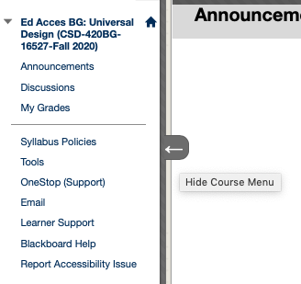
My menu is gone!
Your left-hand menu should always show
If it goes away, hover your cursor next to the left side of your window until an arrow appears, and click it

Slide 8
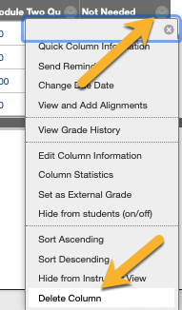
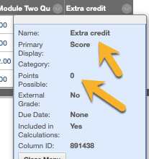
Grade Center issues
Extra columns? If you can delete it, it’s okay to do so
Move columns using “manage” and “column
Extra credit? Make the column worth 0 points

Slide 9
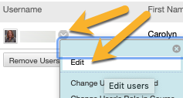
The secrets of email
Email through announcements most of the time
Bb has no “sent mail” feature
WSU spam filters sometimes block Bb emails – from both students and instructors
You CAN change student email addresses

Slide 10
Adding Panopto into the mix
If you have Panopto videos, or you want to use Panopto for the first time, you have to configure your class for it

Slide 11
Assorted advice from IDA
Don’t make changes to a quiz after an attempt has been made
If you’ve hidden a folder from users, all content in that folder is hidden, even if it’s linked elsewhere
If your Grade Center total column is wrong, you probably hid columns from yourself
Remember to deploy your exams and make them available to students
Your content may not want to reorder. If this happens, contact IDA
You can’t make a discussion worth points after there have been posts
Never use force completion

Slide 12
Thank you! IDA@Wichita.edu

