Slide 2
Universal Design and UDL

Slide 3
Carolyn Speer, PhD, CPACC
Manager of Instructional Design and Access at Wichita State
PhD in Adult Education
Certified Professional in Accessibility Core Competencies
Notes:
IAAP: international association of accessibility professionals

Slide 4
Agenda
Session attendance
What is content accessibility?
Universal Design
Universal Design for Learning
UX
Universal Design in education
For a deeper discussion, see “Accessibility Family of Terms”
https://youtu.be/g3w4YnM7UjU

Slide 5
Content accessibility
Creating content with no overt barriers to groups of people
Presented on at least 2 cognitive channels
Not: tailoring presentation to one person

Slide 6
Who are “qualified individuals”
People who meet the skill, experience, education, and/or other requirements necessary to “be there” and can perform the essential functions necessary with or without reasonable accommodation

Slide 7
Accessibility IS “universality”
The goal is to create learning experiences that don’t create unnecessary barriers to qualified individuals.

Slide 8
Thinking about how to get there
Course design is the purview of the instructor
Academic freedom includes the right to adopt personal teaching methods
All students accepted to the university have an equal right to equal access

Slide 9
Many ways to get there

Slide 10
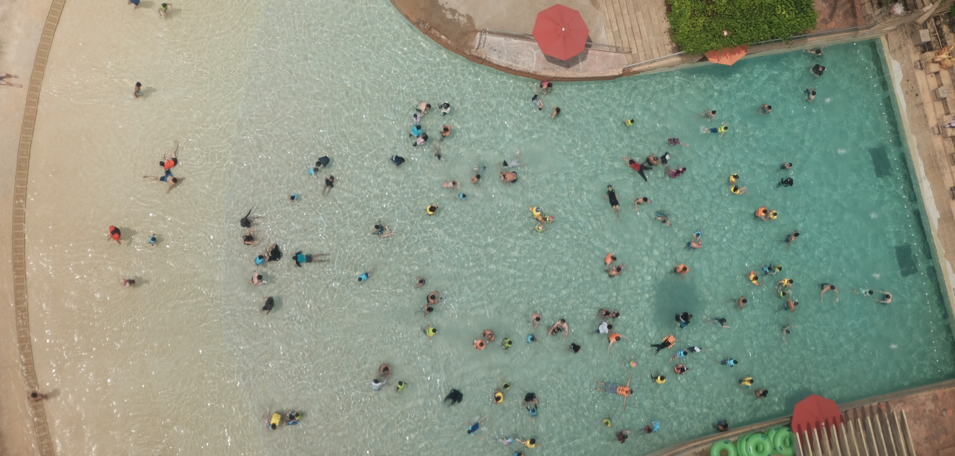
Universal Design
According to the Center for Universal Design, Universal Design is defined as, “The design of products and environments to be usable by all people, to the greatest extent possible, without adaptation or specialized design.”

Slide 11
Seven principles of UD
UD came out of the “built environment”
equitable use
flexibility in use
simple and intuitive
perceptible information
tolerance for error
low physical effort
size and space for approach and use

Slide 12
Universal Design for Learning
Applied some of the concepts of UD to learning environments
Stemmed from K-12
CAST (Center for Applied Special Technology)
Not simply “universal design in an educational context”

Slide 13
Three principles of UDL
Multiple means of engagement
Multiple means of representation
Multiple means of action & expression

Slide 14
User experience (UX) design
A design philosophy (used by the WSU instructional design office)
Look at the whole thing being designed
Asks “why do people use the ‘product?’ what should it do? How is it used?
Broad concept that can include UD, UDL, and other approaches

Slide 15
A model for your consideration
1) Can all QIs complete in an equally effective way?
Yes
1b) Can they complete activities independently?
Yes
2) Can presentar(s) respond to QI differences immediately?
Yes
3) Is all program complexity necessary for program goals?
Yes
4) Does the program provide QIs with all necessary information to complete program activities?
Yes
1a) No: STOP. Revise activities and return to 1.
No. STOP. Revise activities for maximum independence and go to 2.
5) Do all activities support learning through discovery?
Yes
6) Does assessment of program activities suppor QIs goal mastery?
Yes
7) Are activities and assessments designed for varied delivery modes?
Yes
8) Are physical and digital resources appropriate for all QIs?
Yes
9) Yay! you are finished with your UD review and have done what you can, at this time, to reach all QIs.
No. STOP. develop new/additional resources. Return to 1.
If no in reevaluation, STOP. Solve barrier issue and go to 3.
No. Simplify unnecessary complexity and go to 4.
No. Is this info fundamental to being qualified for the program?
If yes, go to 5.
No. STOP. Add necessary info to content and go to 5.
No. Can learning through discovery reasonably be added?
No. Go to 6.
Yes. Add learning through discovery and reevaluate by returning to 3.
No. Are all assessments appropriately fitted to the goals?
No. Revise and go to 7.
Yes. Create a recommended remediaton step for QIs and then go to 7.
No. Consider developing activities and/or assessments for other delivery modes and evaluate them separately.
No. Remediate physical space and/or digital resources for accessibility.
Notes:
Can all QI’s served by this program complete the activities in an equally effective way?
If yes, go to 1.b. If no: STOP. Revise activities and return to 1.
Can they complete all activities independently?
If yes: go to 2. If no: STOP. Revise activities that cannot be done independently to maximize independence and go to 2.
Can presenter(s) respond to QI differences immediately?
If yes, go to 3. If no, develop new/additional activities and return to 1.
If no a second time (after reevaluation), then STOP. Solve barrier issue(s) with outside help and go to 3.
Is all program complexity necessary for program goals?
If yes, go to 4. If no, simplify unnecessary complexity and go to 4.
Does the program provide the QI with all information necessary to successfully complete program activities?
If yes, go to 5. If no, evaluate the following: Is this information fundamental to being deemed “qualified” for the program?
If yes, go to 5. If no, STOP, add necessary information to content, and go to 5.
Do all activities support learning through discovery?
If yes, go to 6. If no, evaluate the following: Can learning through discovery reasonably be added?
If no, go to 6. If yes, add learning through discovery to activities and reevaluate by returning to 3.
Does assessment of program activities support QIs mastery of goals?
If yes, go to 7. If no, evaluate the following: Are all assessments appropriately fitted to the goals?
If no, revise assessments and go to 7. If yes, create a recommended remediation step for QIs and then go to 7.
Are activities and assessments designed for varied delivery modes (eg: online, in-person, synchronous, asynchronous).
If yes, go to 8. If no, consider developing activities and/or assessments for other modes of delivery and plan to evaluate those activities/assessments separately; for original activities/assessments, go to 8.
Are physical and digital resources appropriate for all QIs?
If yes, go to 9. If no, remediate physical space and/or digital resources for necessary accessibility to, at least, meet the needs of your QIs and then go to 9.
Yay! You are finished with your UD review and have done what you can at this time to create a program that is appropriate for all qualified individuals whom it might reach.

Slide 16
What does all of this mean to YOU?
There is no “one way” to do accessibility
UD: goal oriented
UDL: prescriptive
UX: user focused
Our model: blended

Slide 17
In review
Decrease overt barriers
Two cognitive channels
Consider the user
Fit different models to your needs and your students’ needs
Try things

Slide 18
Thank you! IDA@Wichita.edu

