Slide 1
The American Classroom/Culture
Freh Wuhib, PhD
Instructional Design and Access (IDA)
Aug.15/2018
Notes:
Hello, my name is Freh Wuhib. This session is about the American classroom culture.

Slide 2
OVERVIEW OF THE SESSION
Different types of classroom formats
Instructors’/GTA’s roles in American classrooms
The American classroom culture
Notes:
In this session, we will discuss about the different classroom formats in America, the roles and responsibilities of instructors and GTAs in American classrooms, and some common American classroom cultures.

Slide 3
WHAT IS AN AMERICAN CLASSROOM LIKE?
The Different Formats
Notes:
There are different classroom formats in American universities and colleges. In this presentation, we will discuss the most common classroom formats.

Slide 4
Lecture
• Lectures usually serve diverse student majors.
e.g. Entry level Physics, Math, and English courses
http://i0.wp.com/execmba.missouri.edu/blog/wp-content/uploads/2013/08/DSC_3746.jpg
Notes:
Lectures: One most common classroom format is Lecture. Some lectures are given in very big halls for hundreds of students.
In the American classroom, students come from different backgrounds and they take courses for very different reasons.
In most cases, instructors usually have more than one GTAs to assist in the class. It is always good for the instructor to set rules and expectations both for students and GTAs.

Slide 5
Recitations/Discussions
A supplement to lectures
Smaller in size (< 30)
Safer space to discuss & answer questions about assigned materials
Prepare for exams/papers
e.g. Mathematics, the Sciences (Chemistry, Physics, ...), Engineering, Psychology...
https://www.coloradocollege.edu/dotAsset/5d85e856-53a4- 4d21-be1c-5f44ab230962.jpg
Notes:
Recitations/Discussions: Recitations or discussions are mostly led by GTAs and are common classroom formats in the American classrooms. Such classes are usually smaller in size than lectures; mostly students in one big lecture room will be grouped in to smaller sizes and a GTA will be assigned to work with them closely.
Recitations are not required sessions, students make their choices to attend or not. Recitations serve as like safe spaces for students to raise questions and concerns to the graduate Teaching Assistant leading the recitation or discussion.
Such formats are mostly common in mathematics, the sciences and engineering courses.

Slide 6
Labs
•An add-on to lectures
•Hands-on experience
•So-lo experiments
•Biology, Chemistry, Physics, Engineering, social science…
•Smaller group (<30)
http://www.iun.edu/~nwacadem/modlang/img/photogal/lang uage_lab_photos/french_class_modlang_lab.jpg
https://www.smith.edu/news/gatenew/wp content/uploads/2016/11/7.jpg
Notes:
Labs: Graduate Teaching Assistants run most laboratories for courses requiring labs. In some cases, they are fully in charge of running the labs. In other cases, GTAs only assist the course instructors.
Labs are mostly hands-on experiences that are add-ons to lectures, and are mostly smaller in size that the actual classrooms.
Courses in engineering, the sciences, and so-lo experiments are very common to have labs run by GTAs.

Slide 7
One-on-one tutorial
Providing help on a one-on-one basis
Fine Arts...
http://how-to-teach-english.ontesol.com/wp- content/uploads/2014/07/iStock_000023334394Small.jpg
Notes:
One-on-one Tutorial: There are occasions where GTAs are required to help students on a one-on-one basis.
There are courses where student athletes may require GTAs to support the athletes individually.
Some courses in the fine arts may also demand GTAs to give individual support for learners.
In some cases, students use office hours with instructors for a one-on-one assistance.
As a course instructor, if you do not want to allow your students to use your office hours as a one-on-one-tutor, let them know at the beginning of the course.

Slide 8
Online classes
Most course materials are made available online on the learning management system, which is blackboard for WSU.
Students interact with instructor and with each other using the online tools.
In most cases, course assessment is also done online.
https://www.teachaway.com/sites/default/files/shutterstock_5 17415605.jpg
Notes:
Blackboard is the main platform for online learning in WSU. A course could be fully online or hybrid, which means it is partly online and partly face-to-face.
In online courses, most course materials are shared on Blackboard, but there could still be text books that learners should purchase.
In online courses, students interact with instructors virtually. Interaction could be written through the Discussion Board, or it could be visual using tools available in blackboard like Zoom and Panopto.
Exams and tests could also be built in blackboard. Blackboard allows you to create tests using questions of all formats.

Slide 9
Flip Classrooms
Do worksheets & Activities in class
Watch / read lectures at home
http://www.knewton.com/wp-content/uploads/flipped-classroom-1.jpg
Notes:
Flip Classroonms: The other classroom format in American classrooms is the Flip classroom. As the name indicates, the home and classroom tasks are flipped or inverted.
In flip classroom formats, students read materials and watch lecture videos at home and do worksheets and activities in class.

Slide 10
ROLES, RESPONSIBILITIES, AND EXPECTATIONS
What Instructors do: GTAs and faculty
Notes:
In the next session we will discuss about the roles, responsibilities, and expectations of instructors; GTAs, and faculty.

Slide 11
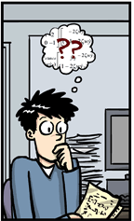
What do I do?
GTAs will lead discussion sections and labs
Mostly expected to do grading, and attend lectures and TA meetings
Teach a course when assigned
Prepare for your section creating a lesson plan
Be ready to take questions about all the materials
Set rules and expectations for your classroom creating your own section syllabus (ask Prof.)
Notes:
While a faculty does most of the teaching at WSU, GTAs might also be assigned to teach a course.
Aside from teaching, GTAs do so much more depending on the needs of their department.
GTAs might also be responsible to lead discussion sections and labs.
In most classroom settings, grading student work, attending lectures and GTA meetings are the major duties of GTAs.
Teaching a class alone or assisting on a teaching a few sessions, GTAs might also be required to create their own syllabus for a course and lesson plans for their sections, or in some cases create their own section syllabus.

Slide 12
Best Approaches
Make yourself available by assigning office Hours.
Be very approachable.
Use verbal signals when you speak.
When you are preparing students for exams, give them study guides.
Notes:
It is always very good to make yourself available to your students. You can do that by assigning office hours; students do not always come to office hours, but it is always good to have one.
Be approachable and create a friendly atmosphere. Telling them about yourself, and trying to learn their names helps for that.
If English is not your first language, tell them that and urge them to ask you right away when they do not understand you. Using verbal signals might help for your communication with students.
Preparing students for exams is a key mechanism for your relationship with them. Students value their grades very much, so any effort you put to help them do well in exams means a lot for them.
Giving them study guides and sample questions will help them get prepared for the exams.

Slide 13
Asking Questions in the Classroom
Respond
Ask
To start with a yes/no question
Follow with questions that are direct, clear, and specific.
Do not ask more than one question at once
Wait for students to think and formulate responses;
Do not interrupt students’ answers;
Show that you are interested in students’ answers, whether right or wrong;
Develop responses that keep students thinking.
Source: https://teachingcenter.wustl.edu/resources/teaching- methods/participation/asking-questions-to-improve-learning/
Notes:
In American classrooms, students ask many questions and classes are very interactive.
The instructor is expected to ask questions to follow up how well the content is learned.
It is recommended that questions are direct, clear and specific to the topic taught. Also, do not ask more than one question at a time.
After asking a question, it is always good to give students some time to think, and never interrupt their answer.

Slide 14
Responding to Students’ Questions in Classroom
Positive Feedback for a Correct Response, Comment, or Appropriate Question:
Scenario 1:
GTA is lecturing on balancing chemical reactions, and a student asks, "Can we change the subscript to get the equation to balance?“
Although you know that it is a major misconception in balancing, you should address the question carefully.
Notes:
Students ask many questions and are open for discussions.
Although the instructor is the person with authority, students could question, or challenge the instructor.
You might observe common misconceptions in your class and may be questioned and challenged on it.
Make sure you give positive feedback for students’ questions, comments, or responses.

Slide 15
Scenario 1: Option 1
“Thanks for bringing that up. The question was, can we change the subscript to get the equation to balance?' Does anyone think they know the answer?”
'Thanks' validates student participation.
Restating the question for the class ensures that everyone can hear what was asked.
Passing the question on to the whole class encourages participation.
Notes:
You can address a question in different ways.
One option is: avoid pointing to the student’s misconceptions.
Always appreciate students for asking questions, and validate their question.
Make sure the rest of the class heard the question, and pass it to them. Doing so encourages participation.

Slide 16
Scenario 1: Option 2
“Interesting question. The question was ‘can we change the subscript to get the equation to balance?' In fact, changing the subscript instead of the coefficient changes the molecule as a whole. For example, …
Starting with a positive response validates student participation.
Restates the question for the class so everyone can hear.
Allows the GTA to move into a lecture-style format and present additional information.
Notes:
Another option to respond to this question is, again validating the student’s question, restating the question. And show them the right way of balancing the equation.
This leads to a lecture that might clear the student’s misconception.

Slide 17
Scenario 1: Option 3
“Good question. The question was ‘can we change the subscript to get the equation to balance?' I believe this question requires that all sections we've talked about be considered, but I am not sure. I will look into it and let you know by email. In the meantime, is there anyone else who knows?"
Positive response.
Restates the question for the class so everyone can hear.
Admits the GTA does not know the answer (honest response) and demonstrates accountability.
Passes the question on to the class for group participation.
Notes:
You might not have the answer for a student’s question on the spot. That is absolutely okay!
You still need to acknowledge the question, and restate it for the rest of the class.
Be honest, admit that you do not know the answer, pass it for the class.
Tell the student that you will look into it and make sure you get the solution for the student.

Slide 18
Asking Question to Students in Classroom
Positive Feedback for an Incorrect Response, Comment, or Appropriate Question:
Scenario 2:
In a Biology class the TA asks: "Who can tell me what distinguishes an animal cell from a plant cell?"
A student responds, "Well, I don't think a plant cell has a cell wall" (an incorrect response).
Sources:http://www.uwo.ca/tsc/resources/resources_graduate_students/ta_handbook/giving_effective_feedback/suggestions_verbal_feedback.html
Notes:
Questions and answers are common in American classrooms.
You might ask a question in a class and get an incorrect response.
Whenever students respond for a question, it is always good to acknowledge their attempt even if the answer is wrong.
Try to avoid emphasizing on students’ mistakes, rather show them the way to rethink about the question in a different way.

Slide 19
Scenario 2: Option 1
OK, let's take a step back first. Who remembers the characteristics of a plant cell from last week?"
Does not emphasize the student's mistake.
Serves as a way to review and consider recent material.
Notes:
You can also use a different approach to address a scenario where a student responded wrong.
Even though you know the response is not correct, do not emphasize the student’s mistake.
Rather, use it to review course materials and lead the student to the correct answer.

Slide 20
Scenario 2: Option 2
“No, that is not quite right. One of these cells has a wall while the other does not. Can you remember what distinguishes the two?"
Encouraging feedback that does not alienate the student.
Restates the student's response and clarifies what is incorrect.
Uses the incorrect response as a chance to compare two concepts and to review other material.
Notes:
Or you can mention that the response is not correct and use it as an opportunity to compare the two concepts and review other materials.

Slide 21
THE AMERICAN CLASSROOM CULTURE
How is it different?
Notes:
Let’s discuss about the American classroom culture in greater depth.

Slide 22
Transition: Understanding The American Classroom Within U.S. Culture
U.S. education is more like a business serving customers. Students pay a lot of money for tuition, housing, meals, and other fees.
Students, as customers paying for a service, will be evaluating the service they are receiving for their money.
The American classroom is less formal than many other classroom cultures.
That means: Do evaluations! (≠ “assessments”). Your students’ voice is key.
Notes:
Students in American universities and colleges are like business customers. As instructors, you are expected to satisfy their needs. They would challenge instructors for missed classes, grades, deadline extensions, and so many other issues; and you need to address the issues fairly.
To keep truck of your teaching, take advantage of evaluations, formal semester-end ones or informal ones. Student evaluation is a very important part of your work.
Also, be prepared to the informality of American students. Do not consider it as lack of respect or as an attitude.

Slide 23
The “W” Curve
“Tourist phase”. Initial euphoria
“Rejection phase”, elements of the new culture begin to intrude into your life. You might experience frustration, anger, or loneliness.
“Adaptation phase”, you learn to adapt to and appreciate the local ways.
“Local expert phase”, you feel at home and truly enjoy the country and culture: Biculturalism.
Counter-culture shock when you go home.
Re-adjustment.
Notes:
Getting through the new culture is like riding up and down on a W curve.
At first you are in a tourist mood that you are so excited. When you find things not going the way you imagined, or face rejection, you might experience frustration, anger and loneliness.
You will find coping strategies and beat it up, get accustomed to the new culture. You will be up in the curve until the new culture clashes with the home culture.
The curve goes down again with the culture conflict. Good thing, you will find a way to deal with the cultural difference, and adjust to the situation that will bring the curve up again.

Slide 24
Keep the Curve Up
To make the roller coaster ride as smooth as possible:
Be flexible, keep an open-mind.
Keep a sense of humor, and learn to laugh at yourself.
Notes:
To make the roller coaster ride as smooth as possible and to keep the curve up, you need to be flexible and open minded.
Also, keep a sense of humor and learn to laugh at yourself.

Slide 25
Relationships 101:
Friendship
American friendship type: “We'll do lunch." Avoiding awkward situation at any cost.
Once school starts, people tend to prioritize their work; they’ll only have time for a handful of friends.
Other secondary “friendships” are usually
kept in case for networking.
It would be better for you to meet people outside of your campus bubble!
Notes:
If you need to build friendship with students, you need to avoid awkward situations at any cost. For example, while it is okay to have dinner with students, it is really not good to get drunk with them.
Students might invite you for a party; if you do not want to go, it is okay to tell them that you can’t be there.
GTAs, do not forget that you are also a student; once school starts, you need to prioritize your work and will only have time for selected friends.
In fact, you will get newer information about your city, or environment in general, when you meet people outside of your campus bubble.

Slide 26
Relationships 101: Professional Life
Usually informal with hierarchy, first-name basis. You can use this or not in your classroom. Establish early on what you want to go by.
Key word for student/GTA relationship: amicable. Remember you have the power to give grades.
Avoid conflicts of interests and always stay professional. You represent the department you work for. You represent the school in general.
Notes:
Early on in your introduction, tell the students your name, and emphasize on what you want to be addressed as.
Be friendly, but have boundaries to your relationship with students. Never forget that you have the power to give grades and your relationships with students shouldn’t affect your grading, positively or negatively.
Always stay professional and remember that you represent the department and the school you work for.

Slide 27
Relationships 101:
Personal Life
Public displays of affection, and personal space.
Most American millennials you may encounter tend to see dating as casual and open-ended. Exclusivity is not required nor is it the norm.
Yes means yes.
No means no.
Notes:
You need to be careful of your public displays of affection. Your norm and value for dating might be different from people around you, including your students.
It is always important to understand the binding rule: Yes means yes, and no means no.

Slide 28
Finances 101
If you plan on staying in the U.S. long-term and eventually buying a car or a house here, you’ll need to start building credit.
The Office for Student Money Management at Wichita State University will assist you with your needs on building good credit.
Notes:
Building credits is one most important thing in the American life style. If you plan on staying in the United States long term, is better to start building credit early.
Find help from the Office for Student Money Management in campus or from your colleagues about how and where to start establishing good credit.

Slide 29
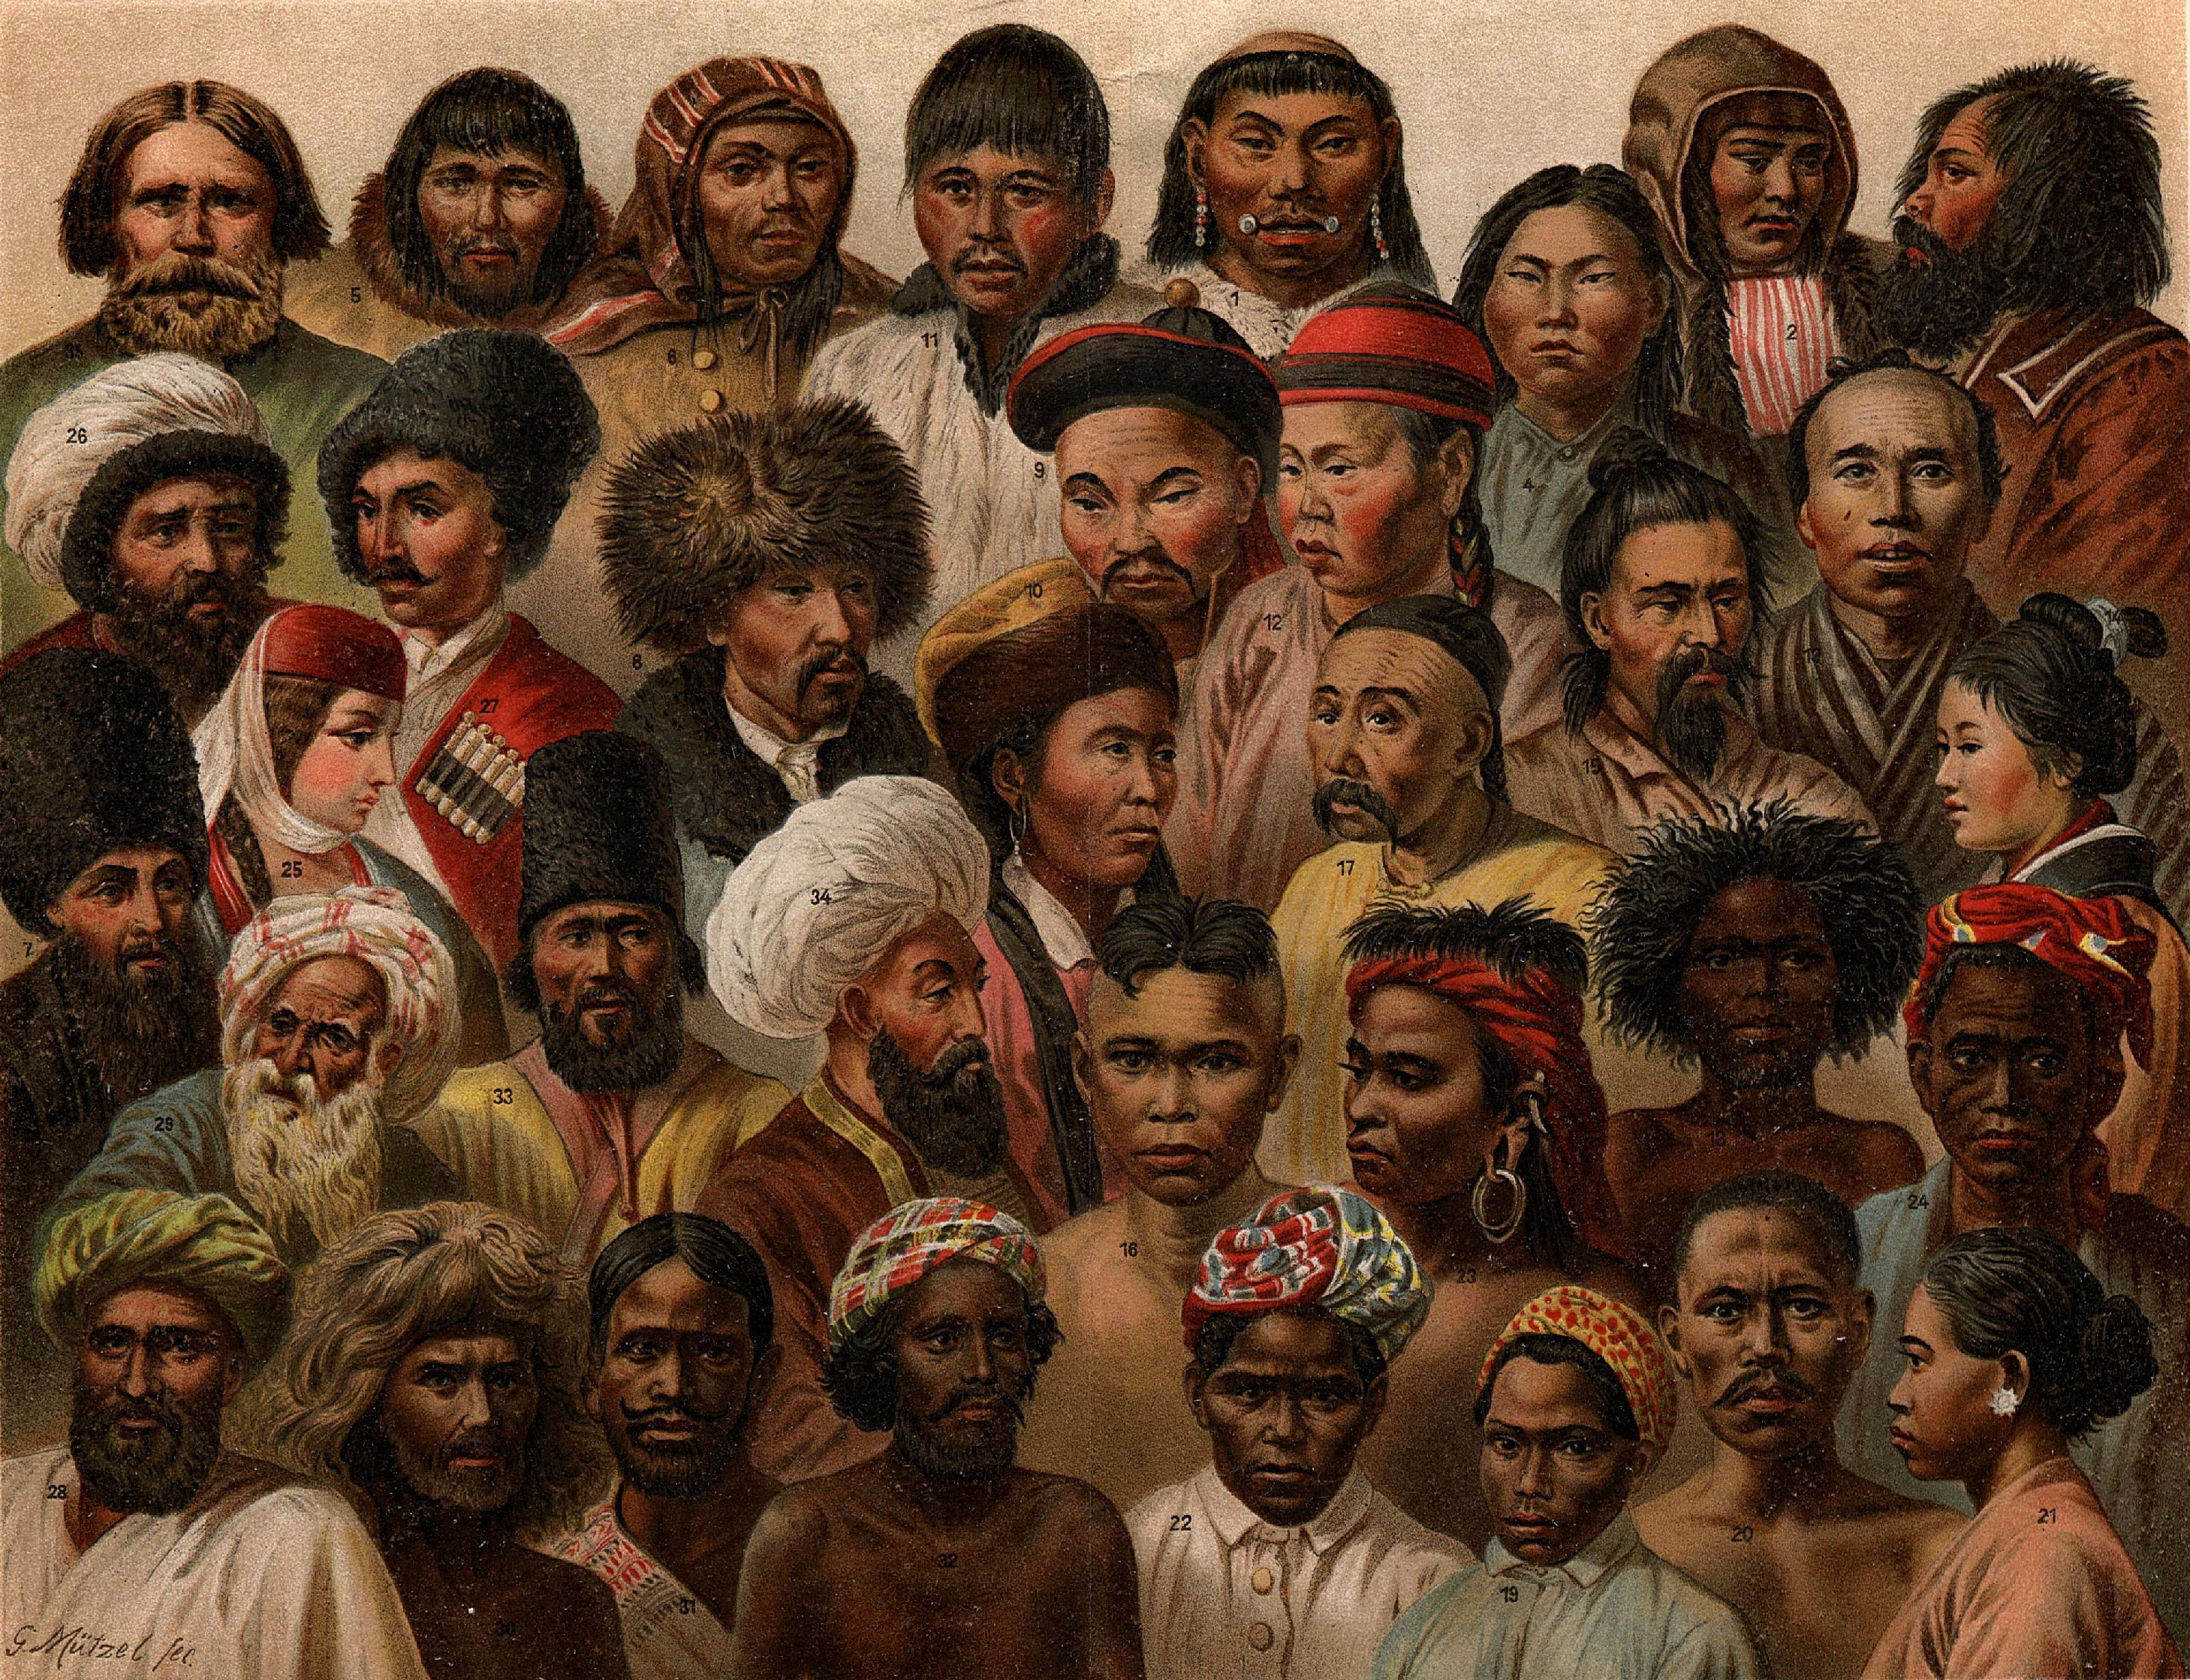
Be Aware of Cultural Differences
Key concept: Safe place in the classroom and on campus.
Diversity is about:
Recognition of identity and of historical traumas
Representation of self and multitude
Redistribution of resources and opportunities
Notes:
Be aware of cultural differences. American classrooms are more diverse than classes in most other nations.
Make sure to make your classroom a safe space for all learners and anyone involved in it.
Consider the diversity of your students and recognize their identity and historical traumas whenever necessary.
Acknowledge students representing themselves and multitude.

Slide 30
Always Remember: They Chose You
You made it here for a reason!
GTSs: Although your jobs is all about the students, YOU are here primarily to get your degree.
New faculty: Although your job as a new faculty has a lot to do with students, YOU have other responsibilities (research/service)
Put your work first, but don’t let your students down.
Make the most out of the resources available in campus as well as the opportunities coming your way.
Good luck!
Notes:
Always remember the university chose you for a reason. GTAS, do not forget that you are here first to earn your degree. Even faculties have more responsibilities than classroom teaching;
Put your work first, but don’t let your students down.
There are different opportunities in the university to build your career: trainings, workshops, support groups and the like. Try to learn about them and get engaged in the ones that suit your interests.
Also, there are awards, and fellowships that you could compete to. Seek for information about all such opportunities and prepare yourselves to compete in the ones that are appropriate for your field. Department offices, dean offices and the graduate school will have relevant information about such opportunities.

Slide 31
Thank you!
Questions or Comments?
Notes:
Good luck with the new academic year, and if you have questions, or comments, the floor is yours!

Slide 32
Reference Books
Ross, C. and Dunphy, J. (2007). Strategies for Teaching Assistant and International Teaching Assistant Development: Beyond Micro Teaching. Jossey-Bass, San Fransisco.
Sarkisan, E. (2006). Teaching American Students: A guide for International Faculty and Teaching Assistants in Colleges and Universities, 3rd ed. Derk Bob Center for Teaching and Learning, Massachusetts.

