Slide 1
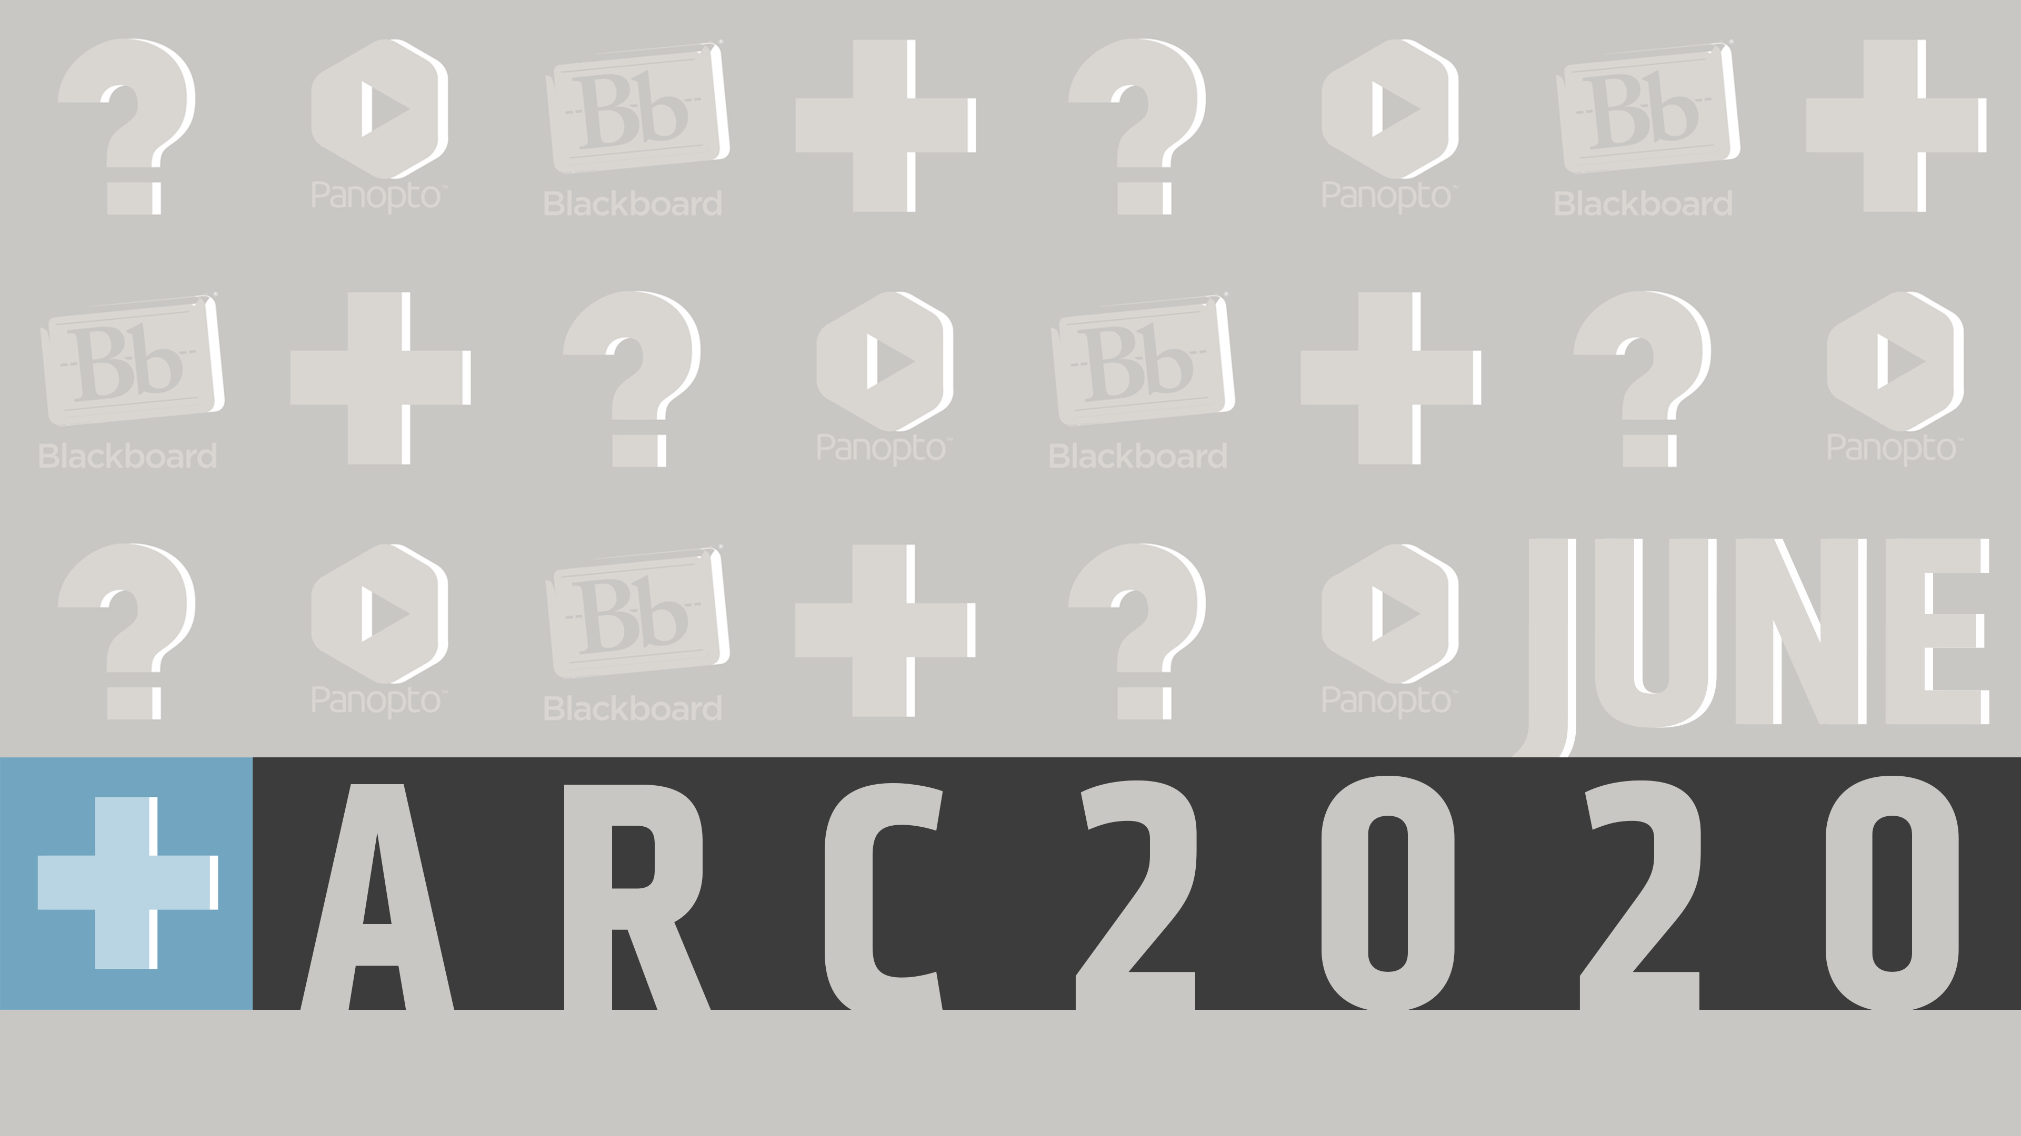
Online proctoring options at wsu
Online Proctoring Options at Wichita State
Notes:
Hello, my name is Mark Porcaro and I am the Executive Director of Online Learning. In this presentation, I want to talk to you about the proctoring options for distance exams at Wichita State University

Slide 2
Topics
Improving Test Integrity
Requirements for all remote proctoring
Proctoring Options without a Cost to Students
Proctoring Options with Cost to Students
Notes:
During our time together I want to introduce you to a few ideas that we hope will set you on a successful path to maintaining integrity in your assessment practice.
First, I’d like to discuss some concepts about improving test integrity.
Second, I want to make sure that you understand what requirements your students and you have with remote proctoring.
Third and fourth, I will discuss the no-cost-to-student and student-paid options for proctoring.

Slide 3
Test Integrity Online
Work toward “Authentic Assessment”
Differentiate between formative and summative assessment
Use Blackboard test settings to discourage cheating
https://www.wichita.edu/services/mrc/instructional_technology/Respondus/onlinetestintegrity.php
Notes:
One of the questions all instructors have when going online is, "How can I make sure my students don't cheat on my tests?" Instead of focusing on "cheating" since that is a behavior we cannot directly control, Instructional Design and Access focuses instead on the concept of "test integrity." Test integrity is something that instructors can control directly. You can improve test integrity in our Blackboard environment in the following ways:
*Work Toward "Authentic Assessment": The concept of Authentic Assessment comes from the late 1980s and early 1990s and is particularly associated with the work of Grant Wiggins. The goal of authentic assessment is to create an assessment of learning that requires students to apply concepts to real-world examples.
*Differentiate Between Formative and Summative Assessment Opportunities: There is a difference between tests/quizzes that provide data about how a student is developing in your class ("formative" assessments) tests/quizzes that provide data about what information a student has mastered in your course ("summative" assessments). Formative assessments are often most effective when they can be redone until the student has reached mastery for a particular concept. If you create a series of "low stakes" quizzes that students can retake until they master the knowledge or skills covered by the quiz, you do not need to use proctoring for these quizzes. You may still consider proctoring for summative assessment events such as midterms and final exams.
*Use your Blackboard Test Settings to Discourage Cheating: Blackboard has many test settings that can make it much more difficult for students to cheat, but not all settings are intuitive. Some strategies include things like, never use “Force Completion” in Blackboard, setting a timer for your test, requiring a password, randomizing answers and questions, especially with a test pool.
For a greater discussion of these and other strategies, see the link at the bottom of the slide.

Slide 4
Requirements for All Remote Proctoring
Students
Faculty
Working webcam and microphone
Download and install software on their computer
Disable or alter various settings on their computer
Troubleshoot audio or video options, often on their own
Access to desktop or laptop. No mobile device or Chromebook.
Set up software ahead of time
Private, quiet, and enclosed space
Paid options MUST be in the syllabus ahead of time (ProctorU)
Use Blackboard to set up record and review exams (Respondus and ProctorU Review+)
Schedule exams with proctoring service at least 2 weeks in advance of due date for live proctoring (ProctorU Live+)
Webcam and microphone (Zoom)
Monitor that can show details from video (recorded or live)
https://www.wichita.edu/services/mrc/instructional_technology/Respondus/proctoringoptions.php
Notes:
Regardless which of the remote proctoring options you choose, to use them, students must have certain hardware and be able to download software. The following requirements must be listed in your syllabus.
In order to use required proctoring in this course, all students must:
have a working webcam and microphone
be able to download and install software on their computer
be able to disable or alter various settings on their computer
be able to troubleshoot audio or video options, often on their own
have access to a desktop or laptop computer. Proctoring will not work on a mobile device or Chromebook.
set up any software ahead of their exam time – recommended one business day before in case they need additional support troubleshooting issues or finding a different option
be in a private, quiet, and enclosed space. If the system or a live proctor detects extra noise or people, it may flag that exam erroneously.
Faculty need to consider that if you require students to pay for a proctoring solution for your course, you MUST indicate that in the syllabus. If you are using a record and review option (we’ll discuss these shortly), then you’ll set those up in Blackboard. You need to be familiar yourself with how those tools work in Blackboard. If you need a paid live proctoring solution, you need to schedule that exam at least two-weeks prior to your due date with the service. If not, you may not be able to get it scheduled and you may force students to have to pay additional fees for last-minute scheduling.
If you are going to use webconferencing to proctor yourself, then you need to ensure that you have a working webcam and microphone with a monitor sufficient enough to see details.
For more information about the requirements and proctoring options, follow the link at the bottom of this slide.

Slide 5
Proctoring Options without Cost to Students
No cost
Dept. or College Pays
Respondus
  LockDown Browser
  Monitor
Zoom Proctoring
ProctorU
  Review+ $10/exam
  Live+ $18+/exam
Respondus information webpage
Zoom Proctoring webpage
Notes:
Whether you decide to require proctoring once the semester is underway or you simply prefer to have options that do not require students to pay extra for proctoring, there are two good no-cost online proctoring options for you to consider.
Respondus LockDown Browser (with or without) Monitor: With this software, students are unable to leave the browser window that contains their test. Adding the Monitor feature allows for student identity checking and also leverages artificial intelligence to flag suspected cheating behaviors. There is no live proctor with this option. For more information about Respondus LockDown Browser and Monitor, please review our Respondus webpage. You can find this link at the bottom of this page.
Zoom Proctoring: A faculty member, graduate student, or other person serving as a proctor can monitor their students taking live exams using the Zoom platform. If you are interested in using Zoom to proctor your students, please review our Zoom Proctoring webpage.
If your department has funds, it is possible for the university to be charged for proctoring offered by ProctorU instead of the student. If you have questions about that option, please contact the Office of Online Learning or Testing Services.

Slide 6
Proctoring Options with Cost to Student - ProctorU
Live
Record and Review
ProctorU Live+
  $18/1 hr
  $25/2 hr
  Scheduling <72hrs additional fees apply
Covers:
  ID check
  Webcam AND screen
  Microphone
  Room environment scan (with mirror or movable camera/computer)
ProctorU Review+
  $10/exam regardless of length
  No scheduling required
Covers:
  Image of ID and face
  Webcam and screen
  Microphone
  Live proctor reviews recording
Notes:
If you are going to offer proctoring but the students are responsible to pay the fees, then you must disclose this in your syllabus at the beginning of the term. You cannot add paid proctoring options once the course is underway. We also recommend that you limit the use of student-paid proctoring to one or two exams as the costs can become prohibitive.
If you need live proctoring, we currently use ProctorU’s Live+ service. The fees are $18 for a one-hour scheduled exam, and $25 for a two-hour scheduled exam. That means that if you schedule two hours for proctoring that the students will pay $25 even if it takes them 30 minutes. Every Live+ proctoring session must be scheduled. If a student does so more than 72 hours in advance, there are no additional fees. Less than that and there are fees that will make the cost double or triple.
Live+ proctoring will do a live ID verification (as well as an ID verification test for domestic students that is similar to the one that banks use), and it utilizes a plugin that monitors and records the screen, webcam, and microphone. They ask students to demonstrate the testing environment and may pause the student if they notice anomalies in the environment such as noises, constantly looking away from the computer, etc. At that point, they will ask for an environmental scan. They may also ask the student to remove any unapproved items from the testing area. They will not stop a student from taking an exam, even if they notice blatant cheating. Instead, they will note what they observed and send a report to the faculty member.
There is a record and review only option also available from ProctorU. It costs $10 per exam regardless of the length and because it is set up using a link in Blackboard, it requires no advanced scheduling for students. However, it doesn’t connect the student to any live proctor, it will ask for them to provide an image capture of their ID and face, prior to the exam and it will monitor their webcam, screen, and microphone. The recordings are reviewed first by artificial intelligence that flags them and then those are reviewed by a human proctor. If there is a legitimate cause for concern, that flag is reported to the faculty.
For either of these options, there is the possibility to have your department or college pay instead of the student. This must be approved by the Budget Officer and Budget Review Officer before you do this, so that you don’t have a surprise charge from the Online Learning after the exam was administered.

Slide 7
Support
MRC
Testing Services
Training
Troubleshooting
IDA@wichita.edu
Scheduling live proctoring
testingcenter@wichita.edu
Notes:
If you need support you can of course go to the websites mentioned in this presentation. But if you need further help, you can contact the MRC’s IDA team at IDA@wichita.edu and they will be glad to support you with training or troubleshooting your technology and pedagogical needs.
If you need to schedule a live exam at a distance, contact Testing Services at testingcenter@wichita.edu and tell them you need to schedule distance proctoring via them, ProctorU or an authorized testing center.
If you have questions about new proctoring needs, or university policies and procedures for distance learning and assessment, contact me at the information listed in the next slide.

Slide 8
Questions?
Mark Porcaro
Executive Director of Online Learning
316-978-7787
mark.porcaro@wichita.edu
Notes:
For those of you who are participating live, I will now open it up to questions.
If you are watching this as a recording or have any further questions about the information in this presentation, I welcome you to contact me by phone at 316-978-7787 or email: Mark with a “k”, dot P as in papa, O-R, C as in Charlie, A-R-O at wichita.edu.
Thank you.

