Slide 1
Notes:
Welcome to the academic resources conference 2020 at Wichita State University

Slide 2
IDA’s Course Set-Up Series
Notes:
This session covers instructional design and accesses course set up series for the fall semester 2020 at Wichita State University. this is Carolyn Spear. I’m the manager of instruction design

Slide 3
Agenda
Course availability
Course set-up service
Labs service
Next steps
Notes:
In this session we will discuss blackboard course availability, IDA’s course set up service, IDA’S labs service, and your next steps.

Slide 4
Course availability
Normal times
“New Normal” times
Spawn in Bb 30 days before start of term
DEV shells available through IDA@Wichita.edu
Set-up help largely limited to fully online
Spawn as soon as possible
DEV shells also available if needed
Set-up offered to anyone
Notes:
During normal times, courses become available in blackboard 30 days before the start of the term. This is set to offer professors time to set up their classes but not so much time that we invite technical problems with the course of shells. Professors who want to set up their courses earlier during normal times can request a development shell by emailing I DA@Wichita.edu. Instructional design and access does do some course set up help during normal times but typically this help is limited to fully online courses. In an effort to ensure that all instructors are prepared for our less than normal Times now, we have made some changes. We have set up blackboard courses to become available as soon as technically possible. While this is an advantage for many professors, it can lead to some technical problems that we will attempt to fix for you on the backside. Even though courses are now available earlier, professors can also requested development shell if needed. Right now, instructional design and access is also offering to do some course set up in blackboard for anyone who requests the service.

Slide 5
Course set-up service
Three “packages”:
Basic package
Basic package with file uploads
Extended package (All of the above plus more choice about look-and-feel)
Notes:
The course set up that Wichita State is currently offering is divided roughly into three different packages. Anyone requesting the core set up Service can request any of these packages. There is a basic package, the basic package with file uploads, and the extended package.

Slide 6
Basic package
Notes:
The basic package includes an information link in the main menu that takes students to an instructor introduction area, he syllabus area, he schedule area, some WSU remote learner trainings, and some care team information. There is also a content link that takes students to a list of folders for quest content with one folder per week, unit, or module that is available in the course. Each of these folders will have an organizer area where instructors can provide instruction about what to do and went to do it in each module. The basic package also includes an entry banner with the WSU graphic chosen to fit with your course content as well as possible. Courses that are set up using this service will enter on the announcements page. There will also be an ask the professor I’m greeted discussion forum set up where students can post questions to the professor. All unnecessary and unused course elements will be deleted or hidden as is appropriate.

Slide 7
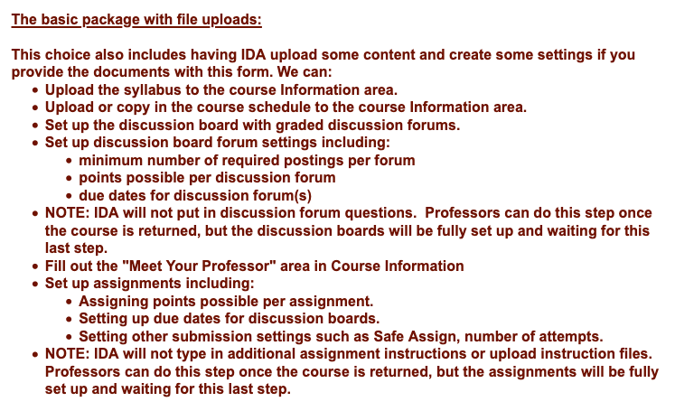
Basic package plus file uploads
Notes:
The basic package with file uploads includes all of the elements of the basic package also includes the files associated with many of the areas that are set up with the basic package. For example, not only would there be a syllabus area, but we would also upload the syllabus document if it is provided to us. there are many options for different kinds of files.

Slide 8
Extended package
Notes:
The extended package includes the basic package plus file uploads, and also options for additional information to be added to the course. For example, you have the option to add information about zoom in your course through the extended package. Looks to the package also offers professors many more choices for customizing the look and feel of their course.

Slide 9
Let’s take a look
https://wichitastate.co1.qualtrics.com/jfe/form/SV_cD7gyJ2oKJuOaeF
Notes:
In order to request for service professors must fill out a rather extensive online survey. The survey can be found at: https://wichitastate.co1.qualtrics.com/jfe/form/SV_cD7gyJ2oKJuOaeF

Slide 10
To be successful with the service
Have as many of your course documents ready as possible
Know if you will have assignments, discussion boards, etc.
Be ready to make many small decisions
Notes:
There are some things that professors should do in order to maximize this service. For example, have as many course documents as ready as possible when you fill out the survey. Know ahead of time if you were going to have assignments in your courses and if so how much each assignment is worth. The same is true for discussion boards. Although this service does not extend to uploading assignment files themselves, we will set up the assignment areas for you and all that will be left for you to do is to type in the assignment itself. Also, when it is time to fill out the survey, allow enough time so that you can work through many small decisions at one time. Don’t plan to rush through this survey, as doing so Will lead you to skip many options that might be useful to you later.

Slide 11
Next steps
Send questions to Instructional Design and Access at IDA@Wichita.edu
Attend our Zoom-based labs most weeks from 1:00pm-3:30pm Tuesday, Wednesday, and Thursday
Download/bookmark the Bb Instructor Guide: https://Wichita.edu/BbGuide
Notes:
After you fill out your course survey and you get your course set up completed. You can send your questions to instructional design and access at the email address ida@Wichita.edu. You are also invited to attend our Zoom based labs which run most weeks from 1 o’clock to 330 in the afternoon on Tuesday, Wednesday, and Thursday. We also strongly encourage you to download the blackboard instructor guide found at this web address: https://Wichita.edu/BbGuide

Slide 12
Thank you IDA@Wichita.edu
Notes:
Thank you very much for your kind attention. If you have any questions about this presentation or anything else related to instruction at Wichita State, please email instructional design and access at ida@Wichita.edu

