Slide 1
TITLE
Notes:
Welcome to this training, which is part of the Academic Resources Conference at Wichita State University.

Slide 2
Intermediate Blackboard
Notes:
Today we are going to discuss some intermediate blackboard skills. There are more trainings available to you at the web address Wichita.edu/BbTraining as well.

Slide 3
Agenda
Linking video
Discussion boards
Assignments
Grading assignments
My Grades
Notes:
In this training we are going to discuss linking video into classes, how to create and subscribe to discussion boards, setting up assignments using the assignments. Tool, grading assignments, and how students see their grades.

Slide 4
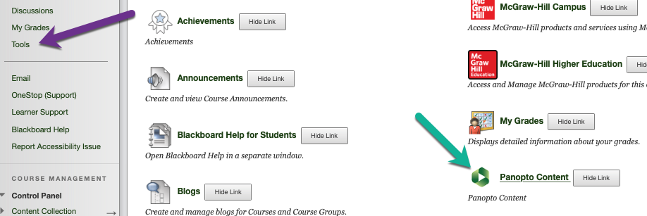
Linking video
Video must be linked in, not uploaded
Web link to YouTube
Panopto
Notes:
Video is a common type of content in many online and flipped classes as well as in organizations. But it is very important that instructors do not attempt to upload video files such as MP4’s and MOV files directly to Blackboard. Blackboard is not a video hosting platform, and while it will technically allow the uploading of these files, the size of all video files is such that classes that contain them are very prone to technical problems and crashing. In addition students are forced to download these large video files onto their own devices to view them, and that is often impossible. Instead, you should upload your video files to a video hosting platform. WSU uses Panopto for video capture, editing, and hosting, and if you already have videos that you have created you can upload them right into panopto. Panotpto is another training entirely, but all classes do contain a link to the Panopto tool in the tools area. You are also free to use YouTube to host your videos.

Slide 5
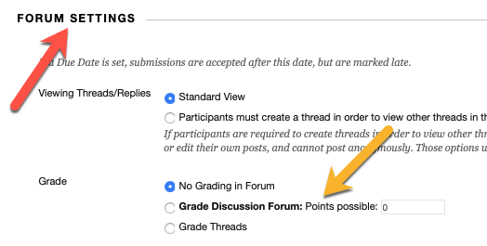
Discussion boards
Discussions can be useful!
Adding points adds them to the Grade Center
Notes:
Discussion boards get a bad rap sometimes, but the discussion tool in blackboard is very useful. Like other assignment-style activities, the discussion board can be set up to have points associated with it. If you add points to a discussion board when you set up the forum, you will get a new column in your grade book. It is important to add points to a discussion when you set up the forum if you think that you want it to be graded. Once there are discussion board postings in it, you can’t change it from ungraded to graded. So make sure to assign point values when you set up your forums.

Slide 6
Subscribing to discussions
Subscribing to discussions can make running your class easier
Notes:
Another useful feature of the discussions tool and blackboard is the professor’s ability to subscribe to a forum. If you set up an ask the professor discussion forum IDA strongly encourages you to subscribe to it. Any time a student posts in that discussion forum, you will receive an email notification to your Wichita State email account. Be careful subscribing to discussion forums because active forms will end up sending you many emails!

Slide 7
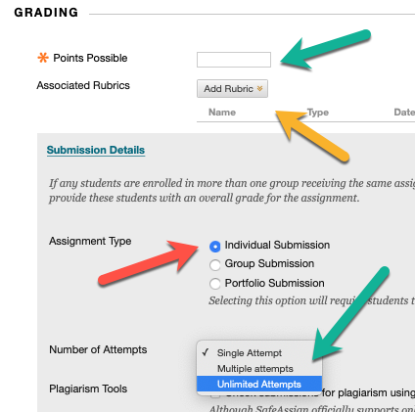
Assignments
Add your assignments with the tool!
Adds to the Grade Center
Consider allowing multiple attempts
Notes:
In many ways, the assignments tool in blackboard maybe the most useful tool for professors. Once you learn how to use the assignments to unlock the full potential of both the grade book and of the grading tools also. It can be tempting to upload your assignments as items and ask your students to email you their assignments. But that is a mistake long-term. Instead, learn to use the assignment stool! You can find the assignments tool under the assessments button in any content area of blackboard. One critical thing to consider when you set up assignments is making sure you assign points possible, even if you don’t want your assignment to be worth any points. You can assignment zero points if you like. Most assignments in blackboard our individual submissions, but you can assign groups assignments to if you would like. A good tip is to allow for multiple attempts for each assignment rather than a single attempt. Blackboard defaults to single attempts, but Multiple attempts will help your students if they have technical problems with their upload. If you allow multiple attempts, you are less likely to have technical problems with your assignments.

Slide 8
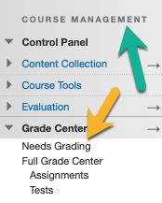
Grading assignments
Needs Graded allows you to organize grading
Notes:
If you use the assignments tool, you will be able to use Blackboard’s grading tools as well. Blackboard will organize all of your assignments that need to be graded in an area called “needs grading” under the Grade Center link in the Course Management area of your class. Once you click on “needs grading” you will have a number of options for accessing your assignments, and most assignment types come with grading tools that allow you to markup papers, add comments, and fill out rubrics if you have added them.

Slide 9
My Grades
Professors can’t see “my grades”
Look at your class as a student
Notes:
Students can see the grades and comments that you provide by going to the area called my grades. As a professor, you do not have access to the my grades panel unless you enter student view first. To enter the student view of your class, click on the eyeball icon towards the top right of your screen next to the edit mode. Once you enter student view, you can click on the my grades link and see what your students see in their grading area. Students will be able to see the Assignments that have zero points required and also the Assignments that are worth regular point values. To exit Student view, simply click “exit student view” and click okay. Typically, you need to accept the default settings when you exit that view.

Slide 10
Next steps
Practice! Request a development shell if needed
Blackboard advanced has several options by topic
Longer video trainings are available online at Wichita.edu/BbTraining
Download or bookmark our Blackboard Instructor Guide and training pages from the same webpage
Notes:
You have several next steps. If you don’t have a Blackboard shell to use to practice on, send a request to IDA@Wichita.edu, and IDA will make you one. Practicing is the best way to learn Blackboard. You should also continue on with your training with the Blackboard advanced training in the ARC. Those are available as a Zoom-based trainings and also as online/on-demand trainings. You should also check out Wichita.edu/BbTraining where you can find much more training and download or bookmark the Blackboard Instructor Guide.

Slide 11
Thank you!
Notes:
Thank you for attending this short Blackboard training as part of the Academic Resources Conference!

