Slide 1
TITLE
Notes:
Welcome to the Academic Resources Conference, 2020.

Slide 2
Introduction to Blackboard
Notes:
This is the short introduction to Blackboard provided to you by the Instructional Design and Access team.

Slide 3
Today’s agenda
Finding classes
Availability
Announcements
Items
File uploads

Slide 4
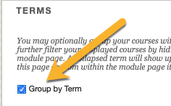
Finding your classes
Blackboard.Wichita.edu
Choose My Courses
Organize your classes by term
Click on titles to enter
Notes:
Login to Blackboard by going to the site directly when possible. Type in blackboard.Wichita.edu
Courses can be found in the “my courses” area
Organize your courses by term to find them more easily: Click on the gear icon in the ribbon where it says “my Courses” on your screen, click “Group by Term” so there is a check in the box, then return to your normal view. Your courses will now be organized by term.
To enter any particular course, click on its title.

Slide 5
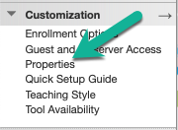
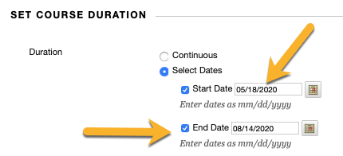
Availability of Blackboard classes
All classes available at least 30 days before the start of a term
You can request a development shell earlier if you need
You can change the dates of your class to open and close at different times
Notes:
Classes in Bb are available at least 30 days before the start of any term, and this includes presession. This year, fall 2020 classes are available as of June 9, 2020, so you should be seeing them soon if not already. If you do not see a Blackboard shell for a class you know you are teaching, contact your department first. You might not be accurately listed as instructor of record in Banner.
You can always request a development shell for your classes if you want. This is a blank Blackboard area where you can build your class, and then you can copy that course into your live Blackboard shell when it becomes available. Students are never enrolled in development shells.
Once you have your Blackboard course, you can change its availability for students. To do that, go to “customization” in the Course management area of your class and choose “properties.” There you can change the start and end dates of your class. Start dates can never be set to after the first day of class, but they can be the first day of class. If you need the class to be open longer than is typical, perhaps because of a student working on an incomplete, you can also make that change here. Please never set your class to “unavailable” specifically, just use the dates to change the availability. By using the dates this way, your students will still see the link to your class in their Blackboard shells, but the link will not be clickable until the date you have indicated.

Slide 6
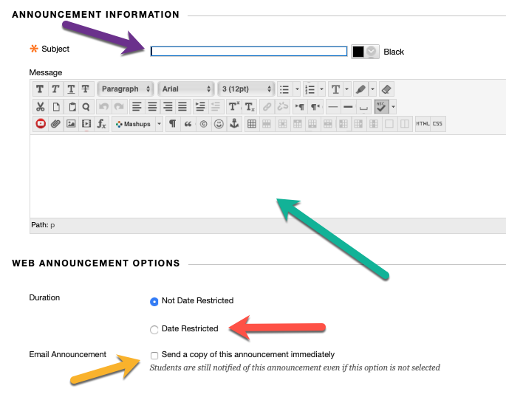
Announcements
Announcements add “presence” to your class
Efficient way to email
Can be scheduled, but don’t combine with email!
Notes:
Announcements are an excellent way to add “presence” to your class. Presence is simply the feeling students get about you and your course activity. If your students are aware that you have come to class by seeing you do things in it, they feel like you are there, and their satisfaction with the experience goes up.
To post an announcement, click “create announcement” on your landing page. If you do not see that button, make sure that the “edit mode” is turned on. You can find the edit mode in the upper right of your screen.
Once you choose “create announcement” you should fill out the subject and message areas of your announcement first. This is the text that your students will see.
You can choose to send a copy of the announcement immediately by checking the box. This will send your announcement now. If you need to go back in to this same announcement later to edit it, make sure to uncheck the email box or your students will receive multiple copies of the email!
You can set up several announcements at once by date restricting them. This is handy for things like test reminders, holiday wishes, etc. But you cannot combine the “email now” tool and the scheduling tool effectively. Even if you set an email to post later, if you choose “email now” it will email immediately. So be careful with those tools.
When you are ready to post and send your announcement, choose “submit” in the lower right corner.

Slide 7
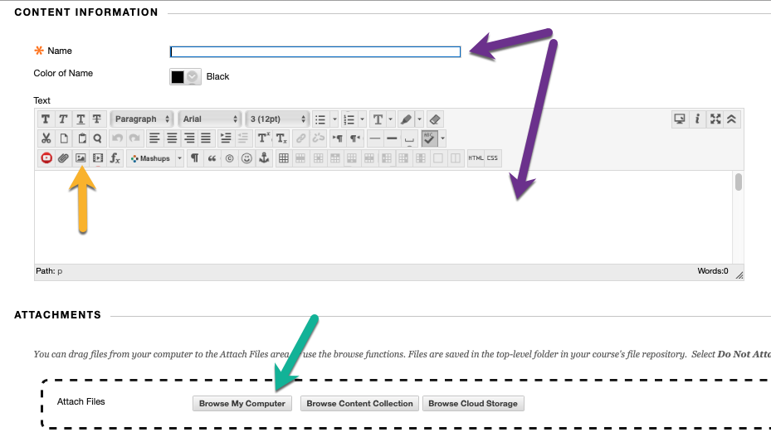
Items
Found in information and course materials
Items allow text, images, files, and web links
Reordering
Notes:
Items are the workhorse of many courses because you can write text, upload files, upload pictures, and make web links. Most items are built in content areas such as the information area, where course information like the syllabus and schedule are found, and the course materials area where the content, activities, and assessments of your course are typically found. Please note that all items need a name, and all items should have some text to accompany them. You can upload an image by clicking the image button on the bottom of the WYSIWYG editor’s ribbon, third from the left. Do not just copy in images as they will not save properly and will be deleted. You can upload files by clicking the paperclip in the editor’s ribbon or by attaching it with the buttons beneath the editor. Both work well, although you may like the way it looks better to use the attach files feature. Once you have created a set of items, you can reorder them in your content area by simply dragging and dropping. If your items do not reorder properly, put in a OneStop ticket because IDA needs to get involved with it.

Slide 8
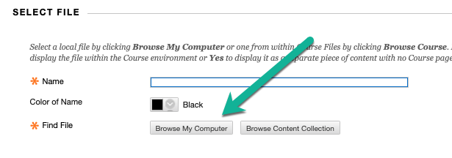
File uploads
Files can be uploaded on their own, not in an item
Useful if there is nothing you need to say about them
Notes:
As you look around in the Build Content area, you will see that you can build many kinds of links and pages, and you should practice with those. One feature in this area you should look at first is the direct file upload. You access it in Build Content right below the item link. The file upload tool allows you to upload files one at a time without any text descriptions, and that can sometimes be useful. The web links tool in this same build content area works much like the file upload tool.

Slide 9
Next steps
Practice! Request a development shell if needed
Blackboard intermediate is your next training step
Blackboard advanced has several options by topic
Download or bookmark our Blackboard Instructor Guide and training pages from Wichita.edu/BbTraining
Notes:
You have several next steps. If you don’t have a Blackboard shell to use to practice on, send a request to IDA@Wichita.edu, and IDA will make you one. Practicing is the best way to learn Blackboard. You should also continue on with your training with the Blackboard intermediate training in the ARC. That is available as a Zoom-based training and also as an online/on-demand training. You should also go to Wichita.edu/IDA and click on the “Blackboard Training” link where you can find much more training and download or bookmark the Blackboard Instructor Guide.

Slide 10
Thank you!
Notes:
Thank you for your time and attention! We hope you are enjoying your Academic Resources Training opportunities.

