Slide 1
Library Services 101: What your Library can do for you
Aaron Bowen and Maria Sclafani

Slide 2
Agenda
General questions
Library services
Librarian services
Conclusion

Slide 3
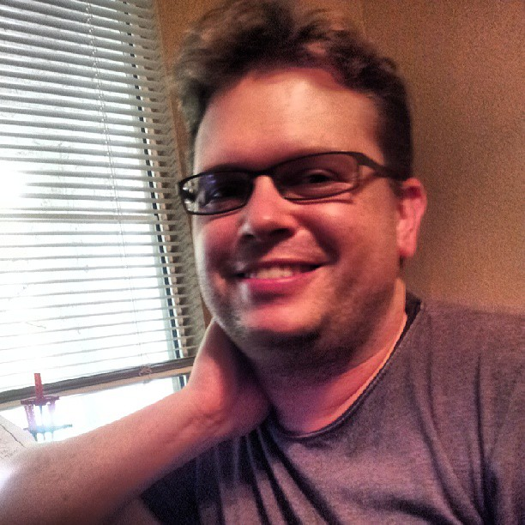
About Me: Aaron Bowen
Instruction and Research Services Librarian
Liaison to College of Health Professions, Elliott School of Communication, and Department of Psychology
Started at WSU in August 2015
Email: aaron.bowen@wichita.edu

Slide 4
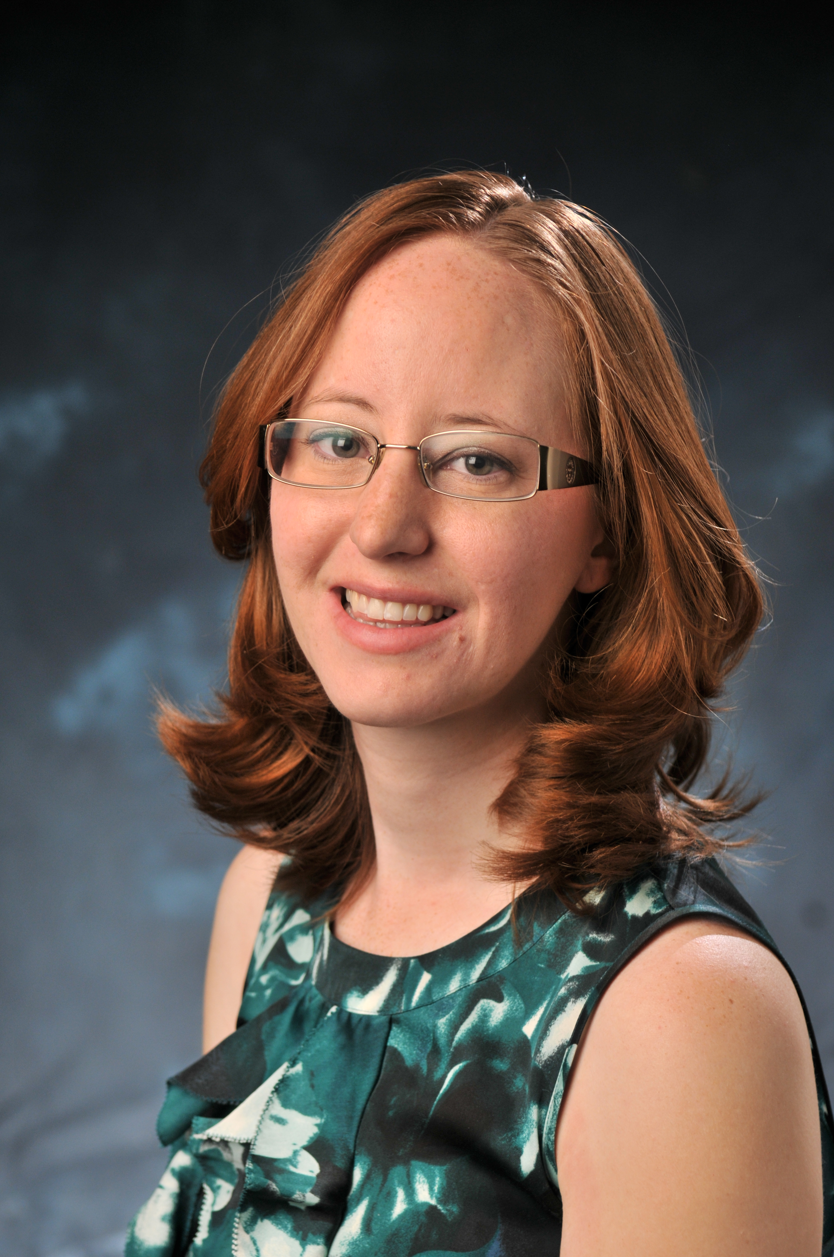
About Me: Maria Sclafani
Coordinator of Library Instructional Services and Assistant Professor
Liaison to College of Applied Studies
Started at WSU in August 2019
Email: maria.sclafani@wichita.edu

Slide 5
Some general questions about the
WSU University Libraries
Have you taken advantage of any of our library services in the past? If so, what?
What services do you imagine a university library would provide?

Slide 6
Two general questions about librarians
What are your general impressions of what librarians do?
What previous interaction have you had with us (or any other librarians)?

Slide 7
Adapting library services to COVID-19 conditions
Some library services have been reduced or modified due to the coronavirus
For the most current information on services affected by the shutdown, go here:
https://libraries.wichita.edu/covid19

Slide 8
A sample of our services relevant to you
(and to teaching your students)
Library services
Librarian services
• Our spaces
C-Space
One Button Studio
• Electronic resources in our collection
You can request textbooks or other resources
• Course & electronic reserves
Place a hold on materials, students will retrieve them so you can get them from the circulation desk holdshelf
(Online) information literacy instruction
Assignment collaboration
Curriculum mapping
Citation and altmetrics searching

Slide 9
Virtual services available to you
• Virtual research consultations
• Synchronous instruction via Zoom
Creation of digital learning objects
Creation of course or assignment guides to library research
Recording instructional videos for class
Embedded librarian in Blackboard (can support students and faculty in a variety of ways)
Savvy Researcher workshop series
For more information check out our (new!) faculty guide: https://libraries.wichita.edu/facultyguide

Slide 10
Research collaborators
Librarians were involved in at least four proposals for President Golden's Convergence Sciences Initiative. All four teams have said they would like to continue collaborating even if their proposal isn't selected to be funded.
Aaron has been an active collaborator in health science research, both as a PI and as a team member
Maria is also an active researcher
Other librarians have collaborated on similar projects

Slide 11
Questions?
Thanks for coming!
Aaron Bowen: aaron.bowen@wichita.edu
Maria Sclafani: maria.sclafani@Wichita.edu

