Slide 2
Zoom Best Practices
Notes:
Good morning—thank you all for attending this session about Best Practices for hosting Zoom meetings. My name is Ryan Corcoran, I’m the manager of Campus Media Services in the Media Resources Center, and I also have the dubious honor of being the University’s Zoom administrator for the past seven years, so I’ve been using and teaching Zoom to folks for quite a while. But, while I feel like I know a lot about Zoom, I still manage to learn new things all the time, especially seeing creative ways that faculty use the tool with their students.

Slide 3
Zoom Best Practices – Overview
Before Class If you fail to plan, plan to fail.
During Class Systematically managing the chaos.
After Class You mean there’s still stuff to do?
Notes:
Today, we’re going to look at some of the most important aspects of hosting Zoom meetings, mostly from the angle of using it for live, synchronous classes. Most of what you’ll learn today is also transferrable to professional meetings as well, but we’ll just focus on classes. We’ll start with what you need to do before class, getting the meeting started and what to do during class, and then even look at a few things to do after class is over.

Slide 4
Zoom Best Practices – Before Class
Basic vs. Licensed
Basic (1:1) | Licensed (1:1) | Feature | Basic (1:x>1) | Licensed (1:x>1)
1 | 1 | # of participants | 100 | 300
Unlimited | Unlimited | Time Limit | 40 minutes | Unlimited
N/A | N/A | Webinar Feature? | No | Yes (Extra Fee)
No | Yes | Customize Meeting ID | No | Yes
No | Yes | Record to Zoom Cloud | No | Yes
No | Yes | Be an Alternative Host | No | Yes
No | Yes | Schedule Delegate | No | Yes
Notes:
Before we get going, let’s talk about your license. All Wichita State folks have a Basic license when they first sign in—this includes all students; anyone who can sign in with their myWSU ID like I’ll show you in a minute. The biggest difference between the Basic and the Licensed account that most folks care about is the fact that the Basic account can only meet for 40 minutes if they’re hosting a meeting with more than 2 participants. So if you’re going to be hosting live, synchronous classes with more than one student for more than 40 minutes at a time, you’re going to want a Licensed account.

Slide 5
Zoom Best Practices – Before Class - 1
Basic vs. Licensed
Who can request Licensed accounts?
Faculty & Staff
TAs, Student Employees should be requested by supervisor
Leaders of Student Organizations
Need to be requested by Student Involvement or Organization’s sponsor
Notes:
So who can request a Licensed account? Basically, any Wichita State employee. We do ask that if you have student employees—like I do—or Teaching Assistants or similar type students that need to have Licensed accounts, that you request those Licensed account for them, so we know there’s a business need.
We do make exceptions for the students in leadership positions of student organizations as well, but they similarly need to be requested either by Student Involvement or the Organization’s sponsor.

Slide 6
Zoom Best Practices – Before Class - 2
Basic vs. Licensed
How do I request a Licensed account?
Visit: http://www.wichita.edu/av, click on “Zoom.us Licensed Account Upgrade Request”
@shockers.wichita.edu accounts (including TAs) will be reverted to Basic accounts after the end of each term.
Note
Notes:
Requesting a Licensed account is easy—simply go to Wichita.edu/av and follow the link for “Zoom.us Licensed Account Upgrade Request.” When you’re filling out that form, you can ignore the fields for funding, since right now, Licensed accounts are available at no cost. If that ever changes, it will be communicated well in advance.

Slide 7
Zoom Best Practices – Before Class - 3
Check your settings
What settings should I set?
Two places to change settings:
Account Settings (stuff for all meetings)
Meeting Settings (stuff for this meeting)
Notes:
OK, so before you even schedule a meeting, you should check to make sure that you’ve reviewed all the settings that are available to you. There are two main places where you will adjust settings: In your main account settings, and then individual meeting settings.

Slide 8
Zoom Best Practices – Before Class - 4
Check your settings
Account Settings
Notes:
First, I’ll show you how to get into your account settings to change your global meeting preferences. This is done through the Zoom web portal.

Slide 9
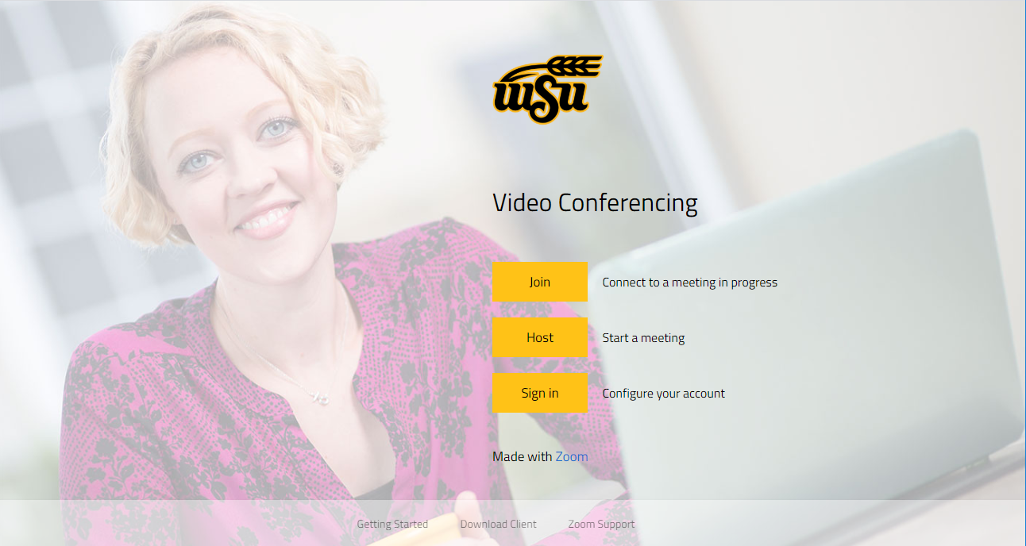
Zoom Best Practices – Before Class - 5
Notes:
In a browser, visit the address: wichitastate.zoom.us and you should see this landing page. First, if you haven’t downloaded the software yet, you’ll want to do that first, which can be done right down here where it says, “Download Client.” But, since you’re here, I’ll assume you have, so we’ll skip that step for now. Go ahead and click the “Sign In” button.

Slide 10
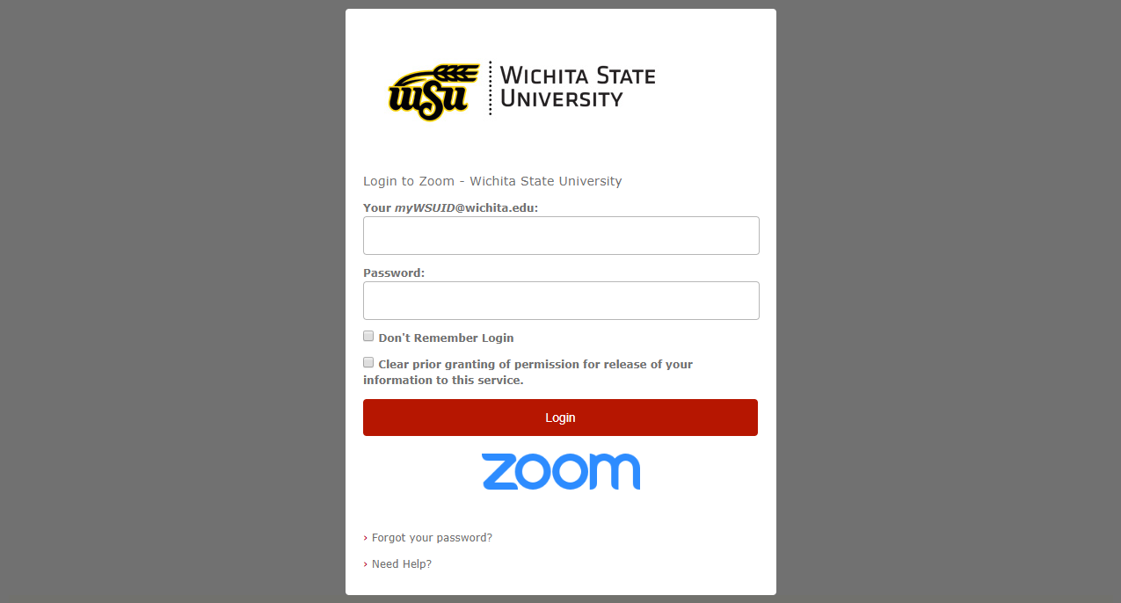
Zoom Best Practices – Before Class - 6
a123z978@wichita.edu
************
Notes:
You are then brought to the University’s single sign-on page, where you need to enter your myWSUID@wichita.edu plus your password. Click the Login button.

Slide 11
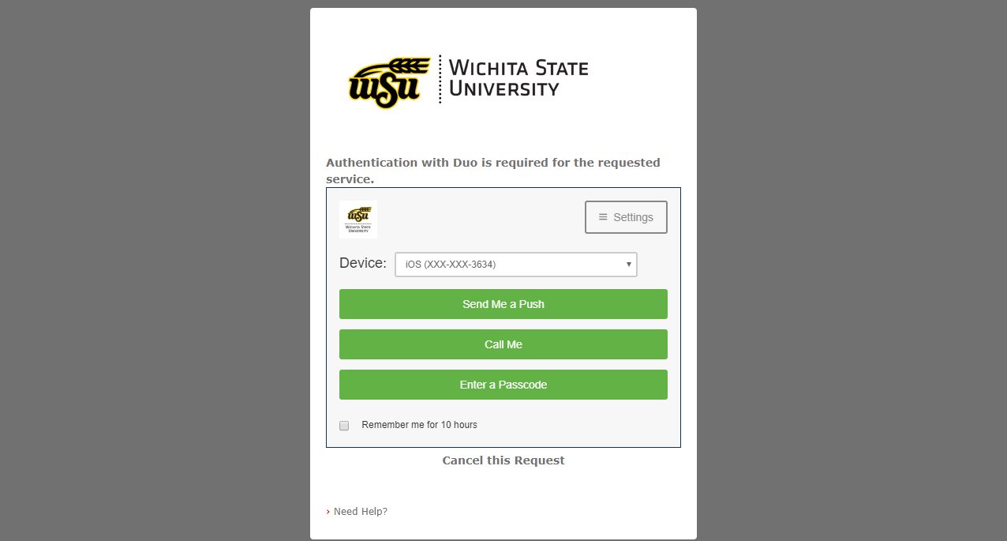
Zoom Best Practices – Before Class - 7
XXXX)
Notes:
This is the University’s standard dual-factor authentication screen proceed here as you normally would. (I’m going to click, “Send Me a Push.”)

Slide 12
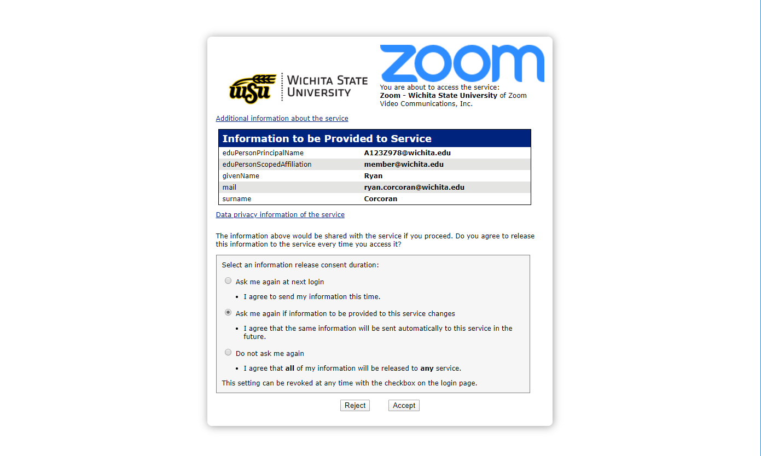
Zoom Best Practices – Before Class - 8
Notes:
You can select whichever of these three options you like, but I recommend choosing the 2nd option and then click “Accept.” You will need to do this step every time you login with a new browser.

Slide 13
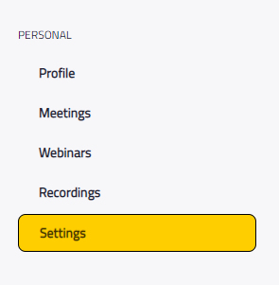
Zoom Best Practices – Before Class - 9
Check your settings
Account Settings
Profile Page
Change your profile picture, department, display name
Customize your Personal Meeting ID (if Licensed)
Verify your Zoom license type (Basic or Licensed)
Notes:
Once you’re logged in to the Zoom web portal, there’s two main areas where you can change stuff. First is the Profile page, which is the top link on the left sidebar. Here, you can change your profile picture, department name, or your name as it’s displayed to others. You can also use this page to verify that you’ve got the right license type, whether Basic or Licensed, and if you’re Licensed, you can also customize your Personal Meeting ID. I won’t really be talking about Personal Meeting IDs today, so if you have questions about that, you can talk to me about it later.

Slide 14
Zoom Best Practices – Before Class - 10
Check your settings
Account Settings
Settings Page
Most recommended settings are already on by default.
Recommend enabling “Only authenticated users can join meetings,” and “Only authenticated users can join meetings from Web client.”
Notes:
The Settings page is where you will find a plethora of options to go through. We’ve already set the defaults for most of the recommended settings, but you should really go through all of them to see what all you can do, and what kind of control you have over your meetings. I do recommend enabling the “Only authenticated users can join meetings,” and the “Only authenticated users can join meetings from Web client options—both of those options ensure that the people who are joining your meeting are already logged in. If you’re bringing in people from outside the University who don’t have a Zoom account, you might need to disable that option at the meeting level, but I would enable this option here, so that ensures most of your meetings have this option pre-selected.

Slide 15
Zoom Best Practices – Before Class - 11
Check your settings
Account Settings
Settings Page
Settings you should consider on your own:
Auto saving chats? (Default: Off)
Polling? (Default: Off)
Waiting Room? (Default: Off)
Settings that are time savers when creating meetings:
Host/Participants video on? (Default: Off)
Join before host? (Default: On)
Mute participants on entry? (Default: Off)
Notes:
Here are a few other settings to look at while you’re here in your Setting page in the web portal. There are things that are more or less optional, but I would highly recommend changing them. Things like auto-saving chats, which will produce a text file of all the messages posted in the chat box during the meeting. Polling, which I encourage faculty to use to increase engagement during your classes. And the Waiting Room, which is almost a must. Then there’s a few more than are just time-savers for when you are scheduling meetings. Let’s go take a look at that step next.

Slide 16
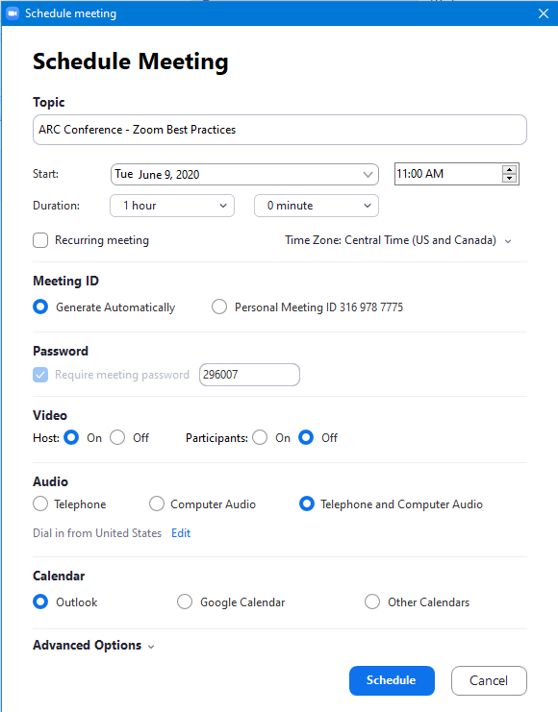
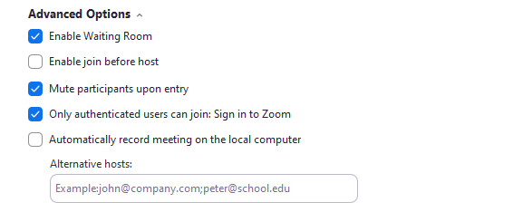
Zoom Best Practices – Before Class - 12
Check your settings
Meeting Settings
Notes:
The next place we can change some settings is at the point that we’re actually scheduling the meeting. This will look slightly different whether you’re scheduling it from the Zoom app or from the Zoom web portal, but I’m going to be demonstrating it from the Windows client software. This is the Schedule Meeting window which pops up when you click “Schedule.” We start by entering the name of the meeting, and the start date & time. You’ll need to check the “recurring meeting” box if you want to re-use the meeting code multiple times. I’ll show you how to set that up later, but just know that this checkbox basically just makes it so the Meeting ID stays good for up to a year.
I recommend that you let the system generate the Meeting ID automatically, and let it choose a password automatically as well. For Video settings, I recommend that you have the Host video turned on and the Participants video turned off. Everyone can always choose to turn on or off their cameras during the meeting, but this just sets it up for what it is when they first join the meeting. For Audio, always select “Telephone and Computer Audio. Next, open the Advanced Options drop down. These are the settings I highly recommend. Only deviate from these settings if you have a really good reason to do so. Make sure Enable Waiting Room, Mute participants upon entry, and Only authenticated users can join are all checked. The Alternative Host is someone who is authorized to run your meeting completely in your absence. This is different from a co-host, who has some moderator functions.
OK—we’re finally ready to click “Schedule”. For most of you, you’re going to leave the “Calendar” option set to Outlook. All this really does is makes it a convenient way to create an Outlook calendar invitation. If you don’t use a digital calendar at all and just plan on putting the link into Blackboard, then just click “Other Calendars.” Then, click Schedule.

Slide 17
Zoom Best Practices – Before Class - 13
Communicate Your Meeting
Your meeting is scheduled—now what?
Set Outlook invitation settings for your calendar.
Set recurring pattern, if any.
Either send Outlook calendar invite or post in Blackboard. (Please no Twitter!)
Notes:
At this point, your meeting is already scheduled. The steps we do from here are really about communication of the meeting details. We’ll look very briefly at the Outlook calendar invitation settings, including recurring appointments, and also briefly look at posting the information in Blackboard.

Slide 18
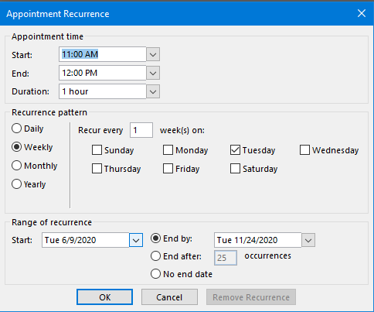
Zoom Best Practices – Before Class - 14
Communicate Your Meeting - Outlook
Notes:
After you click the Schedule button, Outlook will pop up with a calendar appointment window. Here’s the ribbon at the top of that window. Here you can set whatever settings you want for your Outlook calendar, but I’ll call your attention to the Recurrence button. Here’s where you set up how the meeting reoccurs in your calendar. So again, the Meeting ID you setup in Zoom is always good if you click that “Recurring Meeting” checkbox. This part is just to make sure it shows up in your calendar correctly. So set your recurrence pattern the way you need it, including an end date, then click “OK.”
On the main appointment window, you can rename your meeting for the invitation that goes out. This helps if you want the meeting name in Zoom to be one thing, but the name in the Outlook invitation something different. If you’re going to email this to your students, you’ll need to enter their addresses or create a distribution group in your contact, which I won’t be showing you. Finally, just make sure your link is both here in the Location field as well as down below in the body, then you’re ready to either Send it out, or just save it if you’re not going to email it. Next, we’ll quickly look at sharing the link in Blackboard.

Slide 19
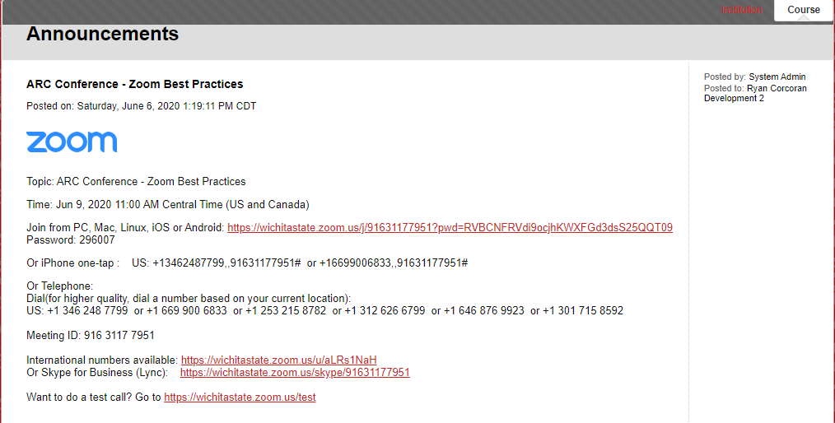
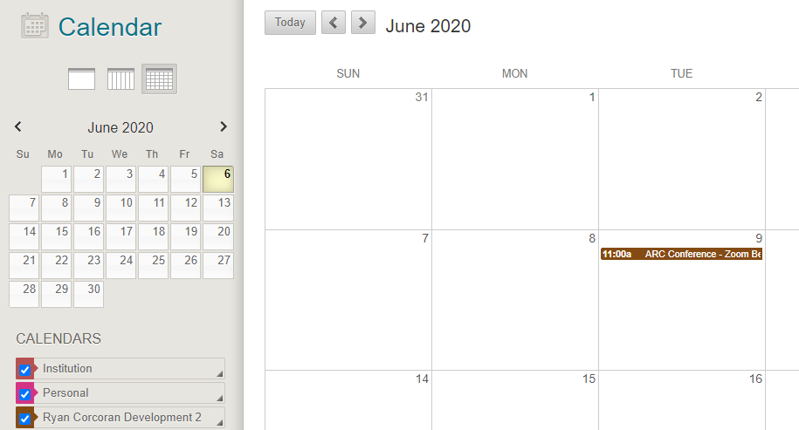
Zoom Best Practices – Before Class - 15
Communicate Your Meeting - Blackboard
Notes:
In Blackboard, just go to your course, and you can either create an Announcement with the body of the Zoom invitation, or post a new Item within a course module. This will be highly dependent on how your Blackboard course is organized. In addition to that, you can also create a calendar item within your course’s Calendar tool. I don’t recommend only putting it here, as students are not well-trained to watch this calendar area.

Slide 20
Zoom Best Practices – Before Class - 16
Communicate Your Meeting – Co-Host
Do you need/want a co-host?
Large classes (>40-50)
Very interactive (lots of muting/unmuting, e.g.)
Want some peace of mind
wichita.edu/av – “Zoom.us Co-Host Request”
Notes:
Finally, think about whether you will need a co-host and make sure they’re invited to the meeting as well. A co-host is basically someone who can manage the logistics of your meeting for you. The main times you’re going to want a co-host is for the larger groups, especially over 49, since Zoom can only show up to 49 camera feeds at once. Also, if intend on making your classes very interactive with lots of different people speaking, having a co-host is helpful for muting and unmuting microphones so you don’t have to worry about it. But, you may also want a co-host just for a little peace of mind to know that someone else is in there just watching for little hiccups.
If you’re lucky enough to have a GTA, you can ask them to be your meeting co-host. Otherwise, Campus Media Services offers a service that’s currently free where you can invite in one of our student technicians to act as this meeting co-host for you. To request a co-host for your meeting, just go to Wichita.edu/av and click on the link for a “Zoom.us Co-Host Request.”

Slide 21
Zoom Best Practices – Before Class - 17
Setup Polling Questions in Advance
Go to web portal at https://wichitastate.zoom.us & go to “Meetings”
Click on the title of the Meeting to which you want to add polls, scroll down to “Poll” and click “Add.”
Notes:
OK—just a couple more things that you’ll want to think about before your meeting. If you want to have some polling questions—and I highly recommend it for more engaging classes—I would suggest getting those polling questions setup ahead of time. To do this, you’ll go to the Zoom web portal that we were in a little bit ago; then you’ll go to your Meetings tab and then click on the title of the Meeting you want. Then, just scroll down to Poll and click ‘Add.’ It should be fairly intuitive from that point. Just remember to hit “Save” when you’re done.

Slide 22
Zoom Best Practices – Before Class - 18
Setup Breakout Rooms in Advance
Go to web portal at https://wichitastate.zoom.us & go to “Meetings”
Click on the title of the Meeting to which you want to add polls, scroll down and click “Edit this Meeting.”
Check “Breakout Room pre-assign” then “+Create Rooms”
Importing names by .csv is possible, but tricky.
Notes:
Last step of prep work, I promise. If you plan to use Breakout Rooms for small discussion groups, you can actually pre-set the number and name of those rooms ahead of time. Again, you’ll go to the Zoom web portal and find the Meeting you want to add the Breakout Rooms to, then click “Edit this Meeting. Check the box that says, “Breakout Room pre-assign” then the “Create Rooms” button. Then, you can add the email addresses of all the students you want to pre-assign to rooms, but it does have to be their Wichita State student email address.

Slide 23
Zoom Best Practices – Ready to Meet?
Ready to meet?
Notes:
OK, finally—all the prep work is done, and you’re ready to get the meeting started. Here’s what we’ll need to do to actually run your meeting smoothly.

Slide 24
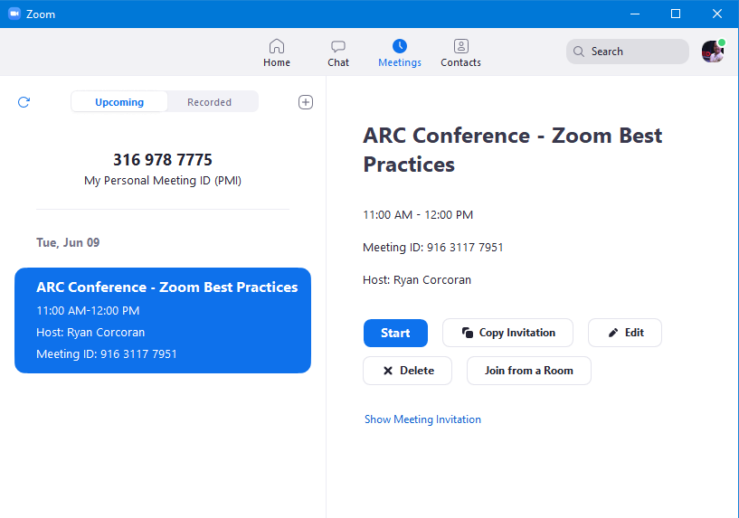
Zoom Best Practices – During Class - 1
Starting the Meeting
Start the Meeting from Zoom,
NOT Outlook/Blackboard
Notes:
First, you’ve got to start the meeting correctly. I highly recommend not just clicking the link in your calendar. To make sure that you’re starting the right meeting and that you’ll come into the meeting as the host, open up your Zoom app, then go to the meetings tab. Once there, select the meeting you want to start on the left, then click the “Start” button under the meeting on the right hand side. This will ensure that you’re logged in to Zoom and that you’re starting the meeting as the host. If you start in Outlook or Blackboard and just click on the link, it’s possible you can join the meeting as a regular Participant and not have the full host controls.

Slide 25
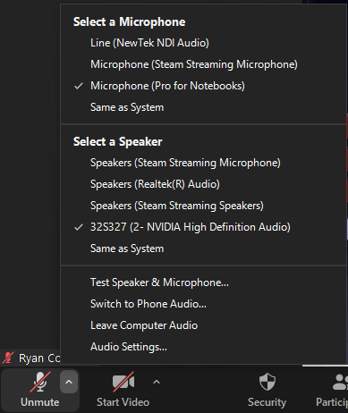
Zoom Best Practices – During Class - 2
Troubleshoot Audio/Video
Notes:
Once you’re in the meeting, we first have to make sure that your audio and video settings are correct. I do this every time, even if I just checked it in the Zoom app. First, for your audio, click the little carrot next to the Mute or Unmute button in the lower left corner. Then, if you think you’re probably okay, just click the “Test Speaker & Microphone” link. Go through the little wizard. If you know you’re not okay, or if you had any issues with the wizard, click the “Audio Settings…” link. That will open up a little settings window.

Slide 26
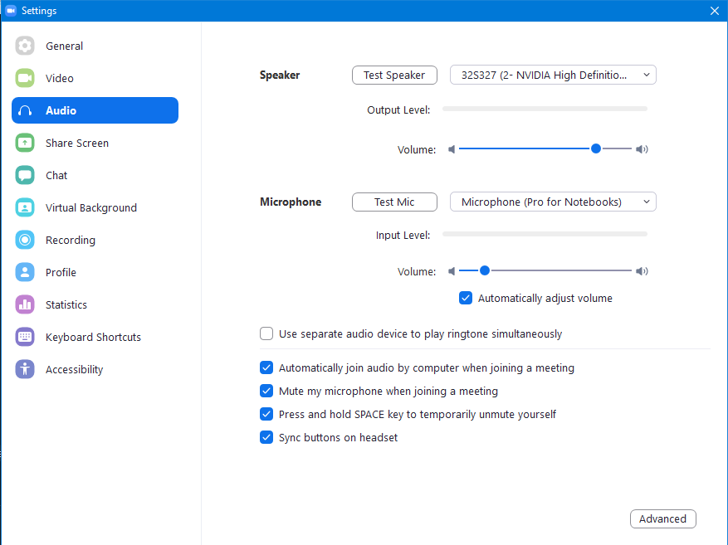
Zoom Best Practices – During Class - 3
Notes:
On this Audio settings page, you just need to select your correct speaker and microphone from their respective drop-down boxes and then test them both. Keep testing and changing settings until it sounds like you want it. Also, I do recommend having all four of these boxes checked, but those are your preference.

Slide 27
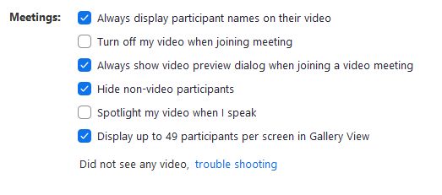
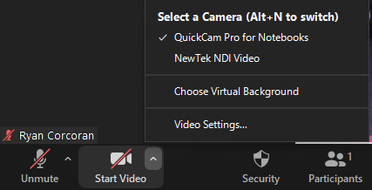
Zoom Best Practices – During Class - 4
Notes:
Next, we’ll do the same thing for our Video settings—first, click the carrot next to the Start or Stop Video button. You can see there what camera your computer is using. There’s also a link there to use a Virtual Background, if your computer supports it; we won’t really go into that here. So, we’re going to open up our Video Settings link. This will bring up the Video Settings window, where again, we can select the camera we want to use under the drop down box, and there’s lots of options there to go through. What you see here are my own personal preferences—your settings may vary depending on your own preferences and your computer’s graphics capabilities.

Slide 28
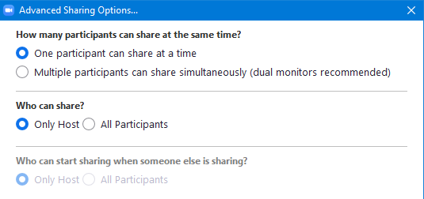
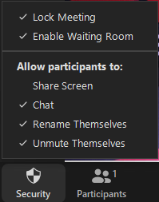
Zoom Best Practices – During Class - 5
Check Your Settings
Notes:
Next, we’re going to look at your Security settings. We’ll click the Security button, which gives you a list of shortcuts to common security settings. If you’re not using a co-host and are concerned about unauthorized people joining the meeting, you can lock the meeting. Just be aware that if someone accidentally drops out of the meeting, they won’t be able to get back in unless you unlock the meeting. Likewise, you can choose to let participants unmute themselves—this is most useful for the smaller classes that are discussion-based. If you’ve got a large lecture-type class, probably leave that one off.
There are also some security-related settings under the Share Screen button—click the carrot next to the Share Screen button, then click “Advanced Sharing Options.” From that dialog box, I highly recommend setting this so that only One participant can share at a time, and that only the Host can share. If you ever do need a student to share content, you can either change that second option, or temporarily promote that student to a co-host.

Slide 29
Zoom Best Practices – During Class - 6
Check Your Settings
Don’t forget to hit “Record” (if you want to)
Record locally to your computer (more later!)
Cloud recording available for iOS/Android/Chromebooks
Cloud recordings will be deleted ~6 months later
Notes:
Finally, before your class gets started, don’t forget to hit “Record,” if you are wanting to do that. Most of the time, you’ll be recording locally to your computer—which we’ll talk about later. If you’re on a device that doesn’t allow for that, like Chromebooks or iOS devices, you can also record to the Zoom cloud—just be aware that the recordings in the Zoom cloud are automatically deleted about 6 months after they’re created.

Slide 30
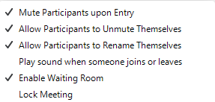
Zoom Best Practices – During Class - 7
Manage Participants & Chat
Participants listed alphabetically
Participants with Raised Hand & unmuted participants float to top
Notes:
Participants tab
Mute All button
The “More” button
Allow Participants to Unmute Themselves
Yes button
No button

Slide 31
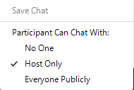
Zoom Best Practices – During Class - 8
Manage Participants & Chat
Notes:
Chat button
“More” Button
Recommend Host Only

Slide 32
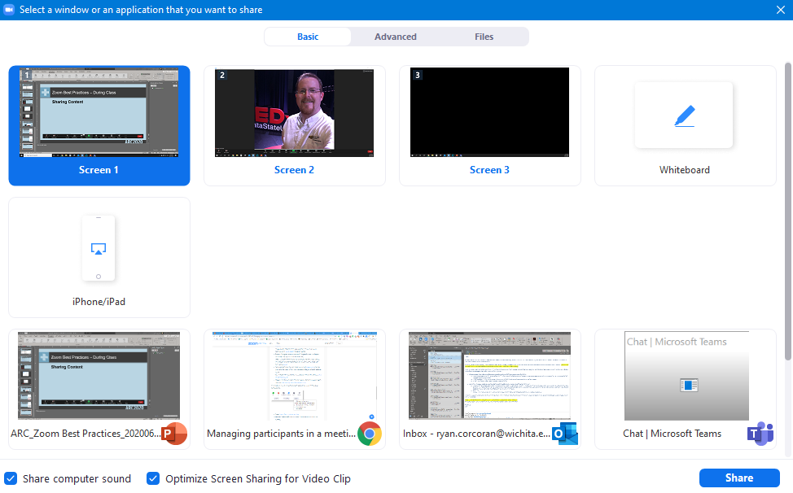
Zoom Best Practices – During Class - 9
Sharing Content
Notes:
Next we’re going to look at sharing content during a Zoom Meeting. First, click the “Share Screen” button to open up a menu of what you can share through your meeting. Let me explain that there’s a difference between sharing your screen and sharing just one application that appears on that screen. If you share your screen (like Screen 1, Screen 2, etc.), then any pop-up window, notification, whatever, that shows up during your meeting will get shared with everyone in the meeting. So, if you’ve got your Outlook open—which you should not—then any new email notification will show up as well, which could be a potential FERPA concern. But, sharing only the application has its pitfalls, too. If, for example, you’re sharing a PowerPoint presentation, but then want to share something within Google Chrome or Firefox, you have to remember to change what content you’re sharing, which can disturb your flow. Just something to be aware of.
Also, if you’ll be sharing video content of any kind, whether it’s a YouTube video or something in a PowerPoint, make sure that you check the “Optimize Screen Sharing for Video Clip” checkbox.

Slide 33
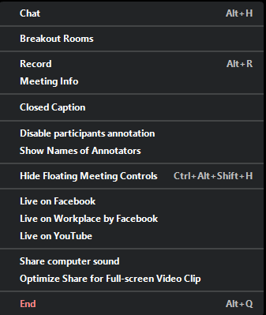
Zoom Best Practices – During Class - 10
Sharing Content
Meeting controls move to top of shared content
Disable participants annotation
Notes:
After you click “Share,” the meeting controls will move to the top of whatever you chose to share. You’ll see a lot of the same buttons you saw before, they’ve just been moved a bit. There are a couple of new buttons that weren’t there before—Pause Share and Annotate. Annotate’s a cool feature that lets you draw or write on top of whatever it is you’re sharing. One thing to note about annotation—It’s a very good idea to disable participants’ annotation. To do this, click the “More” button, then “Disable participants annotation.” Annotation is a very helpful tool for just about any class with shared content, even if you just use it for emphasis.

Slide 34
Zoom Best Practices – During Class - 11
Ending the Meeting
Use “Leave Meeting” if you need to change something on your computer and come back in.
Use “End Meeting for All” if you’re ready to close the door and shut off the lights.
Recurring Meetings can always be reopened.

Slide 35
Zoom Best Practices – Now What?
Whew! —Now What?

Slide 36
Zoom Best Practices – After Class - 1
Where did my recording go?
Video starts processing immediately after meeting end.
Default location is: Documents>Zoom>MeetingName
Cloud Recordings are in your web portal, under “Recordings”
If processing was interrupted, go to Meetings tab, toggle to “Recorded.” Click the meeting, then “Convert” on the right.

Slide 37
Zoom Best Practices – After Class - 2
Where should my recording go?
Upload to your class’s Panopto folder
You can request a “Personal” folder in Panopto for video shared between classes
Videos with any students visible/audible, etc., should NOT be uploaded to YouTube, Vimeo, et al.
But 1:1 interviews with guest speakers can!
Share Panopto video in your Blackboard course

Slide 38
Zoom Best Practices – After Class - 3
What about attendance?
Go to web portal at https://wichitastate.zoom.us/ & click on “Reports,” then “Usage Reports”
Find the meeting for which you want to see attendance & click the linked number of Participants.

Slide 39
Zoom Best Practices – After Class - 4
What to do differently next time?
You can edit Recurring meetings without changing the Meeting ID or Password.
Write down what you want to change for meetings you haven’t scheduled yet
Ask questions:
http://www.wichita.edu/av
WSU Media Resources Center on Facebook
Next time…

Slide 40
Zoom Best Practices – End

