Slide 1
Legacy PowerPoint Slides
Please make me Accessible

Slide 2
ACCESSIBILITY CHECKER
Run the Accessibility Checker
Go to File->Check for Issues->Check Accessibility

Slide 3
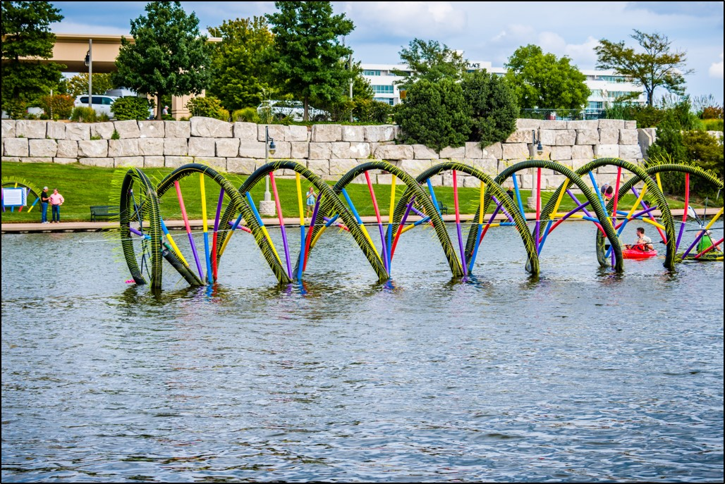
Add Alt Text
Right click on image
Select Format Picture
Select Size and Properties
Select Alt text
Add in description box

Slide 4
I LOOK LIKE A TITLE, BUT AM I?
Add titles
View tab->Outline View

Slide 5
Check Reading Order
Home tab -> Drawing group -> Arrange dropdown -> Selection Pane

Slide 6
LAYOUTS
Alternate way to add titles / change layouts
Home tab -> New slide -> choose appropriate layout -> Copy and paste into new slide

Slide 7
Select appropriate design
Click the design tab
Select a design with the most contrast, a white background is best

