Slide 1
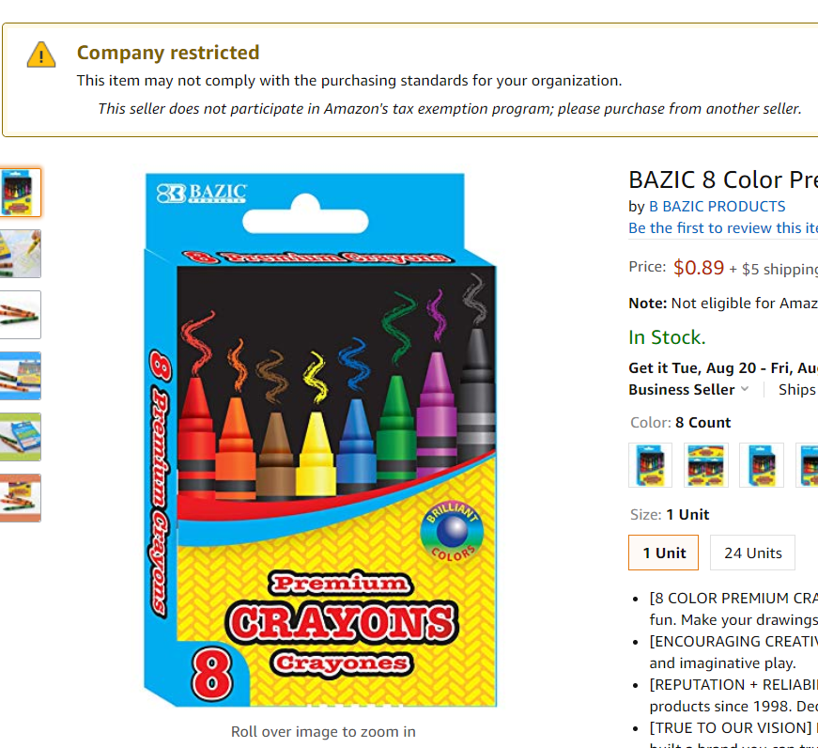
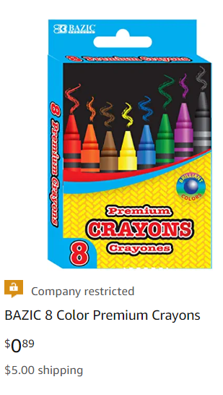
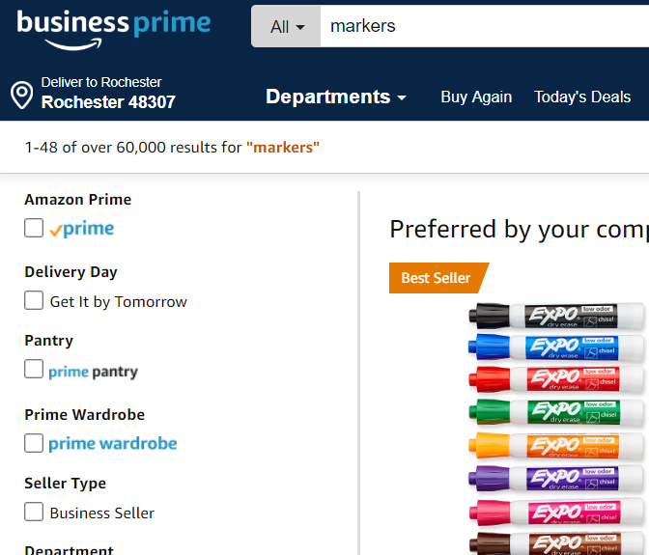
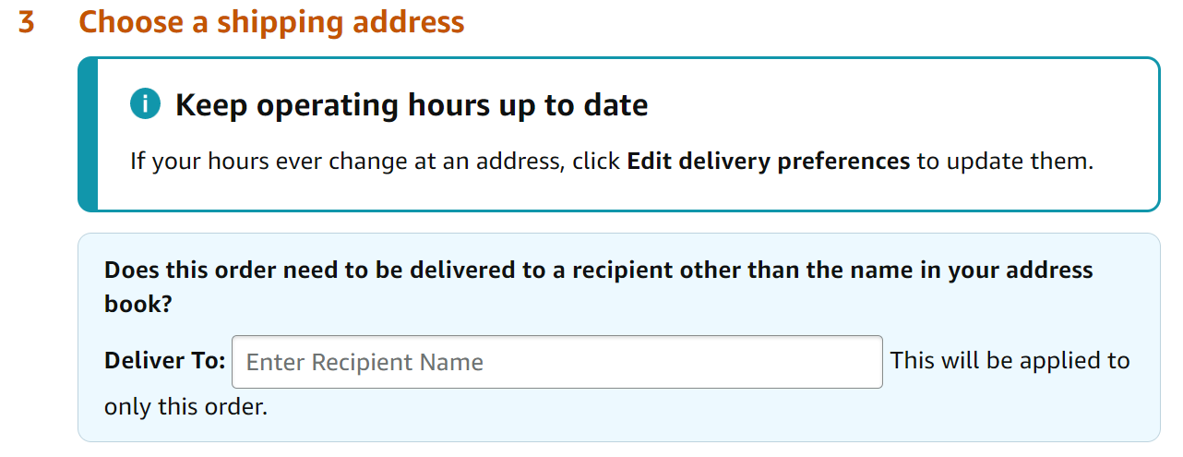
Shopping Quick Reference Guide
Shopping with Amazon Business Prime
Business Prime ensures the quality of the vendor interaction regarding merchandise, customer service, ease of returns.
Amazon Tax Exemption
Tax Exempt Policies: These Policies notify employees when buying from sellers not participating in the Amazon Tax Exemption Program.
Fast, FREE business delivery
FREE Two-Day Shipping
FREE One-Day
Quick Tips
1. Use a Broad Search
Search for an item
Instead of searching for Brand Name Markers 8 pack try searching dry erase markers.
Scroll down to identify savings.
1
122
Amazon Checkout
When selecting your delivery address, you will have the option to edit the Deliver To field. ​
​
Use this optional field to indicate a specific department, room number, or recipient if needed. ​
2. Filter by Business Prime
Select “Prime” in the upper left hand corner of the search results
Please log into your account and use “Contact Us” to reach the Amazon Business Customer Service team. If you can’t log in, call (888) 281-3847

Slide 2
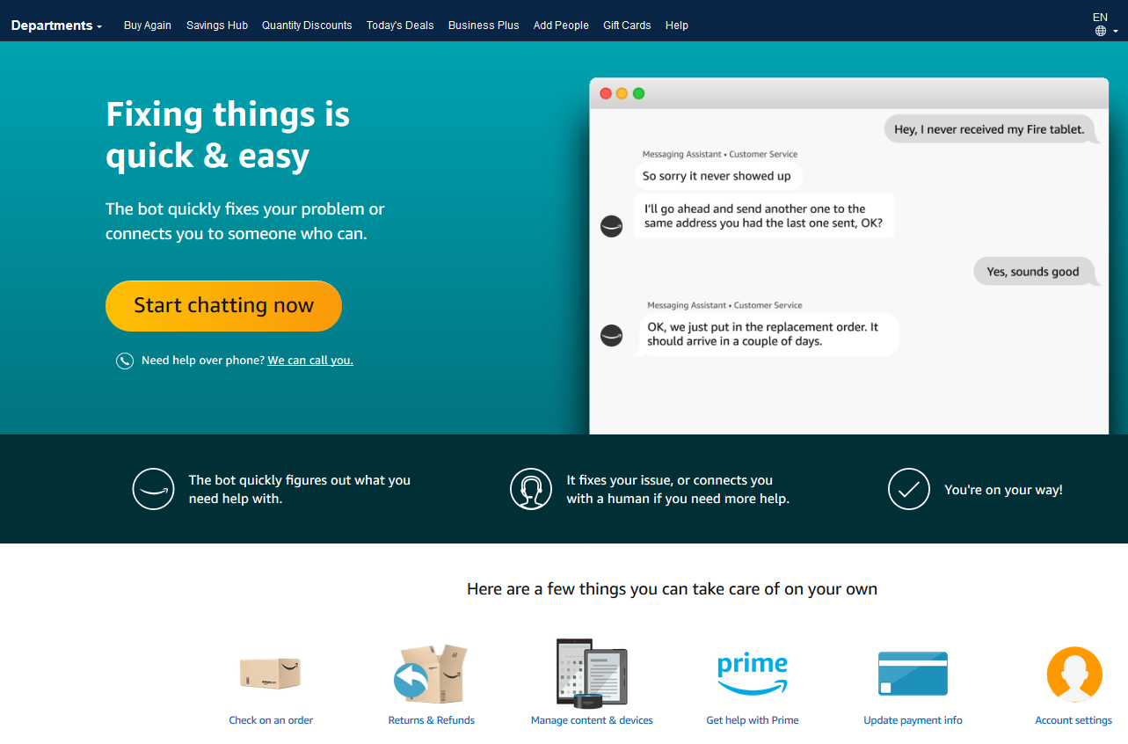
Business Customer Support
Dedicated U.S. based Business Customer Support can be reached a number of ways including email, chat and phone.
Not sure what you’re looking for? Learn more about the features and benefits on Amazon Business HERE.

