Slide 1

Amazon Business Buyer Training
Kristie Courtney – Director of Purchasing & Accounts Payable
Exelane Lanzaga – Senior Customer Success Manager
November 8, 2022

Slide 2
Table of Contents
What's Changing
Registration and Accessing the Amazon Business Account
Account Navigation & Shopping Experience
Placing an Order
Things to Know
Additional Resources

Slide 3
Wichita State University Process Change
Consolidate existing Amazon accounts
Realize additional savings campus-wide
Amazon Business is a cost-effective resource for non-contracted supplies.
Employees should no longer have Amazon accounts (personal or work-related) tied to their work email outside of the centralized Amazon Business Account effective November 7, 2022
Employees should only access the centralized Amazon Business Account through Single Sign On (SSO)

Slide 4



Amazon Business Benefits
There are a variety of discounts available on Amazon Business that your organization can take advantage of to unlock savings.
Business Pricing
Cheaper pricing available only for registered Amazon Business customers.
Business-Only Selection
Business-only selection refers to items and offers that are only available for purchase by Amazon Business customers.
Quantity Discounts and Limited Time Deals/Coupons
Volume-tiered discounts
Amazon Business Analytics
Use Amazon Business Analytics to view data about your orders, create and filter reports based on your business needs, and view both charts and tables. Click to learn more.

Slide 5


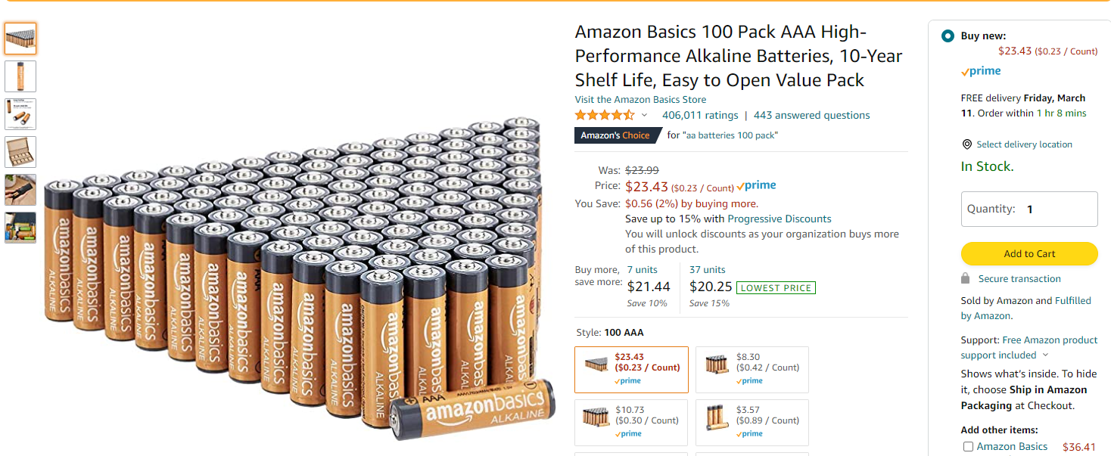

Take Advantage of Amazon of Business Prime Shipping
Once Business Prime Shipping has been purchased, it provides Free Two-Day Shipping on eligible items for all users in the business account. There are multiple pricing tiers to meet the needs of businesses of all sizes. Click to learn more.
Prime Eligibility – Fulfilled by Amazon
Prime eligible items are fulfilled by Amazon. We recommend searching for prime eligible items to ensure that your products arrive on time and as expected. All products clearly mark who the seller is on the product detail page.
What’s not Included?
Business Prime Shipping does not include additional Prime benefits such as Amazon Fresh, Pantry, Video, or Music.

Slide 6
Business Account Access and Navigation
Registration & Accessing the Amazon Business Account

Slide 7
Amazon Business Registration Scenarios
Depending on how you have used your work email on Amazon in the past, you will be prompted through a corresponding registration flow
Persona | Objective
New User | Has never used @Wichita.edu email domain on any Amazon account
Existing Amazon.com account used for Business Purchases | Amazon User has @Wichita.edu email linked to Amazon. Since they have only made business purchases in the past, their order history and account information (payment methods, addresses, etc.) should be converted/migrated to the centralized Business account.
Existing Amazon.com account used for Personal Purchases | Amazon User has @Wichita.edu email linked to Amazon. Since they may have made personal purchases, they would like to transfer all previous order history and account information to a personal email, and start a clear profile in the new centralized Business account.
Existing Amazon Business | Amazon Business User @Wichita.edu email is linked to a separate AB account) who needs to either 1) merge the current account into the central Business account from an email invitation or 2) deregister the account (convert to a .com account) before joining the central account.

Slide 8
Accessing Amazon Business through Single Sign On
Accessing the Amazon Business account is simple when Amazon is integrated with your organization
How do you sign in?
All registration flows when you click the link provided to access the centralized Amazon Business account. This will automatically log you into the appropriate account.
For those who have not used their work email in the past, they will be immediately authenticated into the central account.
For those who do need to take action to separate out their existing account, this is a one time process that they will be guided through. They will be authenticated automatically each subsequent time.

Slide 9
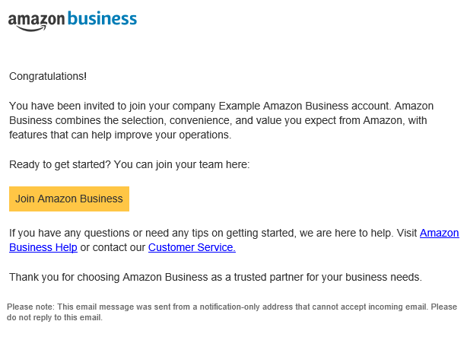
Account Invitations
How do Invitations Work?
You received an emailed invitation to your work email from business@amazon.com
Call to Action:
Click on the “Join Amazon business” link in the email to ensure you have access to your Amazon Business Account
If you don't take action within 90 days, your invitation will expire
For Easier Access in the Future - Save this as a Favorite or bookmark in your web browser! Amazon Business

Slide 10
Account Navigation

Slide 11


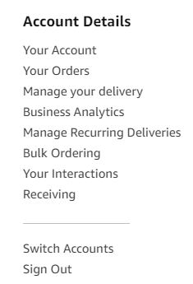
Account Navigation
Hover over your name in the top right hand corner to access additional tools in your account
Page | Functionality
Your Account | Standard Amazon account information including name, email address & password
Your Orders | View and track your orders. Administrations can view orders others have placed on behalf of the organization
Business Analytics | Create and filter custom reports based on your business needs to view your organization’s orders
Switch Accounts | Allows you to easily toggle between your different Amazon accounts

Slide 12
Start Your Shopping Experience
Utilize the Search bar or your Lists to search for specific items
Click here to shop by department and/or category
Click here to create and manage lists. You can also
access lists shared with you.
Access your Shopping Cart Here
LINKS TO EXPLORE:
Workplace Essentials: 4+ star rated work supplies, including top searched and purchased
PPE Workplace Essentials
Featured programs and storefronts
Best Sellers: Shop best-selling items across all departments, updated hourly
Today’s Deals: Discover all current deals, including coupons
Wholesale: Save by purchasing items in bulk, case packs, and large packs
Private Brands: Discover Amazon Business brands, including Amazon Commercial, Amazon Basics and more

Slide 13
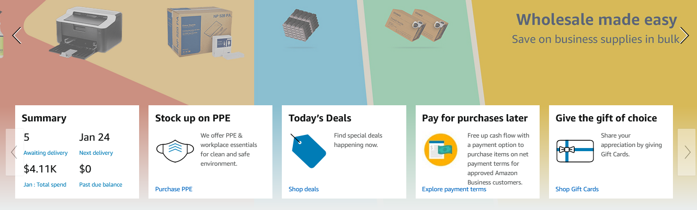
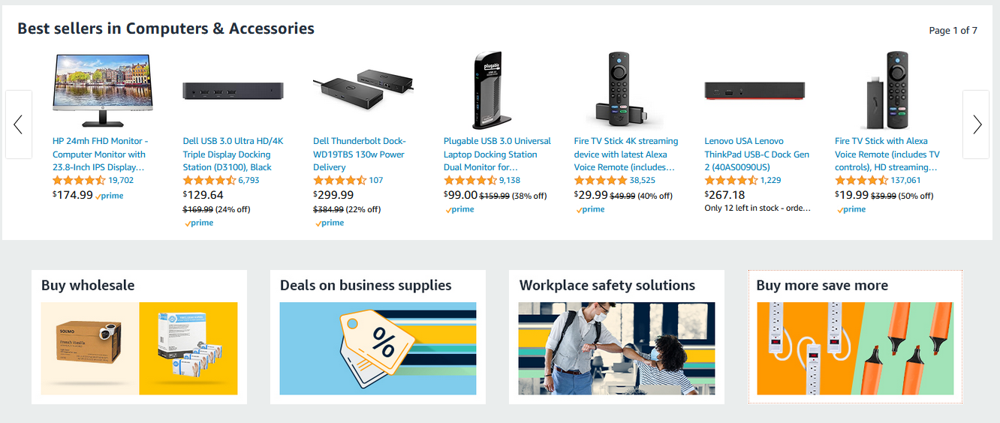
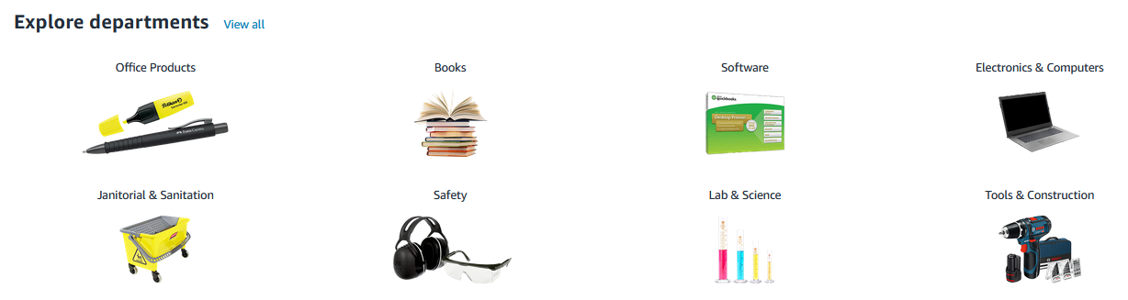
Amazon Business Homepage
Notification Panel
  Order Summary & Recommendations
Customized to Each User
  Features and Programs you could benefit from
  Product Recommendations
  Purchased by Your Organization

Slide 14
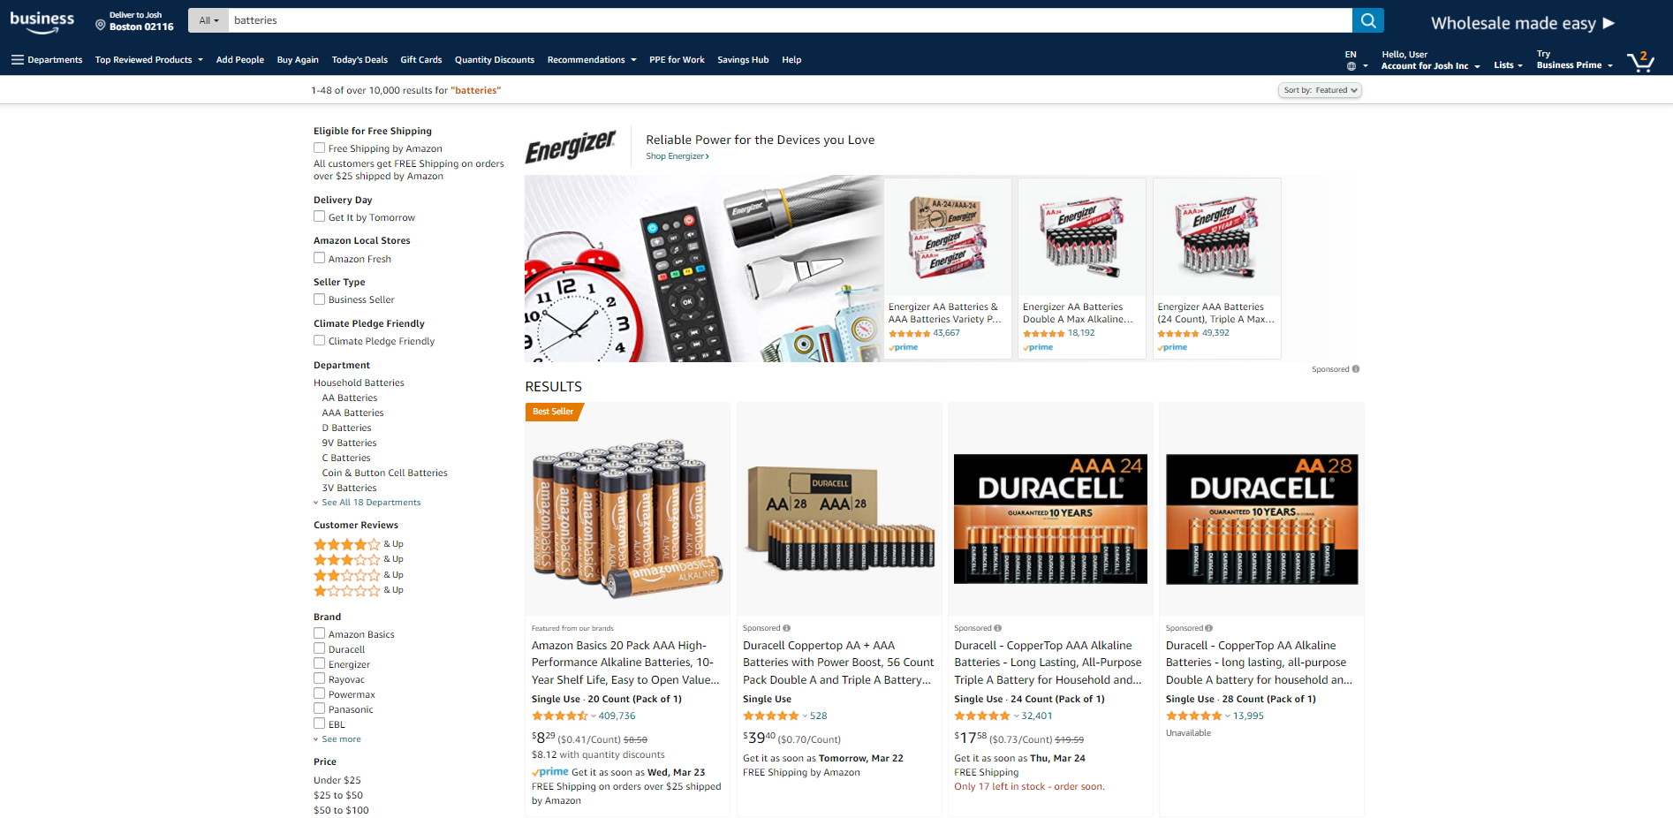
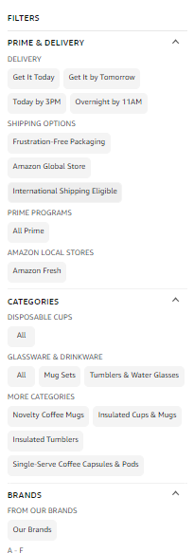


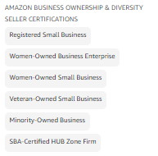
Traditional Marketplace Search
Search for and filter results to identify items you are looking for.
Enter item or key word(s) in the search bar. Search All Departments & try using generic descriptors instead of brand names
Consider refining search results with filters available of left side of your screen, such as Prime or Business Seller or Climate Pledge Friendly
Sort results by options listed on the top left of your screen, such as Price: Low to High

Slide 15
Search & Shopping Experience

Slide 16

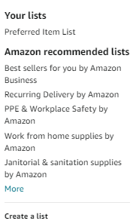
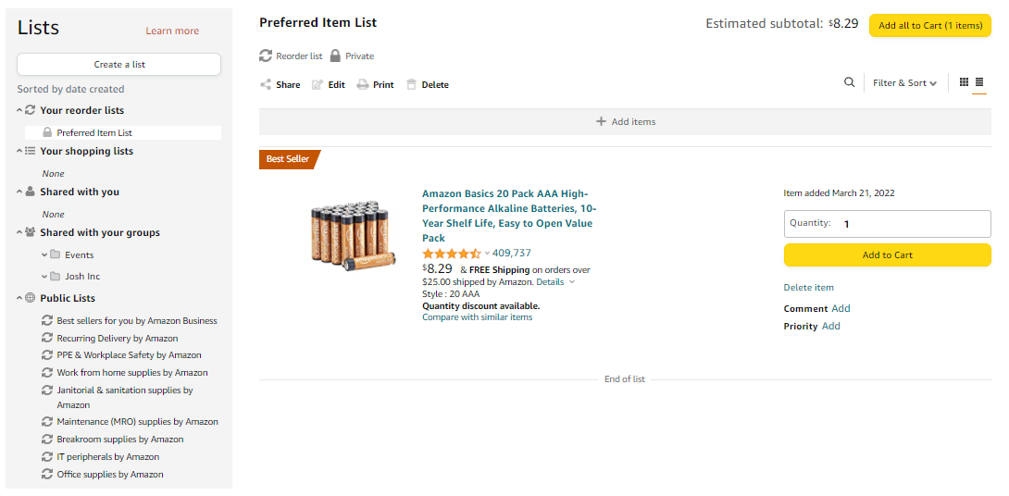
Search & Order From Within Your Lists
Lists make it easy to keep track of the things you need and are easy to share with others. Any User on Amazon Business can create a shopping list
Review lists that have been shared with you
  Shared with you
  Shared with your groups
  Public Lists
Add items from your lists directly to your cart
Utilize Search functionality to find specific items within the list

Slide 17
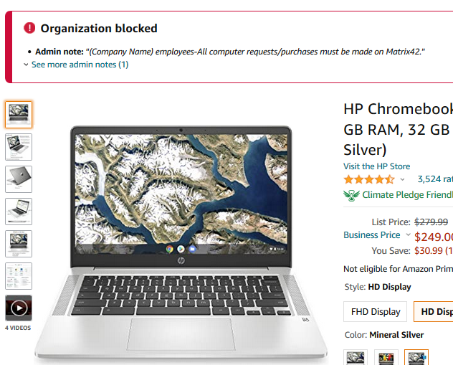
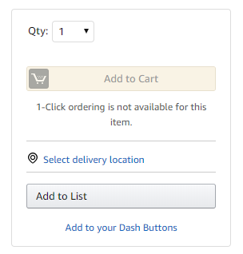
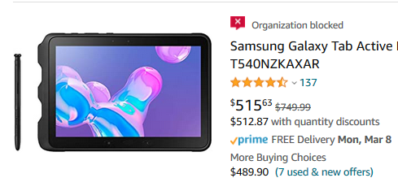
Wichita State University Blocked Policies
Your organization has blocked certain product categories based on its internal buying policies.
This seller does not participate in Amazon’s Tax Exemption Policy. Please find this item from another seller for purchase.
Please contact IT for laptop acquisition.
Types of Items Blocked by your Administrator:
Items from Sellers not participating in Amazon’s Tax Exemption Program
Computer Services
Televisions & Gaming Consoles
Gift Cards
Alcohol & Tobacco Products
Adult Products
Paper
Phones
Computers
Printers
Software

Slide 18

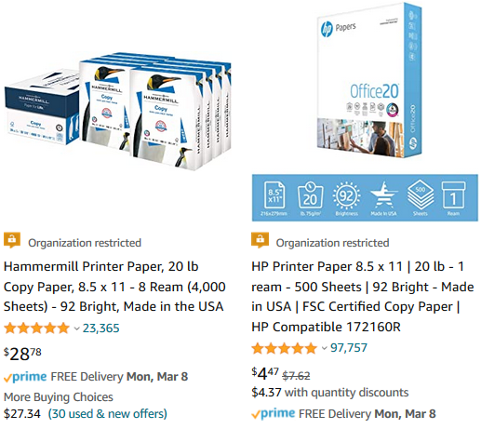
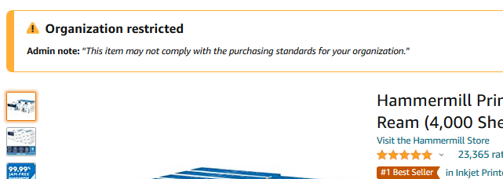
Wichita State University Restricted Policies
Your Account Administrator has restricted categories for purchase within Amazon Business based on your organization’s buying policies
Restricted products will be clearly marked throughout the buying process
Purchases with Restricted items may require additional approval
Administrators have direct visibility into any restricted purchases via Business Analytics
Types of Items Restricted by your Administrator:
Monitors
Electronic Publications & Music
Furniture and Furnishings
Office Supplies
This item requires additional review by the University Purchasing Office

Slide 19
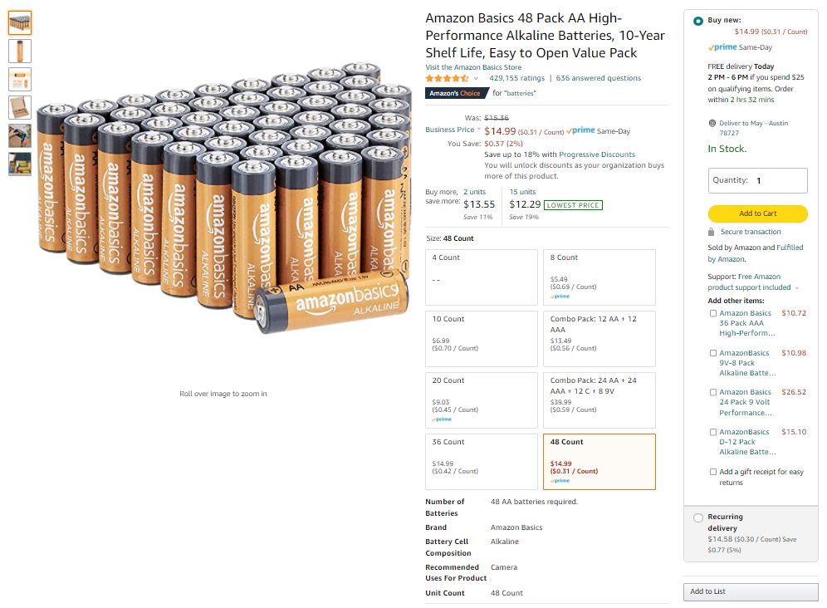

Adding Items to Your Shopping Cart
Product considerations
Prime eligibility
Expected delivery time
Quantity
Seller and fulfillment

Slide 20
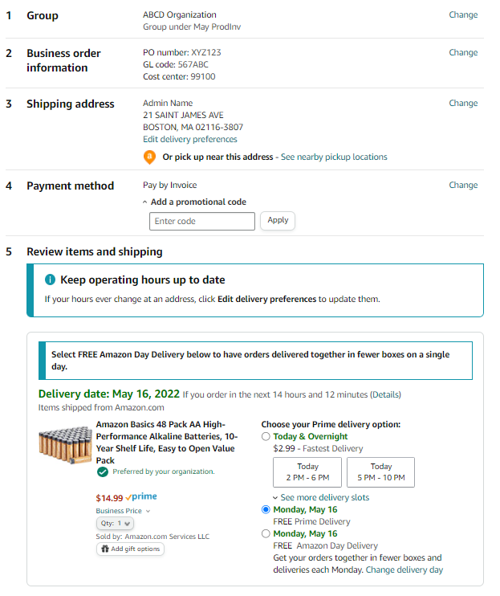
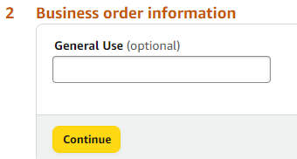
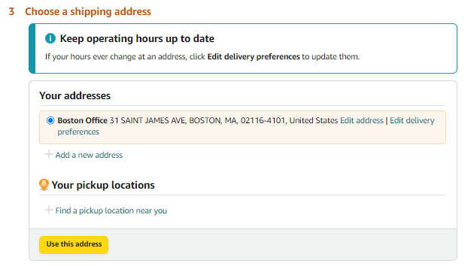

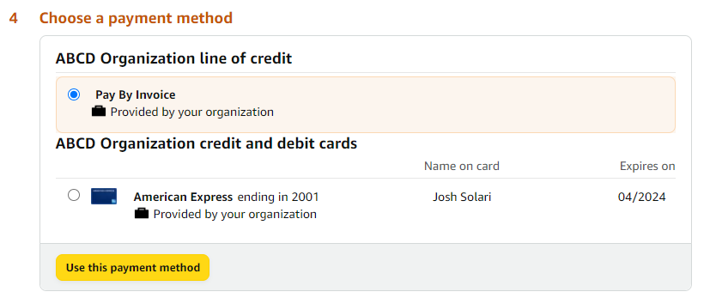
Checkout
Enter Business Order Information
Select Shipping Address
Enter Payment Method
Review items and Place your order

Slide 21
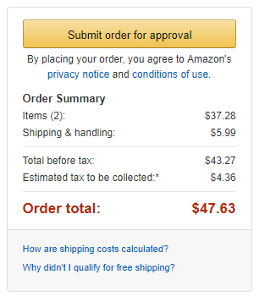
Checkout – Approvals
Some orders or all orders placed on the account may be subject to approval before being fulfilled
How do I order with Approvals configured?
There are no additional steps to take to submit your order for approval. Check out as you normally would and you will see the option at checkout.
Your order will not be processed until it is approved by the appropriate approver. Keep this in mind for shipping timelines.
You will be notified over email once your order is submitted and then again once your order has been approved and processed. Just as with a normal order on Amazon, you will also receive relevant shipping updates.
If your order is not approved within 7 days, the order will automatically be canceled; however, the items in your order will not be deleted. If your order is canceled, you will need to submit the order again for approval.

Slide 22
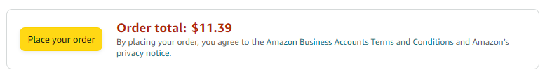
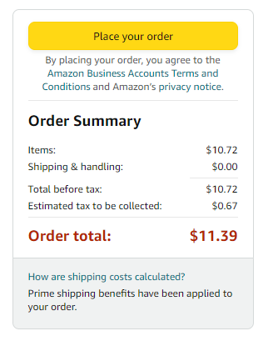
Checkout – Review and Finalize Order

Slide 23
Things to Know

Slide 24
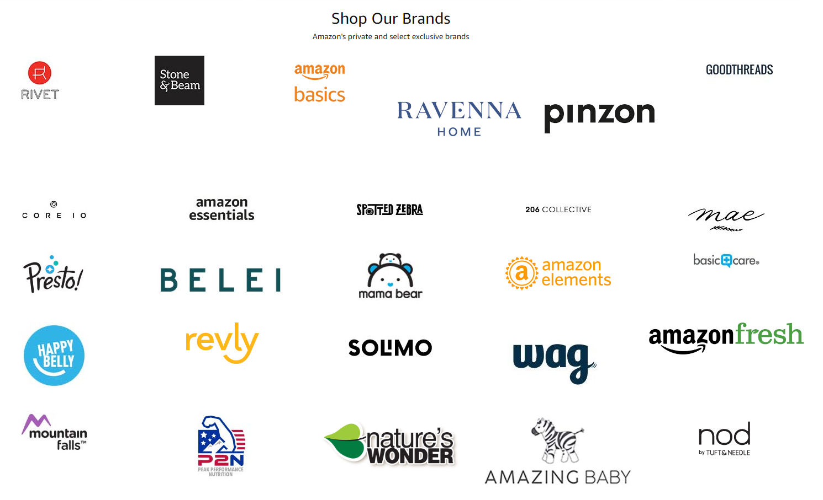

Amazon’s Private Brands
Private Brands
High-quality and durable products, Average Rating 4.2+ stars
Over 48,000 products in 352 categories and growing
Cost-effective options, including quantity discounts and lower-priced alternatives to national brands
Quantities needed to get the job done, including large pack sizes and case packs
End-to-end purchasing solutions for work, from everyday essentials to professional-grade selection
Learn more in this video

Slide 25
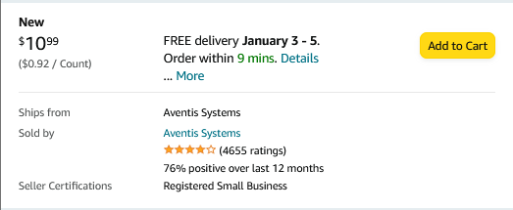
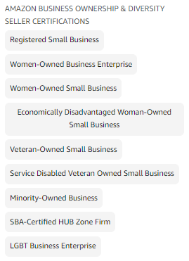


Socially Responsible Storefronts
Socially Responsible Purchasing
Climate Pledge Friendly
Women-Owned Businesses
Black-Owned Businesses
Veteran-Owned Businesses
Small & Local Businesses

Slide 26
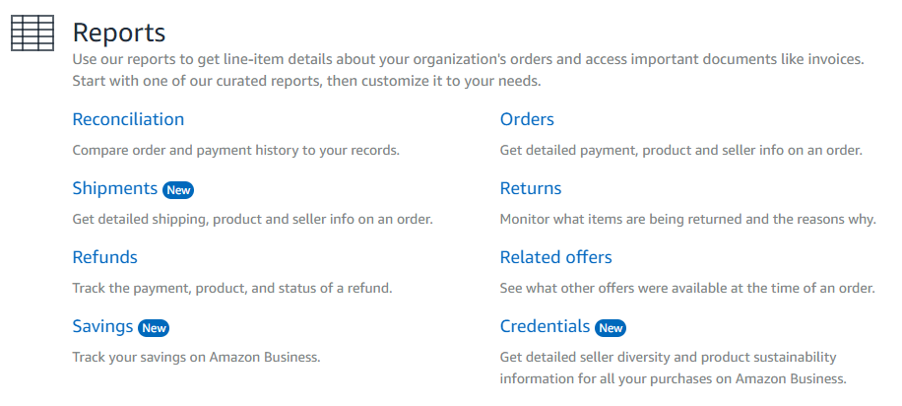
Amazon Business Analytics
Amazon Business Analytics provides the ability to:
Aggregate purchases to compare and track spend over time
Monitor and track 60+ data fields including customer info, shipment info, payment info, and seller info
Customize and save report templates to meet business needs
Download CSV files to analyze your data in excel

Slide 27
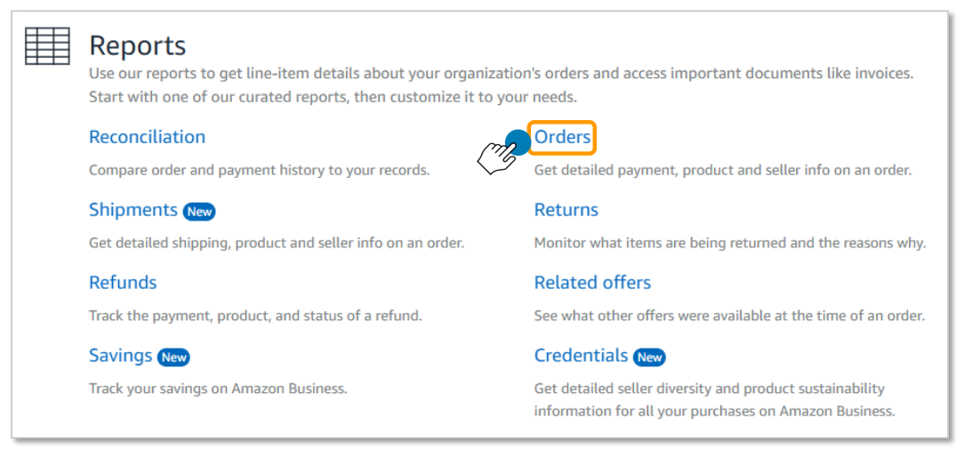
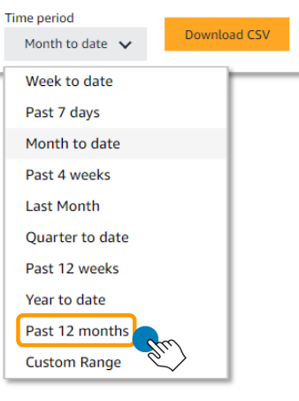
Orders Report
Use the orders report to review orders you’ve made
Select the type of report you would like to run (orders)
Select a Time Period for your order report. This report will be downloaded to ensure your order history is saved.
Add any relevant order Filters to your report and click Submit.
Adjust columns of order data that you wish to include or remove from your report and click Submit. Clicking + will expand the selection you are able to choose from.
When the report has loaded, click Download CSV.
Save the downloaded Excel CSV file to your computer.

Slide 28
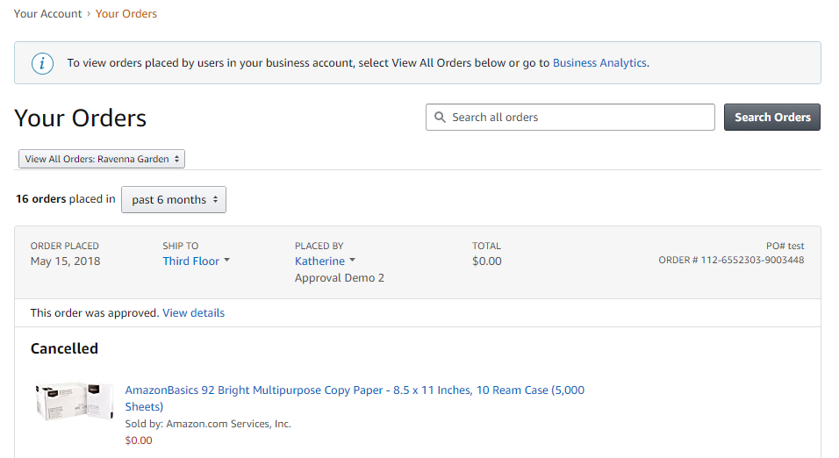
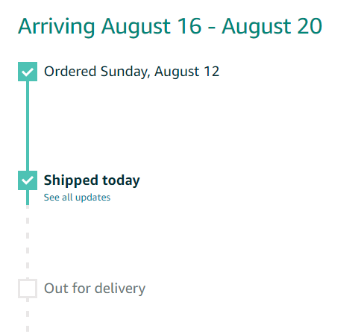
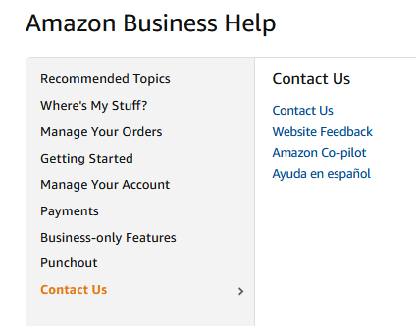
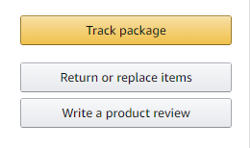
Your Orders
This section of the account provides additional detail regarding the status of all orders you have placed within the Business Account.
Take a variety of actions on Your Orders:
Track Packages
Initiate a Return
Use Contact Us or our Chat feature for assistance with Returns

Slide 29
Additional Resources

Slide 30
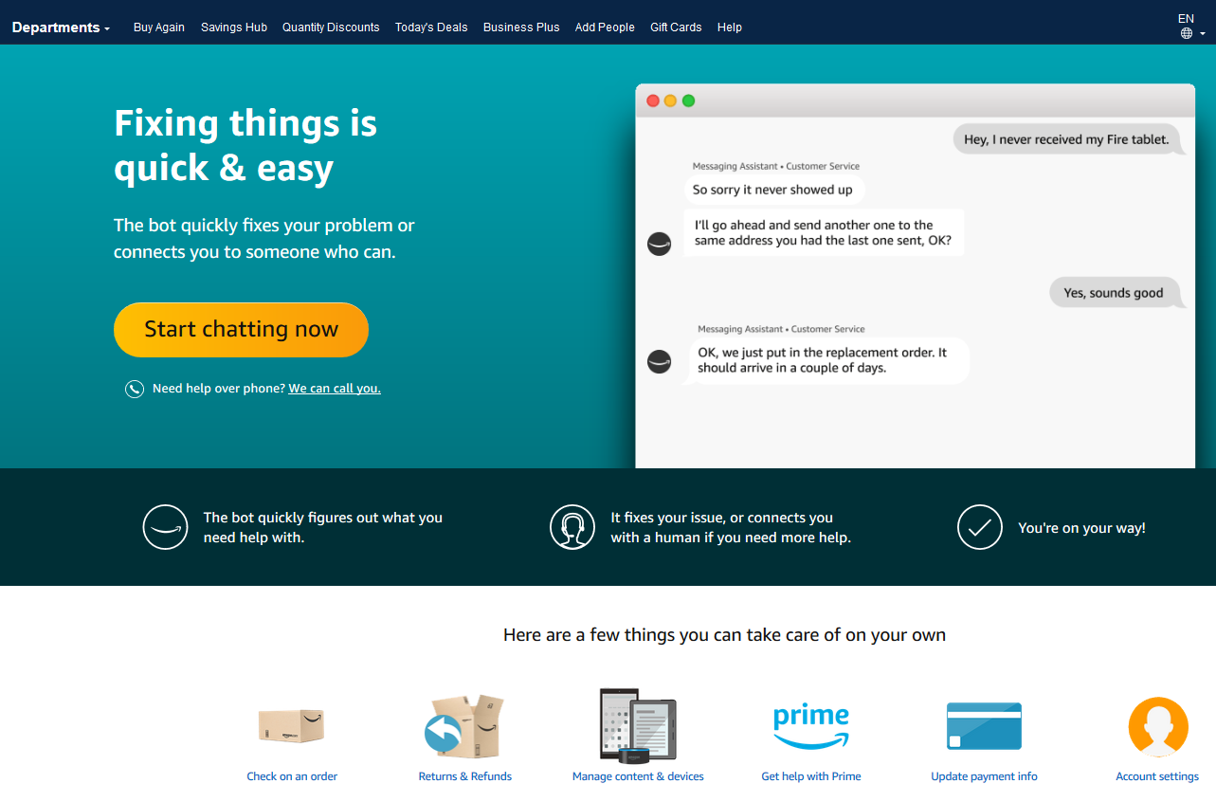
Amazon Business Customer Support
Dedicated U.S. based Business Customer Support can be reached a number of ways including email, chat and phone. Not sure what you’re looking for? Learn more about the features and benefits on Amazon Business HERE.

Slide 31

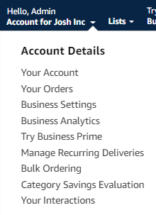
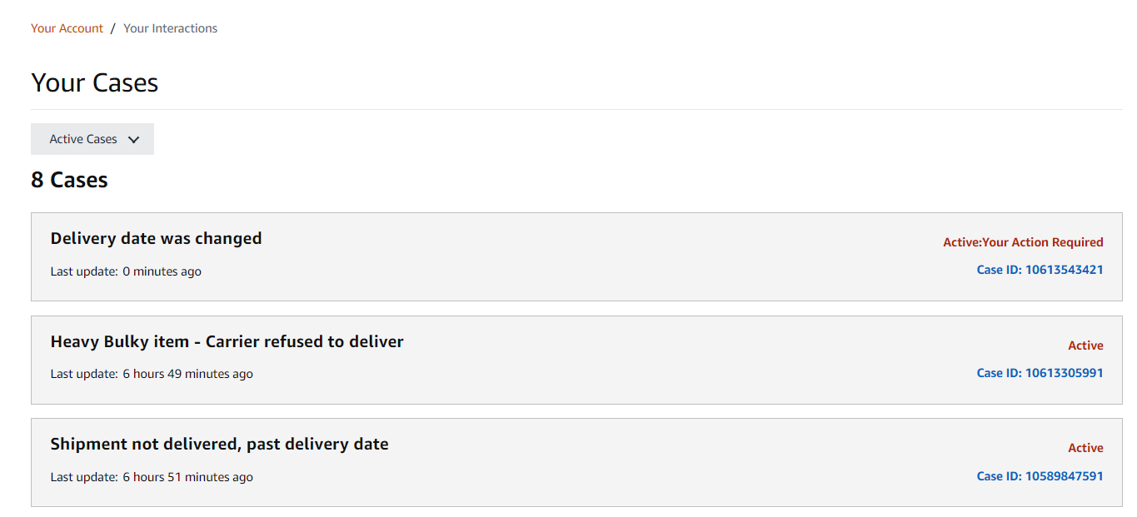
Your Interactions
Built in Amazon Business tool to track the issues that remain unresolved after the initial contact with Amazon Business Customer Support.
One-stop location to track progress of open support issues. Allows users to monitor progress and re-open cases on their account without requiring follow-up.
How it works?
When a customer reaches out to a support team or selling partner with an issue, a ticket is created that customers can directly reference from their account at any time.

Slide 32

Common Amazon Business Support Questions
Quick resolutions to frequently asked questions and contact information for a variety of support resources
Contact Business Customer Support: CLICK HERE
  Provides end users the option to call, email, or live chat. Please use this method of contact for anything relating to an order, transaction, charge, or shipment
Request a Tax Exemption Refund:
  Your Orders > Locate Order > Contact Seller > Request refund through email
  Additional tax queries can be emailed to tax-exempt@amazon.com
Dedicated Education Advisor: Liza Mills
  This person is a dedicated resource assigned to Wichita State University to assist your administrative team with Amazon Business account structure, new features and functionality

Slide 33
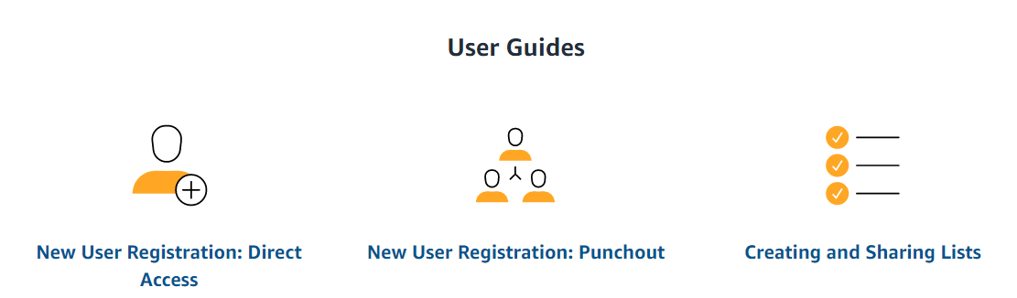
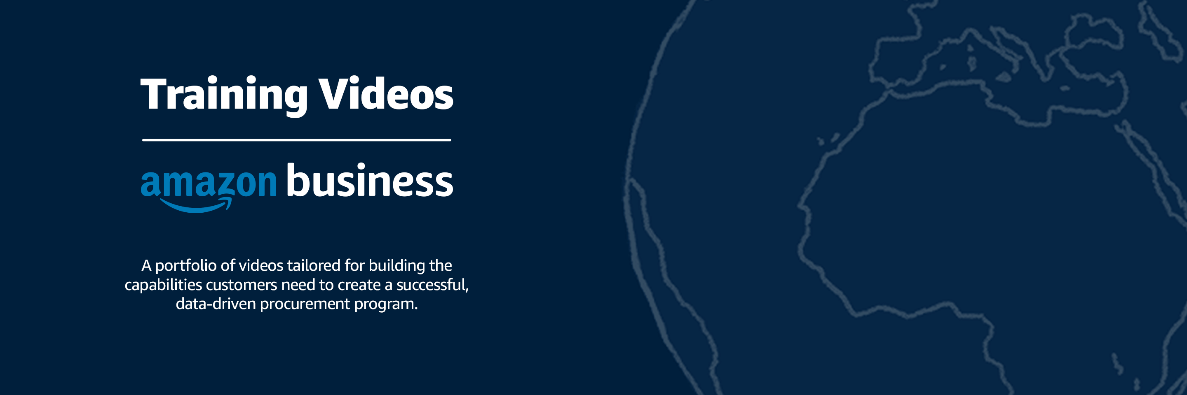
How To Guides and Helpful Videos
Self Service Resources
Training Videos

Slide 34
Thank You

