Slide 1
Talent Management Revisioning Update and Introduction
Vicki Whisenhant
Executive Director Human Resources
4/18/2023

Slide 2
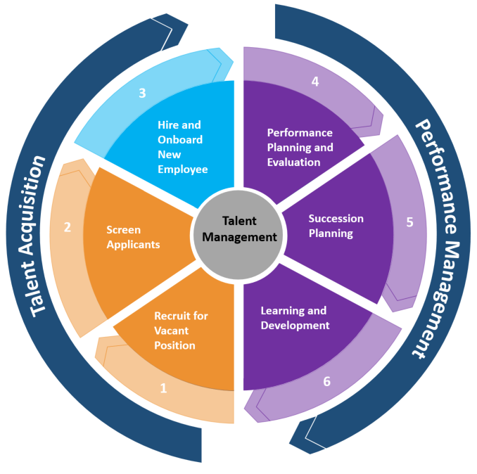
Talent Management Revisioning Project
Talent Management refers to the strategy of an organization related to attracting, recruiting, retaining and developing people.
It spans the life cycle of an employee – starting with attracting them as a candidate who is matched to organizational needs, then developing their skills and expertise as an employee to retain them in a position that nurtures commitment and engagement and achieves desired results.
Notes:
Talent Management Revisioning – encompasses the whole employee life cycle. This is where we started.

Slide 3
Talent Management Revisioning
2020 – Talent Management Revisioning Recommendation
Revisioning Project team members included representation from all areas for both Operational Leadership and Functional Leadership
Project team reviewed current processes, identification of gaps, and creation of vision for talent management at Wichita State
Identified and recommended vendor
2023 – Approved vendor and project
First project focus will be on Talent Recruitment, Sourcing, and Onboarding 2023
Second project focus will be on Learning, Performance and Succession 2024
Notes:
History – Talent Revisioning Committee began in January 2020. They made their recommendations in October 2020. We received approval and funding to proceed in the end of February. It will be done in two projects. The first is focused on Talent Acquisition and will happen this year. The second project will happen in 2024.

Slide 4
Recruiting, Sourcing, and Onboarding Benefits
For our Candidates
Mobile: easier to view, apply and onboard
Text: easy to communicate
Experience: interactive and engaging
For our Employees
Single sign on: easy access
Text: easy to communicate; manage hiring process
One system: I-9 and Backgrounds
Dashboard: at-a-glance information
Notes:
Based on the needs, goals and direction of Wichita State University, these are some of the capabilities that we gain.

Slide 5
Talent Recruiting, Sourcing, and Onboarding Future Benefits – part 2
For our Hiring Managers, Department Assistants, and WSU end users
Text, mobile & dashboard: easy to communicate and manage hiring process
Marketing: advanced capability to promote open positions
Single sign on: easy access
Banner interface: reduces manual data entry
For WSU
DEI &B: more accessibility, easier process, and better experience
Student Success and Persistence: one application, multiple job postings; easy access and communication
Enhanced information: increased reporting capability
Notes:
And more improvements. An additional note: Kansas State University has been with this vendor since 2016 and really likes it and is updating to a couple of the newer modules that we are implementing. Washburn implemented this last year and really love it. They previously had PeopleAdmin and they also use Banner. They say it is so much better!

Slide 6
Implementation Structure
Notes:
This is the implementation structure. We have received recommendations from leadership across the organization. We are currently speaking with recommended representatives and will announce the members of the Steering Committee and Advisory Committees soon. We will be communicating and providing updates each month or more often if pertinent to each of the Informed Stakeholder Groups.

Slide 7
Timeline Project 1 – Talent Acquisition
Timeline development and Technical Kickoff March 2023
Introduction for University and development of steering and advisory committees April 2023
Build Webpage/Marketing July 2023
Project Kickoff May 2023
Calendar HOLD for Academic Year start and hiring July/Aug 2023
Testing September 2023
Training October 2023
Go Live November/December 2023
Notes:
Timeline

Slide 8
Next steps
Contacting selected members to serve on Steering and Advisory Committees
Introduction of Talent Management System to Informed Stakeholder Groups
Name Project – we want your help
Use the ideas of talent management, transformation, candidate and employee experience, integration, interface, and any of the other gains that excite you to recommend a name for the project.
Send suggestions to Krista.thacker@wichita.edu
Suggestions accepted until May 1st

