Slide 1


Shockers and United Way Fighting for the Health, Education, Financial Stability and Basic Needs for everyone in South Central Kansas

Slide 2


YOUR
UNITED WAY
MAKES A
LOCAL
IMPACT.
THOUSANDS OF AREA CITIZENS
in these counties have better lives each year
because of YOUR investments.
In fact, the United Way helps people
more than 453,792 times annually!

Slide 3
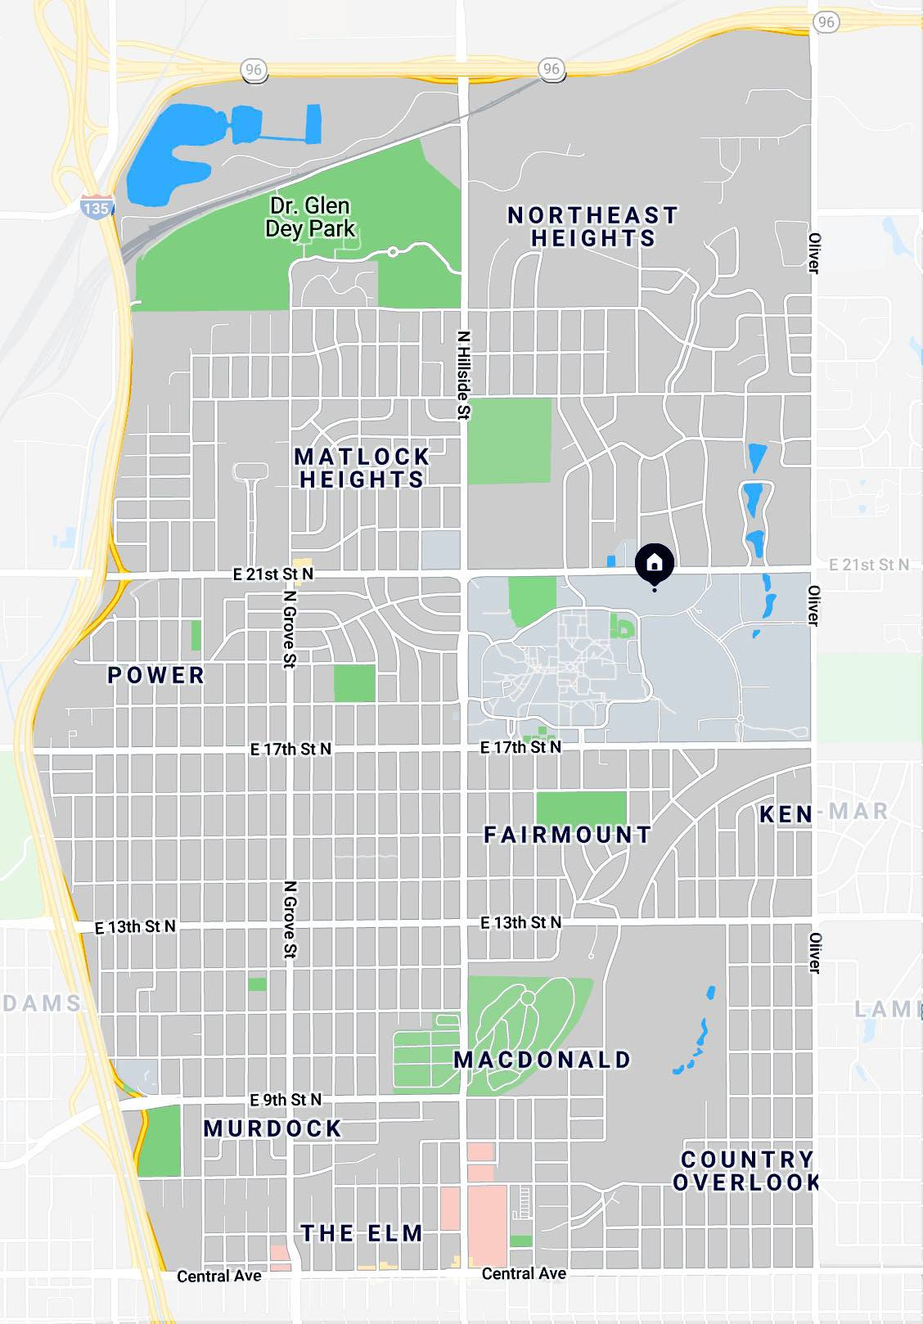

Providing direct support to your Shocker Neighborhood
Last year, United Way of the Plains supported individuals in the Shocker Neighborhood over 17,356 times.
211 alone assisted this neighborhood 8,082 times.
The top service support categories were emergency social services and case management, food assistance, homeless prevention and developmental support for children.

Slide 4




OUR FOCUS
HEALTH
Providing access to quality services so all can get – and stay – healthy.
EDUCATION
Helping children enter school ready to learn, achieve at grade level and graduate on time.
FINANCIAL STABILITY
Empowering adults with
the tools needed to
ensure fiscal security.
BASIC NEEDS
Addressing a lack of resources and overcoming barriers to life-saving assistance. Helping those in need survive today, propels them to live their best lives possible tomorrow.
Notes:
With United Way, you make sure children have an equal opportunity to learn. You gift the next generation a pathway out of poverty. You provide access to services so your neighbors can be healthy and strong, both physically and mentally. You support families in crisis, making sure their basic needs are covered.

Slide 5

HEALTH
$1.18 MILLON
invested last year in the community through United Way-funded programs to improve the health and well-being of our neighbors.
41,381 TIMES
last year United Way-funded programs helped people feel and live better. ​

Slide 6
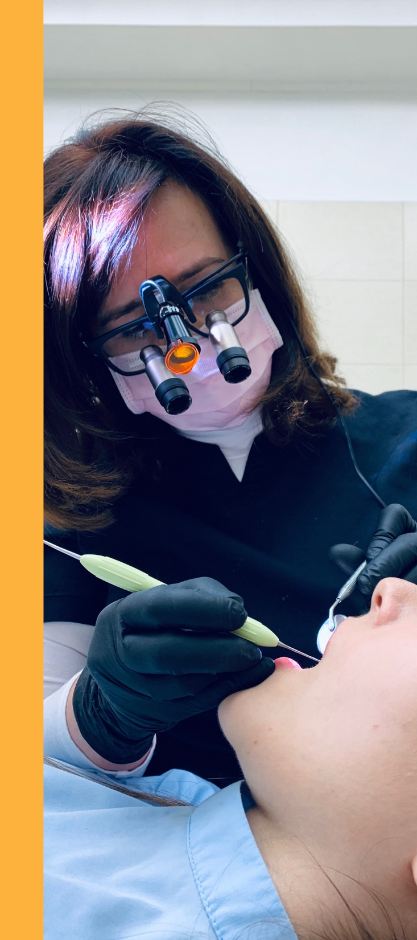

COMMUNITY BENEFIT PLAN
Covers 100% of diagnostic, preventive, basic and major dental services for low-income individuals for a $5 annual deductible.
$587,374
worth of free dental care provided to low-income individuals in 2021.
Notes:
An unhealthy mouth can increase your risk of serious health conditions. Don’t let finances hold you back from a happy, healthy smile.
Delta Dental of Kansas has partnered with United Way of the Plains to fund dental coverage for those who would otherwise not be able to afford it.
Learn more and enroll by dialing 2-1-1 or visiting unitedwayplains.org/dentalplan.

Slide 7

EDUCATION
$2.03 MILLION
invested last year in the community through United Way-funded programs to help children thrive in their education.
137,478 TIMES
last year United Way-funded programs helped children reach their potential.

Slide 8
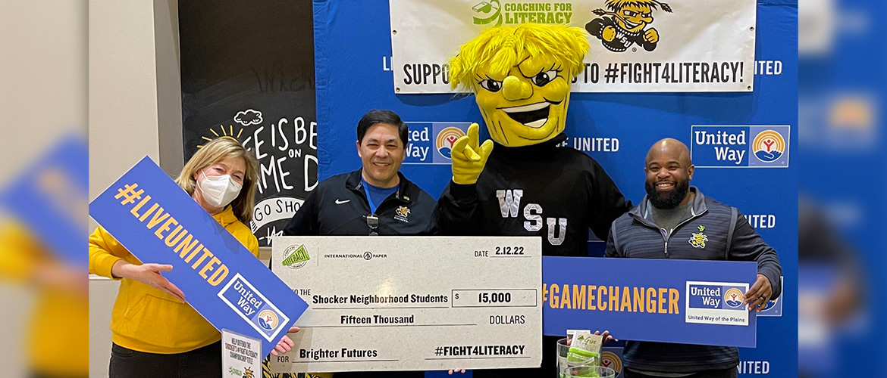
Supporting Educational Outcomes in the Shocker Neighborhood
In partnership with WSU Men’s Basketball, United Way of the Plains raised funds through Coaching for Literacy.
Students in grades K-3 at 14 schools in the Shocker neighborhood received new reading materials to take home and combat summer learning loss.
A total of 6,100 books were delivered, with 3,050 children receiving two books and resources for parents to assist students with improving their reading skills.

Slide 9
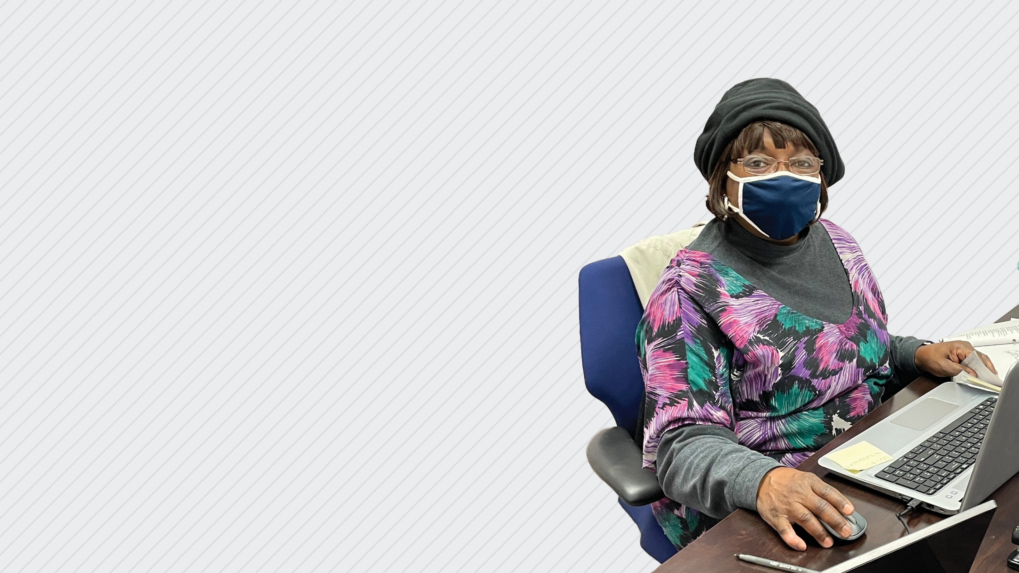
FINANCIAL STABILITY
$2.49 MILLON
invested last year in the community through United Way-funded programs to empower people on the road to financial stability
61,973 TIMES
last year United Way-funded programs helped people gain financial stability.

Slide 10
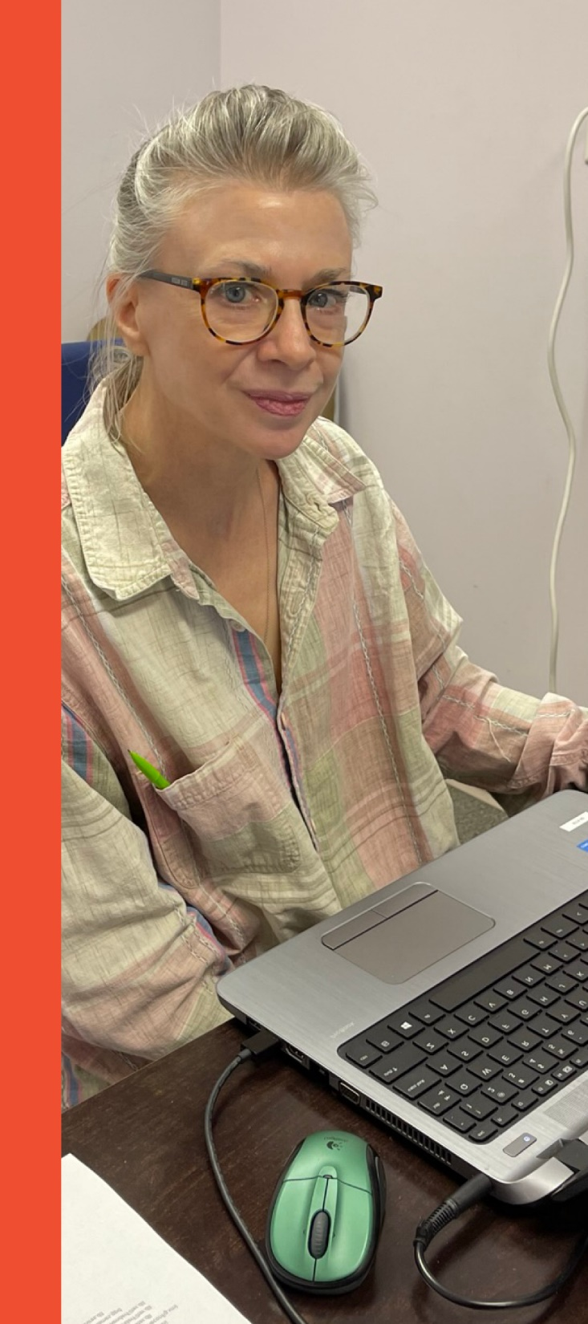



FREE TAX PREP
$7.6 million in tax refunds were returned last year to local households, which fed into the local economy.
192
6,364
$7.6 MILLION
volunteer income tax assistance (VITA) volunteers.
federal returns filed.
tax refunds returned locally.
Notes:
United Way’s free tax filing service helps low-to-moderate income households file their taxes for free to avoid costly fees. United Way recruits and trains volunteers to become IRS certified to file taxes and identify tax credits. Tax refunds help clients become financially stable by retaining more of their money for rent, food, medical costs and other necessary expenses while also helping to boost the local economy. United Way partners with the City of Wichita and the IRSA to conduct the program.

Slide 11


Bank On ICT is a coalition, led by United Way, is working to ensure that all households have access to banking and financial services that meet their needs, allow them to increase assets and strengthen their financial stability.
6.6%
of Wichitans lacked a bank account in 2019.
Notes:
Are you using check cashers, payday lenders or pawn shops to get your money? Have you been turned down or turned away at a financial institution? Bank On ICT and United Way of the Plains can help you access a safe and affordable bank account.
Having a bank account is important because it helps you save money, offers security for your assets and helps you gain financial stability.
Bank On certified bank accounts are…
Safe – Your personal information and money are protected.
User Friendly - Accounts offer a variety of FREE tools to help you manage your money – direct deposit, debit card, bill pay, withdrawals, low balance alerts, smartphone apps and more.
Open to all - Account providers work with past credit challenges. Only $25 is needed to open an account. There is no minimum balance or overdraft fees. You’ll never be hit with surprise fees.
A trusted partner for your success - Bank On ICT is more than a bank account. The coalition offers a team of local experts who are ready to meet your financial needs and are invested in your success.
Visit unitedwayplains.org/bankon for more info, including local banks who offer Bank On accounts.

Slide 12

BASIC NEEDS
PRIORITY AREAS
Food Insecurity
Rent & Utility Assistance
Safety
Shelter Assistance

Slide 13
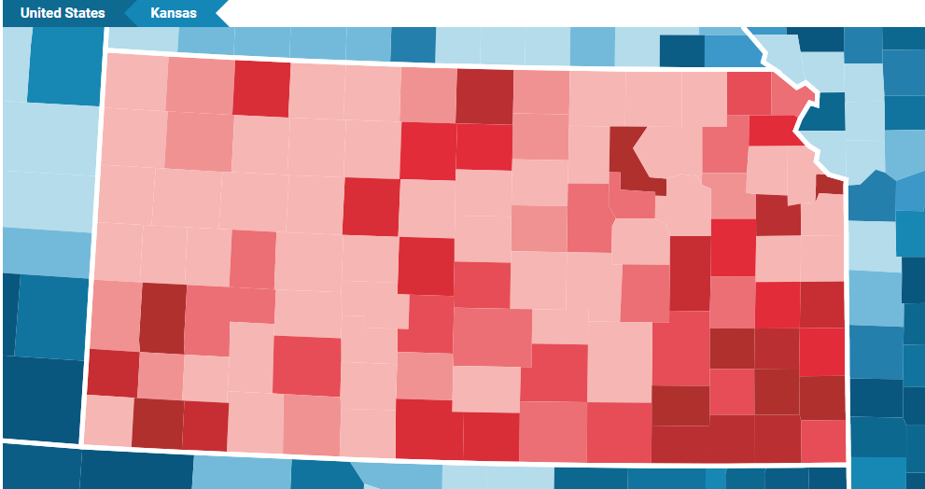






Poverty Rates by Kansas County (2019)
in United Way of the Plains Service Area
Sedgwick County
69,506 People in Poverty (13.7%)
Reno County
7,701 People in Poverty (12.9%)
Butler County
6,025 People in Poverty (9.5%)
Cowley County
4,675 People in Poverty (14.1%)
Harvey County
3,172 People in Poverty (9.6%)
Sumner County
2,667 People in Poverty (11.8%)
Harper County
874 People in Poverty (16.1%)
Kingman County
549 People in Poverty (7.6%)
Map of Kansas
by Poverty Rate Density
Reno
Harvey
Butler
Kingman
Sedgwick
Source: PovertyUSA.org
Harper
Sumner
Cowley
95,169 People living in poverty (Family 4 making $26,500)
Those living in poverty are more likely to have….
Limited education
Limited employment options
Limited empowerment
Limited income
Limited residential options
Limited access to care and services
Limited access to health insurance
Adverse social factors
Adverse environmental factors
Higher health risks

Slide 14
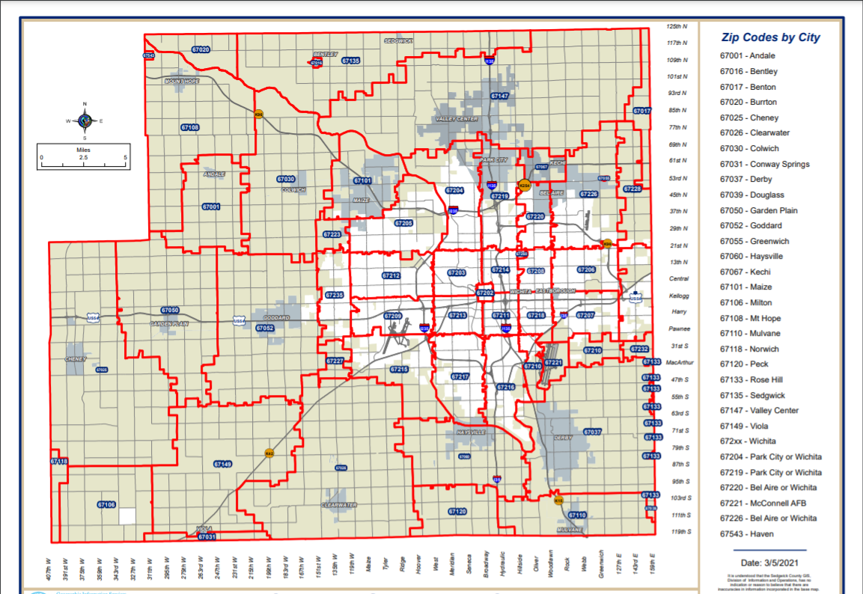
Persons Living Below Poverty Line
By Sedgwick County Zip Code
67204
67219
67205
67220
Sedgwick County, KS
67214 – 32.9%
67211 – 31.3%
67213 – 28.6%
67202 – 27.1%
67219 – 23.4%
67216 – 21.1%
67218 – 20.5%
67210 – 19.9%
67203 – 18.7%
67220 – 18.3%
67217 – 18.3%
67208 – 17.4%
67207 – 14.3%
Kansas – 11.4%
67212
67203
67214
67208
67206
67202
67209
67213
67211
67218
67207
Shocker Neighborhood zip codes
67210
Source: U.S. Census Bureau (2019).
American Community Survey 5-year estimates.
67215
67210
67217
67216
Of the 700 zip codes in Kansas, Wichita is the home to the poorest zip code in the state - 67214.
In fact, 3 of our zip codes are in the top 10.

Slide 15

HOMELESS SERVICES
United Way is the backbone organization of Impact ICT – Continuum of Care, a coalition of 170+ people working to make homelessness rare, brief and nonrecurring. In 2021…
419
2,752
1,128
individuals were
identified as homeless
through the annual
point in time count.
individuals were served by IMPACT ICT - CoC members through emergency shelter, transitional housing, street outreach and housing services.
individuals were housed or kept in housing.
70
$2.8 MILLION
Average days of homelessness per person – down a full week since 2020.
Grant from HUD, submitted by United Way with the help of the coalition, was renewed to fund 14 vital homeless service programs in Sedgwick County.
Notes:
Impact ICT – CoC works to resolve homelessness by identifying and addressing barriers to permanent housing, coordinating resources and annually applying for grant funding from the U.S. Department of Housing and Urban Development (HUD).

Slide 16
IMPACT- ICT CONTINUUM OF CARE
A Community-led and Coordinated effort to end homelessness in Wichita-Sedgwick County through Federal, State, and Local Resources.
WHAT DOES “MISSION ACCOMPLISHED” LOOK LIKE?
Functional Zero – we have more people leaving homelessness than we have entering homelessness
A Quality “By Name List” – we know everyone experiencing homelessness by their name and needs
Notes:
Your United Way has lead the charge in ending homelessness since 2008. Funded in part through your generous gifts and through an annual grant the United Way of the Plains writes for, the Continuum of Care has housed 2,142 households between 2017 and 2021. That’s not just single people; that’s children, that’s couples, that’s families your support has ended homelessness for.
It’s not just United Way of the Plains; it’s a full Continuum of services through all of United Way’s Partners: healthcare, rent assistance, financial literacy, job training, and of course, housing.

Slide 17
WHAT IS THE ROADMAP TOWARDS FUNCTIONAL ZERO
Build Community Good Will & Assess Needs and Resources
Implement staff and clear, quality procedures to assess everyone in homelessness (Coordinated Entry)
Reach Functional Zero for one subpopulation
Reflect and reach Functional Zero for the next subpopulation
Shift excess resources to Preventing Homelessness
Notes:
We know that even in the most extreme sense, we will never full “end” homelessness in our community. Even in the most extreme example, a family who’s house burns down is homeless, even for a night. But we can reach a point where our inflows – the number of people entering homelessness each month – is exceeded by our output – how many people we can house each month.
Functional Zero is not just a pipe dream; other communities

Slide 18



FUNDING UNITED WAY FOR THE COMMON GOOD
122,169 times last year United Way 211 connected Kansans to the help they needed.
8,082 in the Shocker Neighborhood
188 nonprofits saved over $1.19 million last year by shopping for free at the United Way GIV Warehouse.
Do you know a nonprofit that could benefit from this program?
Tell them!
34,734 hours of transformational volunteer work was coordinated by United Way last year.
VolunteerICT ● Wu’s Big Event ● GIV Warehouse

Slide 19



Shockers in the Community
On Oct 8, 155 volunteers gave 465 hours of service to the nonprofit community. Servicing 15 local agencies. Since 2017, the Big Event has generated 1,803 total hours of volunteer support in Wichita.
WSU and United Way partnering to connect staff, students and faculty with more than 323 volunteer opportunities with different local agencies.
Volunteer ICT provides around 7,300 hours of service per year with more than 2,000 individuals annually.
76 volunteers have contributed around 170 hours to UWP’s GIV Warehouse since January 2022

Slide 20








YOUR GIFT HELPS TWICE AS MUCH
LAST YEAR, WE TURNED EVERY DOLLAR DONATED INTO $2.20 OF IMPACT.
$1 DONATION
$2.20 WORTH OF IMPACT
GRANTS
VOLUNTEERS
DISTRIBUTED GOODS
TAX REFUNDS
PRESCRIPTION SAVINGS CARD

Slide 21

Thank you, WSU, for considering a gift to support United Way and your Shocker Neighborhood!
For questions regarding United Way of the Plains or this year’s campaign please contact:
Brooklyn Black
Associate Director of Philanthropy
bblack@unitedwayplains.org
(316) 267-0937 Ext. 4127

